Slide 1
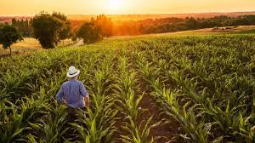
3.5 Food Production

Slide 2
3.5 Food Production
Increasing human population requires increased food yield
Fertilisers contain nitrates to increase yield
Herbicides and pesticides kill plants and animals which reduce crop yield
Nitrates in soil water are used by plants to produce amino acids which are synthesised into proteins
Animals consume plants to obtain amino acids for protein synthesis
Fertilisers can be added to increase soil nitrate content
Fertilisers can leach into freshwater adding nitrates and causing eutrophication
GM crops can reduce the use of fertilisers
Pesticides can pass along food chains and build up over time (bioaccumulation)
Top predators can be badly affected
Biological control and GM crops are alternatives to use of pesticides

Slide 3
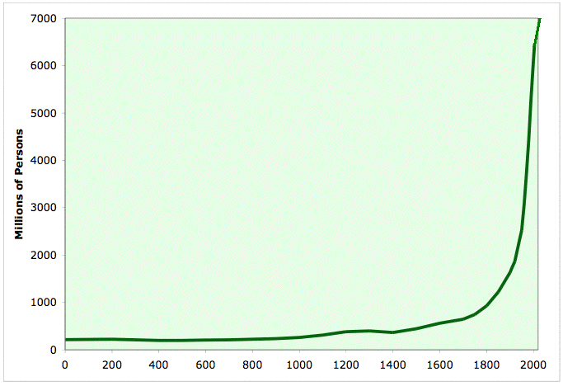
Human Population Growth
Why has the human population risen like this in the last 500 years?
A decrease in death from illness or child birth due to developments in medicine.
An increase in our ability to feed ourselves due to developments in agriculture.
The human population has undergone exponential growth.

Slide 4
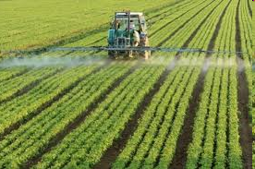
Developments in Agriculture
How has farming changed since Victorian times?
Mechanisation and increased field size increases efficiency
Monocultures – growing one crop over a large area is more efficient
Use of chemicals such as fertilisers, herbicides and pesticides
Improved crop varieties due to crop breeding and GM crops
Intensive farming practices, such as rearing animals in sheds

Slide 5
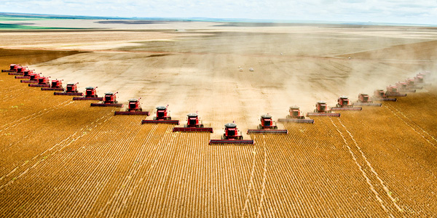
Monoculture – growing one species only
Farm land produces more food as only the best variety of crop is grown
It simplifies sowing and harvesting of the crop as machinery can be used,
which also reduces labour costs.
As similar plants are grown close together, pests and diseases spread rapidly, and more pesticides are needed to control them
Because only one species of plant is wanted, weeds are
killed using herbicides.
Important wildlife habitats such as hedgerows, ditches,
marshes, ponds and small woodlands are removed to
create larger fields
This decreases biodiversity and removes the natural
predators of pests that feed on the crop.

Slide 6
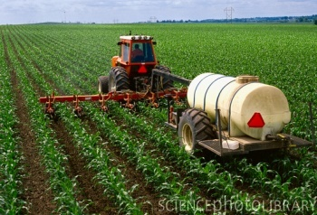
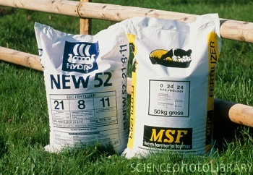
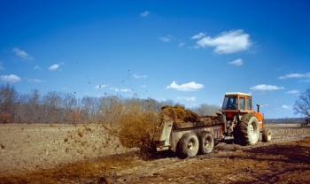
Chemicals in Agriculture - Fertilisers
Plants are able to make some molecules using photosynthesis, but also need minerals from the soil to build other molecules such as proteins
Nitrogen(N), phosphorous (P) and potassium (K) are the most important minerals needed by plants
Harvesting crops removes the essential nutrients.
Fertilisers are added to replace nutrients used up in plant growth.
Adding fertilisers increases crop yields, as the plants grow better

Slide 7
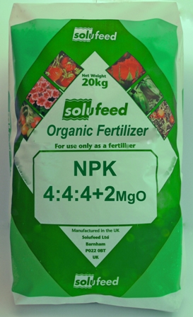
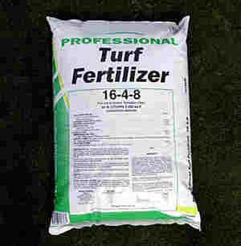
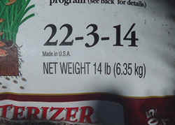
Chemicals in Agriculture - Fertilisers
Plant minerals are needed for leaf (N), root (P), flower and fruit growth (K).
(The numbers on bags of fertiliser refer to ratios of N:P:K)
B
Which fertiliser do you think would be the best one for growing :
Green leafy vegetables like spinach?
Fruit or flowers?
Why would each of these fertilisers be suitable for each use?
A
C
1. C – highest proportion of N for leaf growth (7x quantity of P)
2. B – highest proportion of K for fruit and flowers (equal quantities of N,P and K)

Slide 8
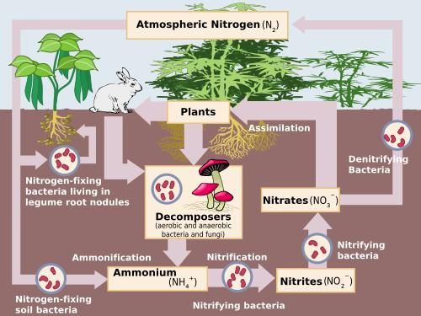
Chemicals in Agriculture - Fertilisers
Nitrates dissolved in soil water are absorbed by plants
Nitrates are used by plants to make amino acids, which are built into proteins
Animals consume plants to obtain amino acids for building their own proteins (protein synthesis)
Fertilisers can be added to increase the nitrate content of the soil
Nitrogen cycle - remember this from Nat 4?

Slide 9
Chemicals in Agriculture - Fertilisers
For Nat 5, you do not need to remember the full details of the nitrogen cycle…
What do the arrows represent?
Plants turn nitrate into amino acids then proteins
2
Animals digest plant protein and release amino acids, which are used to build animal protein
1
3
3
Uptake by roots
Plants eaten
Death and decay
Artificially increase soil nitrate
Fertilisers added
nitrate dissolved in soil water
4

Slide 10
Problems with Fertilisers
If excessive quantities of fertiliser are used, they can wash off the fields
causing eutrophication.
Complete the card sort, and check against the following slide…
Once completed, answer the following questions:
What animal species would you expect to find in freshwater that had been
polluted by fertiliser?
b) What species would be found in unpolluted water?
What do we call a species that by its presence, absence or abundance
shows the environmental conditions in an environment?
blood worms, rat tailed maggots
mayfly, stonefly
Indicator species

Slide 11
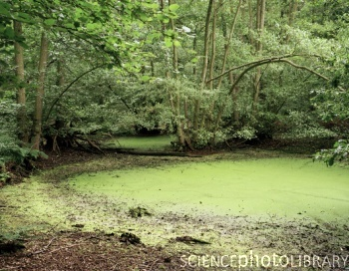
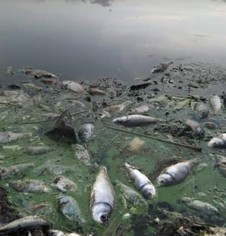
Problems with Fertilisers
When it rains, fertilisers are washed (leach) from the soil into the
rivers, lakes and seas.
Fertilisers encourage excessive growth of algae causing algal blooms.
Algae block out the light and prevent green plants below the surface
getting enough light for photosynthesis.
When the plants and algae die they become organic waste (just like
sewage) and provide food for micro-organisms (bacteria).
Bacteria feed on the algae, reproduce and increase in number.
The increased numbers of bacteria use up more oxygen in respiration
and reduce the oxygen available to other organisms.
As a result many water organisms die and the number of different
species decreases. i.e. biodiversity decreases.
Eutrophication Animation

Slide 12
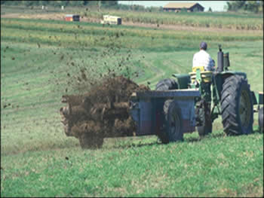
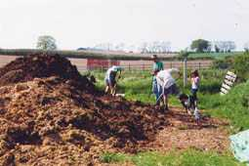
Problems with Fertilisers
How do you think we can solve the problem of eutrophication?
1. Use less fertilisers especially on land near waterways.
2. Use natural fertilisers like manure and compost which
do not dissolve easily in rainwater.
3. Check the weather forecast before adding fertiliser
4. Only apply chemical fertiliser when plants are actively
growing in the spring
5. Farmers could use crop rotation or grow legumes to
replenish nutrients in the soil.
6. Grow GM crops that need less fertiliser

Slide 13
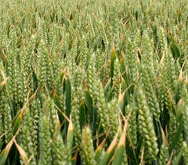
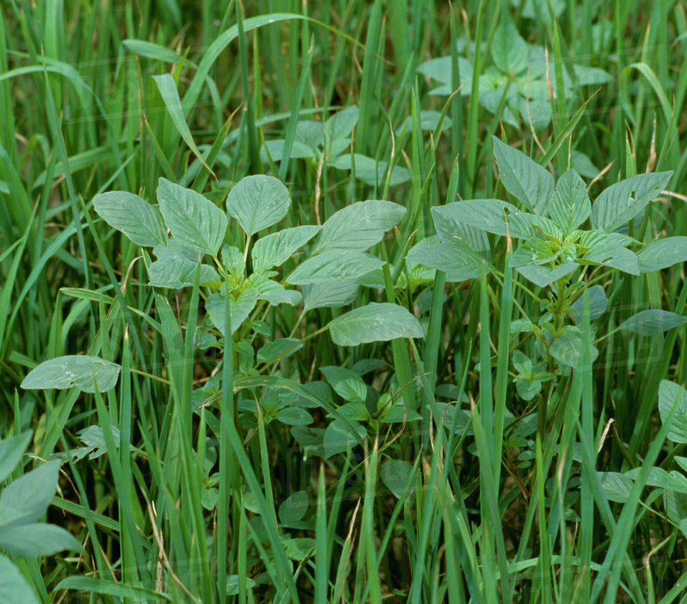
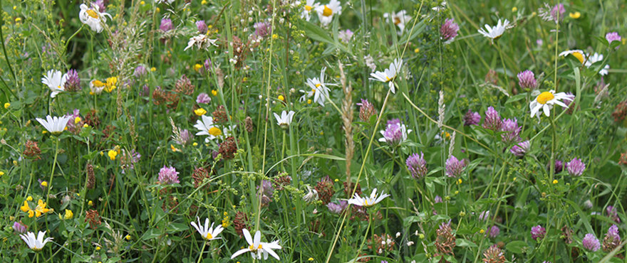
Chemicals in Agriculture - Herbicides
Herbicides are chemicals which are sprayed onto crops to kill unwanted plants (weeds)
Weeds compete with crop plants for light, nutrients, space and water
This reduces crop yield
Weeds competing with crop plants is an example of interspecific competition
monoculture
weeds mixed with crop
Herbicides kill native wildflowers, reducing biodiversity

Slide 14
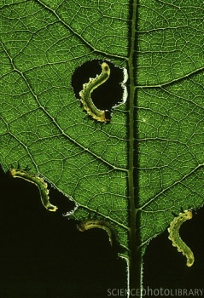
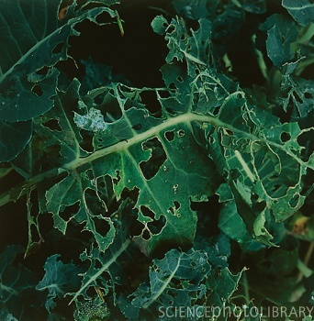
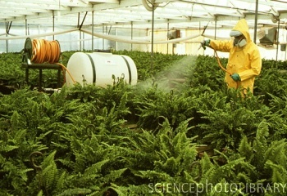
Chemicals in Agriculture - Pesticides
Spraying with pesticides kills pests which attack crops and reduce crop yield.
Crop yield is how much food you produce by growing a crop

Slide 15
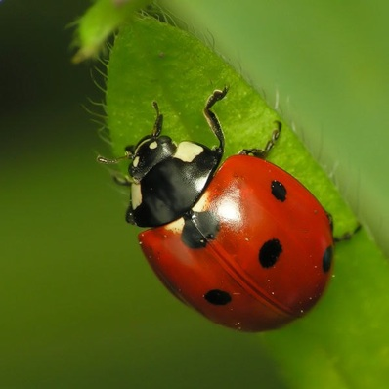
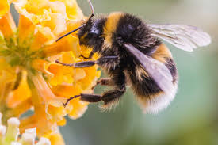
Pesticides are not the perfect solution as they don’t usually kill just insect
pests but other species too, reducing biodiversity
Sometimes the natural predators of the pest are killed eg. ladybirds
Other beneficial insects such as bees may also be affected
Chemicals in Agriculture - Pesticides

Slide 16
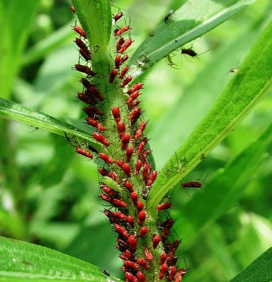
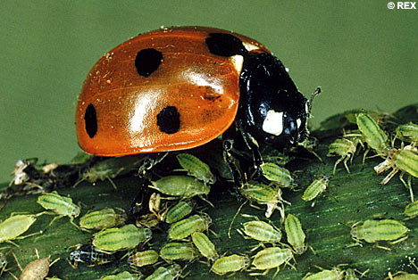
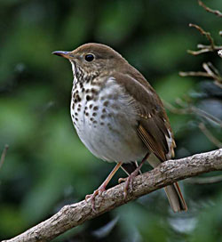
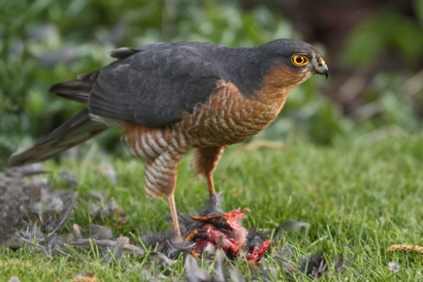
Chemicals in Agriculture - Pesticides
Some types of pesticides sprayed onto crops can build up in the
bodies of organisms over time.
As they are passed along the food chain the pesticides reach fatal levels
and kill top predators.
This is known as bioaccumulation
0.01 mmol of insecticide sprayed on crop
Ladybird eats 20 greenfly : 20 x 0.01 = 0.2 mmol of insecticide in each ladybird
Thrush eats 20 ladybirds : 20 x 0.2 = 4 mmol of insecticide in thrush
Bird of prey eats 3 thrush: 3 x 4 = 12mmol of insecticide in bird of prey

Slide 17
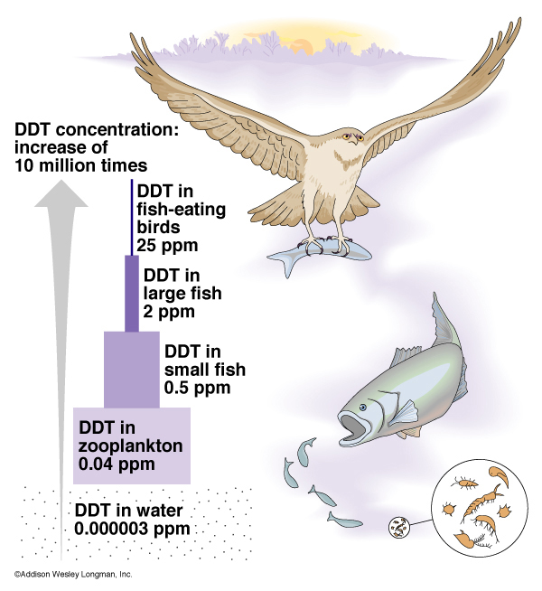
Chemicals in Agriculture - Pesticides
DDT was a pesticide used regularly in the 1940 -50s in agriculture and as a pesticide against the insects carrying diseases such as malaria
It was banned in the 1980s as it had a devastating effect on birds at the top of the food chain.

Slide 18
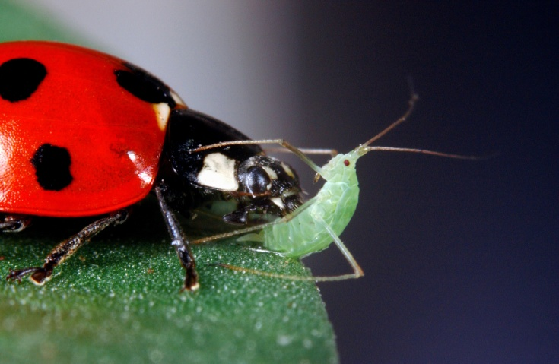
Chemicals in Agriculture - Alternatives
Use biological control instead of spraying with pesticides
This is when farmers introduce the natural predator of the pest to control pest numbers
eg. ladybirds are introduced to feed on aphids (greenfly)

Slide 19
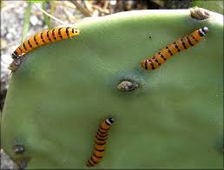
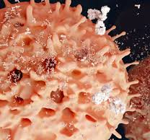
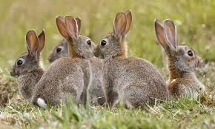
Other examples of biological control include :
Using the caterpillar moth (Cactoblastis) to kill cacti (Optunia)
Using a virus to kill rabbits (Myxoma virus, causing Myxomatosis)
Chemicals in Agriculture - Alternatives
Cactoblastis caterpillars
Myxoma virus

Slide 20
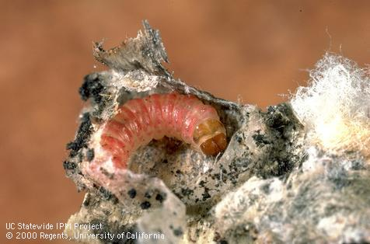
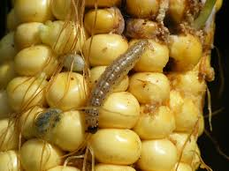
Chemicals in Agriculture - Alternatives
Genetically modified (GM) plants have had genes from other plants or animals inserted into their DNA to improve their characteristics.
Some GM crops have been altered so they can fix their own nitrogen (like peas and beans can), which reduces the need for fertilisers
Others have been engineered to produce a chemical which is toxic to insects, reducing the need for pesticides
GM cotton is resistant to the pink cotton boll worm
GM maize is resistant to the corn borer
Find out about GM rice that uses nitrogen more efficiently and Bt toxin in tomatoes as an alternative to pesticides
Notes:
Taken from news.bbc.co.uk/cbbcnews/hi/find_out/.../gm_foods/.../1746923.stm
20

Slide 21
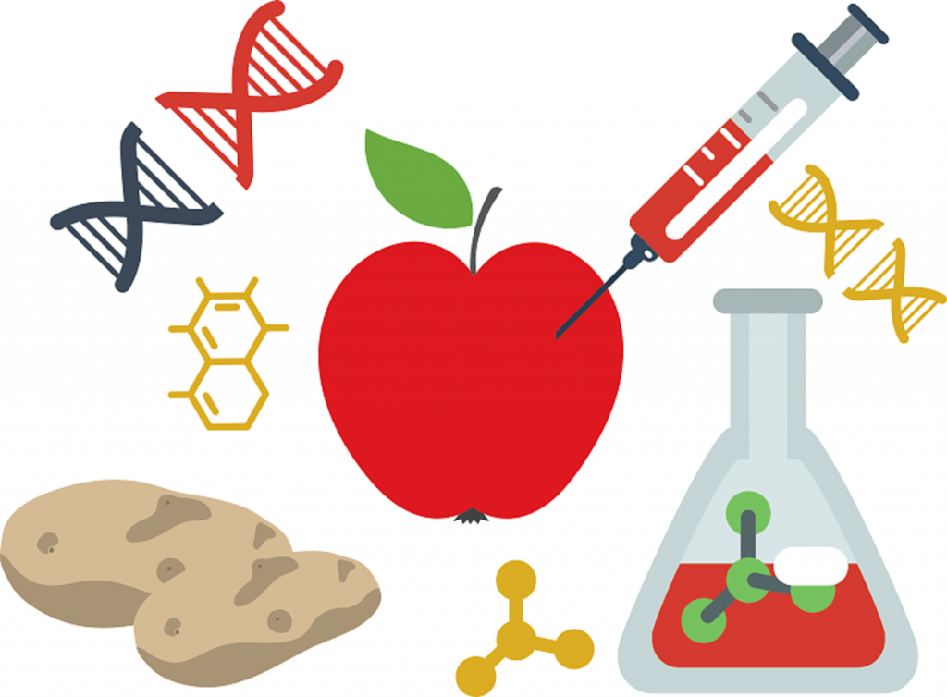
GM Crops
GM crops grow better, and the resulting increase in crop
yield can help to support an increasing human population.
Less chemicals such as pesticides are required, so less environmental damage
Many regard them as unnatural, as genes are transferred between species
Farmers who don’t use the GM variety can’t compete and go out of business.
GM crops that produce their own pesticides or herbicides may contain
chemicals that damage our health.
Herbicide resistant GM crops can be sprayed with huge quantities of herbicides
resulting in more damage to the environment.
Genes may escape into the environment due to cross breeding with wild plants

Slide 22
GM Crops
Consider the case for genetically modified crop plants…
What do you think?
Should GM crops be allowed?

Slide 23
3.5 Food Production
Increasing human population requires increased food yield
Fertilisers contain nitrates to increase yield
Herbicides and pesticides kill plants and animals which reduce crop yield
Nitrates in soil water are used by plants to produce amino acids which are synthesised into proteins
Animals consume plants to obtain amino acids for protein synthesis
Fertilisers can be added to increase soil nitrate content
Fertilisers can leach into freshwater adding nitrates and causing eutrophication
GM crops can reduce the use of fertilisers
Pesticides can pass along food chains and build up over time (bioaccumulation)
Top predators can be badly affected
Biological control and GM crops are alternatives to use of pesticides

