Slide 1
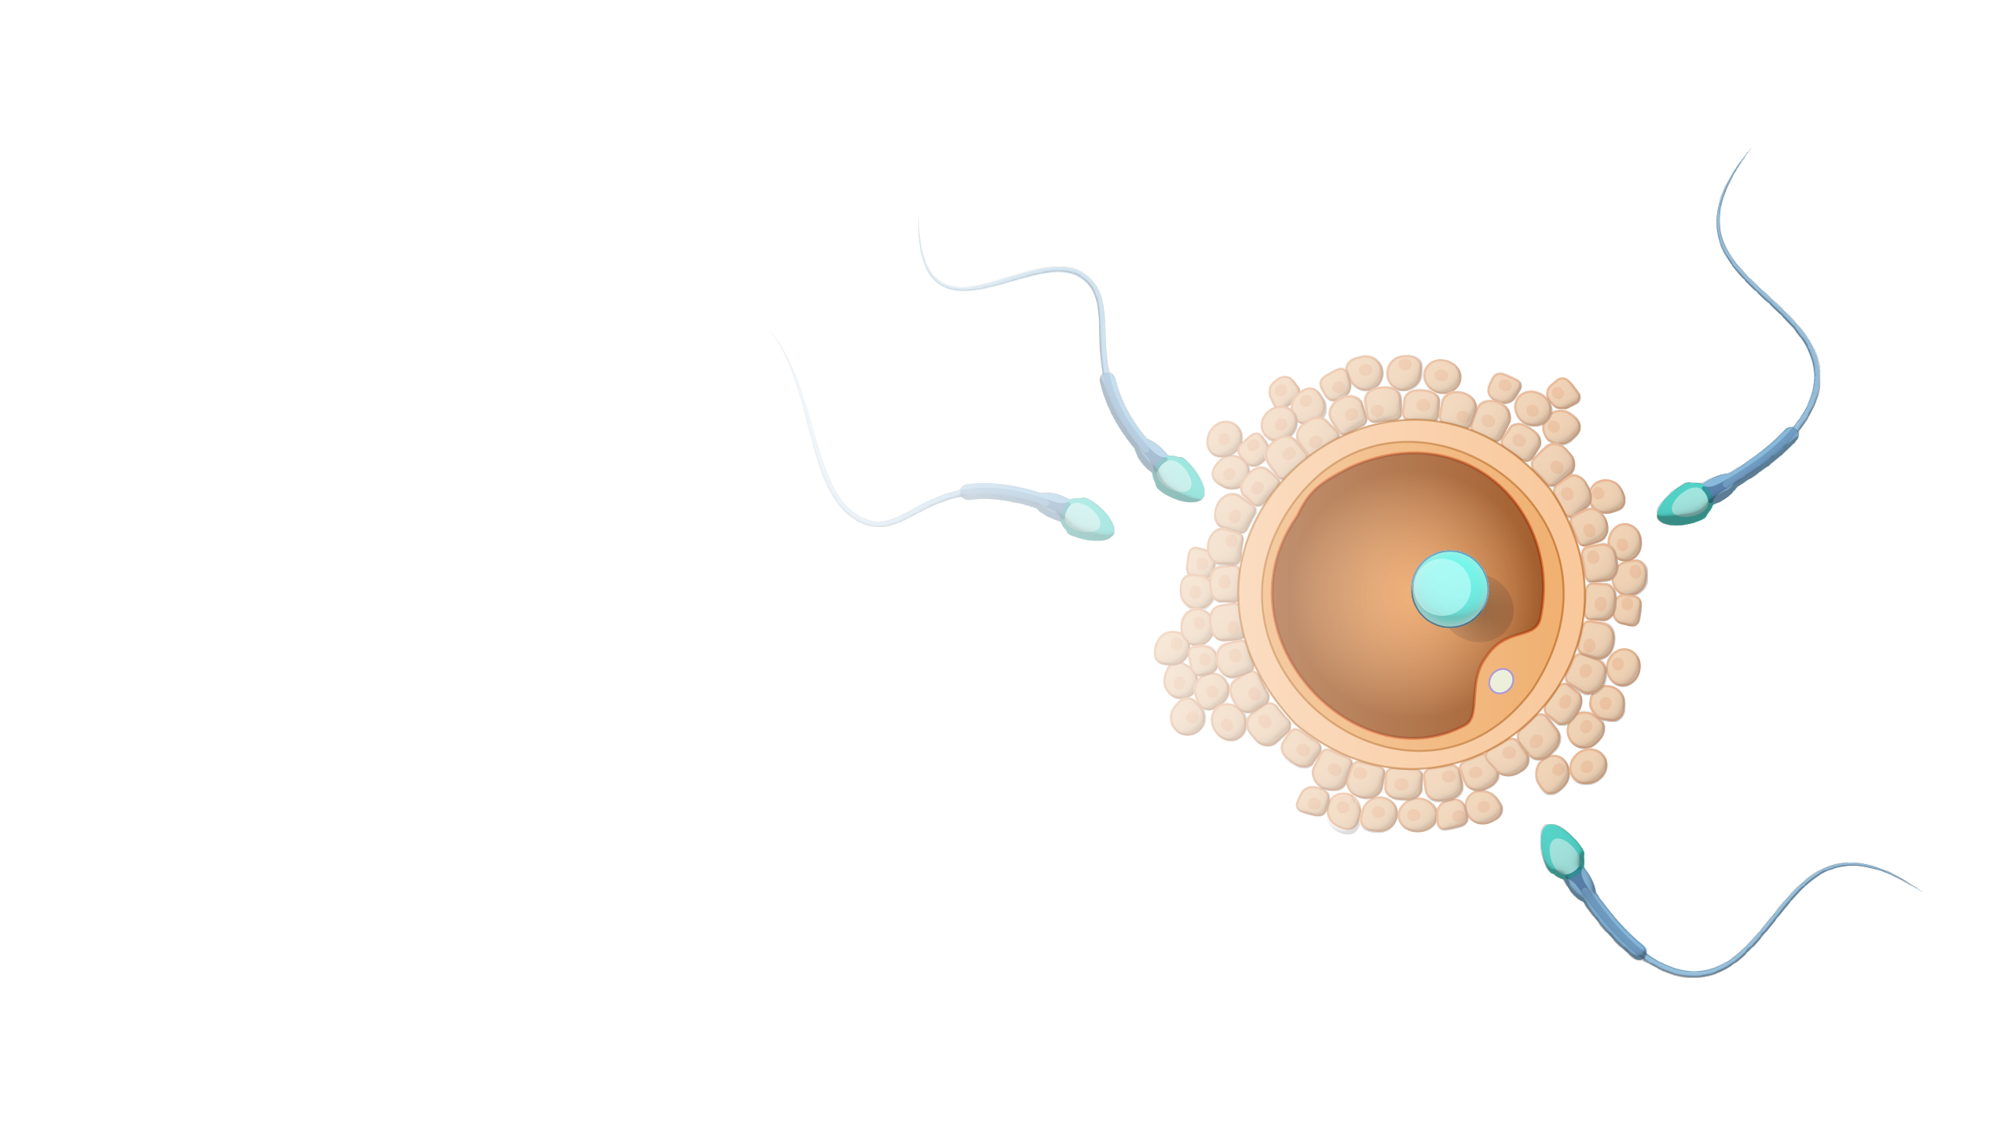
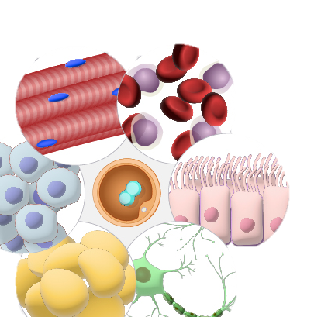
Higher Human Biology
M I S S M C B R I D E
1.1 Division and differentiation in human cells

Slide 2
What should you already know from National 5 Biology?
What word is used to describe sex cells?
Gametes
What word is used to describe the chromosome number in these types of cells?
Haploid
All other cells in the body are described as being…
Diploid

Slide 3
What should you already know from National 5 Biology?
What is a stem cell?
An unspecialised cell that can differentiate into other cell types.

Slide 4
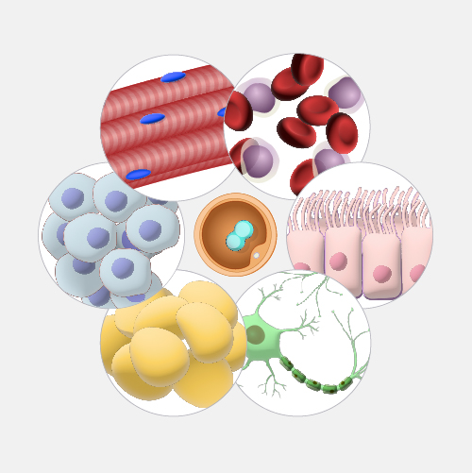
S O M A T I C C E L L S
Somatic cells are the cells in the body other than sperm and egg cells.
In humans, somatic cells are diploid, meaning they contain two sets of chromosomes, one inherited from each parent.

Slide 5
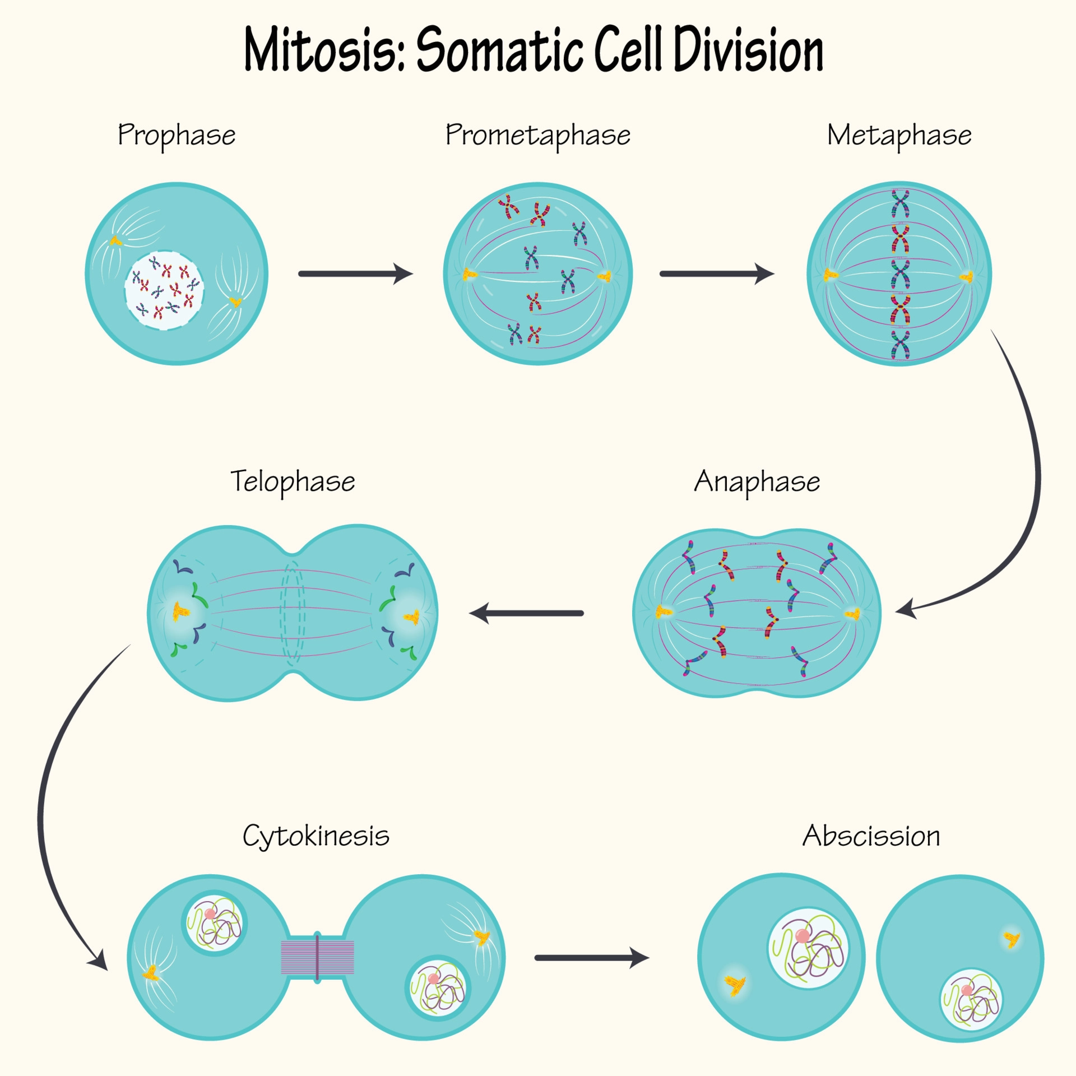
S O M A T I C C E L L S
Somatic cells stem cells divide by mitosis to form more somatic cells.

Slide 6
G E R M L I N E C E L L S
Germline refers to the gametes (eggs and sperm) that sexually reproducing organisms use to pass on their genomes from one generation to the next (parents to offspring).

Slide 7
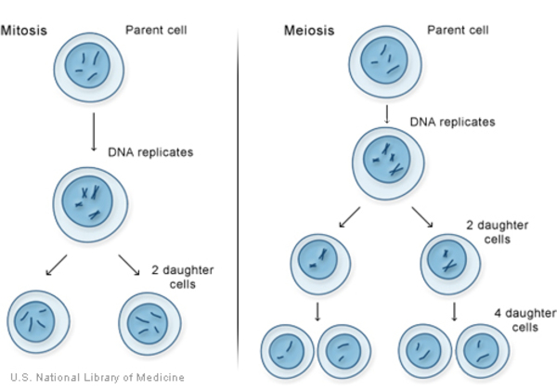
G E R M L I N E C E L L S
Germline stem cells divide by mitosis and by meiosis.

Slide 8
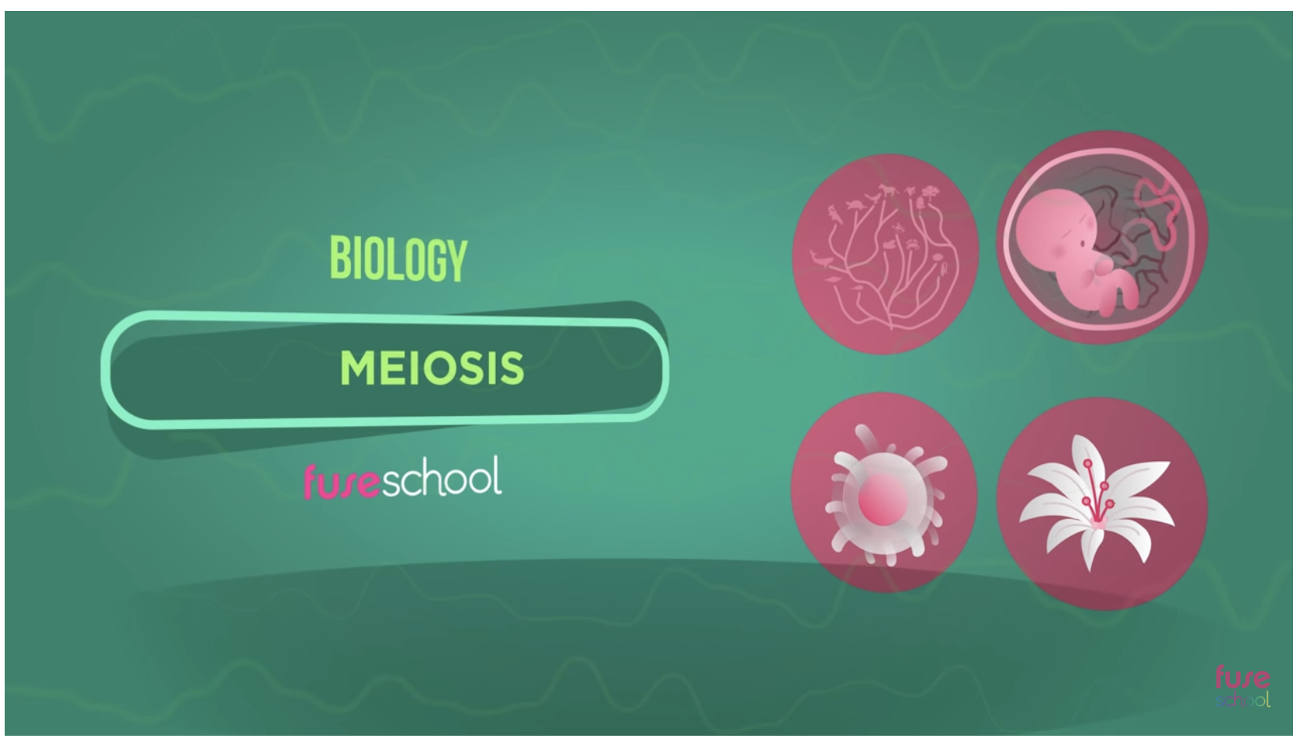

Slide 9
C O U R S E S P E C N O T E S
Division and differentiation in human cells
A somatic cell is any cell in the body other than cells involved in reproduction. Somatic stem cells divide by mitosis to form more somatic cells.
Germline cells are gametes (sperm and ova) and the stem cells that divide to form gametes. Germline cells divide by mitosis and by meiosis.
Division by mitosis produces more germline stem cells. The nucleus of a germline stem cell can divide by mitosis to maintain the diploid chromosome number. Diploid cells have 23 pairs of homologous chromosomes.
The nucleus of a germline stem cell can divide by meiosis. It undergoes two divisions, firstly separating homologous chromosomes and secondly separating chromatids. Haploid gametes contain 23 single chromosomes.

Slide 10
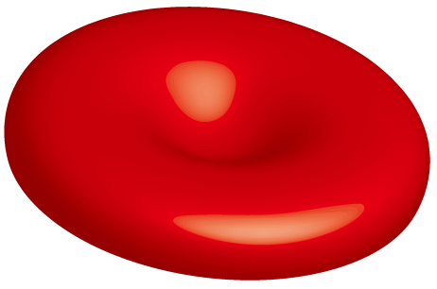
C E L L U L A R D I F F E R E N T I A T I O N
I am a red blood cell, making me a specialised cell.
I only express genes that make the proteins that I need as a red blood cell.

Slide 11
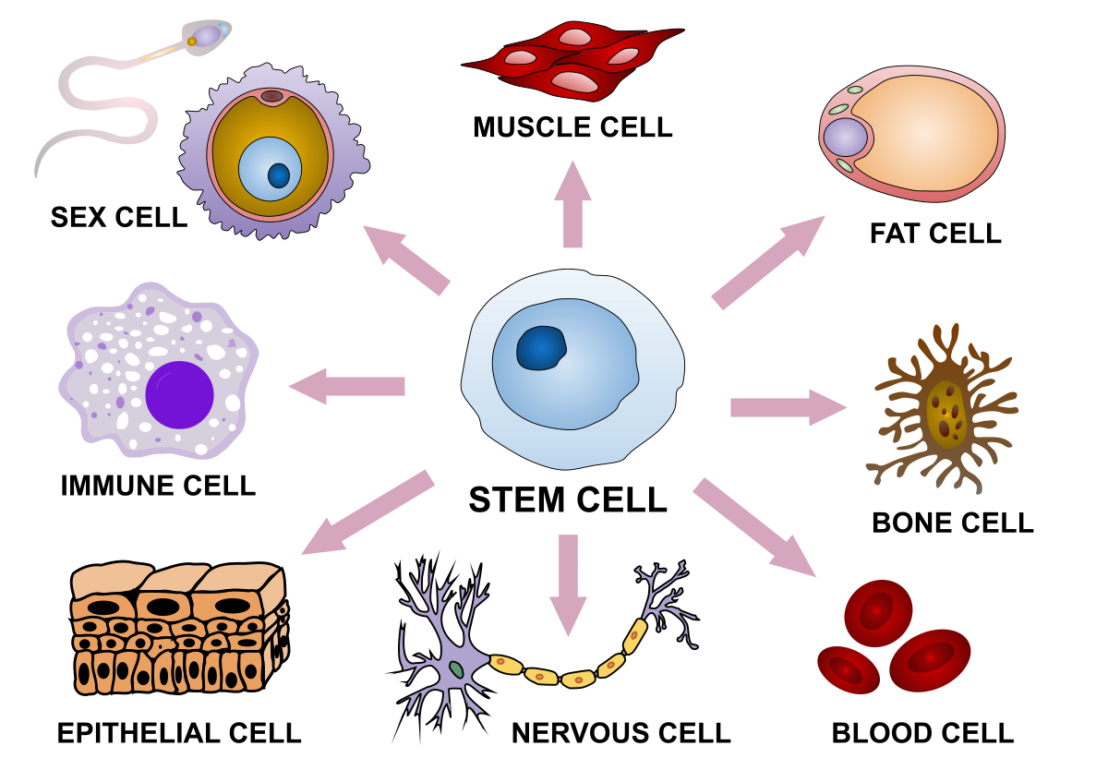
C E L L U L A R D I F F E R E N T I A T I O N
Cellular differentiation is the process by which a cell expresses certain genes to produce proteins characteristic for that type of cell. This allows a cell to carry out specialised functions.

Slide 12
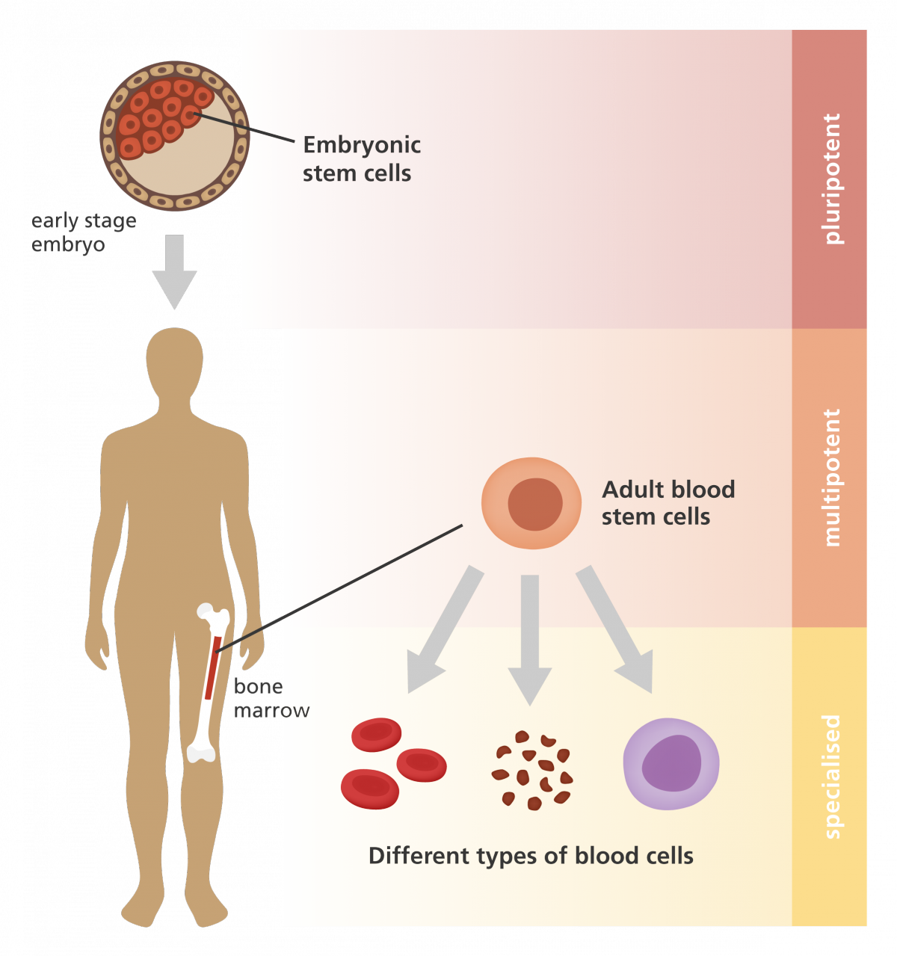
S T E M C E L L S
Most cells in the human body are specialised- perform a specific function in a certain kind of tissue.
Stem cells have not differentiated. They can either self-renew (make more stem cells) again and again, or they can give rise to different types of specialised cells that make up the body.
There are two types of stem cells…

Slide 13
E M B R Y O N I C S T E M C E L L S
Cells in the very early embryo switch on all of their genes meaning they can differentiate into all cell types that make up the individual.
This makes them pluripotent.

Slide 14
T I S S U E S T E M C E L L S
Tissue stem cells can only differentiate into types of cell found in a particular tissue type. This makes them multipotent.

Slide 15
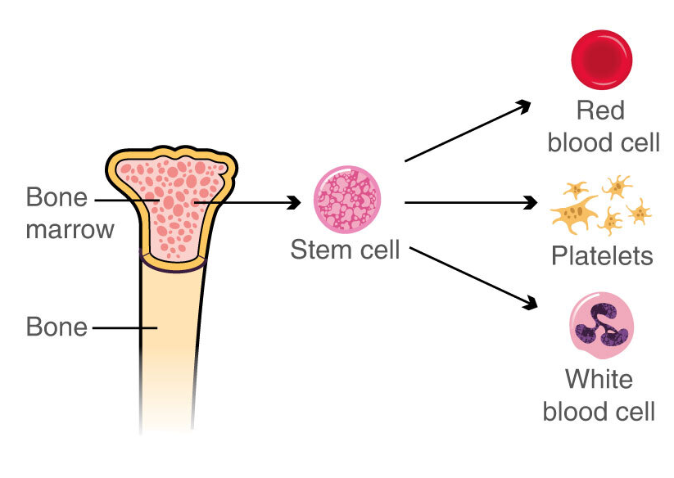
T I S S U E S T E M C E L L S
Tissue stem cells are involved in the growth, repair and renewal of the cells found in that tissue.
For example: blood stem cells located in bone marrow can give rise to red blood cells, platelets, phagocytes and lymphocytes.

Slide 16
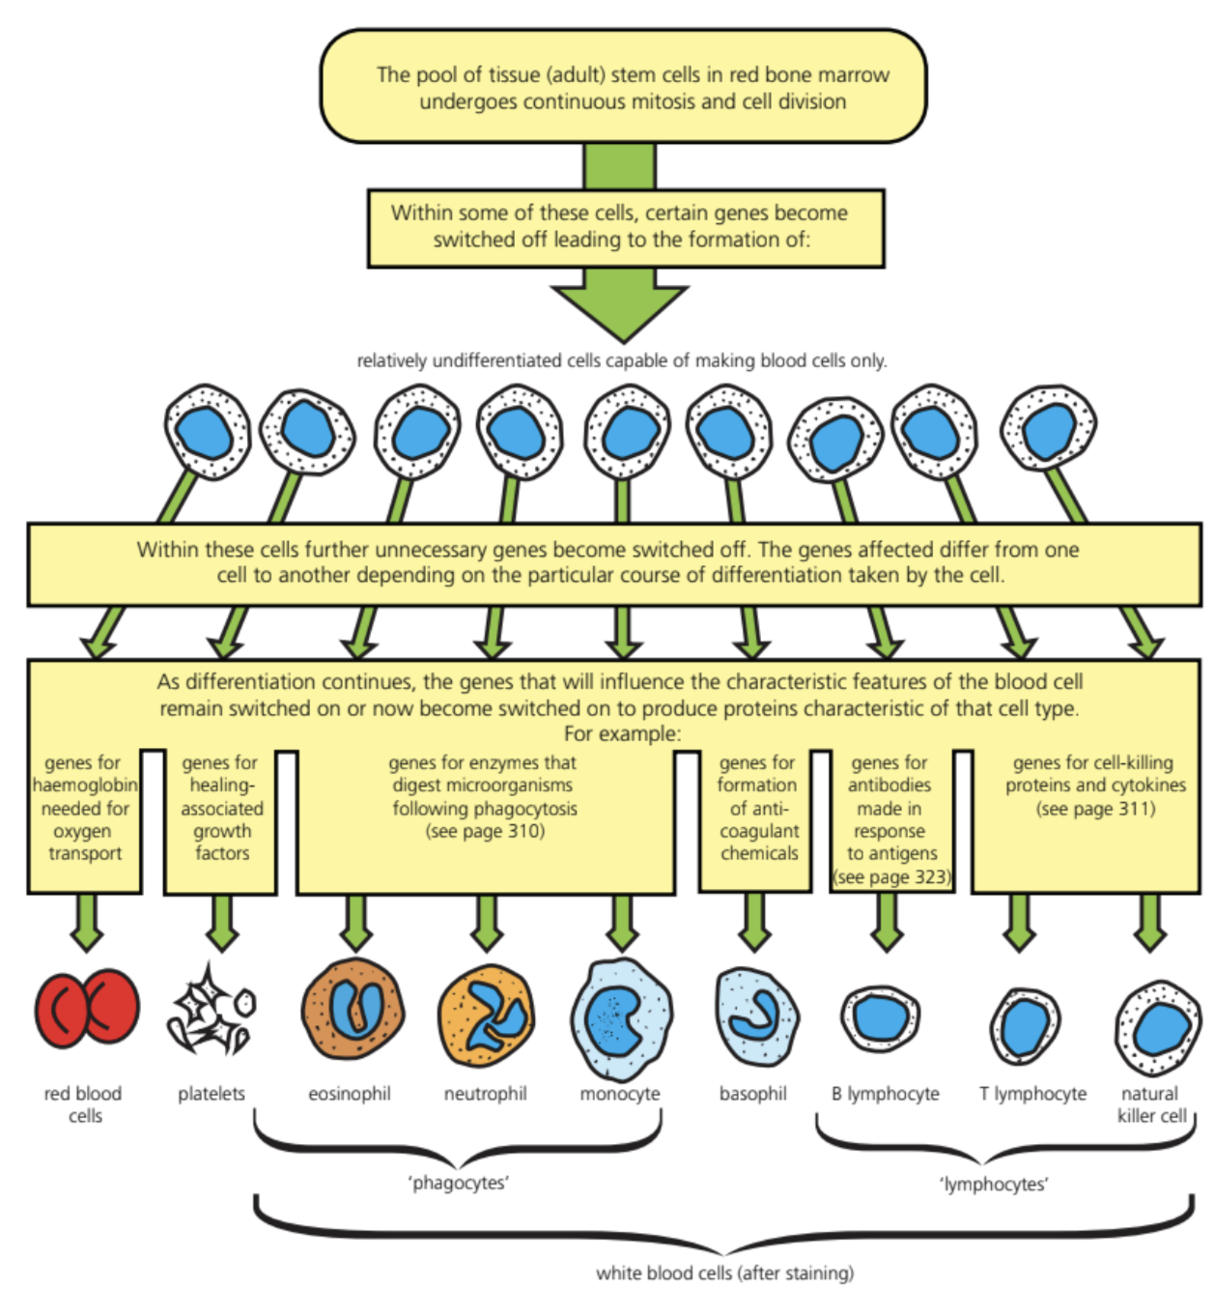

Slide 17
A M A Z I N G S T E M C E L L S
When someone has a heart attack, oxygen supply to the heart is restricted. This causes heart cells to die, which could lead to heart failure. Meaning the heart can no longer pump blood around the body as efficiently as normal.
The British Heart Foundation aim to cure heart failure by using stem cells to make new, healthy heart cells.

Slide 18
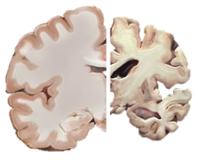
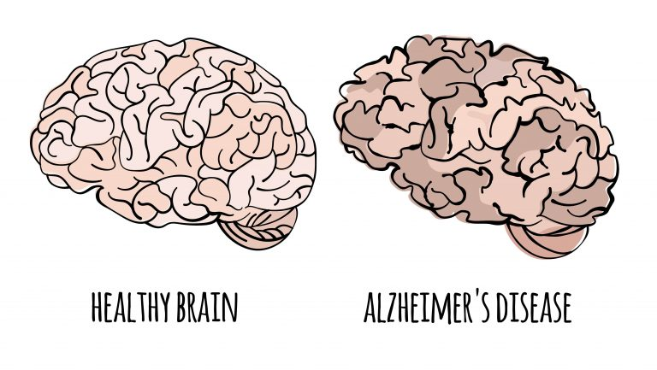
A M A Z I N G S T E M C E L L S
Stem cells can grow into brain cells, and as a result, may have the potential to repair brain damage caused by neurological conditions, such as Dementia and Alzheimer’s.

Slide 19
K E Y T E R M S
SOMATIC
GERMLINE
DIPLOID
HAPLOID
MITOSIS
MEISOSIS
CELLULAR DIFFERENTIATION
PLURIPOTENT
MULTIPOTENT
EMBRYONIC STEM CELLS
TISSUE STEM CELLS
Start a definition page at the back of your jotter.
This will help you make flash cards at some point in the future!

Slide 20
C O U R S E S P E C N O T E S
Division and differentiation in human cells (continued)
Cellular differentiation is the process by which a cell expresses certain genes to produce proteins characteristic for that type of cell This allows a cell to carry out specialised functions.
Cells in the very early embryo can differentiate into all cell types that make up the individual and so are pluripotent. All genes in embryonic stem cells can be switched on so these cells can differentiate into any type of cell.
Tissue stem cells are involved in the growth and repair of the cells found in that tissue. They are multipotent. Tissue stem cells are multipotent as they can differentiate into all of the types of cell found in a particular tissue type. For example, blood stem cells located in bone marrow can give rise to red blood cells, platelets, phagocytes and lymphocytes.

Slide 21
T H E R A P E U T I C U S E S O F S T E M C E L L S
Using your iPad, research some therapeutic uses of stem cells.
Take some notes in your jotters.

Slide 22
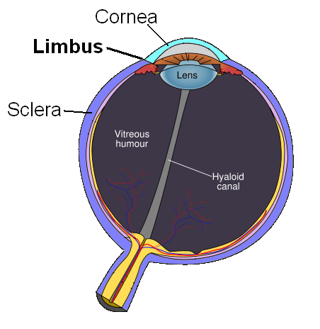
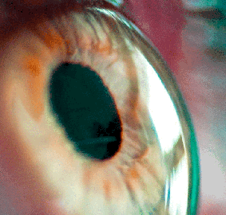
T H E R A P E U T I C U S E S O F S T E M C E L L S
The cornea is the eye’s major protective barrier.
Tissue stem cells found in the corneal limbus (the rim that separates the cornea and conjunctiva) are being used to transplant new corneal stem cells to restore damaged cornea.

Slide 23
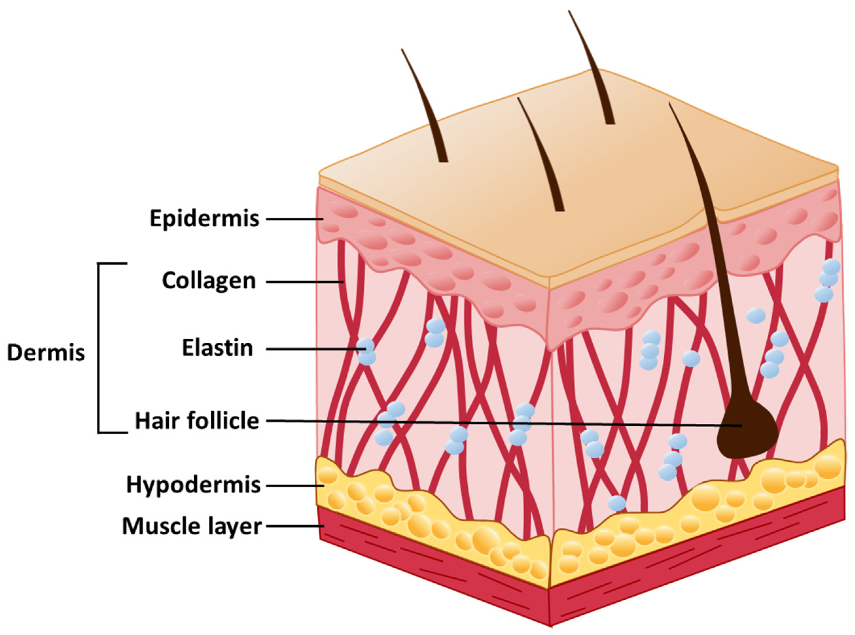
T H E R A P E U T I C U S E S O F S T E M C E L L S
Stem cell treatment have been used to regenerate sun-damaged skin.
Stem cells have been used to smooth out wrinkles and give face lifts.
Stem cells have been used to make pores disappear and reduce skin colouring.
Stem cells are taken from the patients own body and administered exactly where they are supposed to produce regenerating effects.

Slide 24
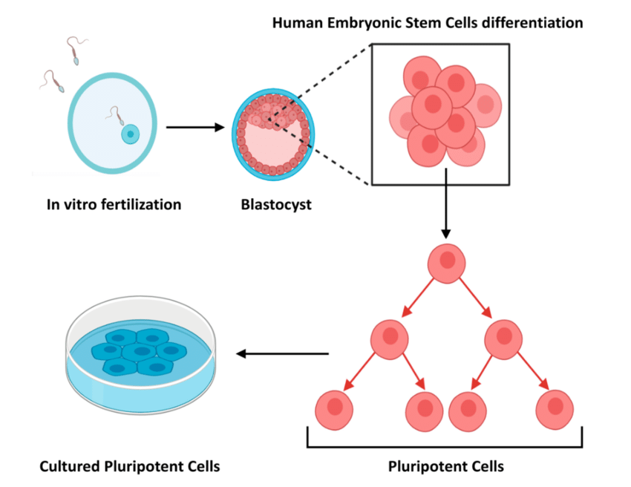
T H E E T H I C A L I S S U E S O F E M B R Y O N I C S T E M C E L L S
Use of embryonic stem cells can offer effective treatments for disease and injury; however it involves the destruction of embryos.

Slide 25
C O U R S E S P E C N O T E S
Division and differentiation in human cells (continued)
Therapeutic uses of stem cells involve the repair of damaged or diseased organs or tissues. The therapeutic uses of stem cells should be exemplified by how they are used in corneal repair and the regeneration of damaged skin.
Research uses involve stem cells being used as model cells to study how diseases develop or being used for drug testing. Stem cells from the embryo can self-renew, under the right conditions, in the lab. Stem cell research provides information on how cell processes such as cell growth, differentiation and gene regulation work.
Use of embryonic stem cells can offer effective treatments for disease and injury; however, it involves destruction of embryos.

Slide 26
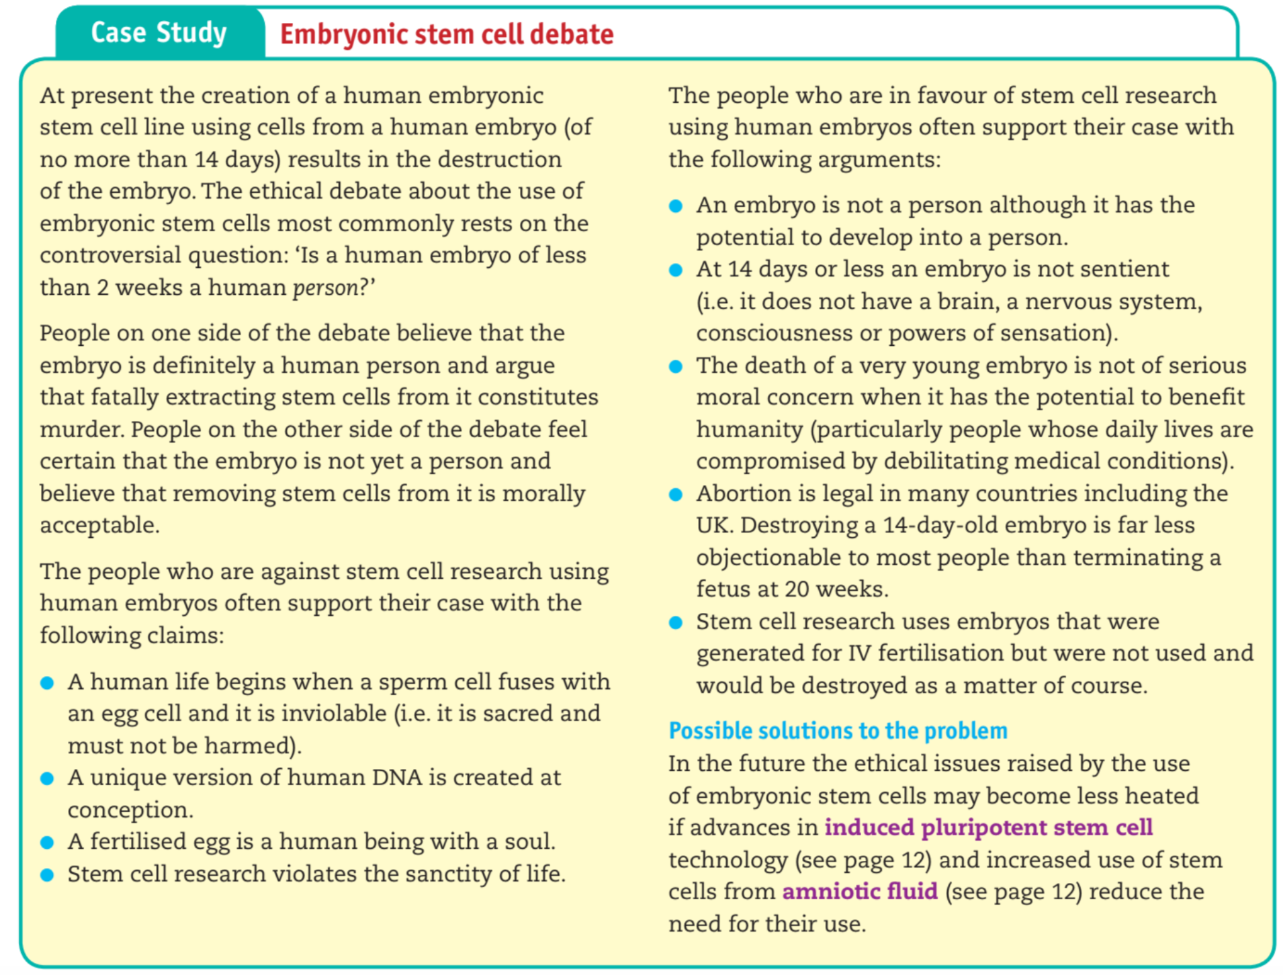
T H E E T H I C A L I S S U E S O F E M B R Y O N I C S T E M C E L L S
Read through the debate and decide which side you agree with and why.

Slide 27
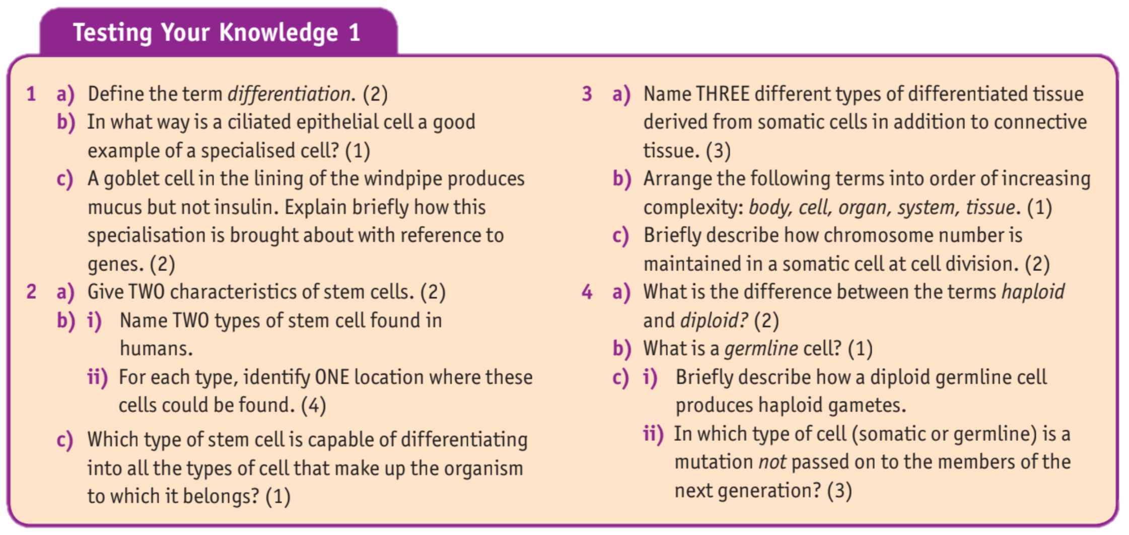
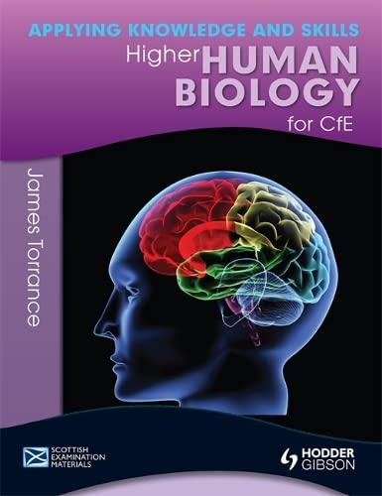
T E X T B O O K Q U E S T I O N S
Questions are on page 8 and all answers can be found on the previous pages. Answer in your jotters in full sentences.

Slide 28
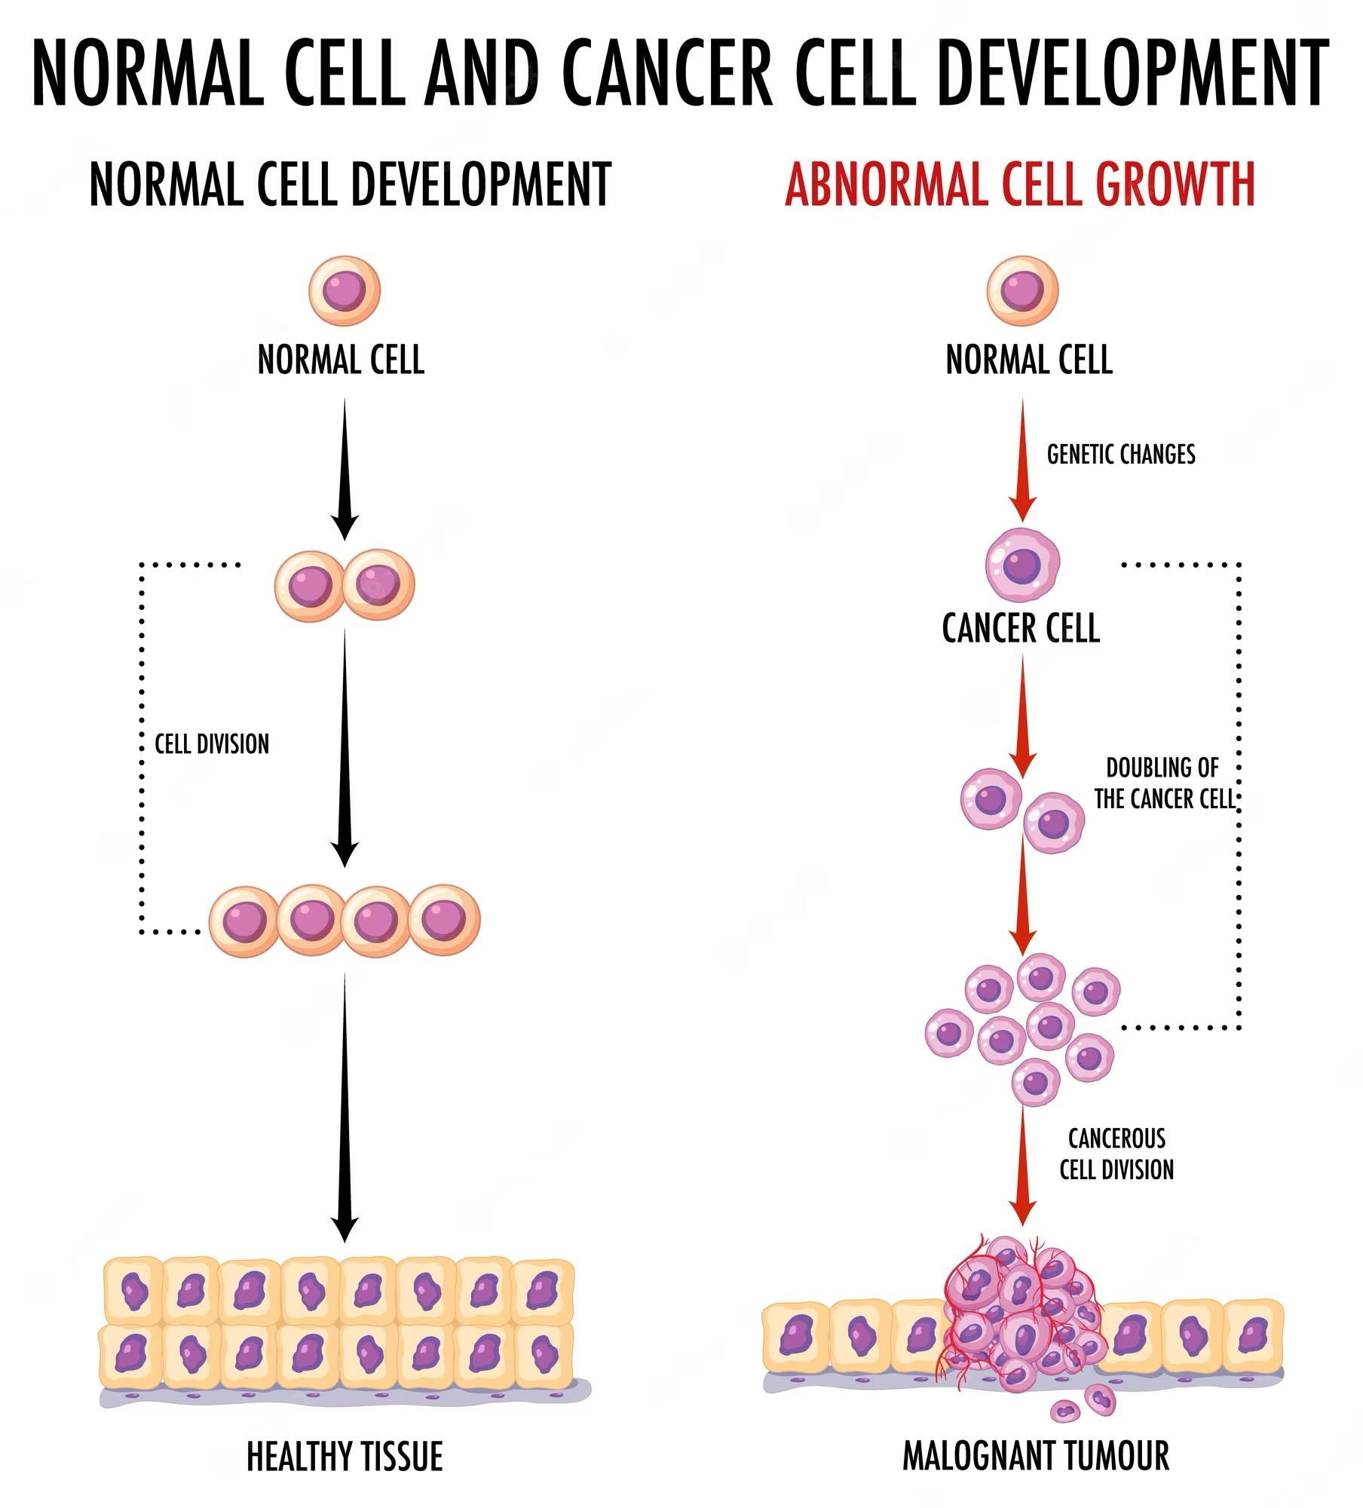
C A N C E R C E L L S
Cancer can start almost anywhere in the human body.
Normally, human cells grow and multiply through mitosis to form new cells as the body needs them.
When cells grow old or become damaged, they die, and new cells take their place.

Slide 29
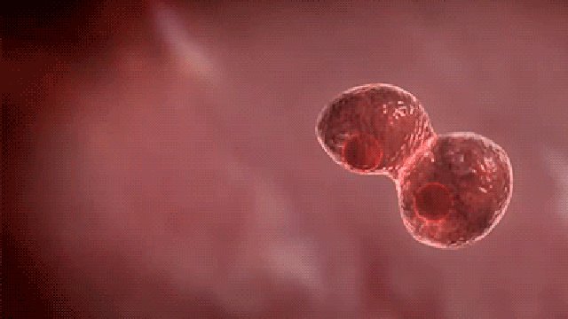
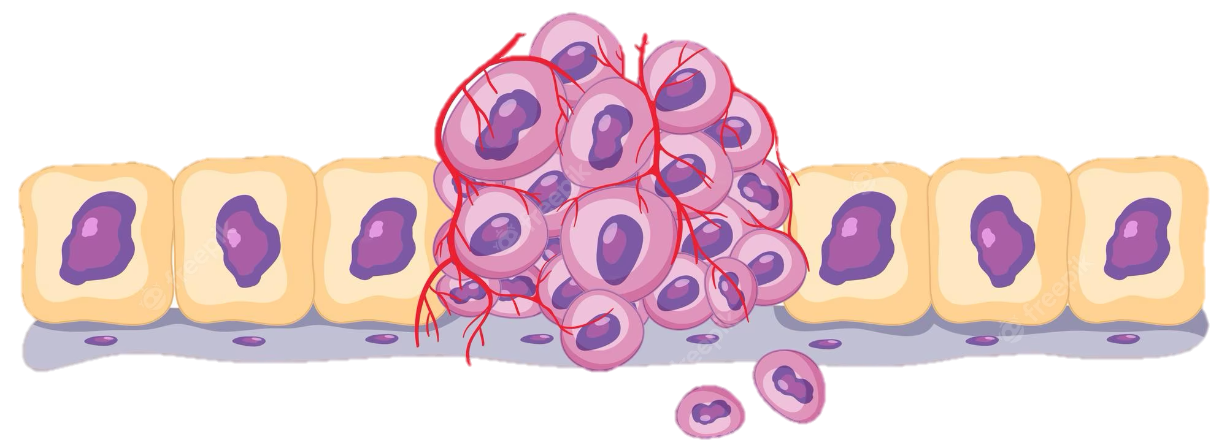
C A N C E R C E L L S
Sometimes this orderly process breaks down, and abnormal or damaged cells grow and multiply when they shouldn’t. These cells may form tumours, which are lumps of tissue. Tumours can be cancerous or not cancerous (benign).

Slide 30
C A N C E R C E L L S
Cancer cells divide excessively because they do not respond to regulatory signals.
This results in a mass of abnormal cells called a tumour.
Cells within the tumour may fail to attach to each other, spreading through the body where they may form secondary tumours.

Slide 31
C O U R S E S P E C N O T E S
Division and differentiation in human cells (continued)
Cancer cells divide excessively because they do not respond to regulatory signals. This results in a mass of abnormal cells called a tumour. Cells within the tumour may fail to attach to each other, spreading through the body where they may form secondary tumours.

Slide 32
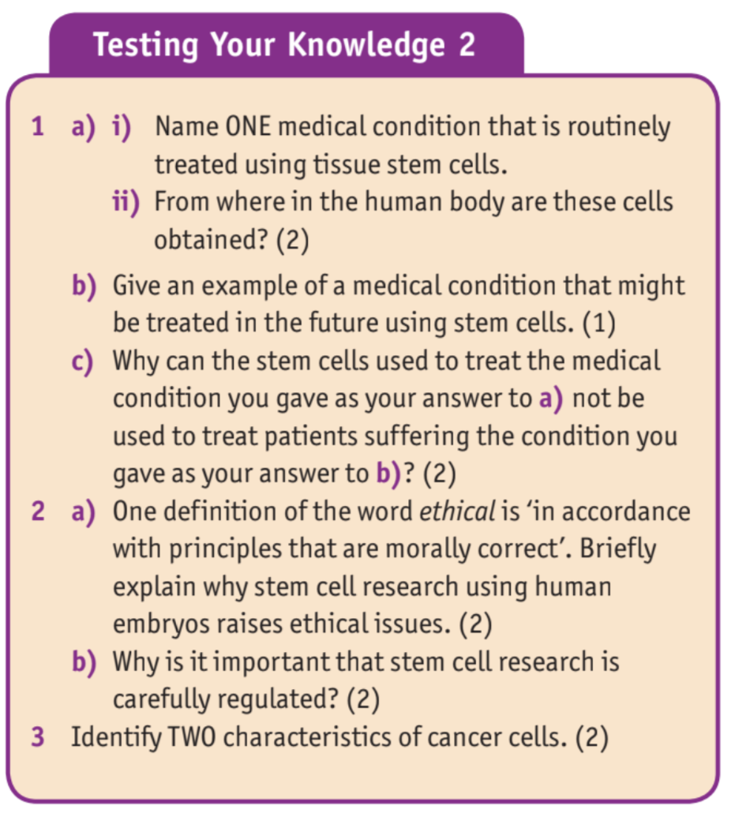
T E X T B O O K Q U E S T I O N S
Questions are on page 15 and all answers can be found on the previous pages. Answer in your jotters in full sentences.

Slide 33
K E Y T E R M S
TUMOUR
SECONDARY TUMOUR
Add these terms to the definition page at the back of your jotter.
This will help you make flash cards at some point in the future!

