Slide 1
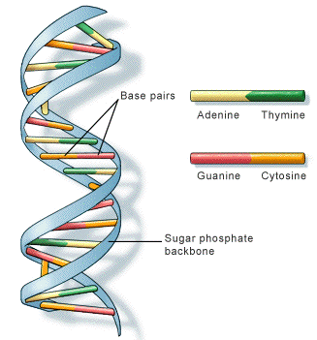
Unit 1: Cell Biology
1.3 DNA and the production of proteins

Slide 2
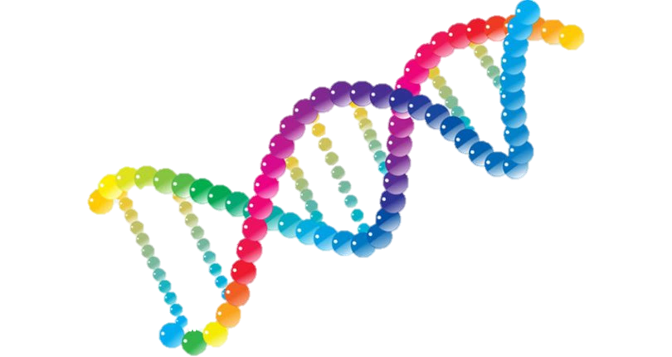
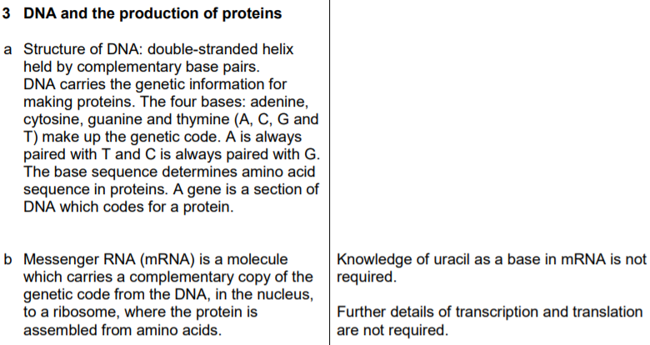
1.3 DNA and the production of proteins

Slide 3
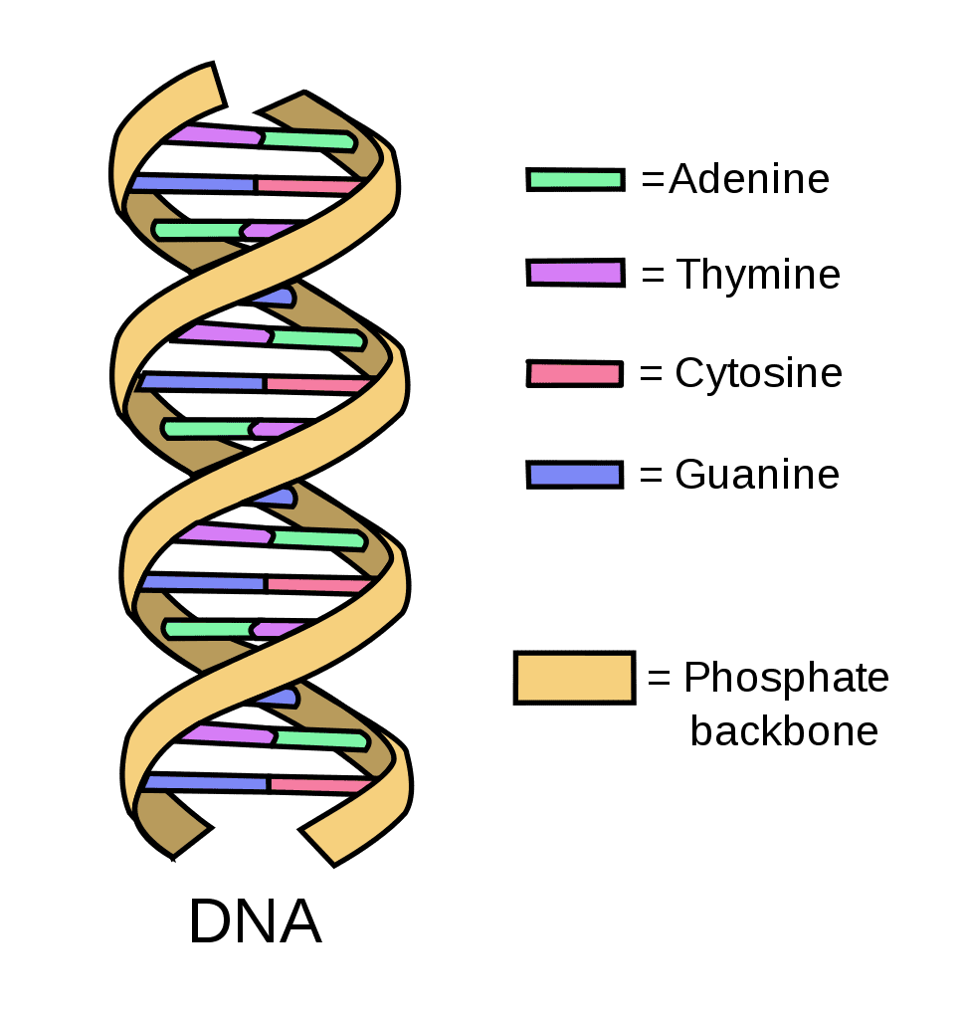
Deoxyribonucleic Acid (DNA)
Stored in the nucleus of every cell
Double stranded
Made up of 4 bases and a backbone
Twisted into a double helix
Contains genetic information
The base sequence determines amino acid sequence in proteins. A gene is a section of DNA which codes for a protein.

Slide 4
DNA bases
They are said to be complimentary to each other.
A
T
C
G
Helpful tip!
A and T are made up of straight lines.
G and C are made up of round lines.

Slide 5
A
T
G
G
G
C
A
T
T
A
G
C
C
T
A
C
G
C
C
G
T
A
A
T
C
G

Slide 6
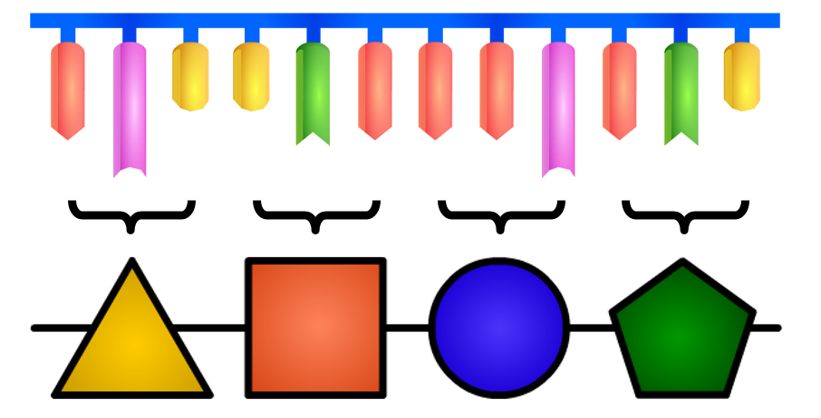
The bases on a DNA strand are the genetic instructions to make proteins.
Proteins are made up of amino acids. You can see in the image above that every 3 bases codes for a different amino acid.

Slide 7
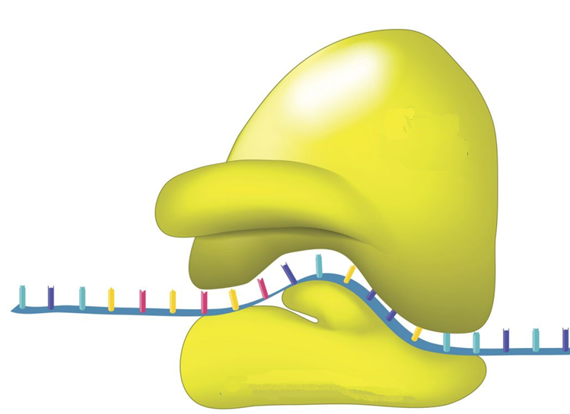
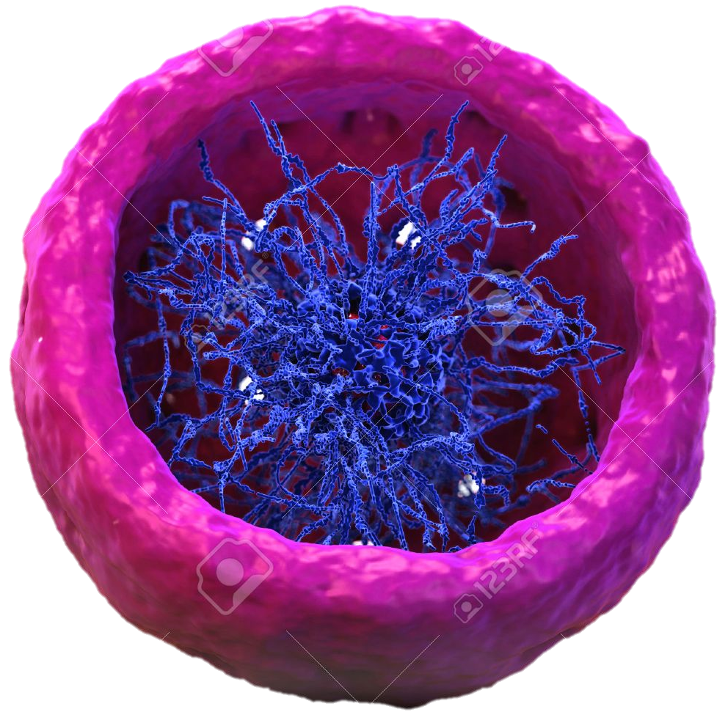
DNA cannot leave the nucleus. So how does the instructions to make proteins make its way to the ribosome, the site of protein synthesis?
Ribosome
Nucleus

Slide 8
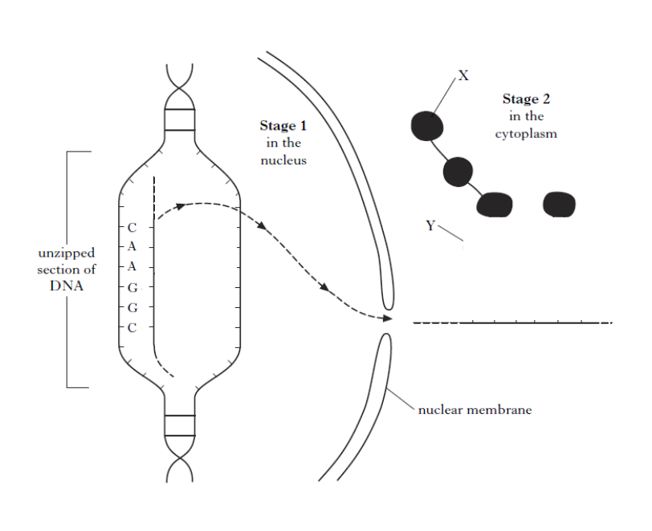
mRNA
mRNA
mRNA is a molecule which carries a copy the code from the DNA in the nucleus to a ribosome.

Slide 9
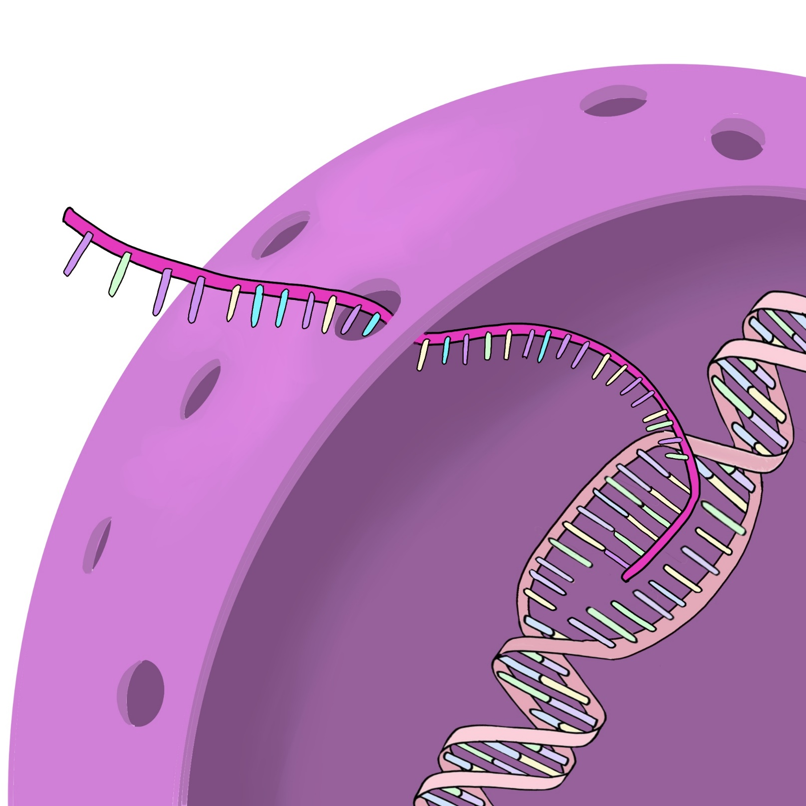
mRNA is a molecule that carries a complimentary copy of a section of DNA out of the nucleus to a ribosome.
mRNA
Cytoplasm
Nucleus
DNA

Slide 10
Ribosome
mRNA
Cytoplasm

Slide 11
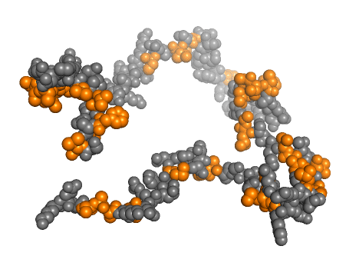

Slide 12
2020 Past Paper Question
Describe the production of proteins (4)
Messenger RNA (mRNA) is a molecule which carries a complementary copy of the genetic code (1) from the DNA, in the nucleus(1), to a ribosome (1), where the protein is assembled from amino acids (1).

