Slide 1
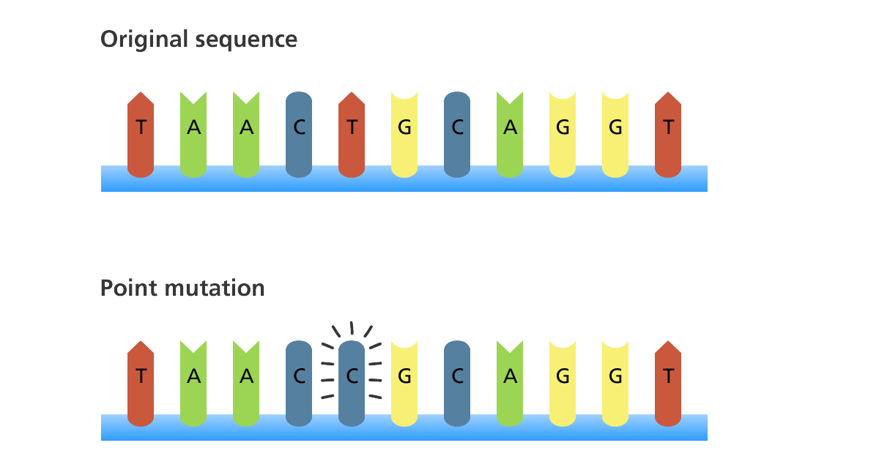
Higher Human Biology
M I S S M C B R I D E
1.4 Mutations

Slide 2
Q U E S T I O N
Put the following into the correct order…
Amino acids
Mature Transcript
Primary Transcript
DNA
Translation
Splicing
Protein
Transcription

Slide 3
A N S W E R
Primary Transcript
Mature Transcript
Amino acids
DNA
Transcription
Splicing
Translation
Protein

Slide 4
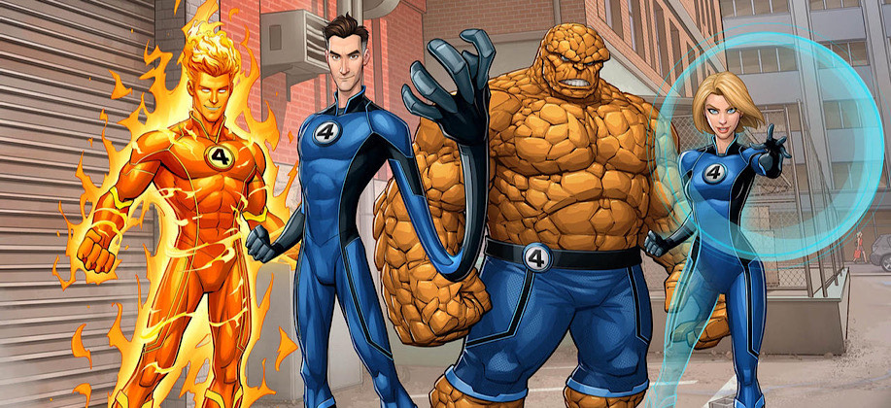
M U T A T I O N S
Mutations are happening in our cells all the time, but almost none of these affect our health.
This is very different than what we often see in science fiction in movies. In real life, a mutation is never so beneficial that it turns a person into a superhero, unfortunately.

Slide 5
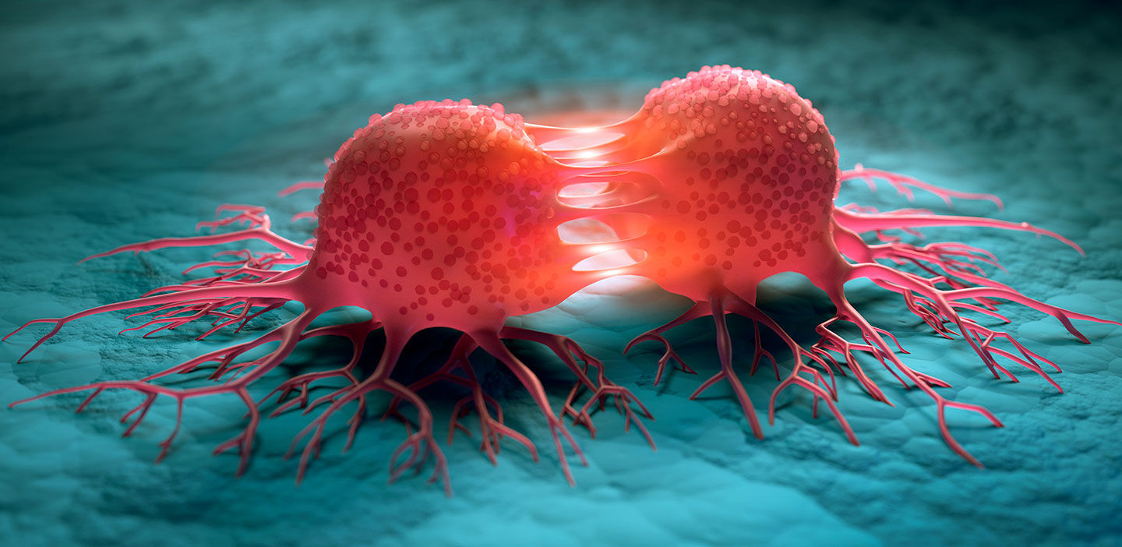
M U T A T I O N S
There are many reasons that mutations usually don't have major consequences.
One reason is that our cells have very sophisticated machinery for repairing mutations very quickly. So there's not enough time for them to cause problems.
Another is that most mutations occur in somatic cells like muscle cells or skin cells and can only affect the cell where the mutation occurred and cells that grow from that cell. On the other hand, when mutations occur in germline cells, eggs and sperm, they will be present in every cell that develops from that egg or sperm, an entire person, and can have larger effects.

Slide 6
M U T A T I O N S
A mutation is a change in the DNA sequence of an organism. Mutations can result from errors in DNA replication during cell division, exposure to mutagens or a viral infection.
Mutations are changes in the DNA that can result in no protein or an altered protein being synthesised.

Slide 7
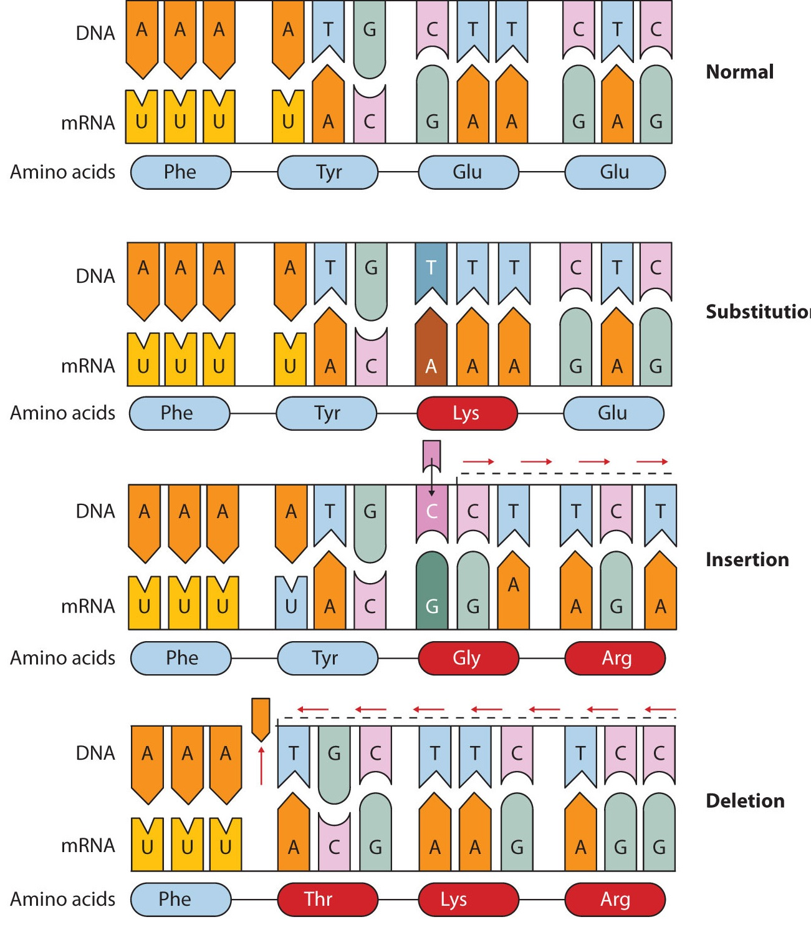
S I N G L E G E N E M U T A T I O N S
Single gene mutations involve the alteration of a DNA nucleotide sequence as a result of the substitution, insertion or deletion of nucleotides.

Slide 8
S U B S T I T U T I O N M U T A T I O N

Slide 9
I N S E R T I O N M U T A T I O N

Slide 10
D E L E T I O N M U T A T I O N

Slide 11
S I N G L E G E N E M U T A T I O N S
A substitution mutation is an example of a point mutation, it only effects one amino acid.
Insertion and deletion are examples frame-shift mutations. Frame-shift mutations cause all of the codons and all of the amino acids after the mutation to be changed. This has a major effect on the structure of the protein produced.

Slide 12
S U B S T I T U T I O N M U T A T I O N
When one nucleotide is replaced with another (substitution mutation) there is one of three outcomes that could occur.
Missense Mutation
Missense mutations result in one amino acid being changed for another. This may result in a non-functional protein or have little effect on the protein.
2. Nonsense Mutation
Nonsense mutations result in a premature stop codon being produced which results in a shorter protein.
3. Splice-site Mutation
Splice-site mutations result in some introns being retained and/or some exons not being included in the mature transcript.

Slide 13
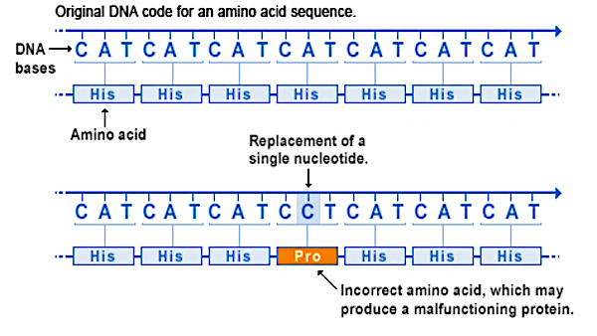
M I S S E N S E M U T A T I O N

Slide 14
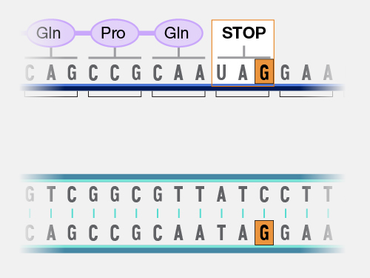
N O N S E N S E M U T A T I O N

Slide 15
S P L I C E - S I T E M U T A T I O N

Slide 16
C O U R S E S P E C N O T E S
Mutations
Mutations are changes in the DNA that can result in no protein or an altered protein being synthesised.
Single gene mutations involve the alteration of a DNA nucleotide sequence as a result of the substitution, insertion or deletion of nucleotides.
Nucleotide substitutions — missense, nonsense and splice-site mutations.
Missense mutations result in one amino acid being changed for another. This may result in a non-functional protein or have little effect on the protein.
Nonsense mutations result in a premature stop codon being produced which results in a shorter protein.
Splice-site mutations result in some introns being retained and/or some exons not being included in the mature transcript.

Slide 17
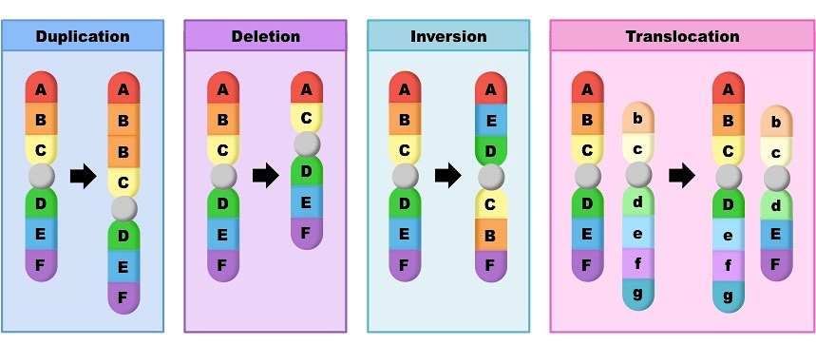
C H R O M O S O M E S T R U C T U R E M U T A T I O N S

Slide 18
C H R O M O S O M E S T R U C T U R E M U T A T I O N S
Duplication is where a section of a chromosome is added from its homologous partner.

Slide 19
C H R O M O S O M E S T R U C T U R E M U T A T I O N S
Deletion is where a section of a chromosome is removed.

Slide 20
C H R O M O S O M E S T R U C T U R E M U T A T I O N S
Inversion is where a section of chromosome is reversed.

Slide 21
C H R O M O S O M E S T R U C T U R E M U T A T I O N S
Translocation is where a section of a chromosome is added to a chromosome, not its homologous partner.

Slide 22
C H R O M O S O M E S T R U C T U R E M U T A T I O N S
The substantial changes in chromosome mutations often make them lethal.

Slide 23
C O U R S E S P E C N O T E S
Mutations
Nucleotide insertions or deletions result in frame-shift mutations.
Frame-shift mutations cause all of the codons and all of the amino acids after the mutation to be changed. This has a major effect on the structure of the protein produced.
Chromosome structure mutations — duplication, deletion, inversion and translocation.
Duplication is where a section of a chromosome is added from its homologous partner.
Deletion is where a section of a chromosome is removed.
Inversion is where a section of chromosome is reversed.
Translocation is where a section of a chromosome is added to a chromosome, not its homologous partner.
The substantial changes in chromosome mutations often make them lethal.

Slide 24
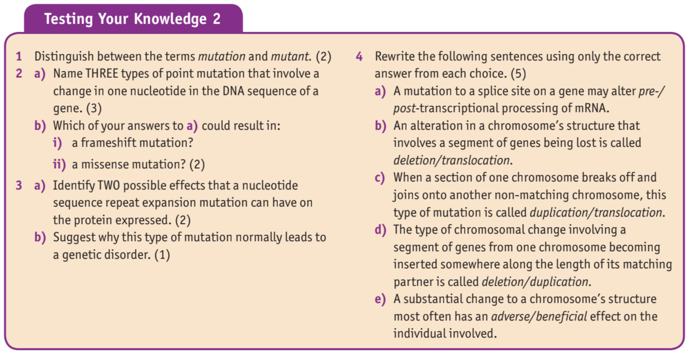
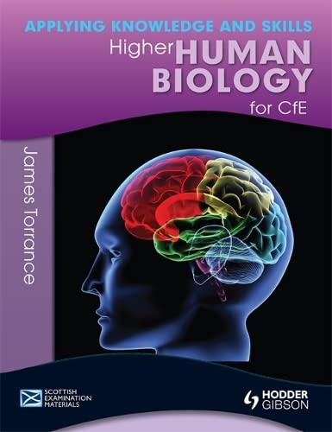
T E X T B O O K Q U E S T I O N S
Questions are on page 62 and all answers can be found on the previous pages. Answer in your jotters in full sentences.

Slide 25
K E Y T E R M S
MUTATION
SUBSTITUTION
INSERTION
DELETION
MISSENSE
NONSENSE
SPLICE-SITE
POINT MUTATION
FRAME SHIFT MUTATION
DUPLICATION
DELETION
INVERSION
TRANSLOCATION
Definition page at the back of your jotter.
This will help you make flash cards at some point in the future!

