Slide 1
2.1 Producing New Cells

Slide 2
Learning Intentions
Success Criteria
Learn about the importance of cell division
Identify the different stages of mitosis
I have made notes on the information from these slides
I can correctly identify the order of the stages of mitosis.

Slide 3
Make notes wherever you see a pencil, but feel free to take as many notes as you like.

Slide 4
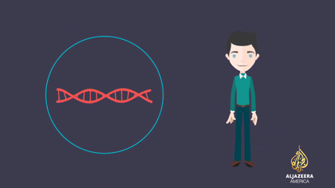
DNA Recap
Remember DNA is an important molecule as it contains your genes
Genes are used to make proteins which determine your height, hair colour etc
Can you remember where DNA is found in cells?

Slide 5
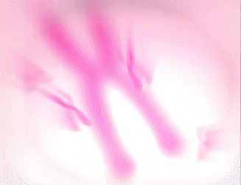
Chromosomes
DNA is found within the nucleus of a cell, specifically in structures called chromosomes
Essentially the long strands of DNA coil over themselves and wraps around proteins, eventually forming chromosomes

Slide 6
Chromosomes
Chromosomes are thread like structures made up of DNA (and proteins), and are found within the nucleus

Slide 7
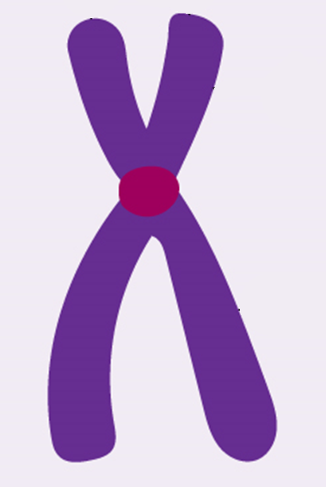
Copy and label the diagram of the chromosome below
A
B
Chromosome
C

Slide 8
Copy and label the diagram of the chromosome below
Centromere
Chromatids
Chromosome
Chromosome

Slide 9
Chromosomes don’t always look the same!
Chromosomes can look different depending on where a cell is in its lifecycle
This is sometimes referred to as a double chromosome
As it is made up of two chromatids
This is sometimes referred to as a single chromosome
As it is made up of one chromatid
These are both chromosomes

Slide 10
Chromosomes don’t always look the same!
How many chromosomes are on this slide?

Slide 11
Chromosomes don’t always look the same!
3
4
2
5
6
1
How many chromosomes are on this slide? 6

Slide 12
How many chromosomes do cells have?
Most cells have 2 copies of every chromosome and are therefore said to diploid
Sex cells however (e.g. egg and sperm cells) only have 1 copy, and are hence said to be haploid
Haploid
1 copy of each chromosome
Diploid
2 copies of each chromosome

Slide 13
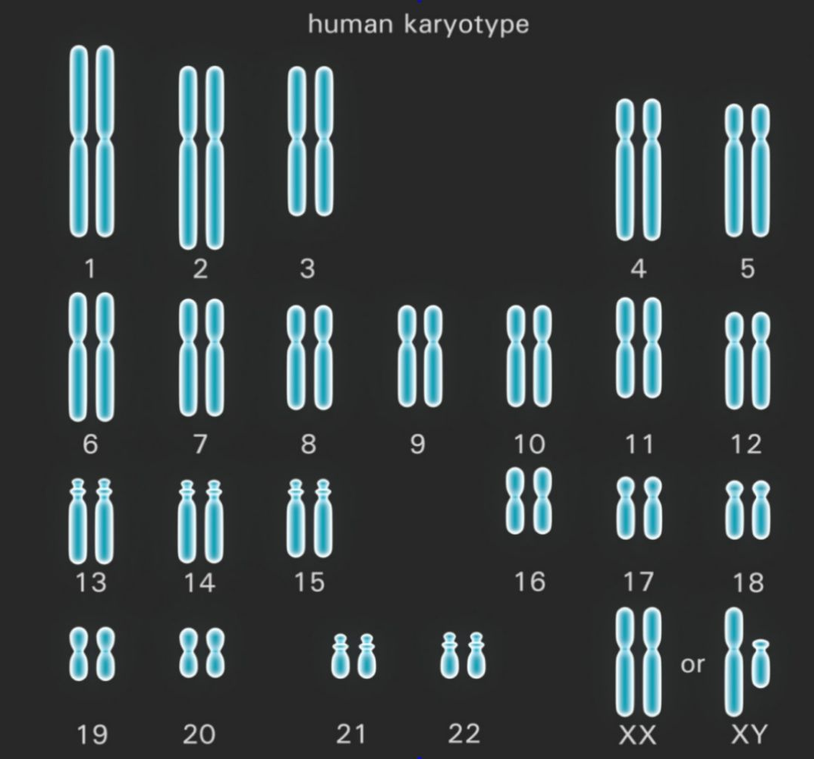
Haploid Human Cell
(e.g. sperm cell)
Diploid Human Cell
(e.g. skin cell)
23 pairs of chromosomes
46 in total
Only 23 chromosomes in total

Slide 14
Use the information on the previous 2 slides to fill out this table
 | Diploid cells | Haploid cells
Number of copies of each chromosome
Total number of chomosomes (in humans)
Example |  | Skin cell

Slide 15
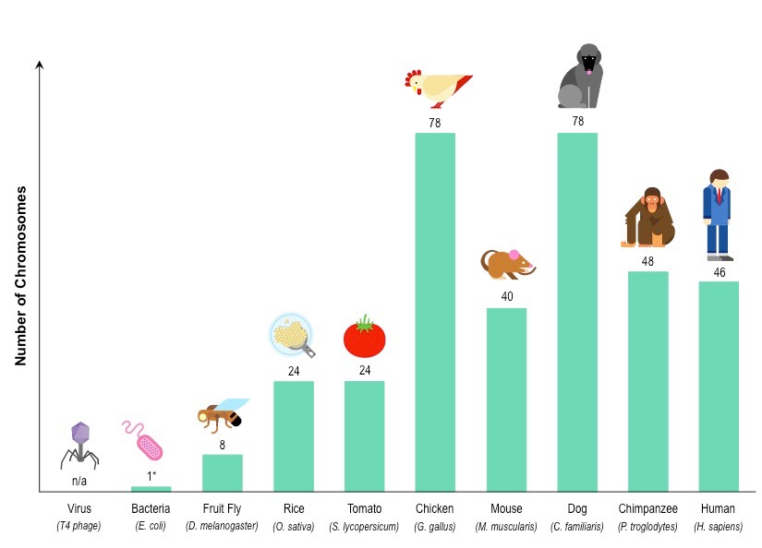
How many chromosomes do cells have?
Different organisms also have different numbers of chromosomes
e.g. humans have 46 chromosomes, chicken have 78, whilst fruit flies only have 8!

Slide 16
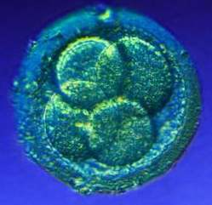
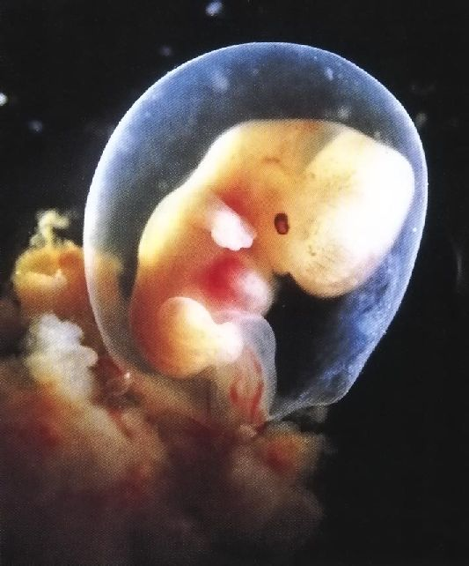
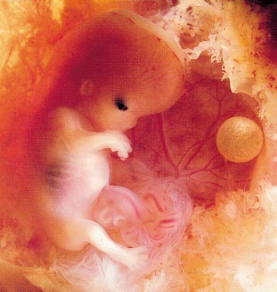
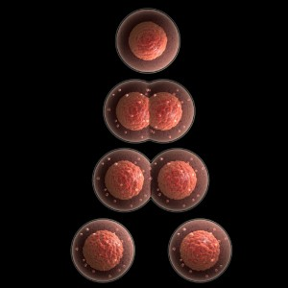
Cell Division - Mitosis
1
After fertilisation, how many cells did you consist of?
How many cells are you made of now?
Where did they come from?
a trillion
The original cell was copied, it divided to form 2 which were then copied…..
Mitosis is a way of increasing the
number of cells in an organism
It is necessary for growth and repair
One cell divides to become 2 cells

Slide 17
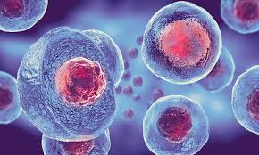
Division of the Nucleus
When a cell divides the nucleus makes a copy of itself, and then it divides
The nucleus co-ordinates and controls the
cell’s activities – growth, chemical reactions,
protein synthesis and reproduction
It stores the cell’s hereditary information in
DNA, which is organised into chromosomes
in the nucleus
Chromosomes carry the information needed to build a new cell
They must be copied to pass this information on to the next generation

Slide 18
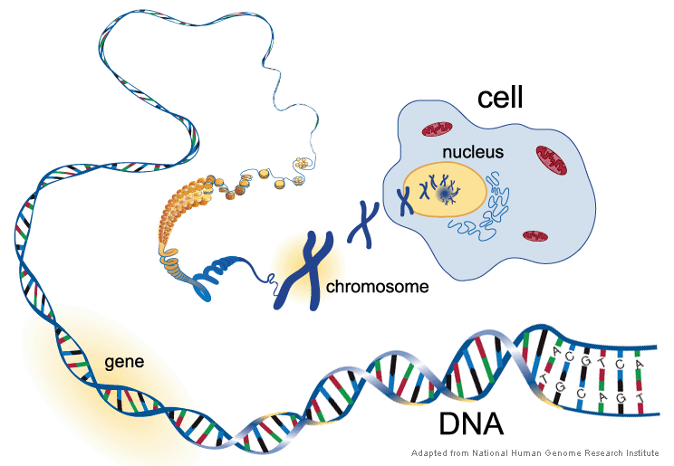
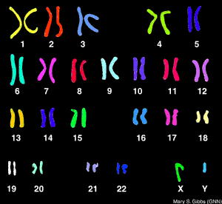
Chromosomes
Body cells have 2 matching sets of
chromosomes (one from each parent)
As they have 2 sets, they are said to
be ‘diploid’
Gametes (sperms and eggs) are
‘haploid’ –they only have one set
The diploid number for human cells is 46 (2 x sets of 23 chromosomes)
Other species have different numbers of chromosomes
Before a cell can divide all the DNA in all the chromosomes must be replicated (copied)

Slide 19
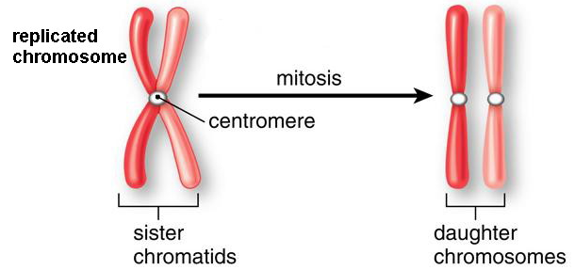
Copying Chromosomes
Chromosomes are copied so that each new cell will have a complete copy
of the genetic information needed to develop
Every new cell produced by cell division needs a full set of chromosomes
When you look at a nucleus under a microscope you don’t normally see the
chromosomes, as they are unwound and are being replicated
Chromosomes appear as 2 identical chromatids (copies) when cells are about to divide by mitosis
During mitosis, the 2 chromatids separate and become daughter chromosomes, which are then copied again the next time the cell divides…
centromere holds the chromatids together

Slide 20
Stages of Mitosis
1
2
3
4
5
6
Chromosomes are long, thin, uncoiled and not clearly visible. Identical copies are made.
Chromosomes shorten, thicken and become visible. Each replicated chromosome consists of 2 chromatids joined by a centromere. The nuclear membrane breaks down.
The chromosomes line up at the equator and become attached to spindle fibres.
The spindle fibres shorten, splitting the centromere and pulling chromatids to opposite poles
The nuclei reform, creating 2 identical daughter nuclei, each with a full set of chromosomes
The cytoplasm divides creating 2 identical daughter cells
Copy the diagram in your notes, along with a description of each stage.
Mitosis in Action (1min 29)

Slide 21
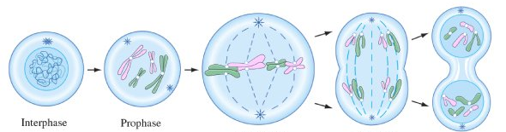
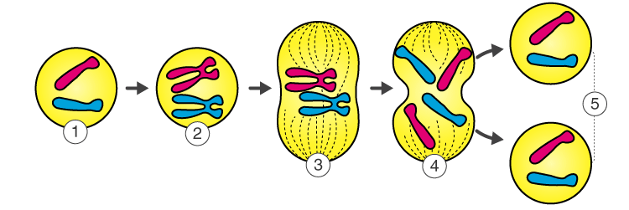
How many chromosomes ?
2 chromosomes
4 chromatids
4 chromosomes
8 chromatids
4 chromosomes
8 chromatids
2 chromosomes
4 chromatids
4 chromosomes
8 chromatids

Slide 22
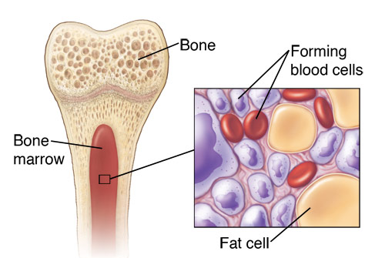
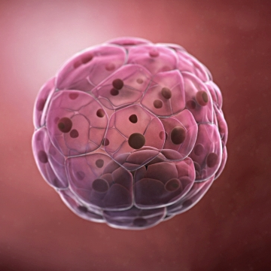
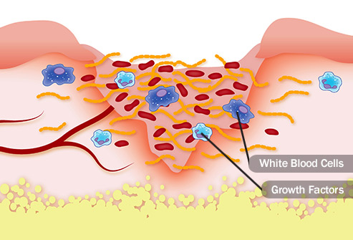
Importance of Mitosis
Mitosis provides new cells for growth and replacement of damaged cells
Because all chromosomes are replicated during mitosis, daughter cells are
identical to the original parent cells
Daughter cells are also diploid, with 2 matching sets of chromosomes
They have the full chromosome complement (number)
growth
wound healing
blood cell production

Slide 23
Activity:
Put these pictures in the correct order
A
B
C
D
E

Slide 24
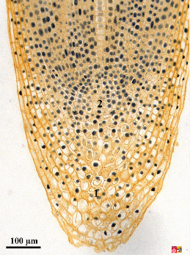
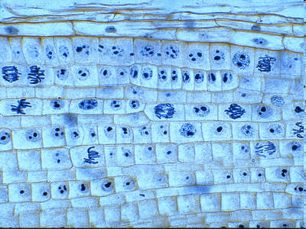
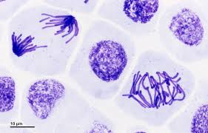
Root Tip/ Meristems in plants
Meristems are found at the tips of roots and shoots. Unspecialised stem cells undergo mitosis here.
This does not occur in other parts of the plants.

Slide 25
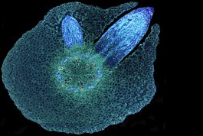
Cells produced by mitosis in meristems help plants continue to grow in height and width throughout their life. Animals do not have meristems, so they stop growing in size once they become adults.

