Slide 1
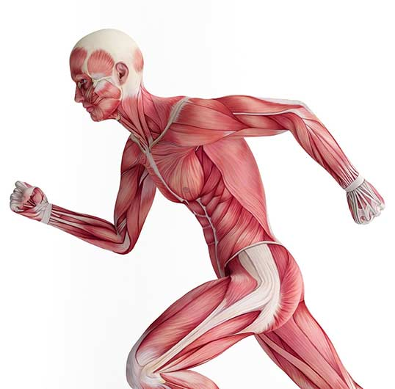
Higher Human Biology
M I S S M C B R I D E
1.8 Energy systems in muscle cells

Slide 2
L A C T A T E M E T A B O L I S M
During vigorous exercise, the muscle cells do not get sufficient oxygen to support the electron transport chain.
Therefore, after glycolysis, pyruvate is converted to lactate.
Glucose
No oxygen
Pyruvate
Lactate

Slide 3
L A C T A T E M E T A B O L I S M
The conversion of pyruvate to lactate involves the transfer of hydrogen ions from NADH (produced during glycolysis) to pyruvate in order to produce lactate.
This regenerates the NAD needed to maintain ATP production through glycolysis.

Slide 4
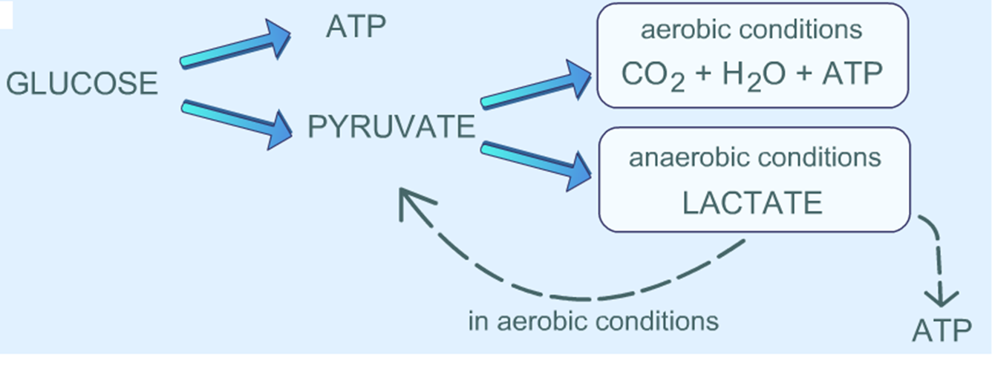

Slide 5
L A C T A T E M E T A B O L I S M
Lactate accumulates and muscle fatigue occurs. This causes a reduction in the muscle’s contractile ability.
The oxygen debt is repaid when exercise is complete.
Aerobic respiration provides the energy required to convert lactate back to pyruvate and glucose in the liver.

Slide 6
M U S C L E C O N T R A C T I O N

Slide 7
T Y P E S O F S K E L E T A L M U S C L E F I B R E S
Type 1 - slow twitch muscle fibres
Type 2 - fast twitch muscle fibres
Most human muscles contain a mixture of both slow (type 1) and fast (type 2) twitch muscle fibres.
Athletes show distinct patterns of muscle fibres that reflect their sporting activities.

Slide 8
S L O W T W I T C H M U S C L E F I B R E S
Efficient at using oxygen to generate ATP for continuous, extended muscle contractions over a long time.
Contract relatively slowly, but can sustain contractions for longer. They can go for a long time before they fatigue.
Endurance activities like long distance running, cycling or cross-country skiing.
Rely on aerobic respiration to generate ATP and have many mitochondria, a large blood supply and a high concentration of the oxygen storing protein myoglobin.
The major storage fuel is fats.

Slide 9
F A S T T W I T C H M U S C L E F I B R E S
Contract relatively quickly over short periods. They are able to fire more rapidly.
Useful for activities such as sprinting or weightlifting.
Fast twitch muscle fibres can generate ATP through glycolysis only and have few mitochondria and a lower blood supply than slow twitch muscle fibres.
The major storage fuel of fast twitch muscle fibres is glycogen.

Slide 10
MAKE A TABLE COMPARING…
S L O W T W I T C H M U S C L E F I B R E S
F A S T T W I T C H M U S C L E F I B R E S
Efficient at using oxygen to generate ATP for continuous, extended muscle contractions over a long time.
Contract relatively slowly, but can sustain contractions for longer. They can go for a long time before they fatigue.
Endurance activities like long distance running, cycling or cross-country skiing.
Rely on aerobic respiration to generate ATP and have many mitochondria, a large blood supply and a high concentration of the oxygen storing protein myoglobin.
The major storage fuel is fats.
Contract relatively quickly over short periods. They are able to fire more rapidly.
Useful for activities such as sprinting or weightlifting.
Fast twitch muscle fibres can generate ATP through glycolysis only and have few mitochondria and a lower blood supply than slow twitch muscle fibres.
The major storage fuel of fast twitch muscle fibres is glycogen.

Slide 11
C O U R S E S P E C N O T E S
During vigorous exercise, the muscle cells do not get sufficient oxygen to support the electron transport chain. Under these conditions, pyruvate is converted to lactate. This conversion involves the transfer of hydrogen ions from the NADH produced during glycolysis to pyruvate in order to produce lactate. This regenerates the NAD needed to maintain ATP production through glycolysis.
Lactate accumulates and muscle fatigue occurs. The oxygen debt is repaid when exercise is complete. This allows respiration to provide the energy to convert lactate back to pyruvate and glucose in the liver.
Most human muscle tissue contains a mixture of both slow- and fast-twitch muscle fibres. Athletes show distinct patterns of muscle fibres that reflect their sporting activities.
Slow-twitch muscle fibres contract relatively slowly, but can sustain contractions for longer. They are useful for endurance activities such as long-distance running, cycling or cross-country skiing.
Slow-twitch muscle fibres rely on aerobic respiration to generate ATP and have many mitochondria, a large blood supply and a high concentration of the oxygen-storing protein myoglobin. The major storage fuel of slow-twitch muscle fibres is fats.
Fast-twitch muscle fibres contract relatively quickly, over short periods. They are useful for activities such as sprinting or weightlifting. Fast-twitch muscle fibres can generate ATP through glycolysis only and have fewer mitochondria and a lower blood supply compared to slow-twitch muscle fibres.
The major storage fuel of fast-twitch muscle fibres is glycogen.

Slide 12
K E Y T E R M S
Lactate
Slow-twitch muscle fibres
Fast-twitch muscle fibres
Glycogen
Start a definition page at the back of your jotter.
This will help you make flash cards at some point in the future!

