Slide 1
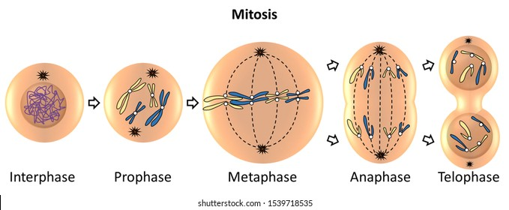
KA 2.2 Producing new cells

Slide 2
Question
Why is mitosis important?

Slide 3
Answer
To make new cells for growth, repair of damaged tissues and replacement of dead or damaged ells.

Slide 4
Question
Mitosis maintains the diploid chromosome compliment. What does this mean?

Slide 5
Answer
Ensuring all cells have the same number of chromosomes and all genetic information.

Slide 6
Question
Put the sequence into the correct order:

Slide 7
Answer

Slide 8
Question
What are these called?

Slide 9
Answer
Spindle Fibres

Slide 10
Question
What is this part of the cell called?

Slide 11
Answer
The equator

Slide 12
Question
What is this called?

Slide 13
Answer
Chromosome

Slide 14
Question
What is this called?

Slide 15
Answer
Chromatid

Slide 16
Question
What are stem cells?

Slide 17
Answer
Unspecialised Cells (do not have a function)

Slide 18
Question
Stem cells can self-renew. What does this mean?

Slide 19
Answer
Stem cells can divide and make more copies of themselves.

Slide 20
Question
What are the two types of stem cells?

Slide 21
Answer
Embryo and Tissue

Slide 22
Question
What are stem cells involved in?

Slide 23
Answer
Stem cells are involved in growth and repair.

Slide 24
Question
What amazing function do stem cells have?

Slide 25
Answer
Stem cells have the potential to become different types of cells.

Slide 26
Question
What does specialisation of cells lead to?

Slide 27
Answer
Specialisation of cells leads to the formation of a variety of cells, tissues and organs.

Slide 28
Question
What do groups of organs which work together form?

Slide 29
Answer
Systems.

Slide 30
Question
Fill in the gaps:
Cells → _______ → _______ → Systems

Slide 31
Answer
Cells → Tissues → Organs→ Systems

Slide 32
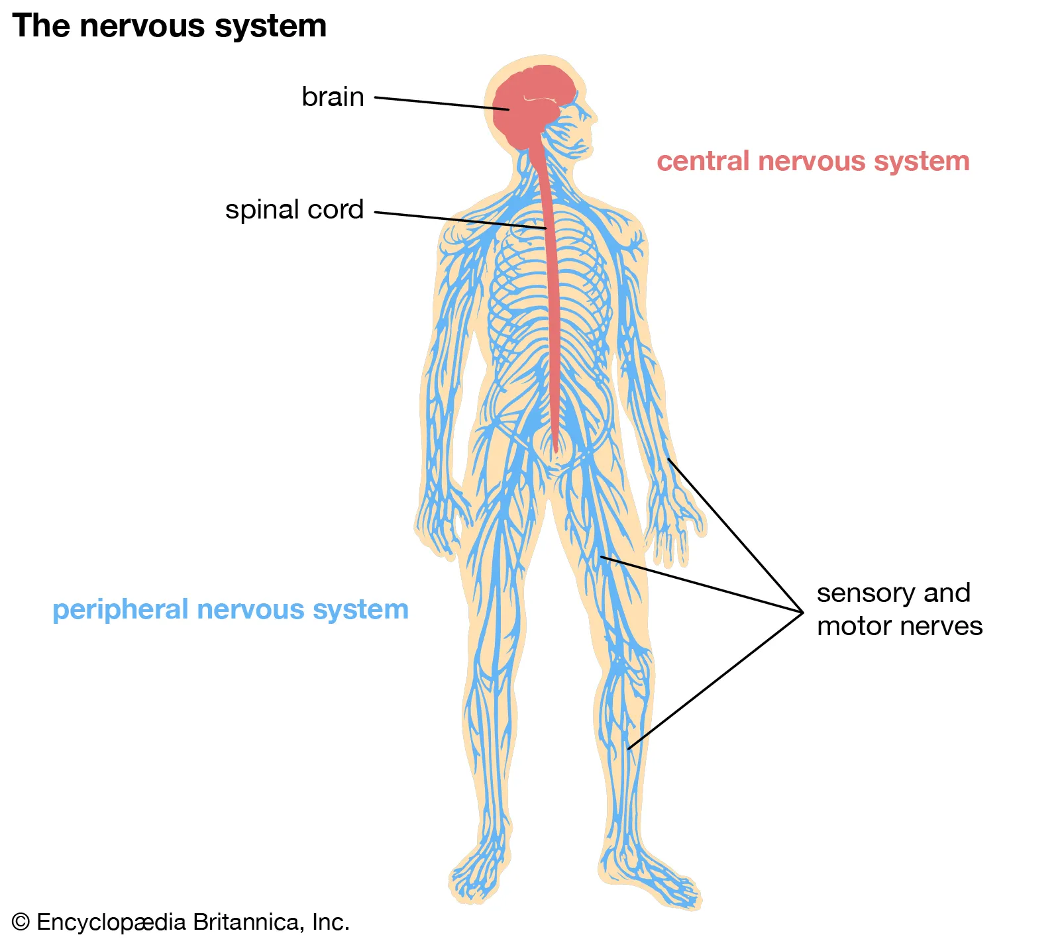
KA 2.2 Control and Communication

Slide 33
Question
What does the CNS stand for?

Slide 34
Answer
Central Nervous System

Slide 35
Question
What does the CNS consist of?

Slide 36
Answer
The CNS consists of the brain and spinal cord.

Slide 37
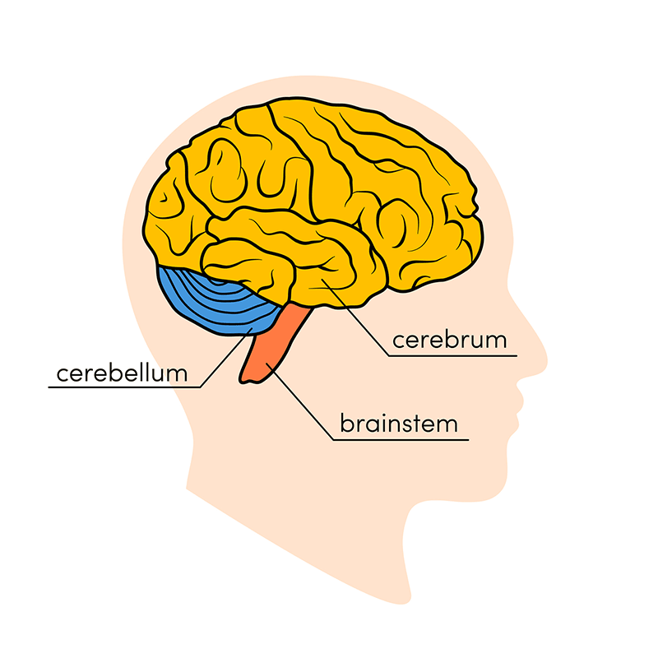
Question
Label the brain:

Slide 38
Answer
Medulla

Slide 39
Question
What is the function of the cerebellum?

Slide 40
Answer
Balance and coordination.

Slide 41
Question
What is the function of the cerebrum?

Slide 42
Answer
Thoughts, memories and personality.

Slide 43
Question
What is the function of a medulla?

Slide 44
Answer
Breathing, heart rate and peristalsis.

Slide 45
Question
What are the 3 types of neurons?

Slide 46
Answer
Sensory, inter and motor.

Slide 47
Question
What structure detects a stimuli?

Slide 48
Answer
Receptors found at all your sensory organs.

Slide 49
Question
How are messages sent along a neuron?

Slide 50
Answer
Electrical impulses.

Slide 51
Question
How are messages sent between neurons?

Slide 52
Answer
Chemical messengers.

Slide 53
Question
Where does the sensory neuron pass information?

Slide 54
Answer
To the CNS.

Slide 55
Question
What does the inter neuron do?

Slide 56
Answer
Found within the CNS, it processes information.

Slide 57
Question
What do motor neurons do?

Slide 58
Answer
Enable a response to occur.

Slide 59
Question
The motor neuron sends the electrical impulse to an _______.

Slide 60
Answer
Effector cell.

Slide 61
Question
There are two types of effector cells, what are they?

Slide 62
Answer
Muscle or a gland

Slide 63
Question
Fill in the blanks: A response to stimulus can be a ______ action from a muscle or a ______ response from a gland.

Slide 64
Answer
Fill in the blanks: A response to stimulus can be a rapid action from a muscle or a slower response from a gland.

Slide 65
Question
What are the gaps between neurons called?

Slide 66
Answer
Synapses

Slide 67
Question
What is the purpose of a reflex?

Slide 68
Answer
Protects the body from harm.

Slide 69
Question
True or False: In a reflect arc response the brain is not involved.

Slide 70
Answer
True, when you have a reflex response the brain is bypassed to save time.

Slide 71
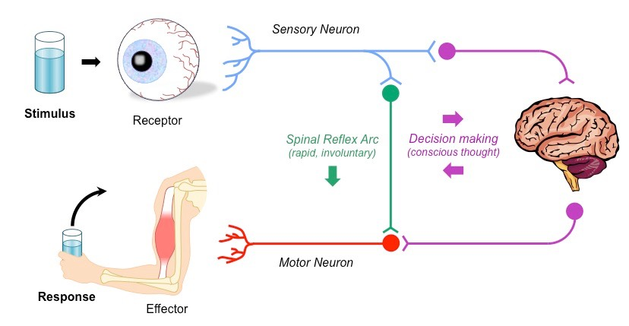
For info

Slide 72
Question
What structure releases hormones?

Slide 73
Answer
Endocrine glands release hormones.

Slide 74
Question
What are hormones?

Slide 75
Answer
Chemical messengers (made of proteins remember!)

Slide 76
Question
How do hormones move around the body?

Slide 77
Answer
In the bloodstream

Slide 78
Question
If hormones are released into the blood stream, how do they not have an effect on every organ?

Slide 79
Answer
There are target tissues with complementary receptor proteins for specific hormones.

Slide 80
Question
Name 3 endocrine glands:

Slide 81
Answer
Pancreas, testes and ovaries.

Slide 82
Question
Which structure detects changes in blood glucose concentration?

Slide 83
Answer
Pancreas

Slide 84
Question
Which two hormones does the pancreas release?

Slide 85
Answer
Insulin and glucagon

Slide 86
Question
What is the target tissue for both insulin and glucagon?

Slide 87
Answer
The liver

Slide 88
Question
When is insulin released?

Slide 89
Answer
When there is an increase of blood glucose concentration (After eating)

Slide 90
Question
When is glucagon released?

Slide 91
Answer
When there is a decrease in blood glucose concentration (Glucose is GONE, glucagon)

Slide 92
Question
What does insulin stimulate the liver to do?

Slide 93
Answer
Insulin stimulates the liver to remove glucose from the blood stream and store it.

Slide 94
Question
What does the liver store glucose as?

Slide 95
Answer
Glycogen

Slide 96
Question
What does glucagon stimulate the liver to do?

Slide 97
Answer
Glucagon stimulates the liver to convert glycogen back into glucose and move this into the blood stream.

Slide 98
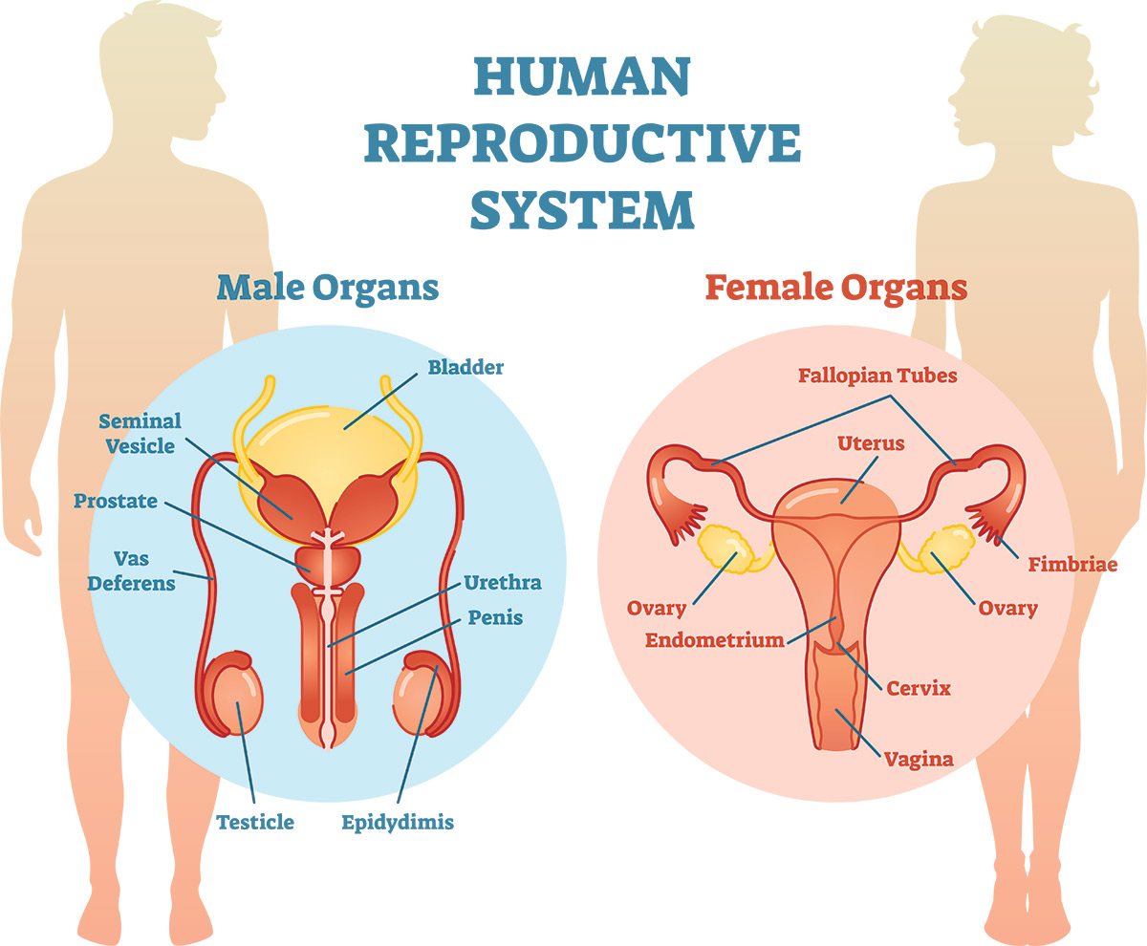
KA 2.3 Reproduction

Slide 99
Question
What term is used to describe two complete sets of chromosomes, one from each parent?

Slide 100
Answer
Diploid

Slide 101
Question
What term is used to describe a single set of chromosomes in a cell, and which type of cells have this?

Slide 102
Answer
Haploid- gametes (Sex cells)

Slide 103
Question
What is the name given to the male gamete and where is it produced?

Slide 104
Answer
Sperm- testes

Slide 105
Question
What is the name given to the female gamete and where is it produced?

Slide 106
Answer
Egg cell- ovaries

Slide 107
Question
What is the definition of fertilisation and what does it produce?

Slide 108
Answer
Fertilisation is the fusion of the nuclei of the two haploid gametes to produce a diploid zygote, which divides to form an embryo.

Slide 109
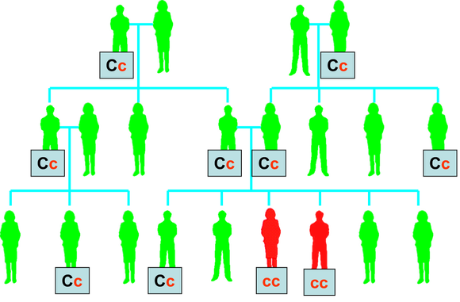
KA 2.4 Variation and Inheritance

Slide 110
Question
What is an example of discrete variation?

Slide 111
Answer
Variation that are in distinct groups for example blood type, eye colour, tongue rolling, hitchhikers thumb.

Slide 112
Question
What is an example of continuous variation?

Slide 113
Answer
Variation that shows a range from a minimum to a maximum, for example hand span, height and leaf length.

Slide 114
Question
What produces variation in a population?

Slide 115
Answer
The combining of genes from two parents.

Slide 116
Question
What type of gene inheritance is discrete variation?

Slide 117
Answer
Single gene inheritance

Slide 118
Question
What type of gene inheritance is continuous variation?

Slide 119
Answer
Polygenic inheritance

Slide 120
Question
What is an allele?

Slide 121
Answer
Different forms of the same gene

Slide 122
Question
What does dominant mean?

Slide 123
Answer
An allele that always expresses itself whether it is partnered by a recessive allele or another like itself.

Slide 124
Question
What is recessive?

Slide 125
Answer
Recessive alleles only express themselves when paired with another recessive allele.

Slide 126
Question
What is a phenotype?

Slide 127
Answer
The visible characteristics of an organism (PHenotype= Physical appearance

Slide 128
Question
What is a genotype?

Slide 129
Answer
The alleles that an organism has for a particular characteristic, usually written as leters.

Slide 130
Question
What does homozygous mean?

Slide 131
Answer
This describes a genotype in which the two alleles for a characteristic are identical (BB + bb)

Slide 132
Question
What does heterozygous mean?

Slide 133
Answer
This describes a genotype in which the two alleles for a particular characteristic are different (Bb)

Slide 134
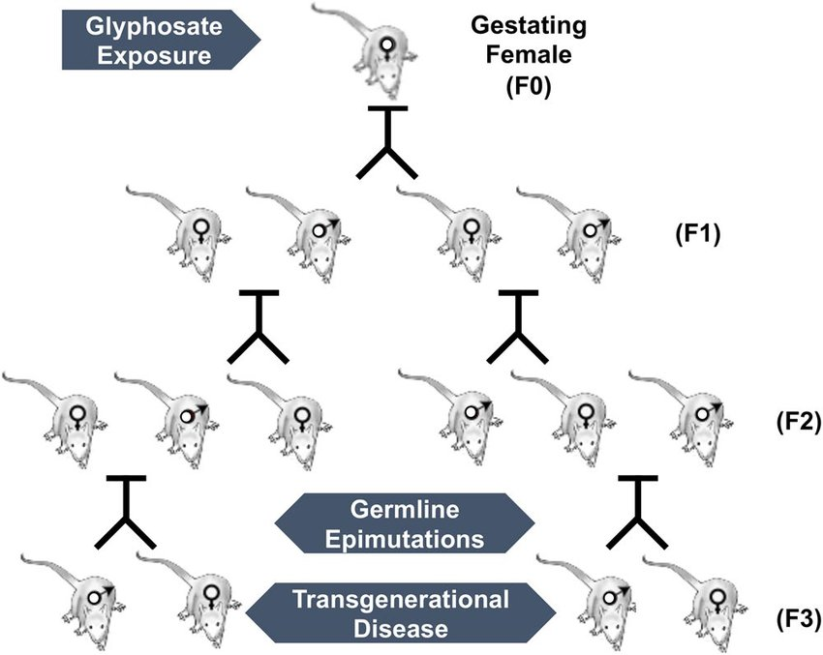
Question
P
What does the P, the F1 and the F2 mean?

Slide 135
Answer
P- Parental generation
F1- First generation
F2- Second generation

Slide 136
Question
Why are predicted phenotype ratios among offspring not always achieved?

Slide 137
Answer
Fertilisation is a random process.

Slide 138
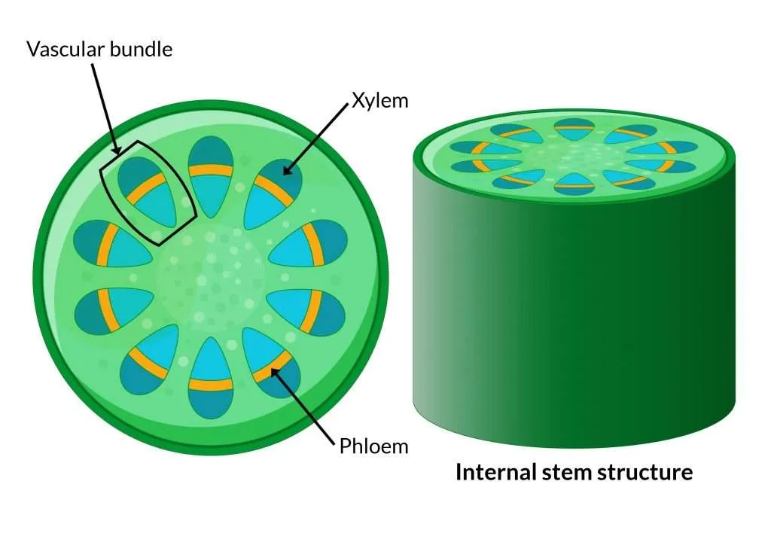
KA 2.5 Transport systems in plants

Slide 139
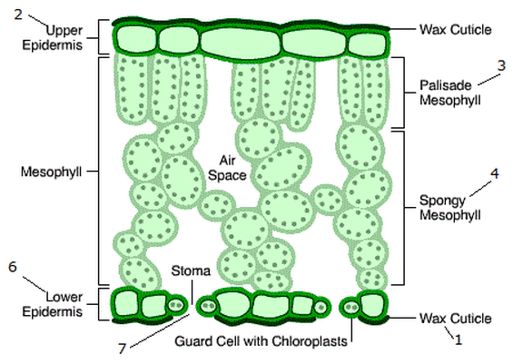
Question
Label the leaf structure:

Slide 140
Answer

Slide 141
Question
What part of the plant is involved in transport of water and minerals?

Slide 142
Answer
Xylem

Slide 143
Question
What does the phloem transport?

Slide 144
Answer
Sugar

Slide 145
Question
Describe the structure of xylem.

Slide 146
Answer
Xylem cells are dead and are lignified to withstand the pressure changes as water moves through the plant.

Slide 147
Question
Describe the structure of the phloem.

Slide 148
Answer
Phloem is living tissue and has sieve plates and associated companion cells.

Slide 149
Question
Which direction is water moved through the xylem?

Slide 150
Answer
Water moves in the xylem from root to shoot.

Slide 151
Question
Which direction is sugar moved through the phloem?

Slide 152
Answer
Both up and down the plant.

Slide 153
Question
What is transpiration?

Slide 154
Answer
Transpiration is the process of water moving through a plant and its evaporation through the stomata.

Slide 155
Question
What four factors can affect the rate of transpiration?

Slide 156
Answer
Wind speed, humidity, temperature and surface area.

Slide 157
Question
Which of the four factors is the only one to decrease transpiration rate?

Slide 158
Answer
Humidity.

Slide 159
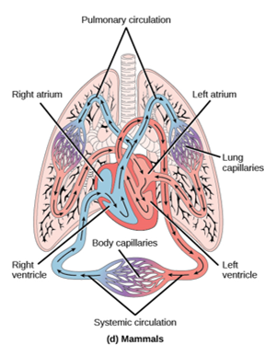
KA 2.6 Transport systems in animals

Slide 160
Question
What is blood made up of?

Slide 161
Answer
Plasma ,red blood cells and white blood cells.

Slide 162
Question
What is the function of the blood?

Slide 163
Answer
To transport nutrients, oxygen and carbon dioxide.

Slide 164
Question
How are red blood cells specialised?

Slide 165
Answer
They are biconcave in shape, no nucleus and contain haemoglobin. This allows them to transport oxygen efficiently.

Slide 166
Question
In what form does blood transport oxygen?

Slide 167
Answer
Oxyhaemoglobin

Slide 168
For Info
Oxygen + haemoglobin → oxyhaemoglobin

Slide 169
Question
Which part of blood has an important role in the immune system?

Slide 170
Answer
White blood cells

Slide 171
Question
What do white blood cells do?

Slide 172
Answer
Destroy pathogens

Slide 173
Question
What are pathogens?

Slide 174
Answer
Disease-causing micro-organisms

Slide 175
Question
Name 3 types of pathogens.

Slide 176
Answer
Bacteria, viruses and fungi

Slide 177
Question
There are two types of white blood cell, what are they?

Slide 178
Answer
Phagocytes and lymphocytes

Slide 179
Question
How do phagocytes destroy pathogens?

Slide 180
Answer
They carry out phagocytosis- engulfing a pathogen and digesting it.

Slide 181
Question
How do lymphocytes destroy pathogens?

Slide 182
Answer
They produce antibodies which are specific to a particular pathogen.

Slide 183
For info

Slide 184
Question
Describe the structure and function of arteries.

Slide 185
Answer
Arteries have thick, muscular walls, a narrow central channel and carry blood under high pressure away from the heart.

Slide 186
Question
What is the structure and function of veins?

Slide 187
Answer
Veins have thinner walls than arteries, a wider channel and carry blood under low pressure towards the heart. Veins also contain valves.

Slide 188
Question
What is the purpose of valves found in veins?

Slide 189
Answer
Prevent the backflow of blood.

Slide 190
Question
What is the structure and function of capillaries?

Slide 191
Answer
Capillaries are thin walled, have a large surface area and form networks at tissues and organs to allow efficient exchange of materials.

Slide 192
KA 2.6 Absorption of materials

Slide 193
Question
Fill in the blanks: ______ and ______ from food must be absorbed in to the ___________ to be delivered to cells for _______________.

Slide 194
Answer
Oxygen and nutrients from food must be absorbed into the bloodstream to be delivered to cells for respiration.

Slide 195
Question
What are 3 features found in all surfaces involved in the absorption of materials.?

Slide 196
Answer
Large surface area
Thin walls
Extensive blood supply

Slide 197
Question
What structure found in lung increases the efficiency of absorption?

Slide 198
Answer
Aveloli

Slide 199
Question
What structure found in the small intestine increases the efficiency of aborption?

Slide 200
Answer
Villi

Slide 201
Question
What does the blood capillary network found in villi absorb?

Slide 202
Answer
Glucose and amino acids

Slide 203
Question
What does the lacteal found in villi absorb?

Slide 204
Answer
Fatty acids and glycerol

