Slide 1
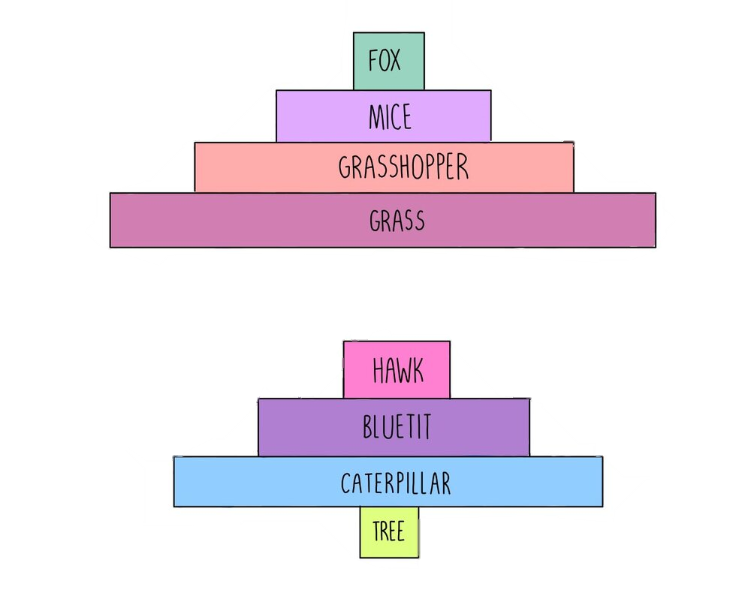
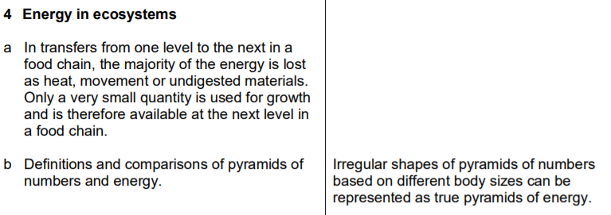
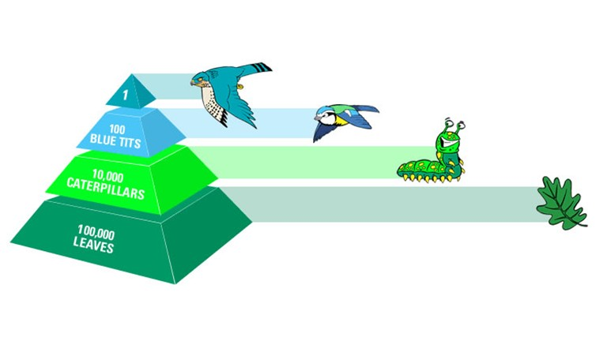
3.4 Energy in Ecosystems

Slide 2
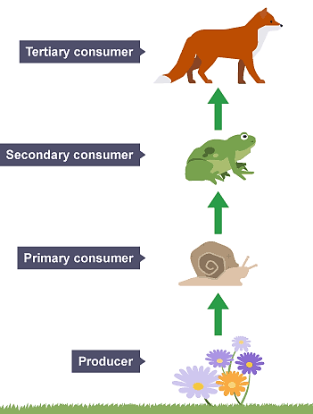
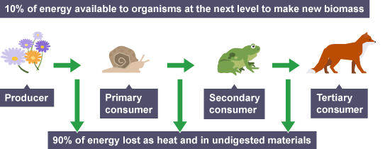
The feeding relationships that exist in an ecosystem can be shown by a food chain. The arrows represent the direction of energy flow and mean 'gets eaten by’.
The energy stored in undigested materials can be transferred to decomposers. Decomposers are organisms such as bacteria and fungi that can obtain energy by breaking down dead organisms.

Slide 3
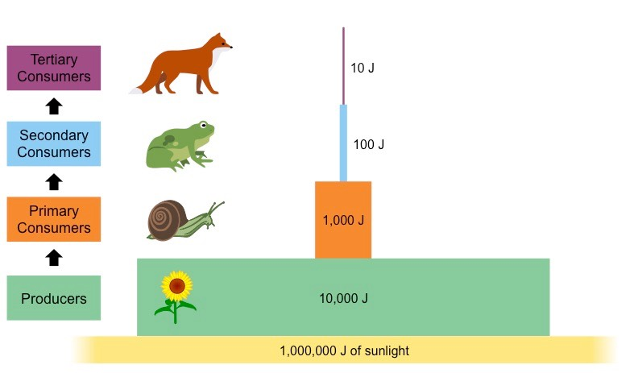
Pyramids of Energy
A pyramid of energy shows the total quantity of available energy stored in the biomass of organisms at each level in the food chain of an ecosystem per year. This can be estimated by burning samples of organisms and measuring the heat released.
Always a triangle shape as energy is lost.
Pyramids of energy show that the producers store the highest quantity of energy and the energy stored then decreases at each level in the food chain of the ecosystem.

Slide 4
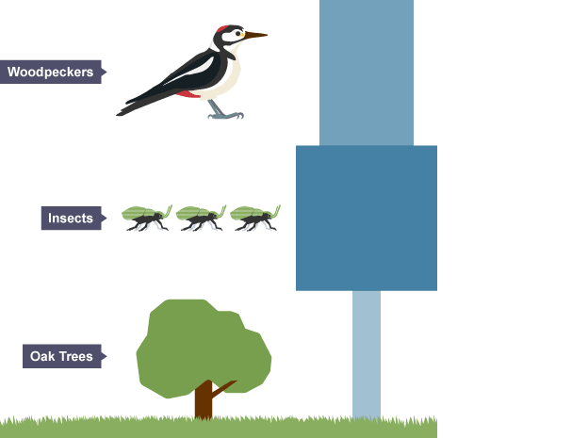
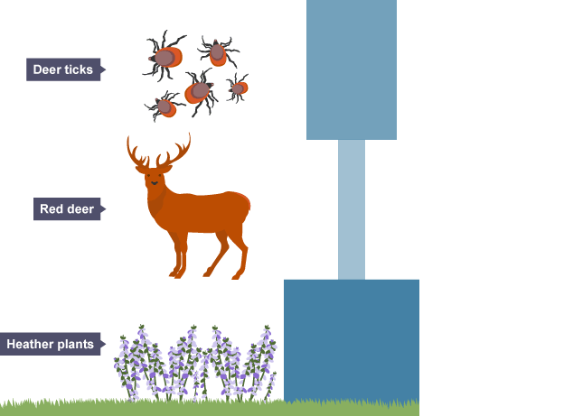
Pyramids of Numbers
A pyramid of numbers shows the total number of individual organisms at each level in the food chain of an ecosystem.
A pyramid of numbers does not always have a regular pyramid shape because it does not take into account the biomass of the organisms. An inverted pyramid of numbers can be found in an ecosystem where the community contains a few producers with a very large biomass that support a larger number of smaller consumers.

Slide 5
