Slide 1
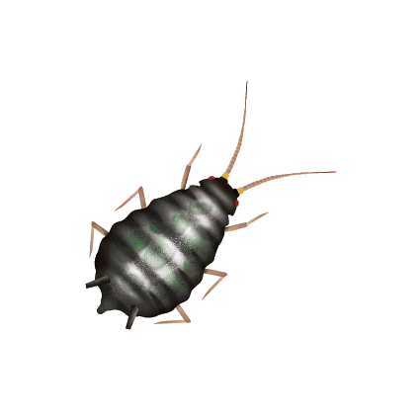
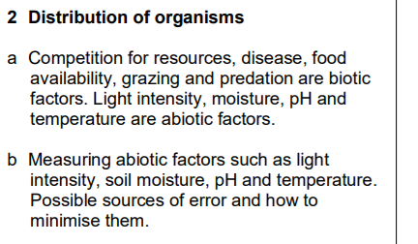
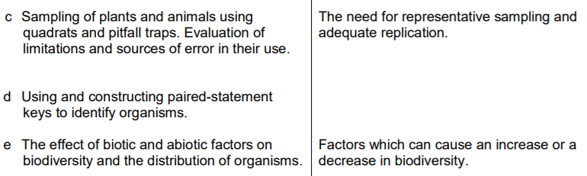

3.2 Distribution of organisms

Slide 2
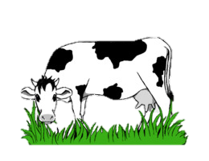

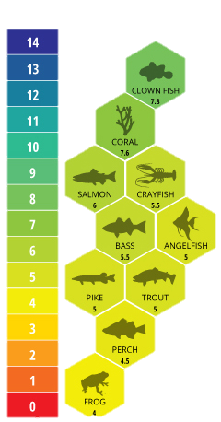

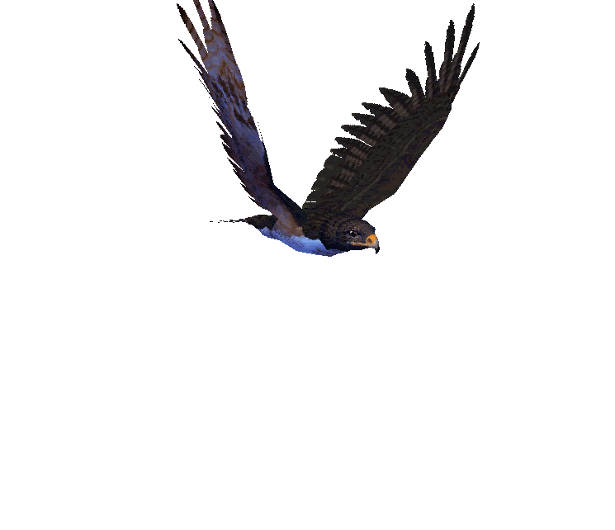
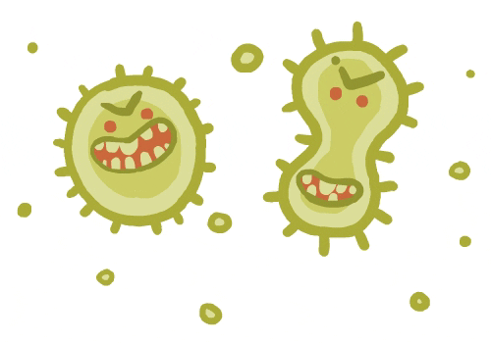
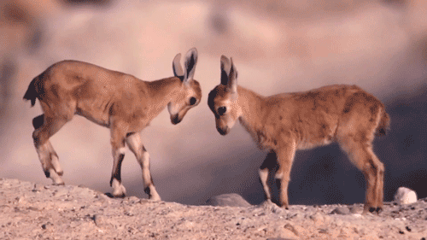

Factors that affect abundance (number) and distribution (location and spread) of living organisms.
Abiotic (non- living) factors include :
Biotic (living) factors include :
moisture
grazing
predation
pH
competition
temperature
disease
light levels

Slide 3
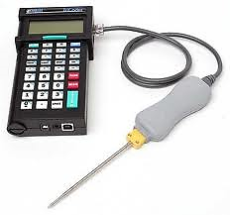
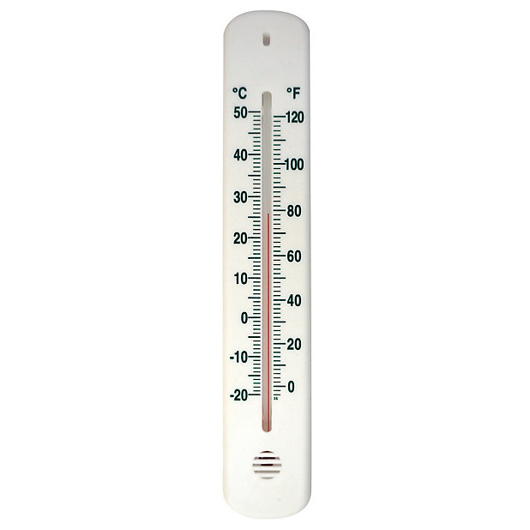
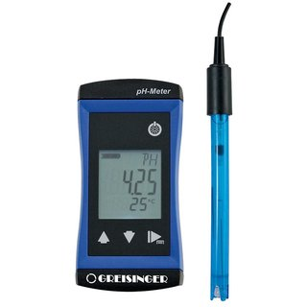
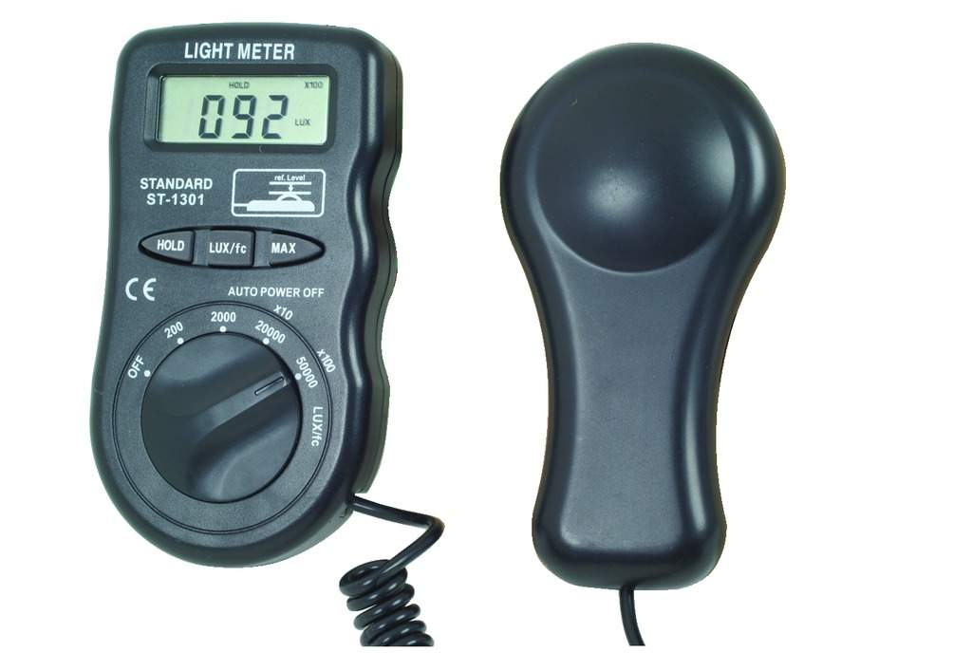
Measuring Abiotic Factors
By measuring biotic factors, we can begin to understand why different organisms are present in an ecosystem and which conditions they prefer.
Thermometer or temperature probe
Light Meter
pH Meter
To reduce errors, take readings within the sample area and keep the probe in the soil when taking readings (or you record air temperature !)
Make sure the light sensitive panel is pointed towards the light source.
Don’t cast a shadow over the sensor.
Clean the probe between samples. Use the probe within the sample area. Take a reading when it stops changing.
When measuring abiotic factors, always repeat readings and take an average for reliability.

Slide 4


Measuring Biotic Factors
Sampling is used to find out which organisms are present in an ecosystem; how abundant they are and to investigate why they are living there
By counting organisms found at random parts of ecosystem it is possible to estimate total number of organisms present in whole ecosystem.
There are different techniques suitable for particular ecosystems, and for mobile and non-mobile organisms

Slide 5
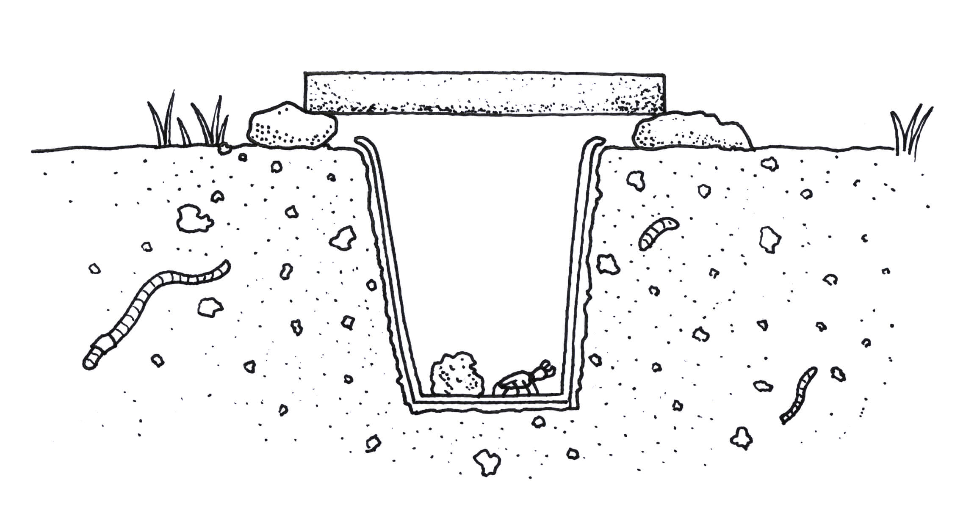
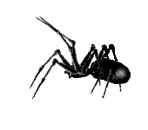
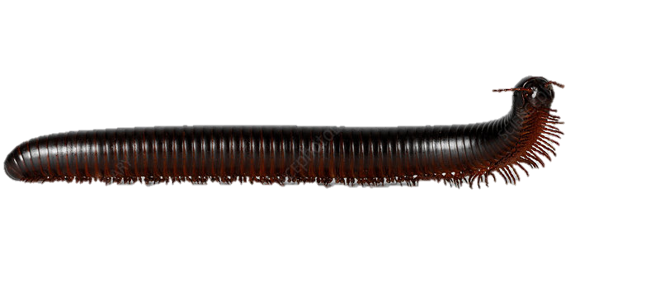
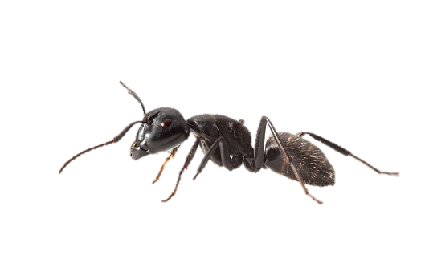
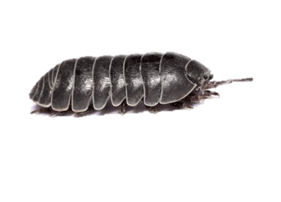
Pitfall Trap
Used to study small crawling invertebrates.
Invertebrates fall into the trap and can’t escape.
They are then counted.
Lid propped up on a couple rocks to stop any birds from eating caught insects.
Hole punched in bottom of container to drain any water.

Slide 6
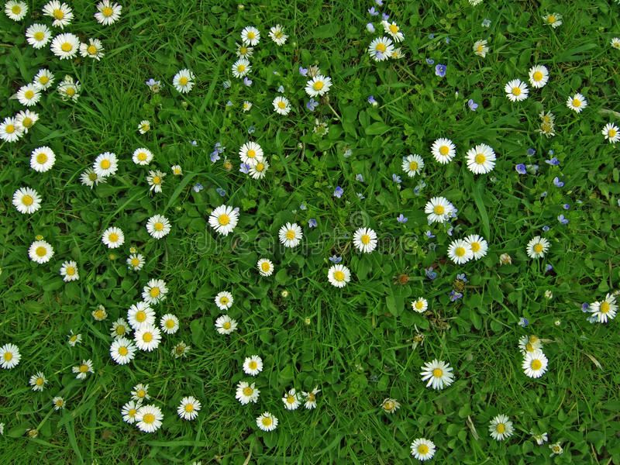
Quadrats
Quadrats are used to estimate the numbers of plants or slow-moving animals in an ecosystem (e.g. limpets)
Quadrats are sampling squares of a known size, which are divided into smaller squares.
They are thrown at random
The number of plants is counted
This is then repeated several times within the area to be sampled
Quadrats can also be used to measure abundance and % cover of different species

Slide 7
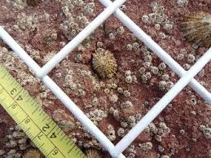
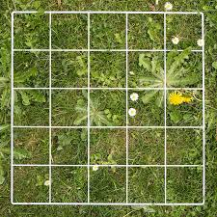
Quadrats
What are the possible sources of error?
Incorrect counting.
What happens when a plant is half in and half out?
Make a rule that if more than half is in then you count it.
Non-random sampling
Don’t aim for interesting bits !
Too few quadrats to get a fair representation of the
ecosystem, especially if the plants grow in clumps.
Repeat or pool results with other groups.

Slide 8
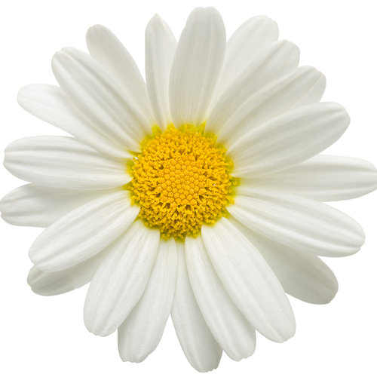
The quadrats are placed randomly and the number of daisies in each are counted.
16 daisies
18 daisies

Slide 9
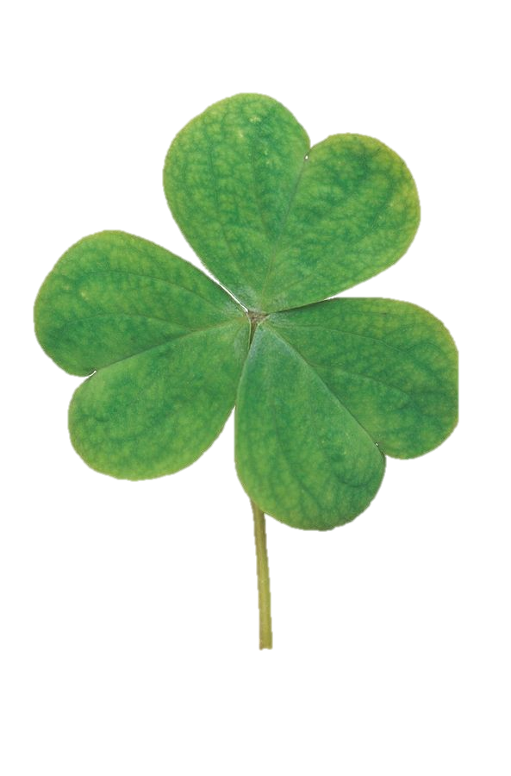
Abundance of types of plant tells us how often it appears in an environment. The number of squares that contain the plant of interest are counted.
Daisies: 10 squares
Clovers: 8 squares
Daisies: 11 boxes
Clovers: 5 boxes

Slide 10
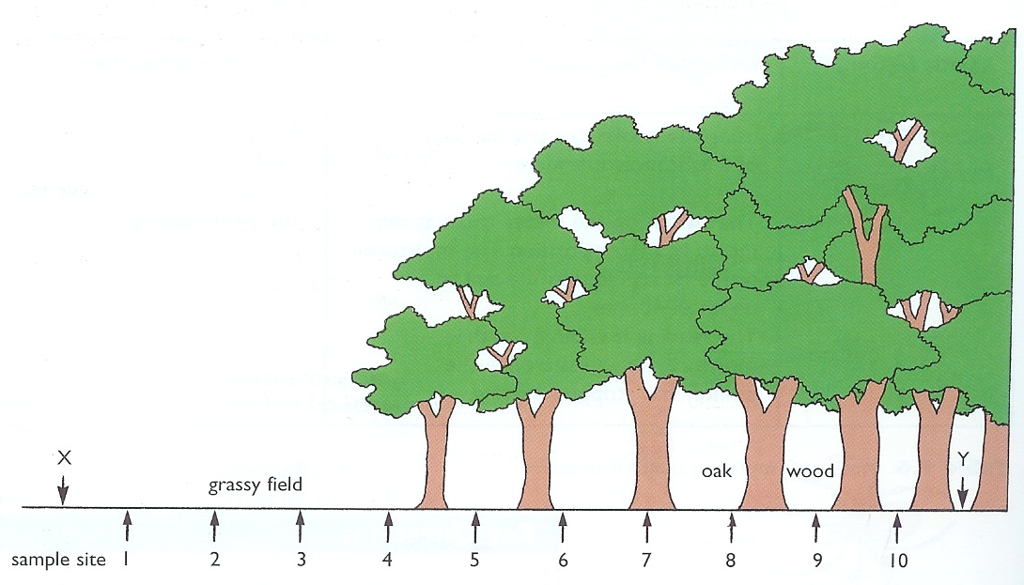
Transects
Transects are used to show how the distribution of species varies across an ecosystem. To set up a transect, lay out a long tape measure.
At each interval :
Take readings of abiotic factors (light, moisture, pH)
Record plant and animal abundance using quadrats and pitfall traps
Samples are taken at intervals along a straight line.

Slide 11
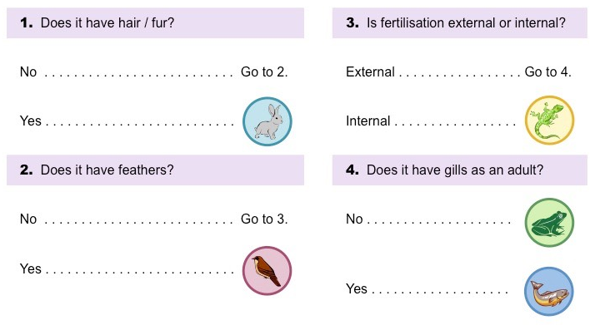
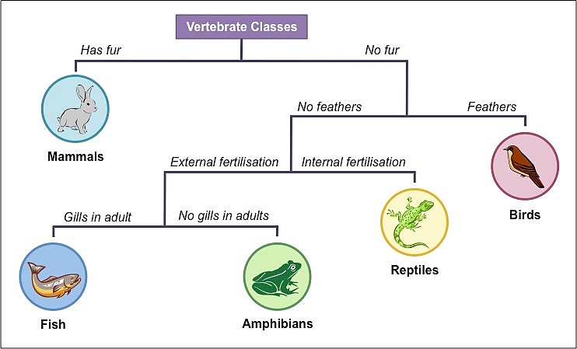
Paired Statement Key
The organisms that are collected or sampled, need to be identified using a branched or a paired statement key.
Paired statement keys ask a question with 2 possible answers, then direct you to more questions until you reach the identity of the organism
Branched keys ask a series of questions with yes/no answers which lead you to the identity of the organism

Slide 12
1.
Paired bladders
Smooth fronds
Toothed wrack
Egg wrack

Slide 13
2.
Leaves toothed
Stem hairless
Creeping buttercup
Meadow buttercup
Notes:
SG Biol.Gen 2004Q2

Slide 14
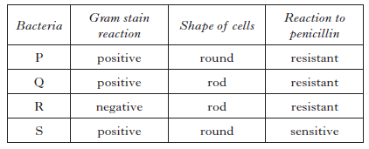
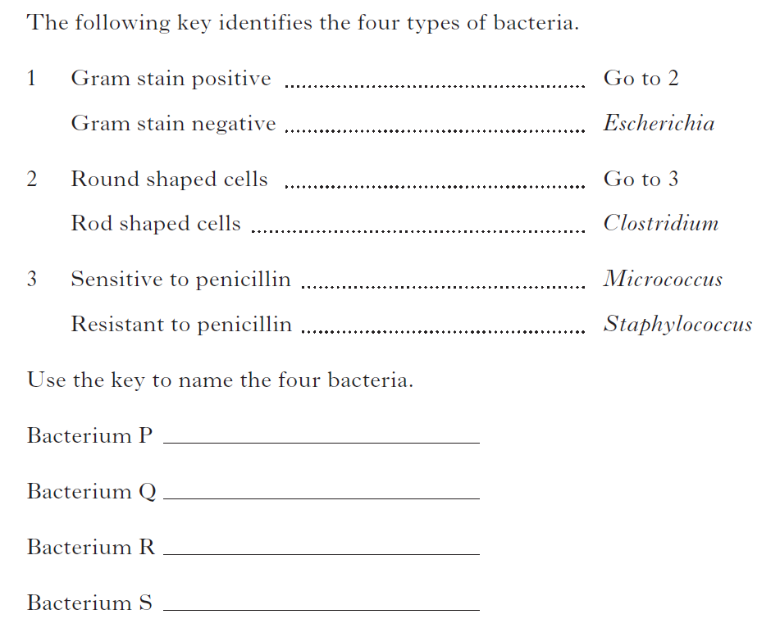
The following table gives information on different types of bacteria. SGC2013 Qu6
Staphylococcus
Clostridium
Escherichia
Micrococcus

Slide 15
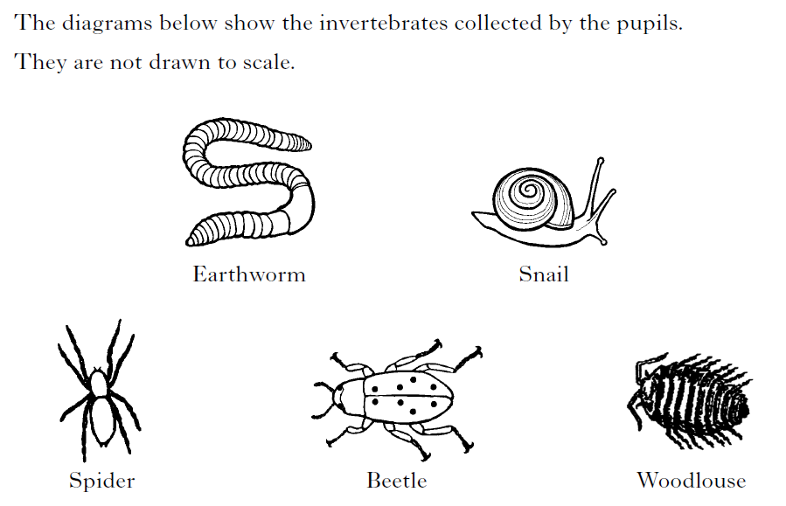
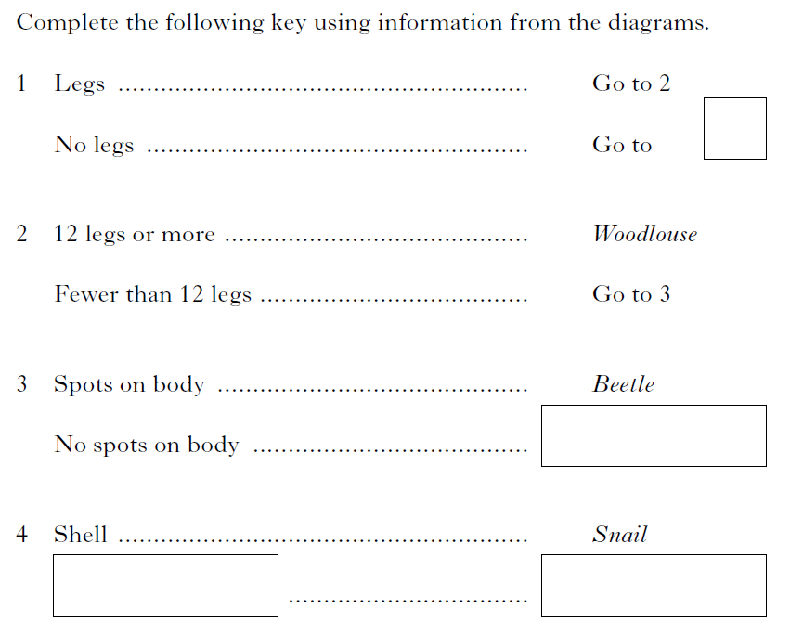
The diagrams below show the invertebrates collected by the pupils. SGC 2010 Qu 1
They are not drawn to scale.
4
Spider
No shell
Earthworm

Slide 16
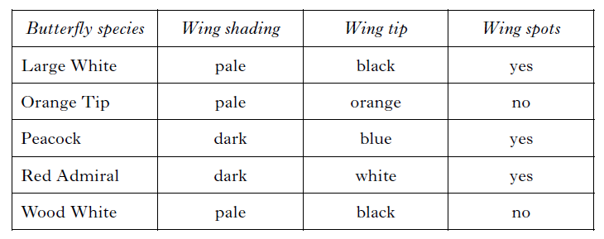
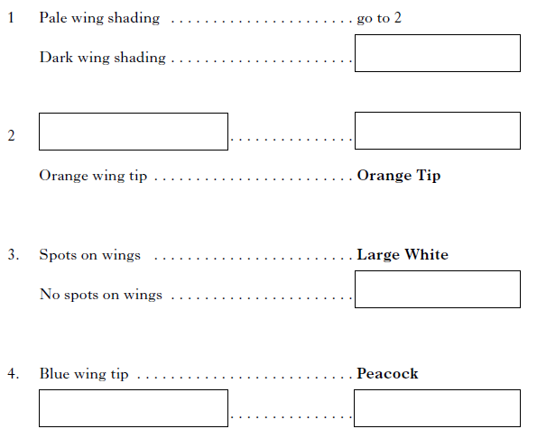
The table below shows some features of five British butterflies. SGC2009 Qu4
(go to) 4
Black wing tip
(go to) 3
Wood White
White wing tip
Red Admiral

Slide 17
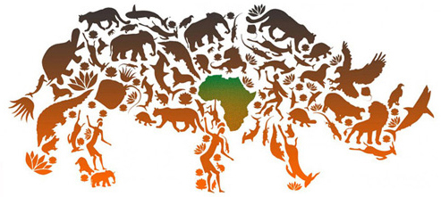
Human Influences on the Environment
Human activities have a major impact on the environment and can lead
to a reduction in biodiversity. These activities cause :
Habitat destruction by deforestation (for farming, housing etc)
Reduction of numbers and biodiversity through overfishing and hunting
Desertification
Air and water pollution
Many species have become endangered because of these activities

Slide 18
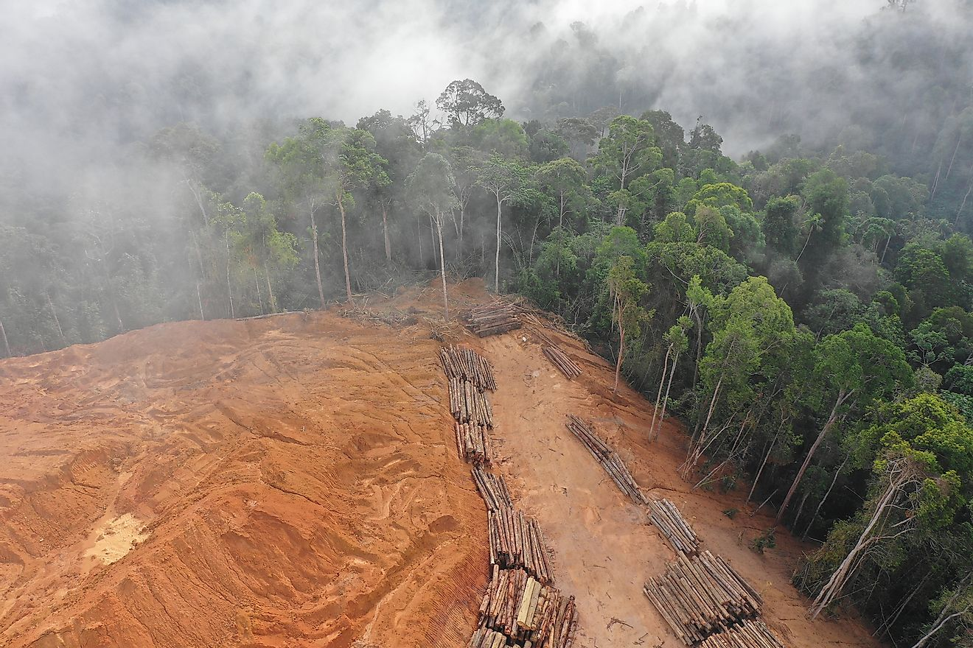
Deforestation
Trees are removed to make land available for
agriculture and housing
This removes habitats and decreases biodiversity
Felled trees are used as timber for building, or are burned as fuel
Fewer trees results in less CO₂ being removed from the atmosphere
by photosynthesis
More CO₂ is released when trees are burned, increasing atmospheric
CO₂ and leading to global warming and climate change

Slide 19
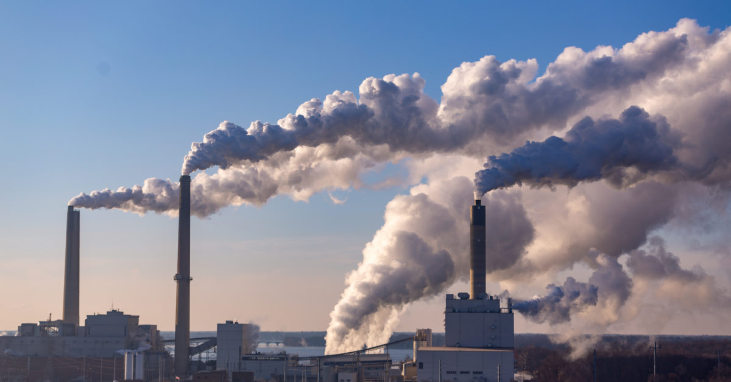
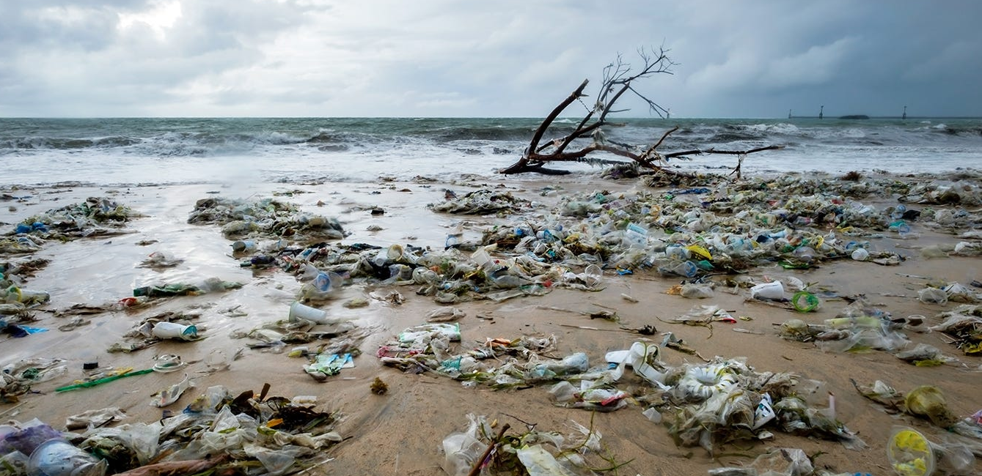
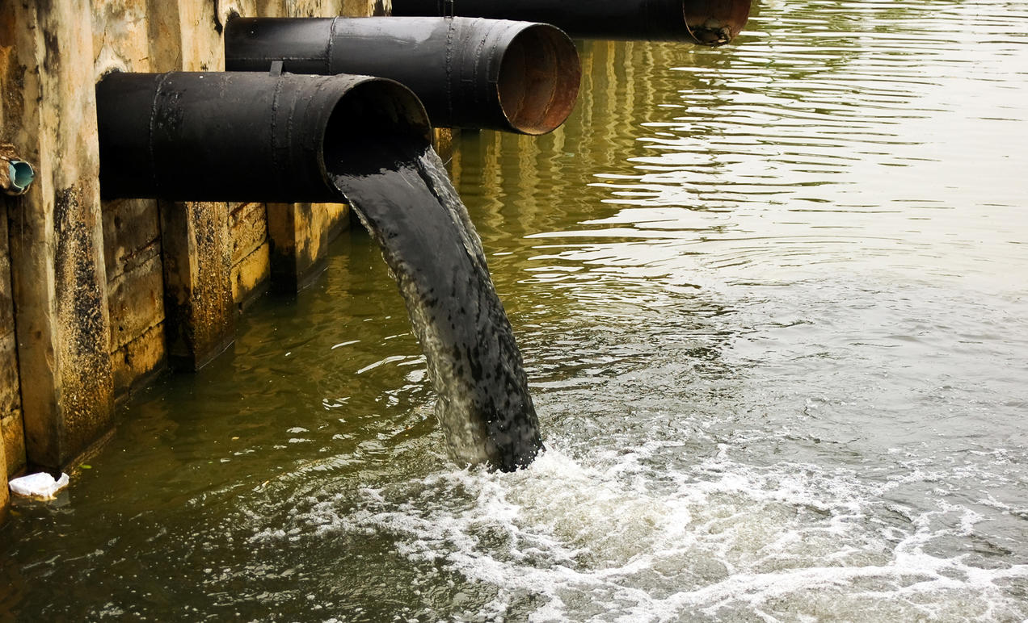
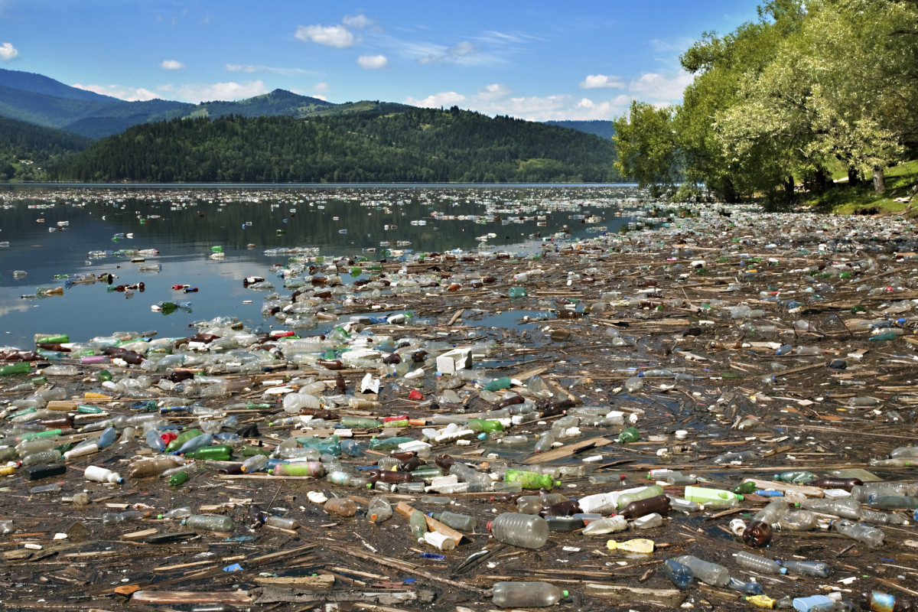
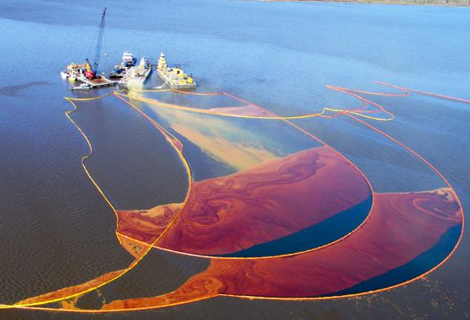
Pollution
Pollution is caused by the presence of a substance (pollutant) which is harmful to the environment or is unsightly.
Pollutants can affect four main ecosystems:
  Air
  Freshwater
  Sea
  Land

Slide 20
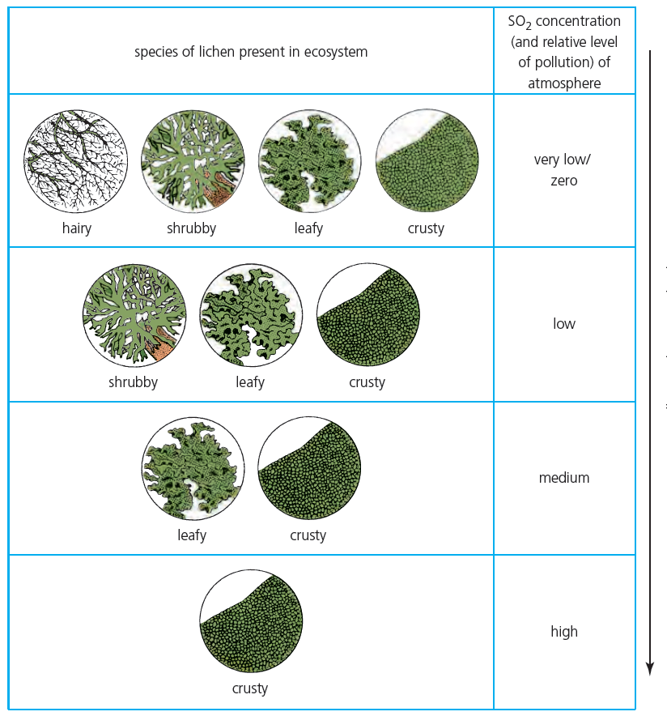
Indicator Species
Some species of organisms will only thrive in certain environmental conditions such as clean air
These are known as indicator species, as their presence or absence indicates how polluted the environment is.

