Slide 1
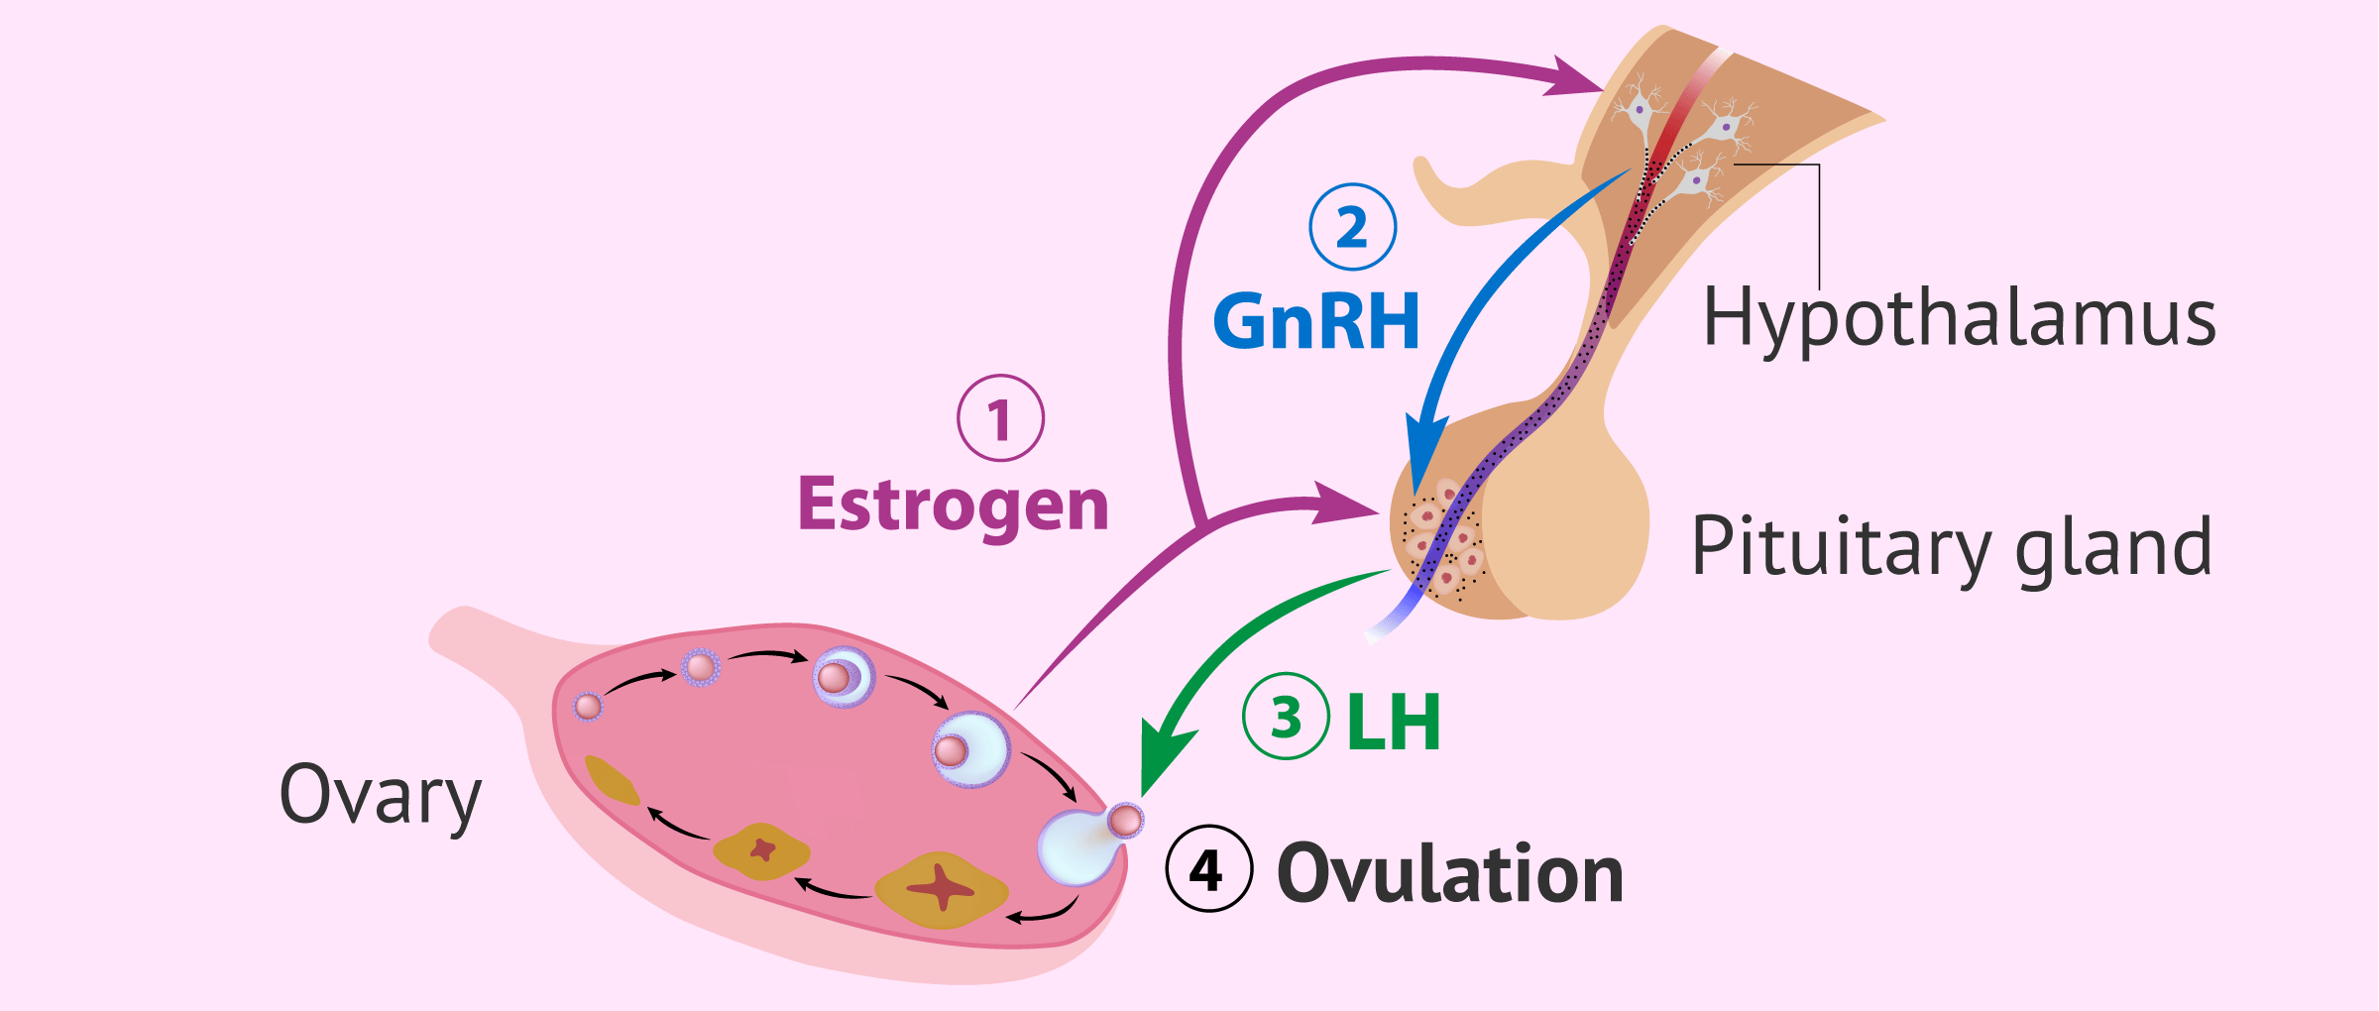
MISS MCBRIDE
Higher Human Biology
2.2 Hormonal Control of Reproduction

Slide 2
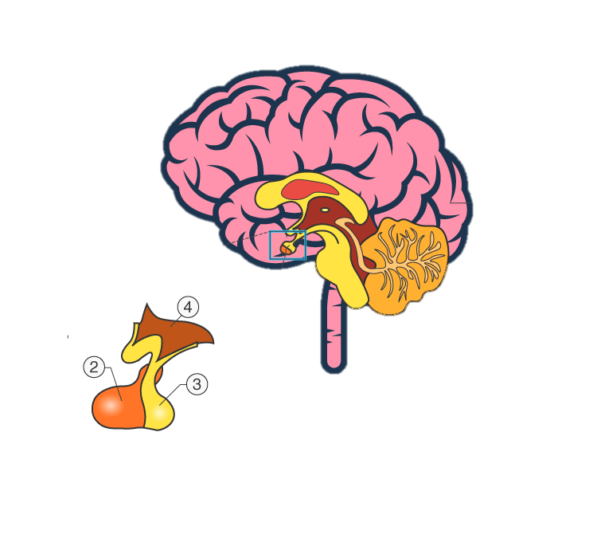
H O R M O N A L I N F L U E N C E O N P U B E R T Y
The hypothalamus secreting a releaser hormone that triggers the pituitary gland.
Your pituitary acts as your body's 'master gland'. It tells other glands in your body what to do.
The pituitary releases hormones in response to this releaser hormone and triggers the onset of puberty.

Slide 3

P I T U I T A R Y G L A N D H O R M O N E S
Follicle Stimulating Hormone (FSH)
Interstitial Cell Stimulating Hormone (ICSH)
Follicle Stimulating Hormone (FSH)
Luteinising Hormone (LH)

Slide 4
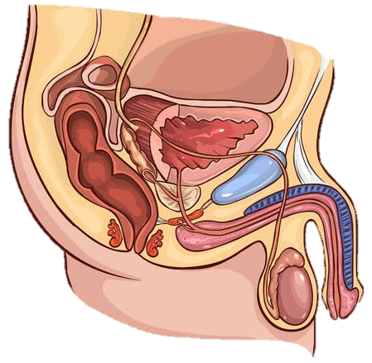

H O R M O N A L C O N T R O L O F S P E R M P R O D U C T I O N
Hypothalamus
RELEASER HORMONE
Follicle Stimulating Hormone (FSH)
Interstitial Cell Stimulating Hormone (ICSH)
Pituitary Gland
FSH
ICSH
Promotes sperm production
Stimulates production of testosterone.
Also stimulates stimulates sperm production and activates the prostate gland and seminal vesicles.

Slide 5
H O R M O N A L C O N T R O L O F S P E R M P R O D U C T I O N
Hormone | Effect
 | promotes sperm production in the seminiferous _________________
ICSH | stimulates the production of __________________ by the __________________ cells
 | stimulates sperm production and activates the _______________ gland and _____________ vesicles

Slide 6
H O R M O N A L C O N T R O L O F S P E R M P R O D U C T I O N
Hormone | Effect
FSH | promotes sperm production in the seminiferous tubules.
ICSH | stimulates the production of testosterone by the intersticial cells
Testosterone | stimulates sperm production and activates the prostate gland and seminal vesicles

Slide 7
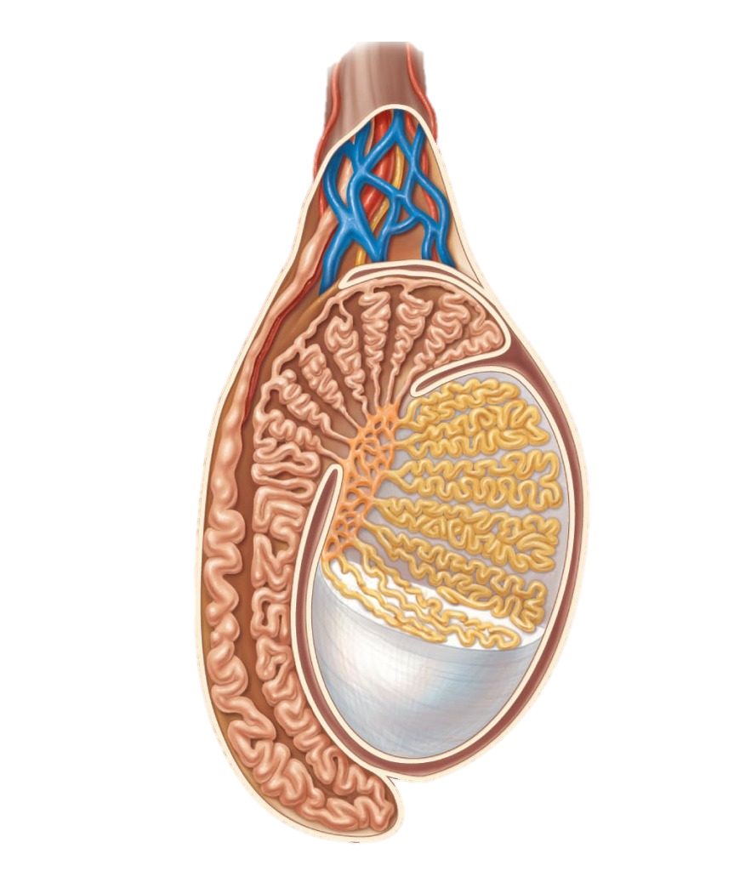
Gamete production: testes
Cross section of a teste
The testes have two functions:
Sperm production
Testosterone production

Slide 8
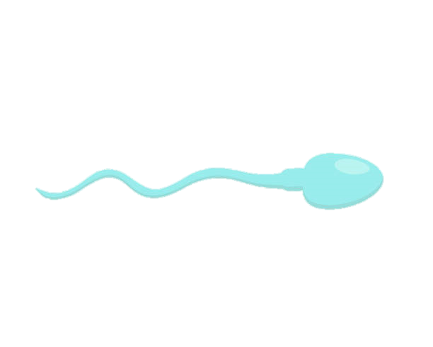
Gamete production: testes
Cross section of a teste
Sperm is produced in the seminiferous tubules.
Seminiferous tubules

Slide 9
Hormone production: testosterone
Cross section of a teste
Testosterone is produced in the interstitial cells.
Seminiferous tubules

Slide 10
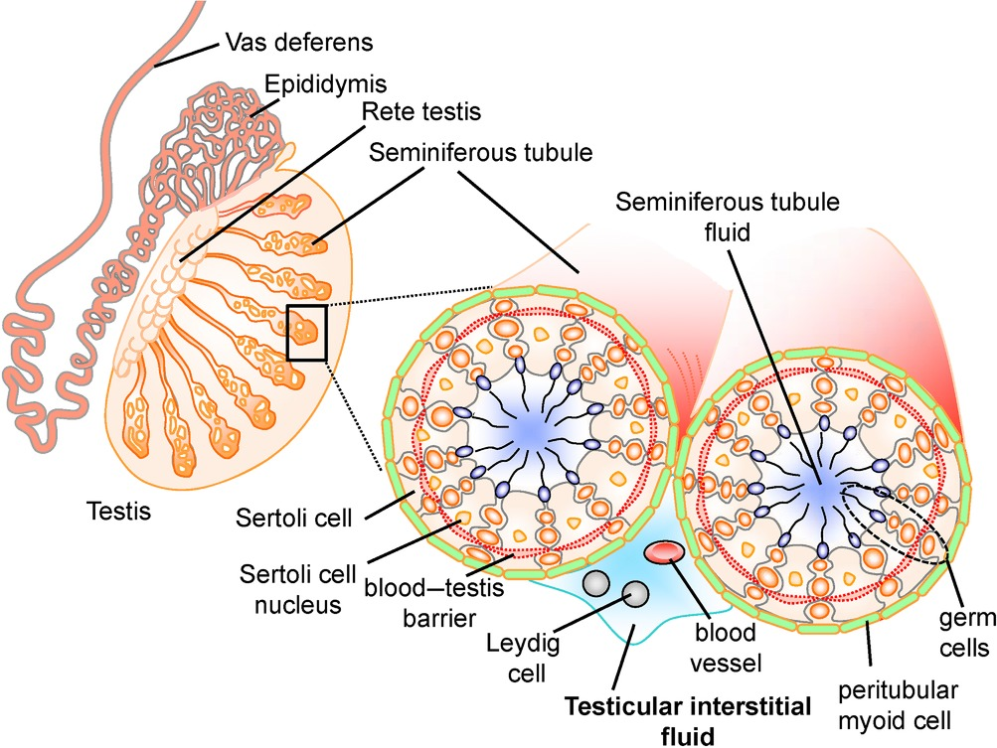
Hormone production: testosterone
Testosterone is produced in the interstitial cells.

Slide 11
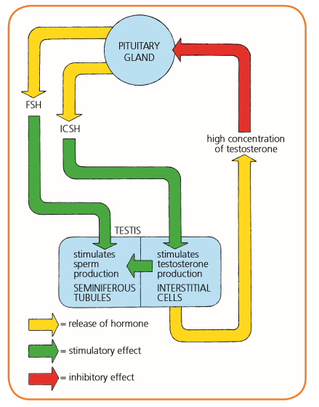
H O R M O N A L C O N T R O L O F S P E R M P R O D U C T I O N
Rising levels of testosterone in the bloodstream reach a level where they inhibit the secretion of FSH and ICSH.
Once testosterone levels are low, the hypothalamus stimulates the pituitary gland and the hormones are made again.
This is an example of negative feedback control and ensures levels of hormones remain steady.

Slide 12
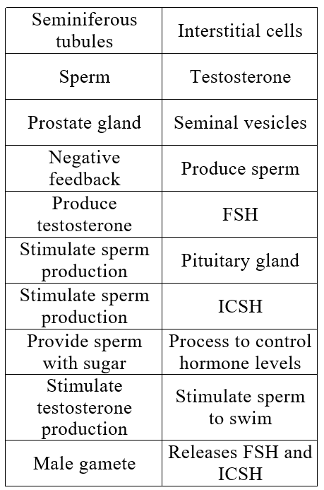
C A R D S O R T A C T I V I T Y

Slide 13
C A R D S O R T A C T I V I T Y
Seminiferous tubules | Produce Sperm
Sperm | Male Gamete
Prostate gland | Stimulate sperm to swim
Negative feedback | Process to control hormone levels
Produce testosterone | Interstitial cells
Stimulate sperm production | FSH
Stimulate sperm production | Testosterone
Provide sperm with sugar | Seminal Vesicles
Stimulate testosterone | Testosterone
Pituitary Gland | Releases FSH and ICSH

Slide 14
C O U R S E S P E C N O T E S
Hormonal influence on puberty.
The pituitary gland is stimulated to release follicle stimulating hormone (FSH), luteinising hormone (LH) or interstitial cell stimulating hormone (ICSH) by a releaser hormone produced in the hypothalamus. This triggers the onset of puberty.
Hormonal control of sperm production.
FSH promotes sperm production and ICSH stimulates the production of testosterone. Testosterone also stimulates sperm production and activates the prostate gland and seminal vesicles. Negative feedback control of testosterone by FSH and ICSH.

Slide 15
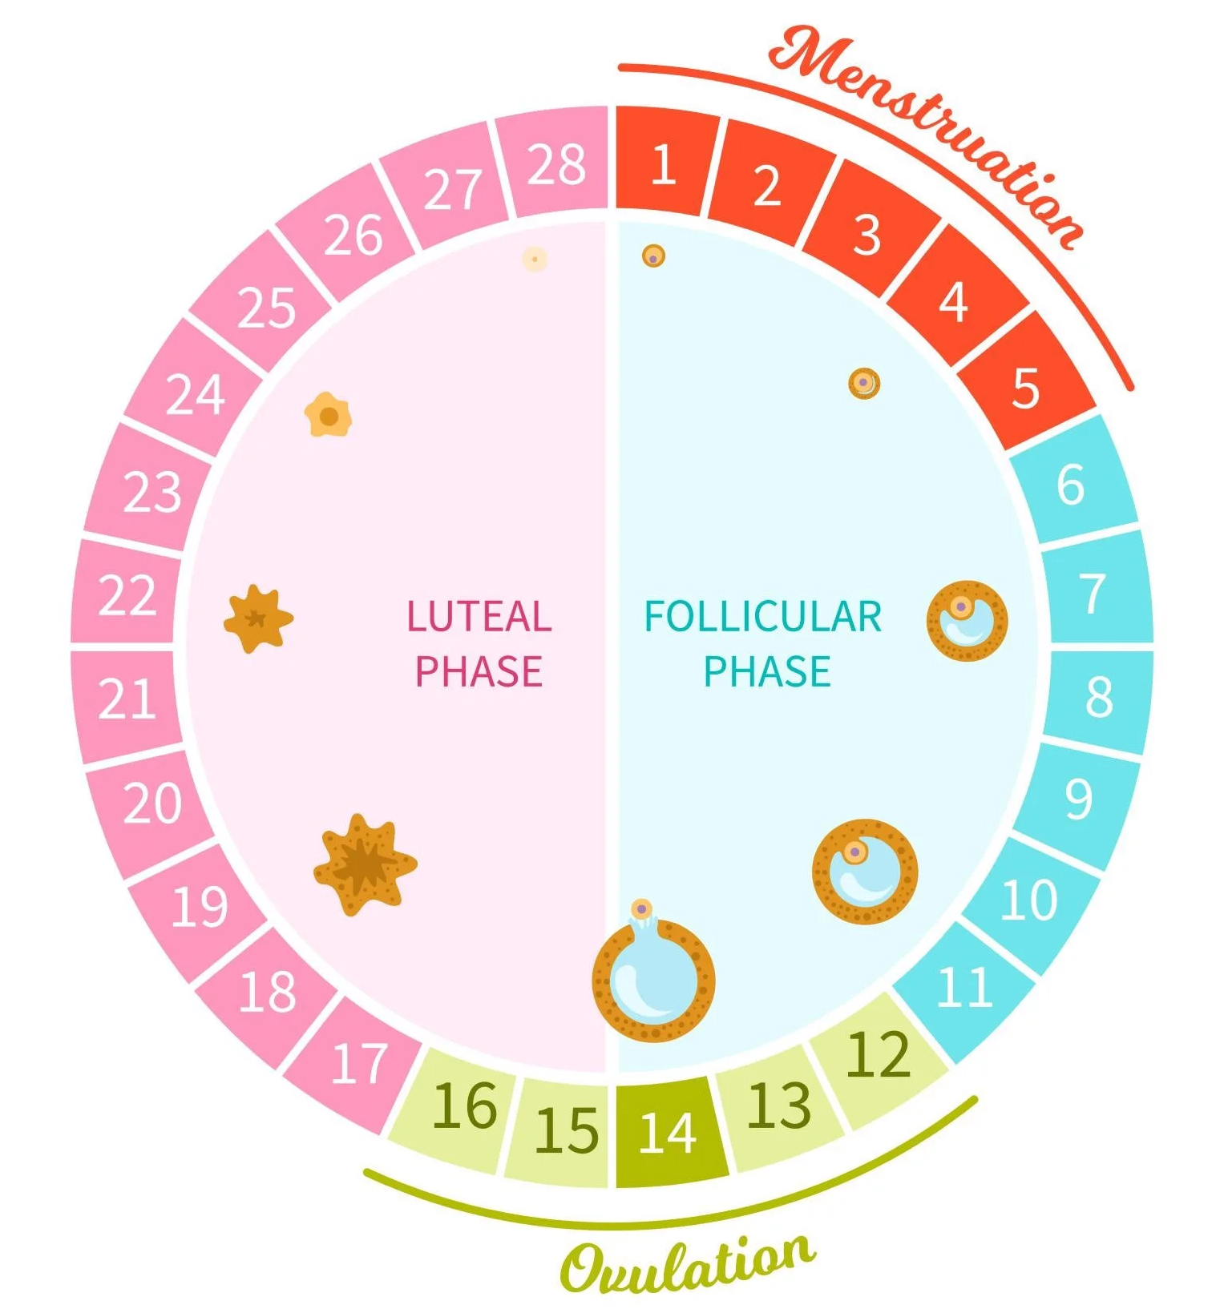
H O R M O N A L C O N T R O L OF THE M E N S T R U A L C Y C L E
The menstrual cycle takes approximately 28 days with the first day of menstruation (period) regarded as day one of the cycle.

Slide 16
H O R M O N A L C O N T R O L OF THE M E N S T R U A L C Y C L E
There are two phases to the menstrual cycle.
- Follicular Phase
- Luteal Phase

Slide 17
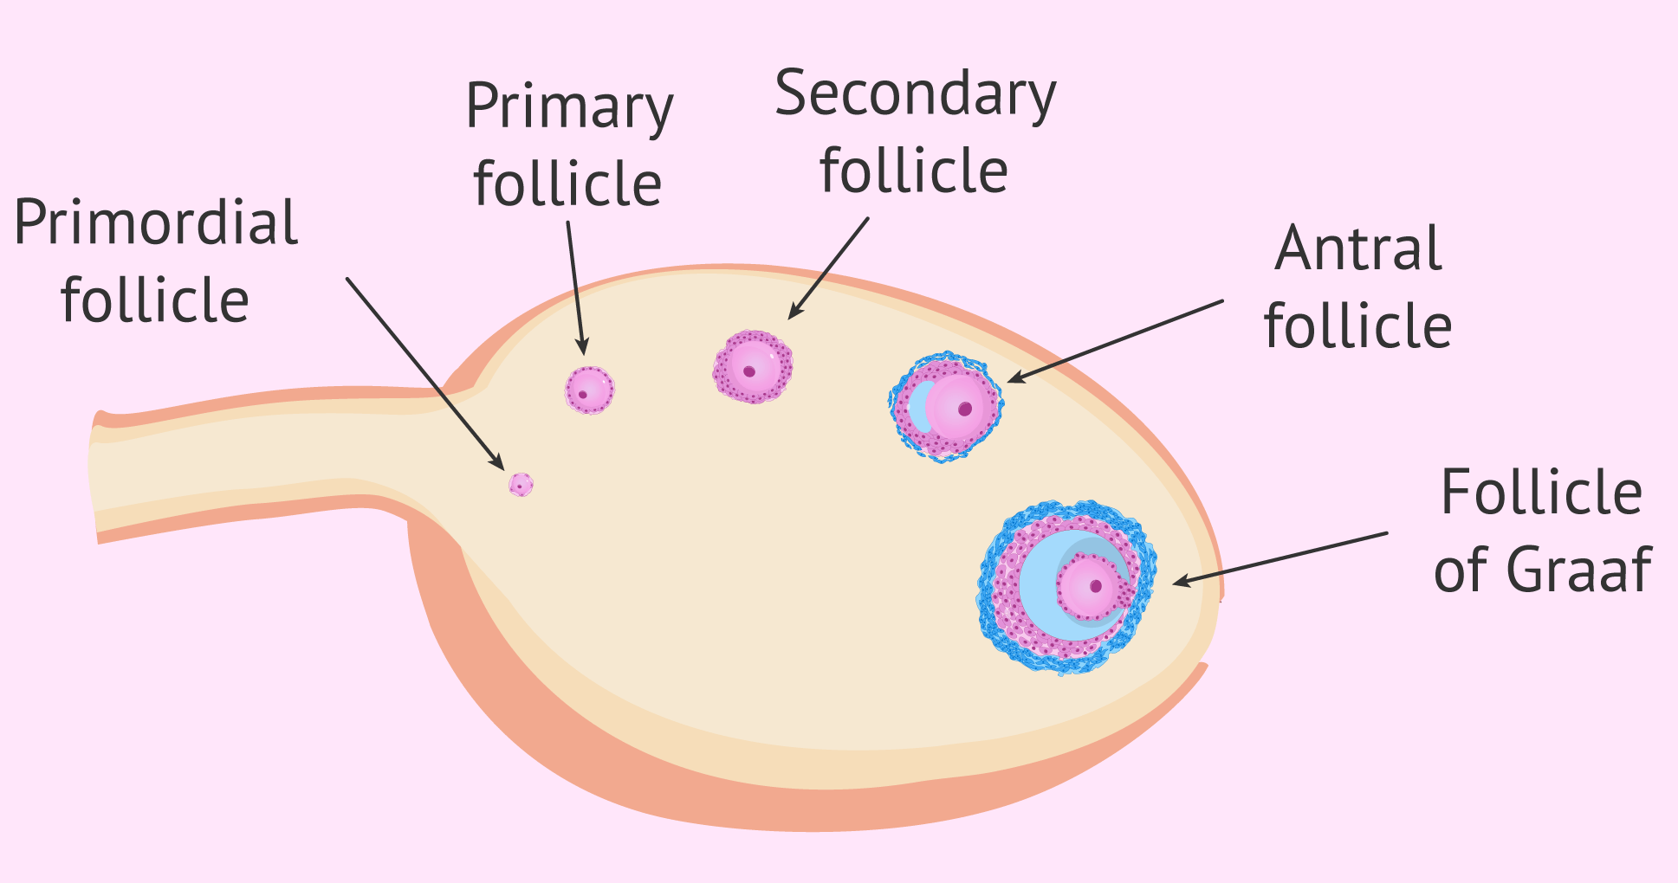
F O L L I C U L A R P H A S E
FSH
stimulates the development of a follicle which then secretes the hormone oestrogen.

Slide 18
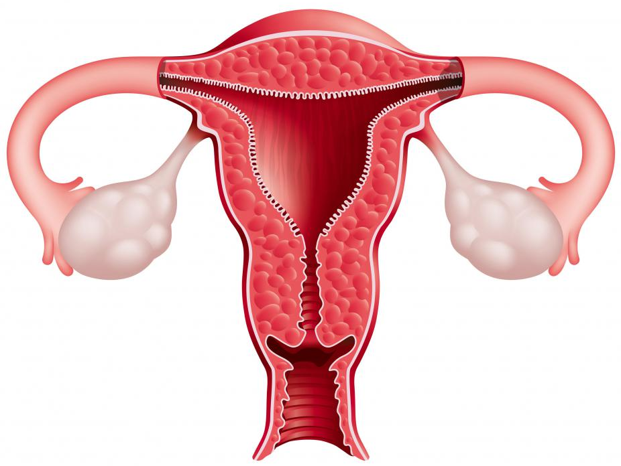
F O L L I C U L A R P H A S E
Oestrogen
Stimulates proliferation of the endometrium preparing it for implantation.
Affects the consistency of cervical mucus making it more easily penetrated by sperm.

Slide 19
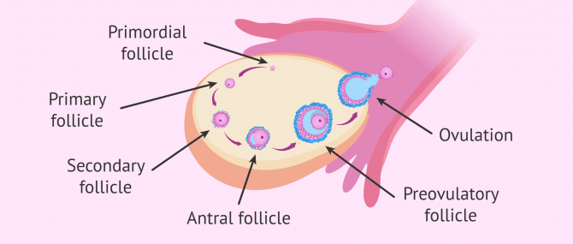
O V U L A T I O N
Peak levels of oestrogen stimulate a surge in the secretion of LH. This surge in LH triggers ovulation.

Slide 20
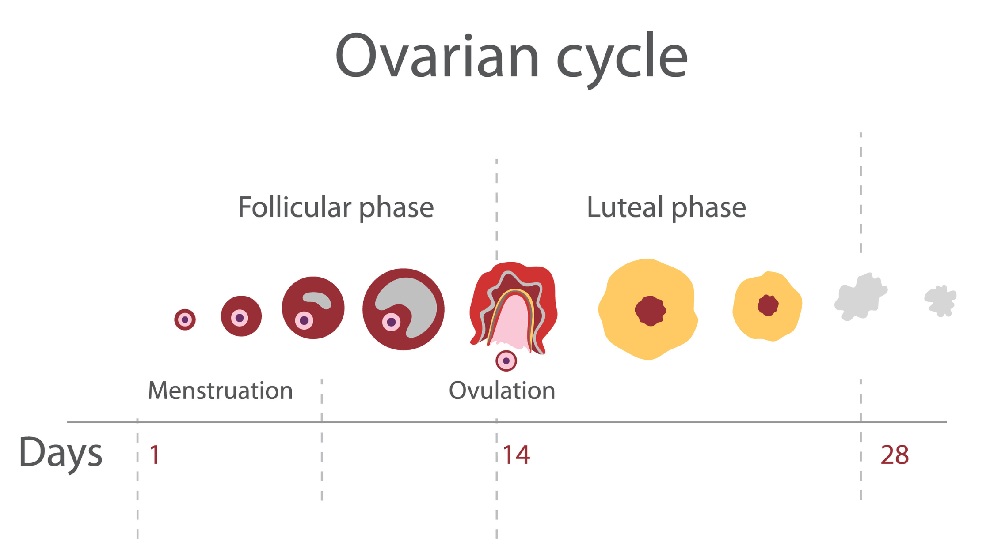
O V U L A T I O N
Ovulation is the release of an egg (ovum) from a follicle in the ovary. It usually occurs around the mid-point of the menstrual cycle.

Slide 21
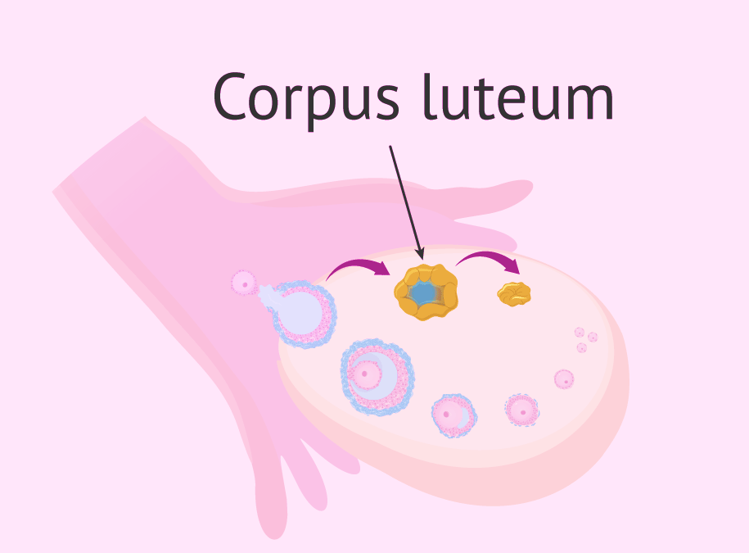
L U T E A L P H A S E
The follicle develops into a corpus luteum.
This secretes progesterone.
Progesterone promotes further development and vascularisation of the endometrium preparing it for implantation if fertilisation occurs.

Slide 22

L U T E A L P H A S E
Drop in FSH means no new follicles develop.
Lack of LH causes degeneration of the corpus luteum and a rapid drop in progesterone.
Endometrium cannot be maintained, and menstruation occurs.

Slide 23
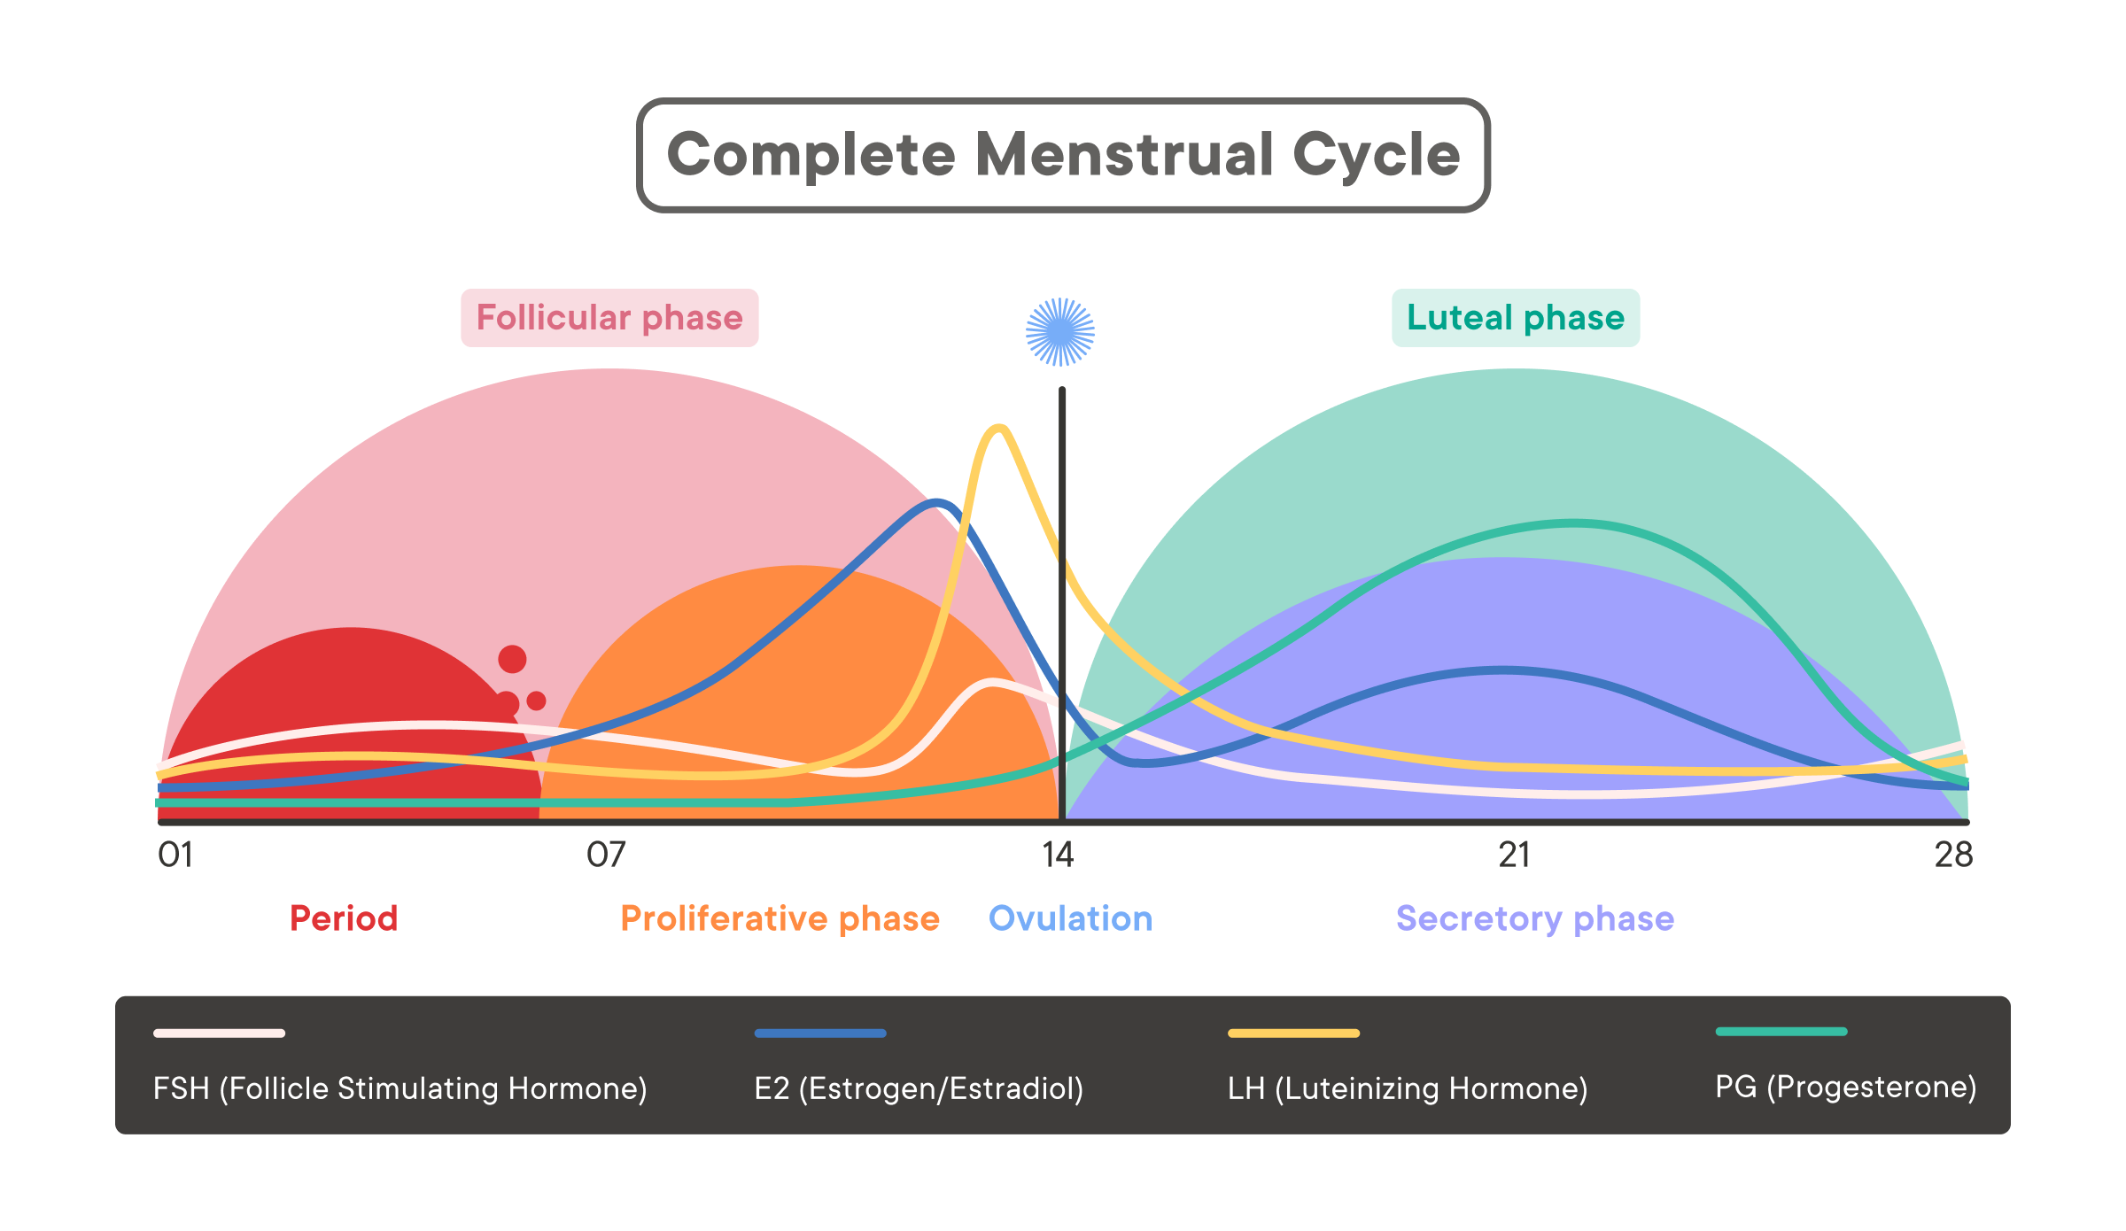

Slide 24
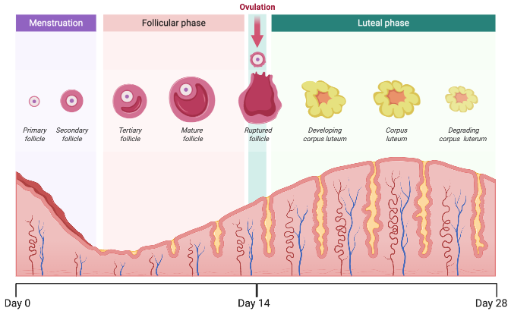

Slide 25
H O R M O N A L C O N T R O L OF THE M E N S T R U A L C Y C L E

Slide 26
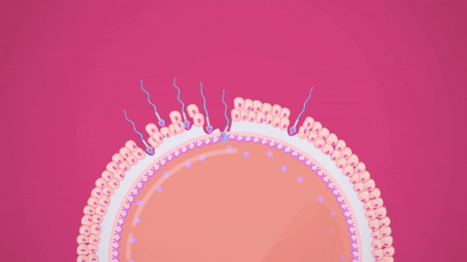
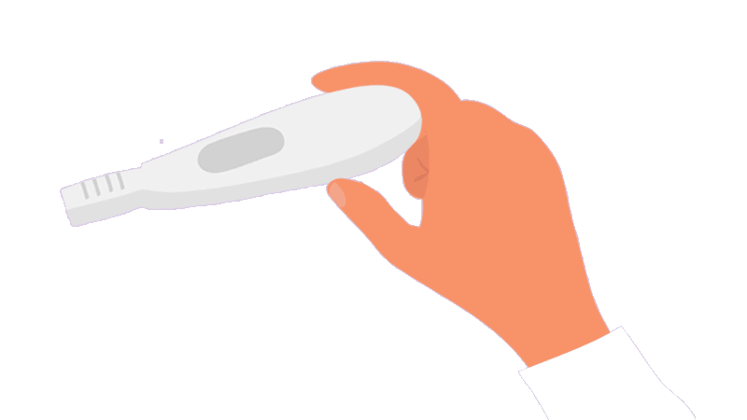
P R E G N A N T !
If fertilisation does occur the corpus luteum does not degenerate and progesterone levels remain high.

Slide 27
C O P Y AND C O M P L E T E
Hormone | Site of Production | One Function of the Hormone
 |  | Stimulates the development and maturation of each follicle.
 |  | Brings about development of the corpus luteum.
 |  | Stimulates secretion of LH by the pituitary gland.
 |  | Promotes vascularisation of the endometrium.

Slide 28
C O P Y AND C O M P L E T E
Hormone | Site of Production | One Function of the Hormone
FSH | Pituitary Gland | Stimulates the development and maturation of each follicle.
LH | Pituitary Gland | Brings about development of the corpus luteum.
Estrogen | Follicle | Stimulates secretion of LH by the pituitary gland.
Progesterone | Corpus Luteum | Promotes vascularisation of the endometrium.

Slide 29
C O U R S E S P E C N O T E S
Hormonal control of the menstrual cycle.
The menstrual cycle takes approximately 28 days with the first day of menstruation regarded as day one of the cycle.
FSH stimulates the development of a follicle and the production of oestrogen by the follicle in the follicular phase.
Oestrogen stimulates proliferation of the endometrium preparing it for implantation and affects the consistency of cervical mucus making it more easily penetrated by sperm. Peak levels of oestrogen stimulate a surge in the secretion of LH. This surge in LH triggers ovulation.
Ovulation is the release of an egg (ovum) from a follicle in the ovary. It usually occurs around the mid-point of the menstrual cycle.
In the luteal phase the follicle develops into a corpus luteum which secretes progesterone. Progesterone promotes further development and vascularisation of the endometrium preparing it for implantation if fertilisation occurs.
The negative feedback effect of the ovarian hormones on the pituitary gland and the secretion of FSH and LH prevent further follicles from developing. The lack of LH leads to degeneration of the corpus luteum with a subsequent drop in progesterone levels leading to menstruation.
If fertilisation does occur the corpus luteum does not degenerate and progesterone levels remain high.

