Slide 1
Learning Intentions:
We are learning about how plants rely on transport systems for their survival.
We will take a closer look into the two main transport systems - 1. Sugar and 2. Water
Success Criteria:
Be able to state the main organs in plants - roots, stems and leaves.
Be able to label the parts of a leaf on a diagram
Be able to state the main properties of each of the two transport systems in plants.
Be able to describe the process of transpiration, how it is measured, and state the factors that can increase the rate of this process.
Numeracy
Leadership
Communication
Literacy
MESPS Wellbeing

Slide 2
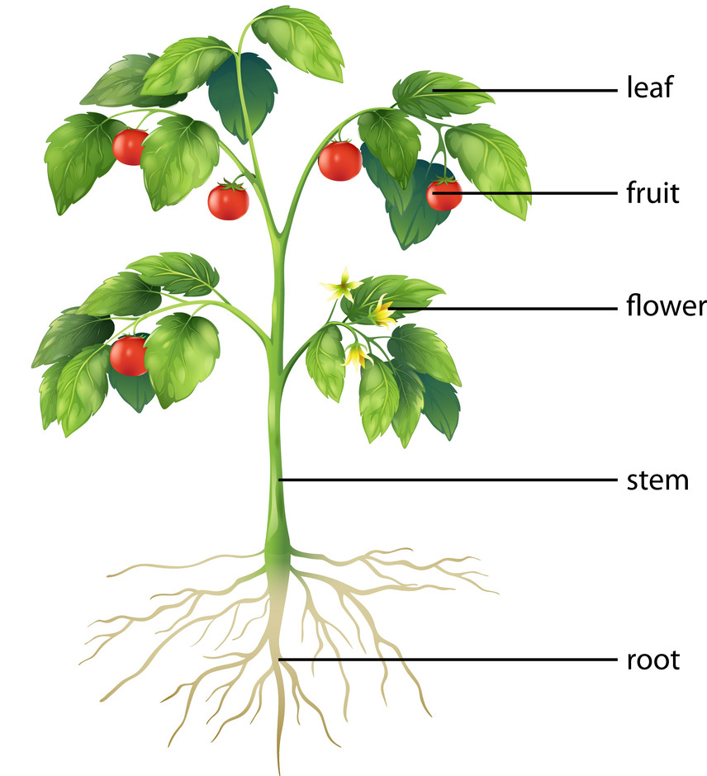
2.5 Plant Transport Systems

Slide 3
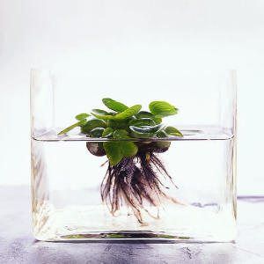
Plants need a transport system - Why?
Green parts of the plant photosynthesise
Roots absorb water and minerals

Slide 4
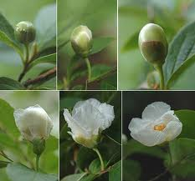
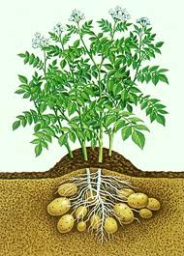
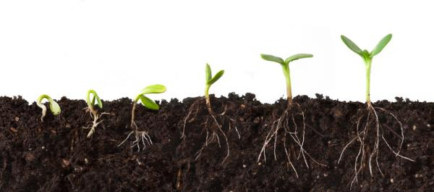
Plants need a transport system – Why?
The sugars made in the leaves during photosynthesis are needed by every part of the plant for different reasons.
The root tips and shoot tips for growth
Shoots for flower growth
Storage organs for new plant growth

Slide 5
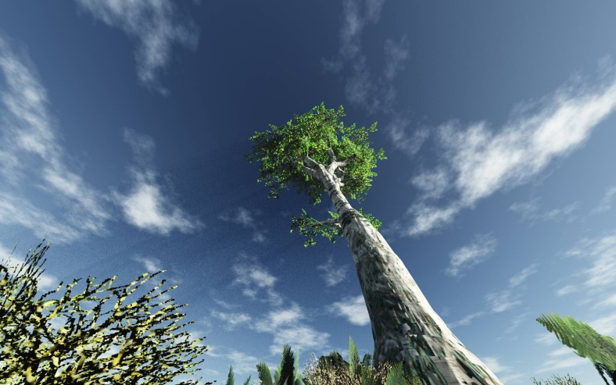
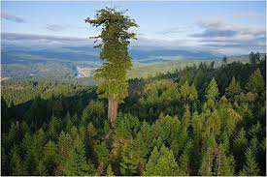
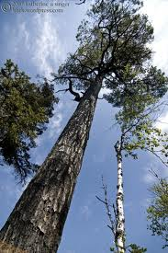
Plants need a transport system – Why?
It’s the same for water and minerals. Although they are absorbed by the root, they are needed in every part of the plant, especially the leaves!

Slide 7
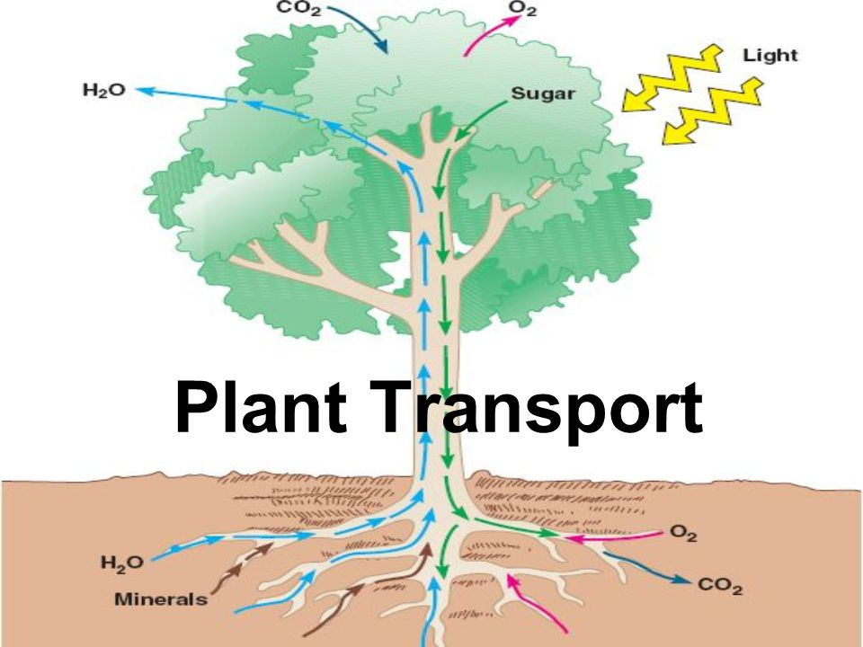
The Transport System
So like us, plants have vessels inside them to allow the movement of sugars, water and minerals.

Slide 8
The Transport System
Water and minerals flow in an upwards direction from the roots to all other parts of the plant.
Sugars flow from the green leaves all over the plant, including down to the roots.

Slide 9
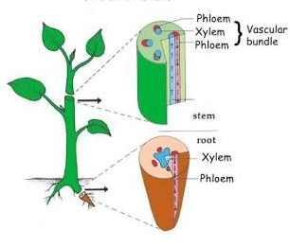
Transport Vessels
There are 2 types of transport vessels within plants. These are called XYLEM and PHLOEM.

Slide 10
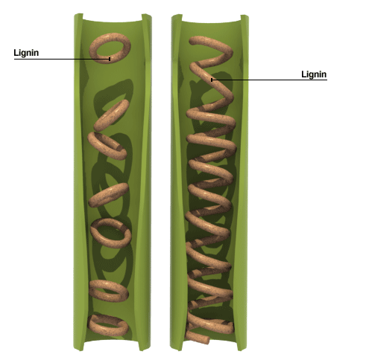
Xylem – transport water and minerals
Xylem cells are dead.
The end walls have disintegrated to leave hollow tubes.
The side walls have become strengthened with rings or spirals of lignin.
Xylem also helps to support the plant.
Roughly sketch and copy notes.

Slide 11
Function of Xylem
Xylem vessels provide support for the plant. The vessels make up a strong lignified tube which runs from the roots to the leaves.
Xylem vessels transport water and soil nutrients from the roots towards the leaves.

Slide 12
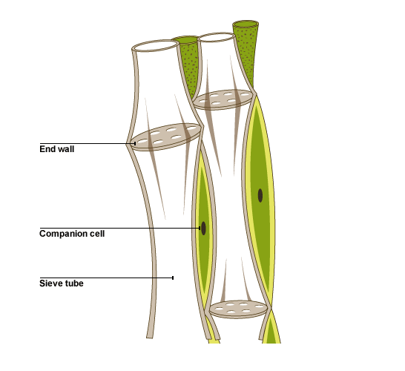
Phloem
Phloem cells are alive.
Phloem tubes have sieve plates with companion cells attached to them.
Sieve plate

Slide 13
Function of Phloem
Plants carry out photosynthesis in their green leaves making sugars.
Phloem transport these sugars from the leaves down to the other parts of the plant.

Slide 14
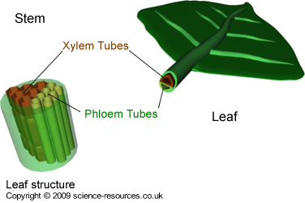
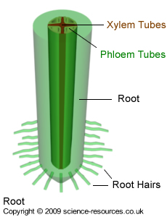
Position of xylem and phloem in root & stem tissue

Slide 15
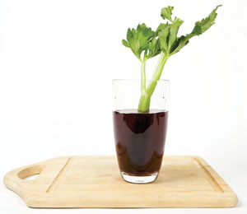
A quick demo at home!
We can do an experiment that lets us see the path water takes up the xylem within a plant.
take a plant stem such as celery or a flower and place the base of it in a beaker of coloured water (use dilutent juice or water with food colouring).
2. Give it time to allow water to move and see what happens!

Slide 16
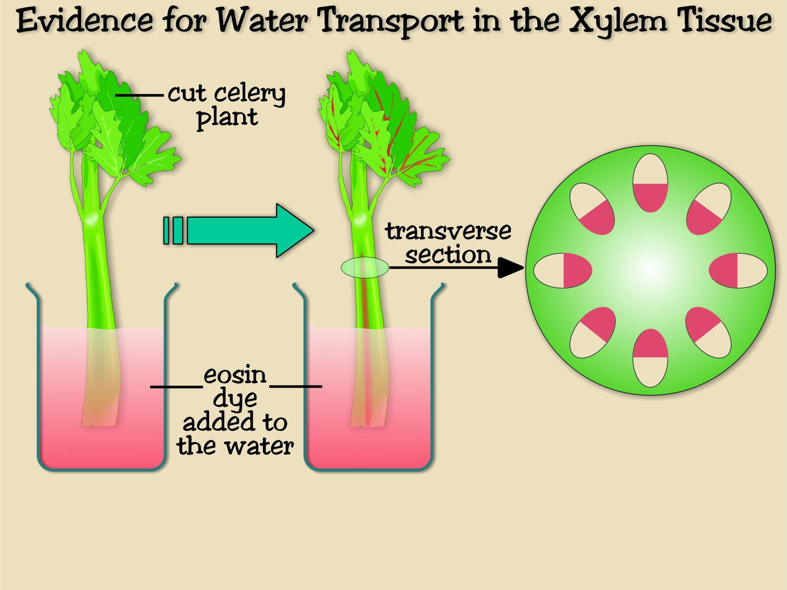
Results
Coloured

Slide 17
Internal Structure of a Leaf
As best you can, copy this diagram into your jotter (or print it if you can!) leaving plenty space to label around it.
Use the next few slides to label the parts of the leaf structure.

Slide 18
Internal Structure of a Leaf
Upper epidermis
Lower epidermis
There are 2 ‘skin’ layers on the outer surface of
the leaf – UPPER and LOWER EPIDERMIS.
They do not contain chloroplasts and so do not photosynthesise

Slide 19
Internal Structure of a Leaf
Waxy cuticle
Upper epidermis
Lower epidermis
The upper surface is covered with a WAXY CUTICLE to reduce water loss.

Slide 20
Internal Structure of a Leaf
Waxy cuticle
Upper epidermis
Palisade mesophyll
Lower epidermis
Below the upper epidermis is the PALISADE MESOPHYLL.
This is the main site of photosynthesis within the leaf.

Slide 21
Internal Structure of a Leaf
Waxy cuticle
Upper epidermis
Palisade mesophyll
Spongy mesophyll
Lower epidermis
Moist air spaces
The SPONGY MESOPHYLL is a layer of photosynthetic cells arranged in such a way as to leave moist air spaces to aid gas exchange.

Slide 22
Internal Structure of a Leaf
Waxy cuticle
Upper epidermis
Palisade mesophyll
Spongy mesophyll
Lower epidermis
Moist air spaces
Gases enter and leave the leaf through the stomata so the internal leaf cells can respire and photosynthesise.

Slide 23
Internal Structure of a Leaf
Xylem
Phloem
The leaf vein contains the transport vessels which enable this to occur.
Xylem transports water and soil nutrients from the roots up into the leaf so the cells can carry out photosynthesis.
Phloem transport the sugars made during photosynthesis away to other parts of the plant.

Slide 24
Structure of the leaf | Role in gas exchange
Waxy cuticle | This layer is water proof thus preventing loss of water vapour from the upper leaf surface
Leaf vein | Contains xylem and phloem to take water to the leaf cells and to deliver the sugars to the part of the plant where it is needed
Palisade mesophyll cells | The main site of photosynthesis. Layer of cells containing chloroplasts which take in carbon dioxide and give out oxygen during photosynthesis
Spongy mesophyll cells | A layer of photosynthetic cells arranged in such a way as to leave moist air spaces to aid gas exchange
Moist air space | Large moist space into which carbon dioxide dissolves before it diffuses into mesophyll cells
Stoma (plural stomata) | A pore on the lower surface which allows carbon dioxide to enter and water vapour and oxygen to leave
Guard cells | Pairs of cells which can change shape to control exchange of gases by closing stoma at night

Slide 25
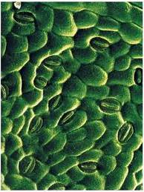
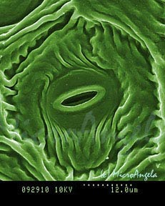
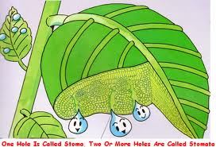
Stomata
Stomata are tiny pores found on the surface of a leaf
Plants take in carbon dioxide from the air through these stomata
Plants lose water vapour from the leaf through the stomata

Slide 26
Transpiration is the process of water moving through a plant and its evaporation through the stomata.

Slide 27
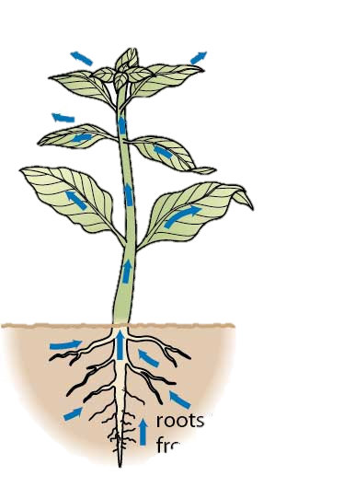
Transpiration
Water evaporates through stomata
Roughly sketch this diagram and add the labels.
Water travels through the plant
Water absorbed by roots

Slide 29
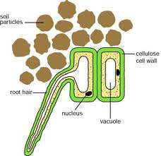
Entry of water
Water enters the plant through root hairs.
This happens by osmosis (think back to unit 1!)
High water concentration
Low water concentration

Slide 30
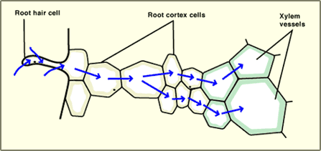
Movement of water
Water molecules then move into and through the cortex cells by osmosis.
Root hair cell
Root cortex cells
Xylem vessels

Slide 31
Movement of water
Water molecules then move into the xylem vessels by osmosis
Root hair cell
Root cortex cells
Xylem vessels

Slide 32
Water Moving up
Water is pulled up the plant in the xylem vessels, towards the leaves.

Slide 33
Water in the Xylem
Because the xylem vessels are very narrow, the water can travel up them a long distance.

Slide 34
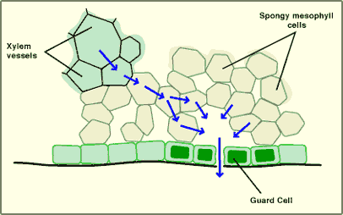
Movement of Water in Leaf
At the leaf the water passes out of the xylem vessel into the spongy mesophyll cells by osmosis

Slide 35
The route taken by water
Soil
Root hair cells
Cortex cells
Xylem vessels
Spongy mesophyll cells
Air spaces
Atmosphere

Slide 36
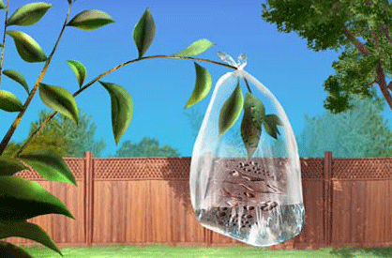
Transpiration Rates
The rate at which transpiration occurs is affected by the following factors:
Temperature
Wind speed
Humidity
Surface area
How do you think these factors affect transpiration rate?!

Slide 37
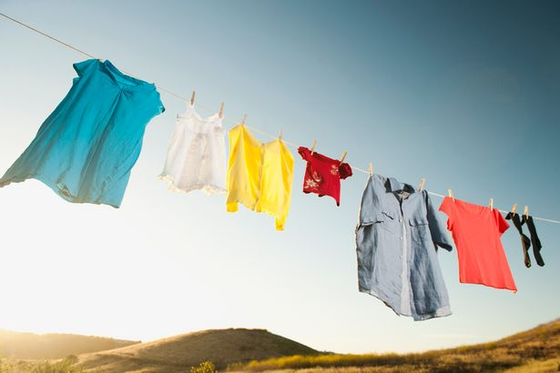
It’s a bit like hanging out your washing!
What conditions would make your clothes dry faster?

Slide 38
Factor | Effect on transpiration Rate
Temperature | As temperature increases, transpiration rate increases
Wind Speed | As wind speed increases, transpiration rate increases
Humidity | As humidity increases, transpiration rate decreases
Surface Area | As surface area increases, transpiration rate increases

Slide 39
Measuring Transpiration Rates
The rate at which transpiration occurs can be measured using potometers.

Slide 40
Measuring Transpiration
Rate of transpiration can be measured using a bubble potometer
https://www.youtube.com/watch?v=gXocZZDDPaw
A cut plant stem is sealed into the potometer using a rubber bung
This is only an estimate as some water is retained in the leaf for photosynthesis.
An air bubble is introduced to the capillary tube
The bubble potometer can be used to compare rates of transpiration in different conditions
The distance the bubble travels shows how much water the stem has taken up

Slide 41
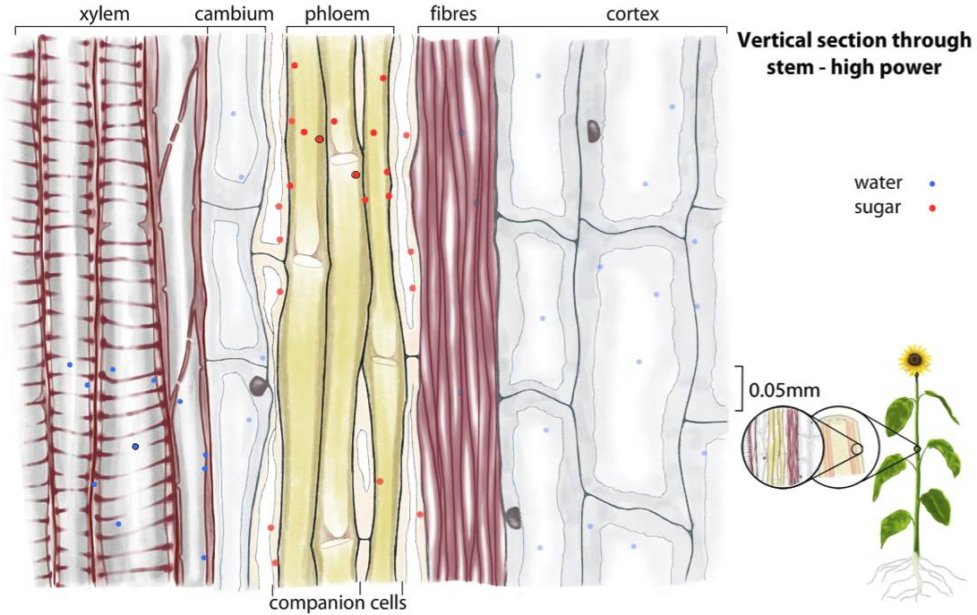
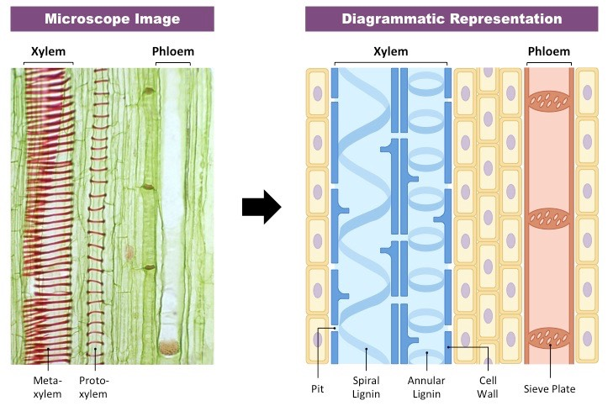
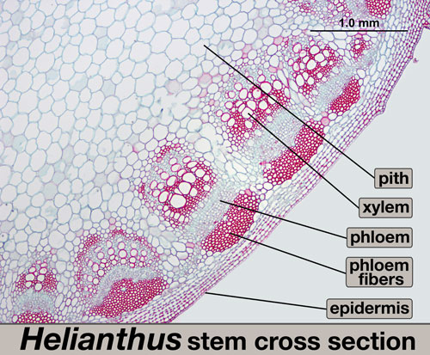
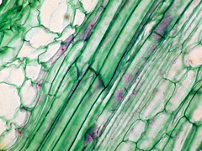
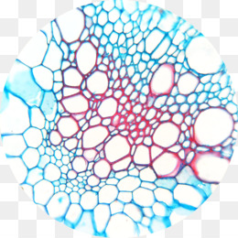
Xylem and Phloem
Stem cross section
xylem
phloem

Slide 42
Past Paper Question

Slide 43
Past Paper Question
Phloem
unsure
Companion cells
Capillary action
D
water
To transport nutrients, water, sugars, oxygen and carbon dioxide to all parts of the plant.

Slide 44
Past Paper Question

Slide 45
Past Paper Question
F or E
C
F or E
Phloem
B

Slide 46
Past Paper Question

Slide 47
Past Paper Question
decreases
increases
increases
*
*
Humidity: put the apparatus in a (transparent bag)
Temperature: put a heater beside it,/water bath at higher temperature
Wind Speed: Use a fan/hairdryer on cool setting beside apparatus.

Slide 48
Past Paper Question

Slide 49
Past Paper Question
P has greater number of stomata/Q has fewer stomata Answer must be comparative: not acceptable ‘different number of stomata”
Guard (cells)

Slide 50
Past Paper Question

Slide 51
Past Paper Question
Will be less evaporation/water loss
Or
Plant will not require as much water.
*
150

Slide 52
Past Paper Question

Slide 53
Past Paper Question
To absorb/capture/trap more light
Xylem- lignin/hollow/no cell contents/ no end walls
Phloem- sieve plates/sieve tubes/companion cells
Palisade mesophyll

Slide 54
Past Paper Question

Slide 55
Past Paper Question
Water moves into/enters/is absorbed by root hairs by osmosis/diffusion (1)
(Water) travels upwards in the xylem (1)
(Water) travels to the stomata/pores and evaporates/transpires/diffuses out (1)

Slide 56
Learning Intentions:
We are learning about how plants rely on transport systems for their survival.
We will take a closer look into the two main transport systems - 1. Sugar and 2. Water
Success Criteria:
Be able to state the main organs in plants - roots, stems and leaves.
Be able to label the parts of a leaf on a diagram
Be able to state the main properties of each of the two transport systems in plants.
Be able to describe the process of transpiration, how it is measured, and state the factors that can increase the rate of this process.
Numeracy
Leadership
Communication
Literacy
MESPS Wellbeing

