Slide 1
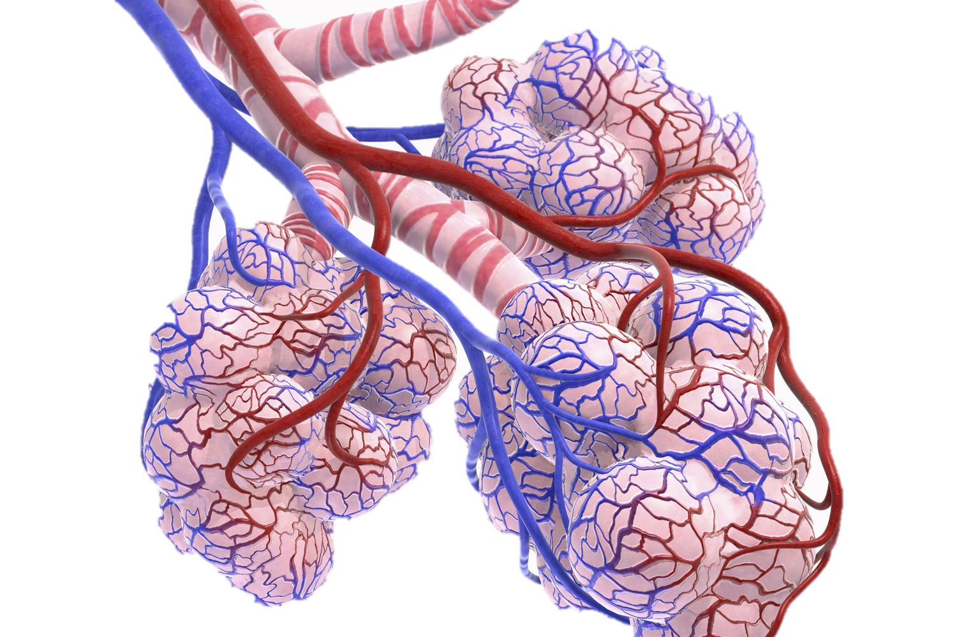
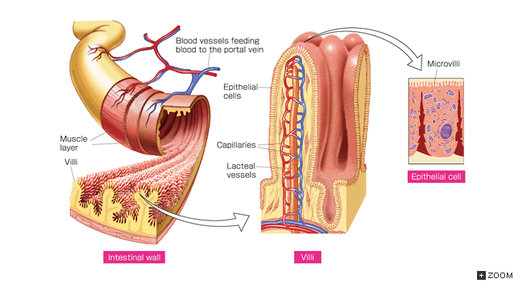
2.7 Absorption of Materials

Slide 2
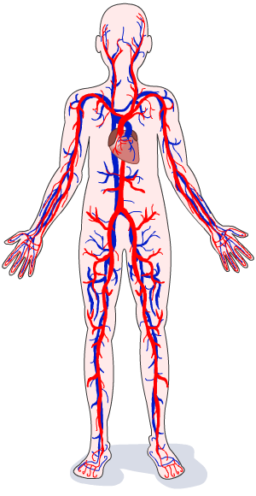
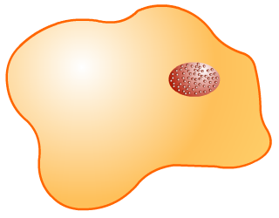
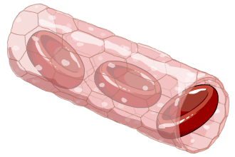
What is carried by the circulatory system?
Which substances are transported to and from the body’s cells by the blood flowing in the circulatory system?
Glucose and Oxygen are needed for respiration and are transported to the body’s cells in the blood.
carbon
dioxide
glucose
oxygen
Carbon dioxide is the waste gas produced by respiration that must be carried away from the body’s cells.

Slide 3
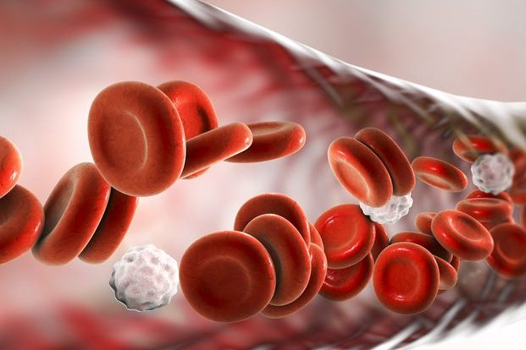
Absorption of Materials
Oxygen enters the blood in the lungs, and carbon dioxide is removed from the blood in the lungs, at specially adapted exchange surfaces
Nutrients such as glucose and amino acids enter the bloodstream through specially adapted exchange surfaces in the small intestine
Alveoli in the lungs
Villi in the small intestine

Slide 4
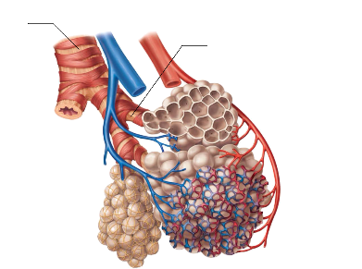
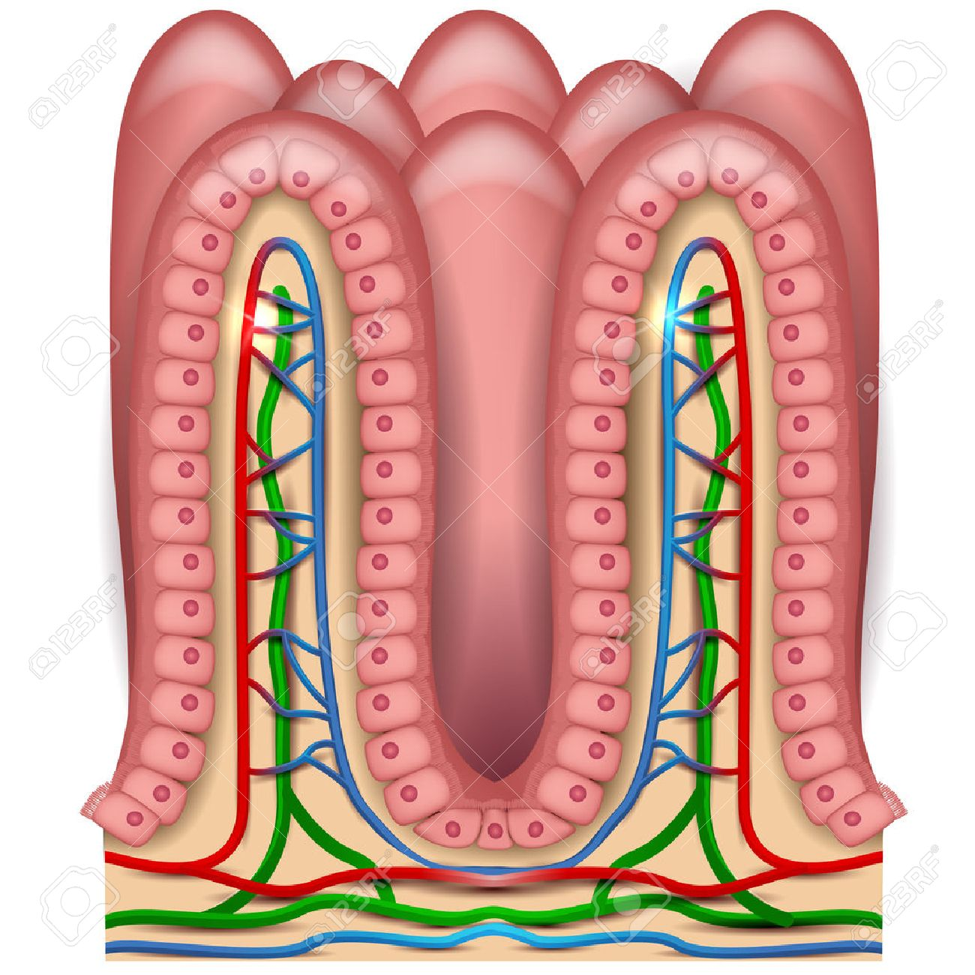
Exchange Surfaces
bronchus
bronchiole
Exchange surfaces such as the
lungs and small intestine have
several features in common :
Thin walls to allow diffusion
They are highly folded, creating
a large surface area
Alveoli in the lungs
Villi in the small intestine
They have an extensive blood supply, creating opportunities for exchange
of materials
These features increase the efficiency of absorption

Slide 5
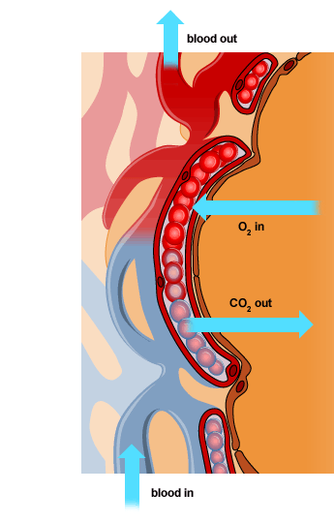
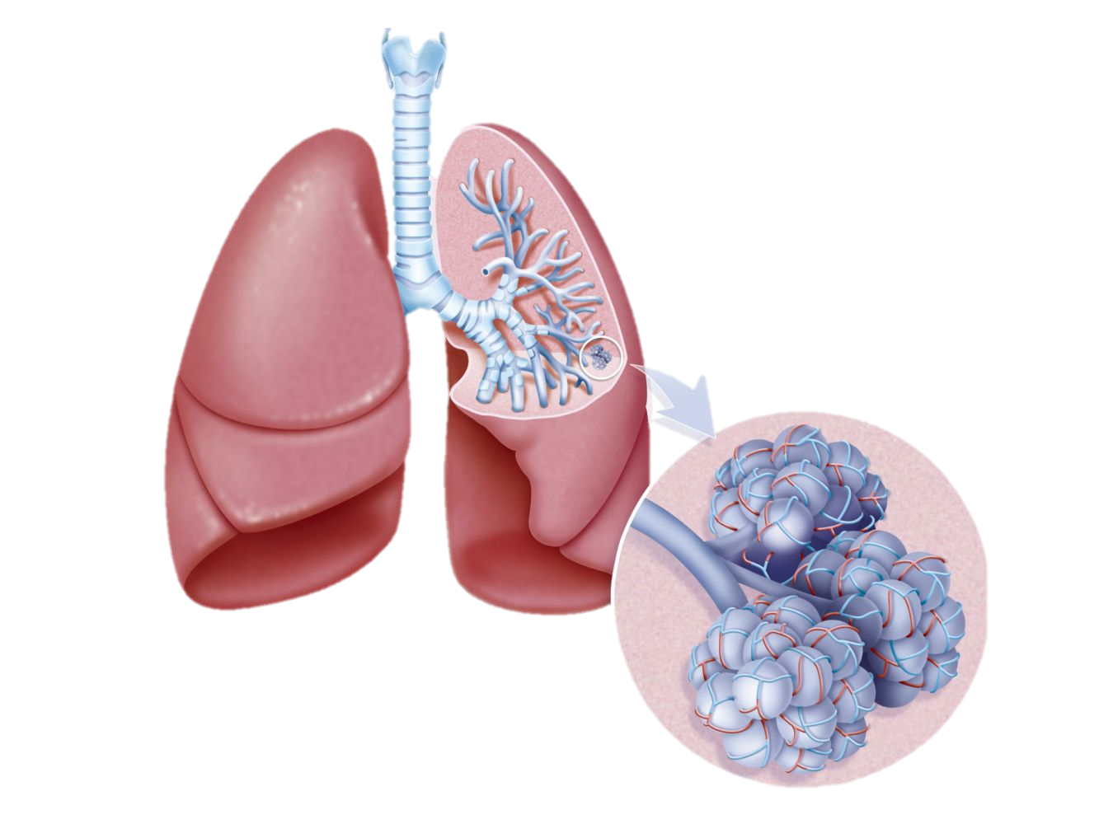
Lungs
Lungs are needed for the exchange of gases with the blood
Oxygen enters the blood, so that it can be transported to cells for respiration
Carbon dioxide, the waste product of respiration, leaves the blood and enters the lungs so that it can be exhaled, removing it from the body
This happens in specialised air sacs in the lungs called alveoli (one = alveolus)
capillaries
alveolus

Slide 6
Lung Structure
Where are the alveoli ?
trachea
rib
bronchiole
bronchus
lung
alveolus
diaphragm

Slide 7
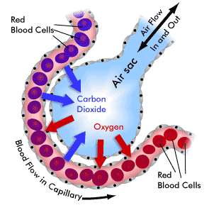
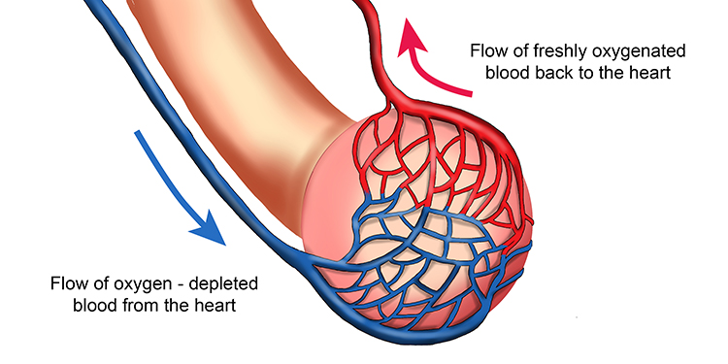
Alveoli
bronchus
Each alveolus has a rich blood supply, due to the network of capillaries surrounding it
bronchiole
oxygenated blood
alveoli
deoxygenated blood
There are a large number of alveoli in each lung, providing a huge surface area for exchange of gases. They have a moist lining to dissolve oxygen.
When you breathe in, oxygen is absorbed into the blood by diffusion through the thin alveolar and capillary walls, and carbon dioxide diffuses out into the air, which is then breathed out.

Slide 8
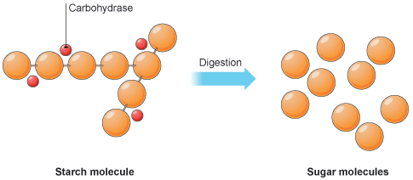
Digestion
amylase (enzyme)
We eat food to obtain nutrients such as glucose and fats which are used in respiration to release energy, and amino acids for building proteins
Our food contains large, insoluble molecules such as starch and protein, which need to be broken down to small soluble molecules which can then be absorbed into the blood
protein
short protein chain
amino acids

Slide 9
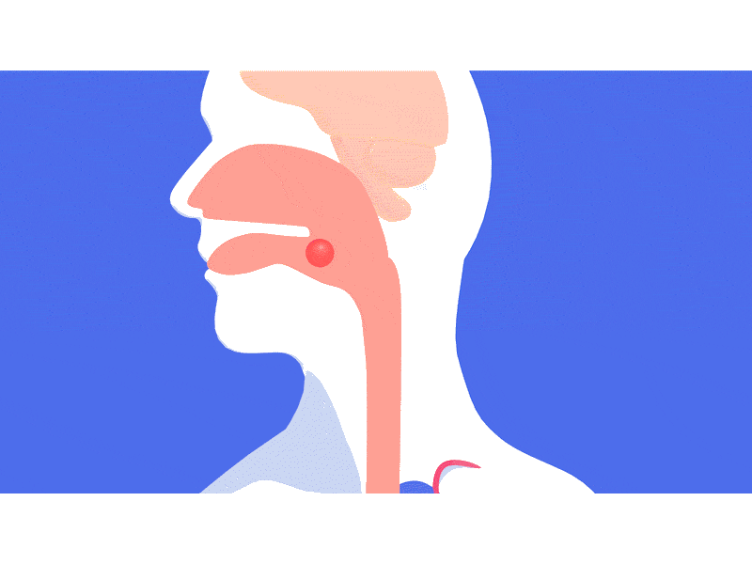
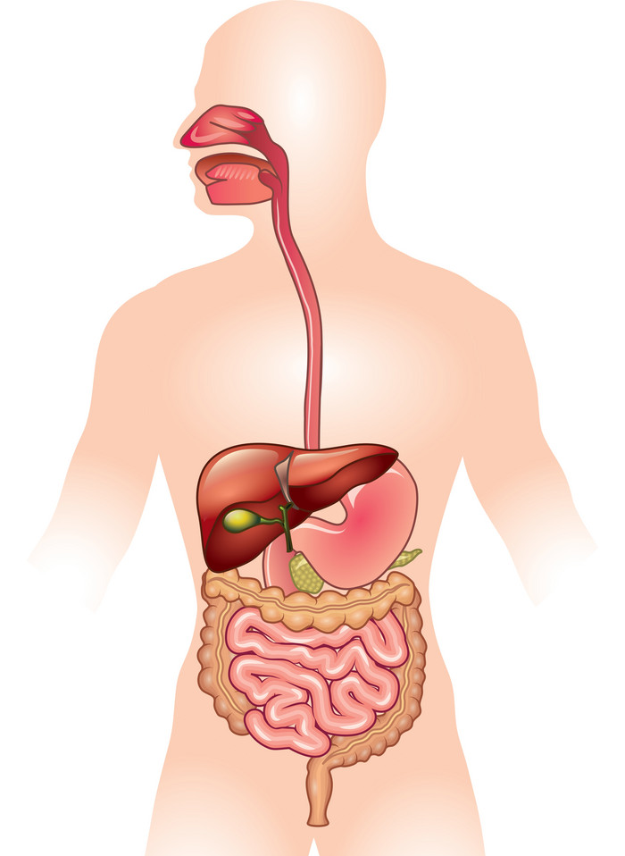
The Digestive System
The digestive system is a long tube running from mouth to anus
Food enters through the mouth, is broken up and mixed with saliva and is swallowed to start the breakdown process
Food is mixed and churned, and enzymes are added in the mouth, stomach and small intestine (from the pancreas)
Bile is added from the liver to help emulsify fats (break them down into smaller droplets)
Products of digestion are absorbed in the small intestine
Waste enters the large intestine, where water is removed before it is egested

Slide 10
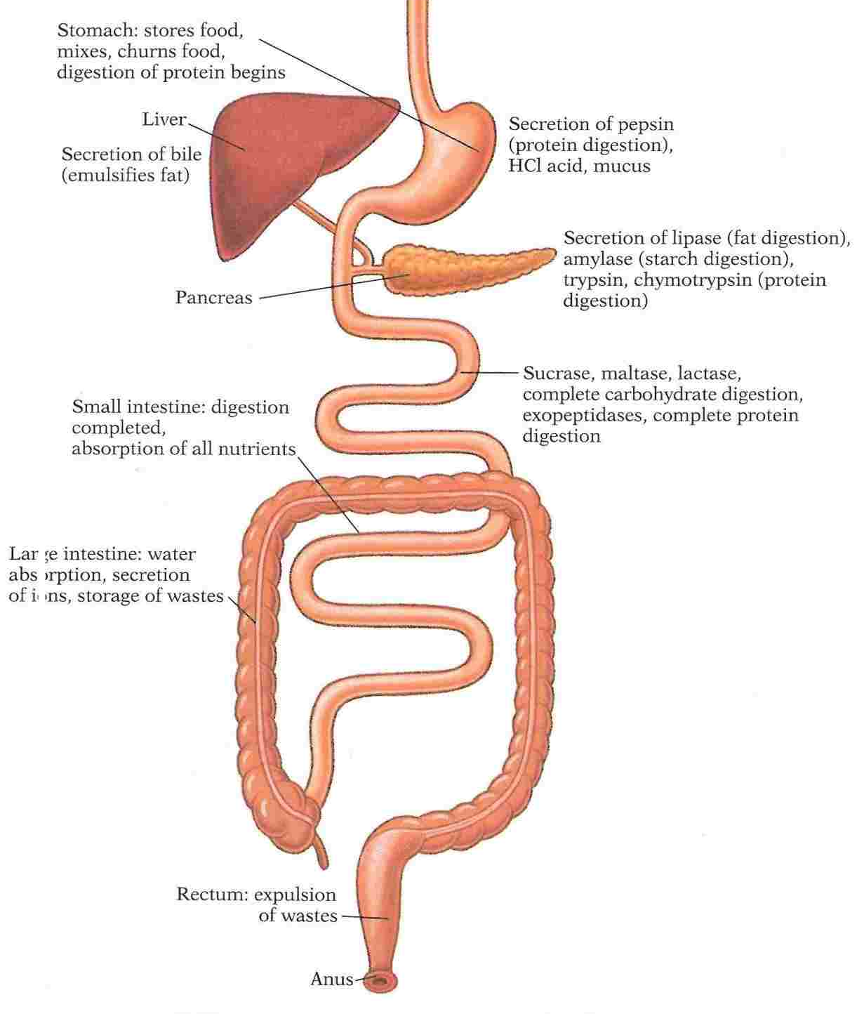
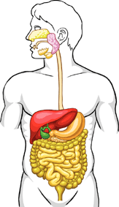
The Digestive System
stomach
liver
Where is the small intestine?
pancreas
Simplified and spread out …
enzymes carry out digestion here
small intestine
products of digestion are absorbed here
large intestine
small intestine
rectum
anus

Slide 11
The Small Intestine
The small intestine is very long, providing plenty of time for food molecules
to be absorbed into the blood
The lining of the small intestine is highly folded into finger-like structures called villi
The large number of villi creates a large surface area for the efficient absorption of nutrients
Each villus is thin-walled and contains a capillary network with a rich blood supply
These are also adaptations for efficient absorption of nutrients
A section (slice) through the small intestine

Slide 12
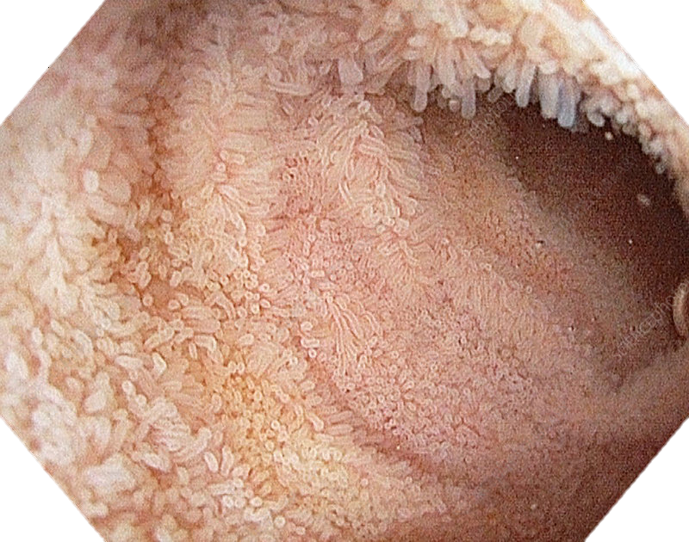

Slide 13
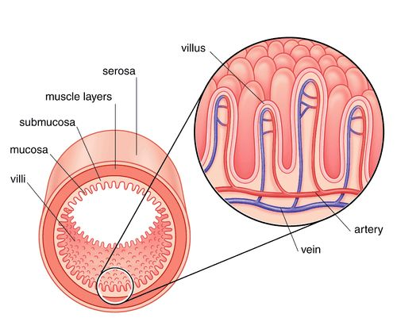
The Role of Villi
Food molecules enter the villus by diffusion and are carried away by the blood
food molecules
Each villus is made of a thin layer of lining (epithelial) cells, specialised cells with folded membranes to increase their surface area even more
Each villus contains a capillary network to absorb glucose, and a lacteal (part of the lymphatic system) to absorb fatty acids and glycerol

Slide 15
(Combines to) form oxyhemoglobin
Alveolus
Trap dirt and microbes/micro-organisms and prevent entry into the lungs
Moist Lining/Thin Walls
Sweep mucus from trachea out of lungs to mouth
Allows gases to diffuse easily and efficiently.
D → A → C → B
Red blood cells

Slide 17
large
soluble
blood
small intestine
100
As level of exercise increases breathing rate increases
Inner lining folded/lining is one cell thick
Many villi
To increase reliability
Long

Slide 18
1.
3.
2.
4.

Slide 19
1.
3.
2.
has thin wall, large surface area, good blood supply/many capillaries (2)
Large number of villi which increases surface area (1)
4.

Slide 22
Alveolus/aveoli/air sac
Large surface area
Thin walls/walls are one cell thick
Good/rich blood supply/dense capillary network
Moist
Dirt/dust/microorganisms are trapped in the mucus
Cilla move these up and away from the lungs

