Slide 1
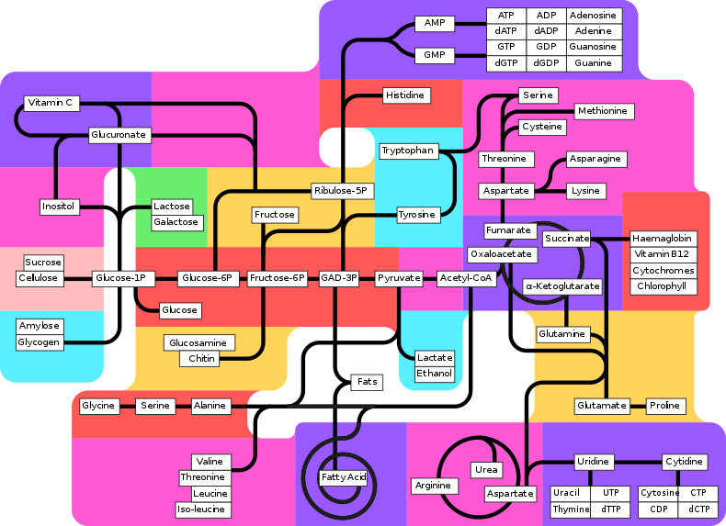
Higher Human Biology
M I S S M C B R I D E
Metabolic Pathways

Slide 2
C E L L M E T A B O L I S M
A cell's daily operations are accomplished through the biochemical reactions that take place within the cell.
Reactions are turned on and off or sped up and slowed down according to the cell's immediate needs and overall functions.
At any given time, the numerous pathways involved in building up and breaking down cellular components must be monitored and balanced in a coordinated fashion.
To achieve this goal, cells organise reactions into various enzyme-powered pathways.

Slide 3
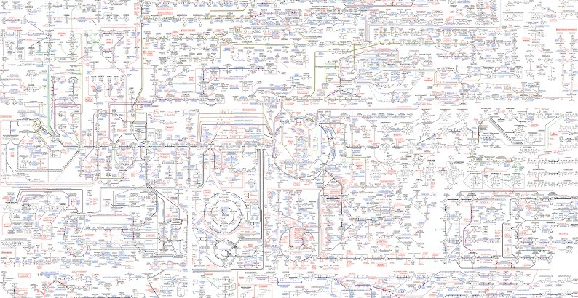
C E L L M E T A B O L I S M
Cell metabolism is the collective term for thousands of biochemical reactions that occur in a living cell.

Slide 4
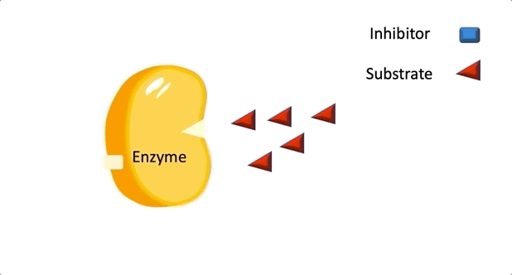
C E L L M E T A B O L I S M
The vast majority of these reactions are steps in a complex network of connected and integrated pathways which are catalysed by enzymes,

Slide 5
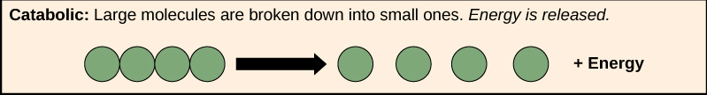
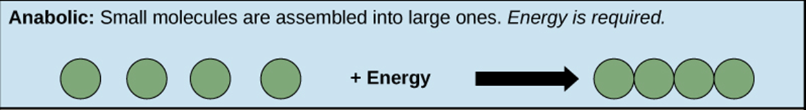
M E T A B O L I C P A T H W A Y S
Catabolic: bring about the breakdown of complex molecules; usually release energy
Anabolic: bring about the biosynthesis of complex molecules from simpler ones; require energy

Slide 6
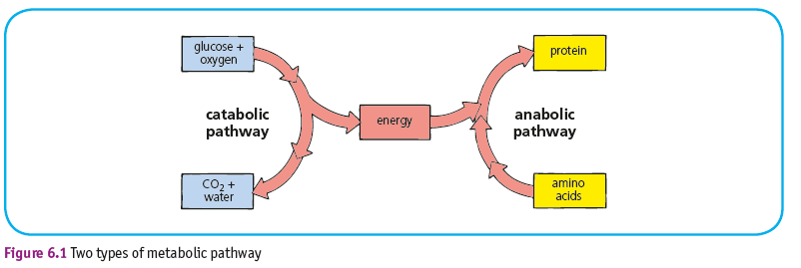
M E T A B O L I C P A T H W A Y S
One pathway often depends on the other: in this example the energy released in aerobic respiration (catabolism) is required to synthesise proteins (anabolism).

Slide 7
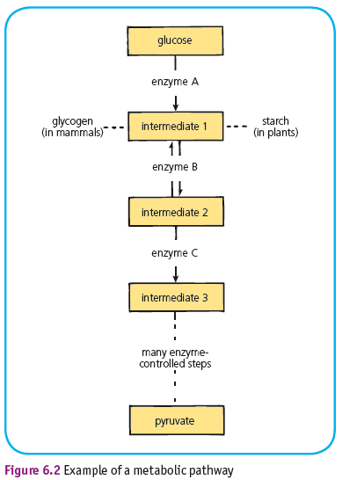
M E T A B O L I C P A T H W A Y S
This diagram shows the first 3 enzyme-controlled st3eps in a long pathway.
What do you notice about the arrows?

Slide 8
M E T A B O L I C P A T H W A Y S
Metabolic pathways can have reversible and irreversible steps.

Slide 9
M E T A B O L I C P A T H W A Y S
Look at this pathway… what is different?

Slide 10
M E T A B O L I C P A T H W A Y S
Metabolic pathways can also contain alternative routes which allow steps in the pathway to be bypassed.

Slide 11

M E T A B O L I C P A T H W A Y S
Metabolic pathways are integrated and controlled pathways of enzyme-catalysed reactions within a cell.
Metabolic pathways can have reversible steps, irreversible steps and alternative routes.
Reactions within metabolic pathways can be anabolic or catabolic. Anabolic reactions build up large molecules from small molecules and require energy. Catabolic reactions break down large molecules into smaller molecules and release energy.

Slide 12
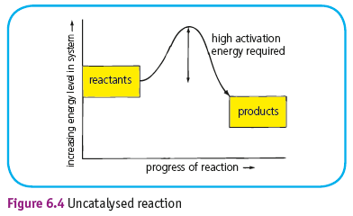
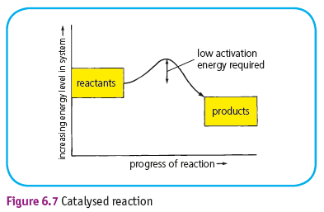
A C T I V A T I O N E N E R G Y & E N Z Y M E A C T I O N
Enzymes serve to lower the activation energy needed for a reaction to proceed.

Slide 13
E N Z Y M E S
Enzymes are biological catalysts, they:
_________ the activation energy required for a chemical reaction to proceed.
____________the rate of reactions.
Remain ___________ at the end of the reaction.
Are made of ___________.
Have an _______________on their surface.
Are ____________ to one substrate.
Shape of active site is __________________ to shape of substrate (lock & key).
Word bank: active site protein complementary lower speed up unchanged specific

Slide 14
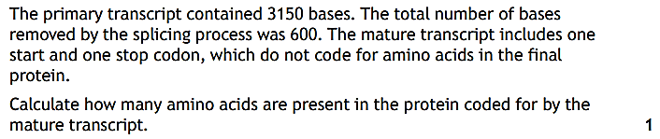
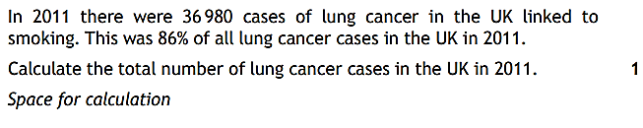
S T A R T E R A C T I V I T Y
1.
2.
3.

Slide 15
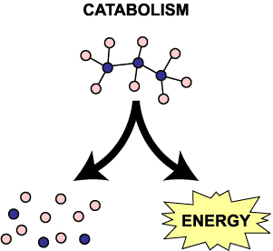
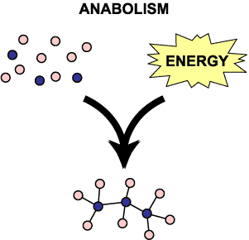
R E C A P
Metabolism is all the chemical reactions taking place within a cell.
A metabolic pathway is a series of chemical reactions occurring in a cell.
These reactions are controlled by enzymes.
Metabolic pathways can have reversible and irreversible steps and alternative routes.

Slide 16
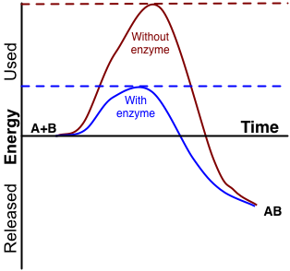
A C T I V A T I O N E N E R G Y
The presence or absence of particular enzymes will affect the rate at which the pathway proceeds.
The regulation of the rate of reaction of key enzymes within the pathway will also affect the pathway as a whole.
The energy needed to allow a reaction to occur is called the activation energy.
The activation energy is lowered when an enzyme is used.

Slide 17
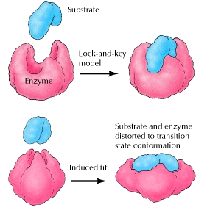
I N D U C E D F I T M O D E L
The lock and key mechanism of enzyme action states that the substrate fits into the enzyme like a key into a lock.
A better explanation of enzyme action is the induced fit model.

Slide 18
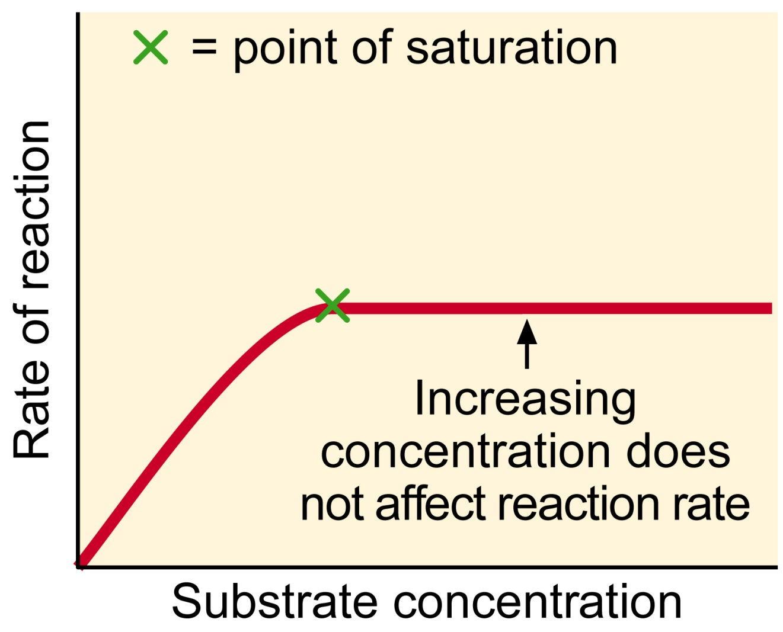
E N Z Y M E A C T I V I T Y
The maximum activity of an enzyme can be found by increasing the substrate concentration, eventually the enzyme cannot work any faster.

Slide 19
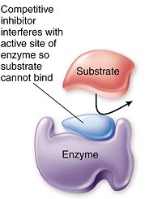
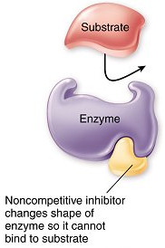
E N Z Y M E I N H I B I T O R S
Inhibitors reduce the rate of enzyme activity.
They work in one of two ways:
  Competitive
  Non-competitive

Slide 20
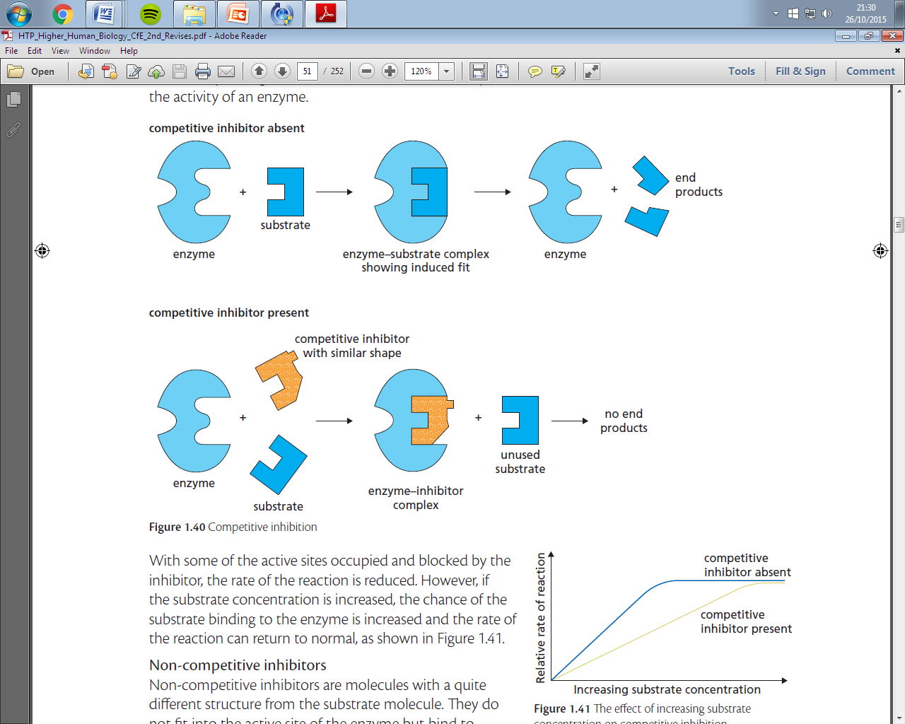
A competitive inhibitor resembles the shape and size of the substrate.
It binds to the active site of the enzyme blocking the entry of the real substrate, slowing the rate of the reaction.
If the substrate concentration continues to increase, the inhibitor is diluted.
It is reversible.

Slide 21
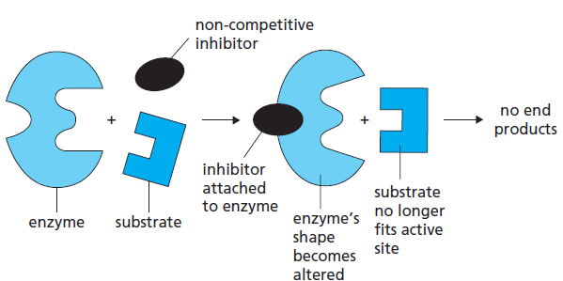
A non-competitive inhibitor binds to another part of the enzyme away from the active site.
This causes the shape of the enzyme to change so the substrate can no longer bind.
This inhibitor is permanent.

Slide 22
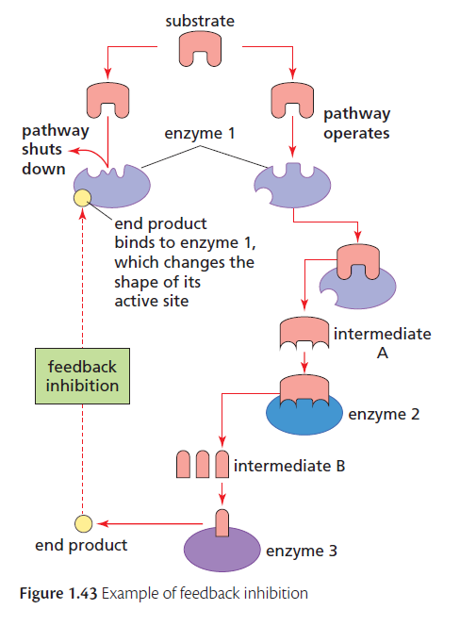
Feedback inhibition involves regulating the output of a pathway according to the amount of its product.
It avoids the wasteful conversion of the intermediates in the pathway, this is a form of negative feedback.

Slide 23

C O U R S E S P E C N O T E S
Metabolic pathways are controlled by the presence or absence of particular enzymes and the regulation of the rate of reaction of key enzymes.
Induced fit and the role of the active site of an enzyme in affecting activation energy and the affinity of the substrate and products for the active site. Induced fit occurs when the active site changes shape to better fit the substrate after the substrate binds.
The substrate molecule(s) have a high affinity for the active site and the subsequent products have a low affinity allowing them to leave the active site.
Some metabolic reactions are reversible and the presence of a substrate or the removal of a product will drive a sequence of reactions in a particular direction.
Competitive inhibitors bind at the active site preventing the substrate from binding. Competitive inhibition can be reversed by increasing substrate concentration.
Non-competitive inhibitors bind away from the active site but change the shape of the active site preventing the substrate from binding. Non-competitive inhibition cannot be reversed by increasing substrate concentration.
Feedback inhibition occurs when the end- product in the metabolic pathway reaches a critical concentration. The end-product then inhibits an earlier enzyme, blocking the pathway, and so prevents further synthesis of the end-product.

Slide 24

K E Y T E R M S
METABOLIC PATHWAY
CATABOLIC
ANABOLIC
INDUCED FIT
AFFINITY
COMPETITITVE INHIBITORS
NON-COMPETITIVE INHIBITORS
FEEDBACK INHIBITION
Definition page at the back of your jotter.
This will help you make flash cards at some point in the future!

Slide 25
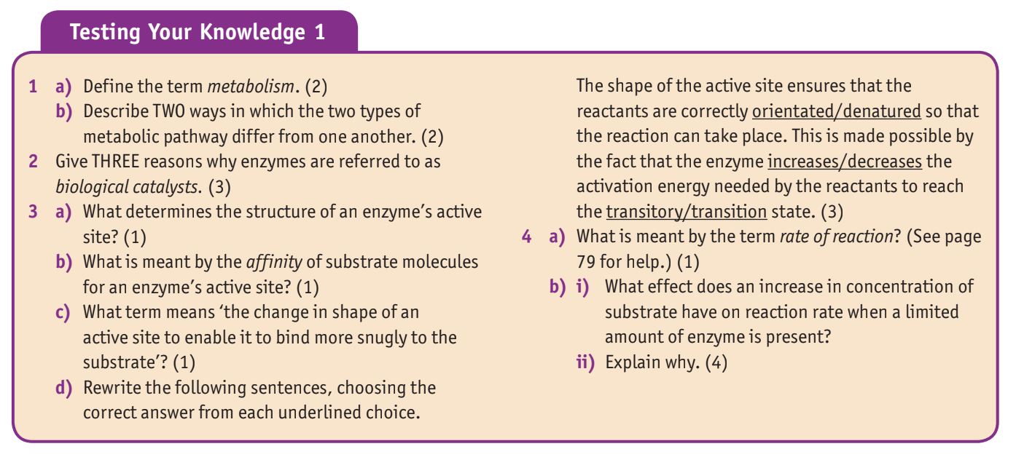

T E X T B O O K Q U E S T I O N S
Answer the textbook questions on page 85 in full sentences.

