Slide 1
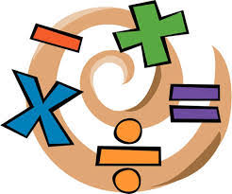
Learning Intention:
We are learning about the endocrine system and the role of different hormones in our bodies.
Success Criteria:
Be able to state where hormones are produced.
Describe the series of events that take place if blood sugar level increases above normal.
Describe the series of events that take place if blood sugar level decreases below normal.
Numeracy
Communication
MESPS Wellbeing
Literacy
Leadership

Slide 2
Hormonal Control
When a muscle responds to a stimulus it is very rapid eg. the eyeblink reflex
A gland responds slowly to a stimulus by releasing a hormone
Hormones are chemical messengers, released by an endocrine gland
They are carried in the blood stream to target tissues
Target tissues have cells with complementary receptor proteins that match the specific hormone
Only the target tissue will be affected by the hormone
hormone binds to receptor
hormone
receptor protein

Slide 3
Endocrine Glands
pituitary gland
Endocrine glands release hormones
The ovaries in females and testes in males are endocrine glands
They release sex hormones that control the menstrual cycle and sperm production
The pancreas is an endocrine gland that releases the hormones insulin and glucagon to control blood sugar
You may also have heard of adrenal, pituitary and thyroid glands
thyroid gland
adrenal gland
pancreas
ovary
testis

Slide 4
Hormones
chemical messengers
changes
body
endocrine glands
blood
target cells

Slide 5
HORMONES
NERVOUS SYSTEM

Slide 6
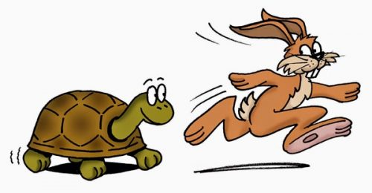
Cells in the body need to send signals to one another to ensure that all the organ systems function
What are the two ways signals are sent around the body?
Nerve impulses
Hormones
Which method is fast, and which is slow?

Slide 7
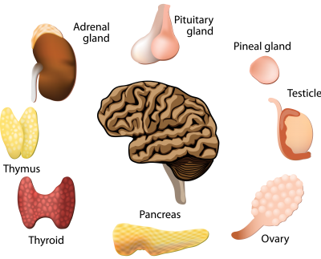
Starter
Can you name any hormones?
- Do you know what they do?
- Do you know where they are made?

Slide 8
Recap! What are hormones made of?
(SHARE)
PROTEIN
They are produced by endocrine glands and carried in the blood to their target tissue.
Target tissues contain cells that have complimentary receptors that can bind the hormone.
Any cells without hormone receptors will not be affected by the hormone.
How do your hormones work? - Emma Bryce - YouTube

Slide 9
Copy into your notes!
receptor

Slide 10
Hormone Production
Hormone Carried In Blood
Hormone Binds to Receptor on Target Cell
Target Cell Performs Function

Slide 11
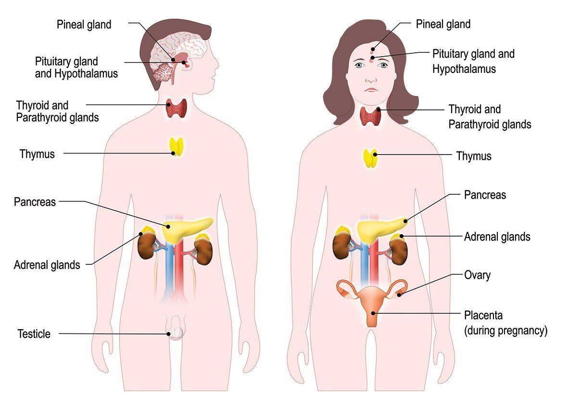
Hormones control:
Growth
Sexual development
Sugar levels
Mood
Metabolism
Feelings of being disconnected, loneliness, and depression can all stem from imbalanced hormones….levels of cortisol ("the stress hormone"), progesterone, oestrogen, androgens / testosterone, and thyroid function when mood changes occur

Slide 12
The endocrine (hormone) system
The endocrine system is the collection of glands that produce hormones that regulate metabolism, growth and development, tissue function, sexual function, reproduction, sleep, and mood, among other things.

Slide 13
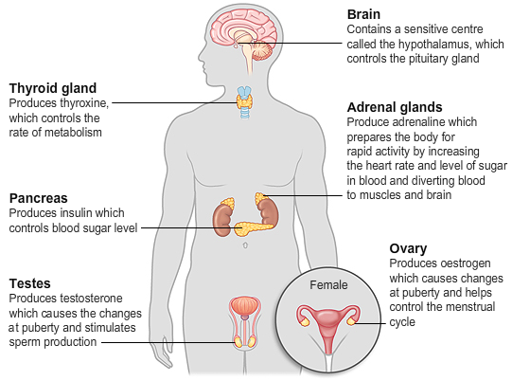
Where are hormones produced?
Can you name any parts of the endocrine system?
1
2
3
6
4
5
Notes:
Thyroid, ovaries, testes, pancreas, kidneys, pituitary gland
The endocrine system is the collection of glands that produce hormones that regulate metabolism, growth and development, tissue function, sexual function, reproduction, sleep, and mood, among other things.

Slide 14
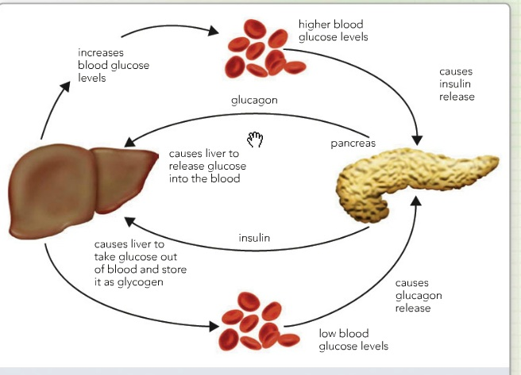
Blood Sugar Regulation

Slide 15
Recap! 1. What is glucose? 2. Why do we need glucose?
Sugar
For Respiration
(energy!)

Slide 16
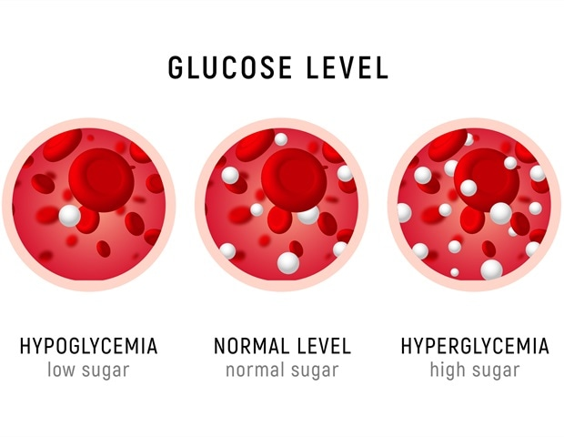
Blood Glucose Concentration

Slide 17
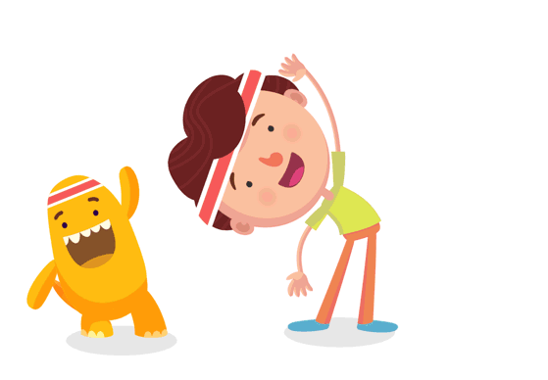
What changes our blood sugar levels?
Eating
Exercising
Blood sugar levels

Slide 18
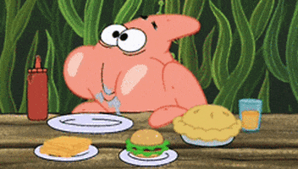
How does your body respond to changes in blood sugar levels?
Lets start with when your blood sugar levels increase…
Eating
Too much glucose (sugar) in the blood!

Slide 19
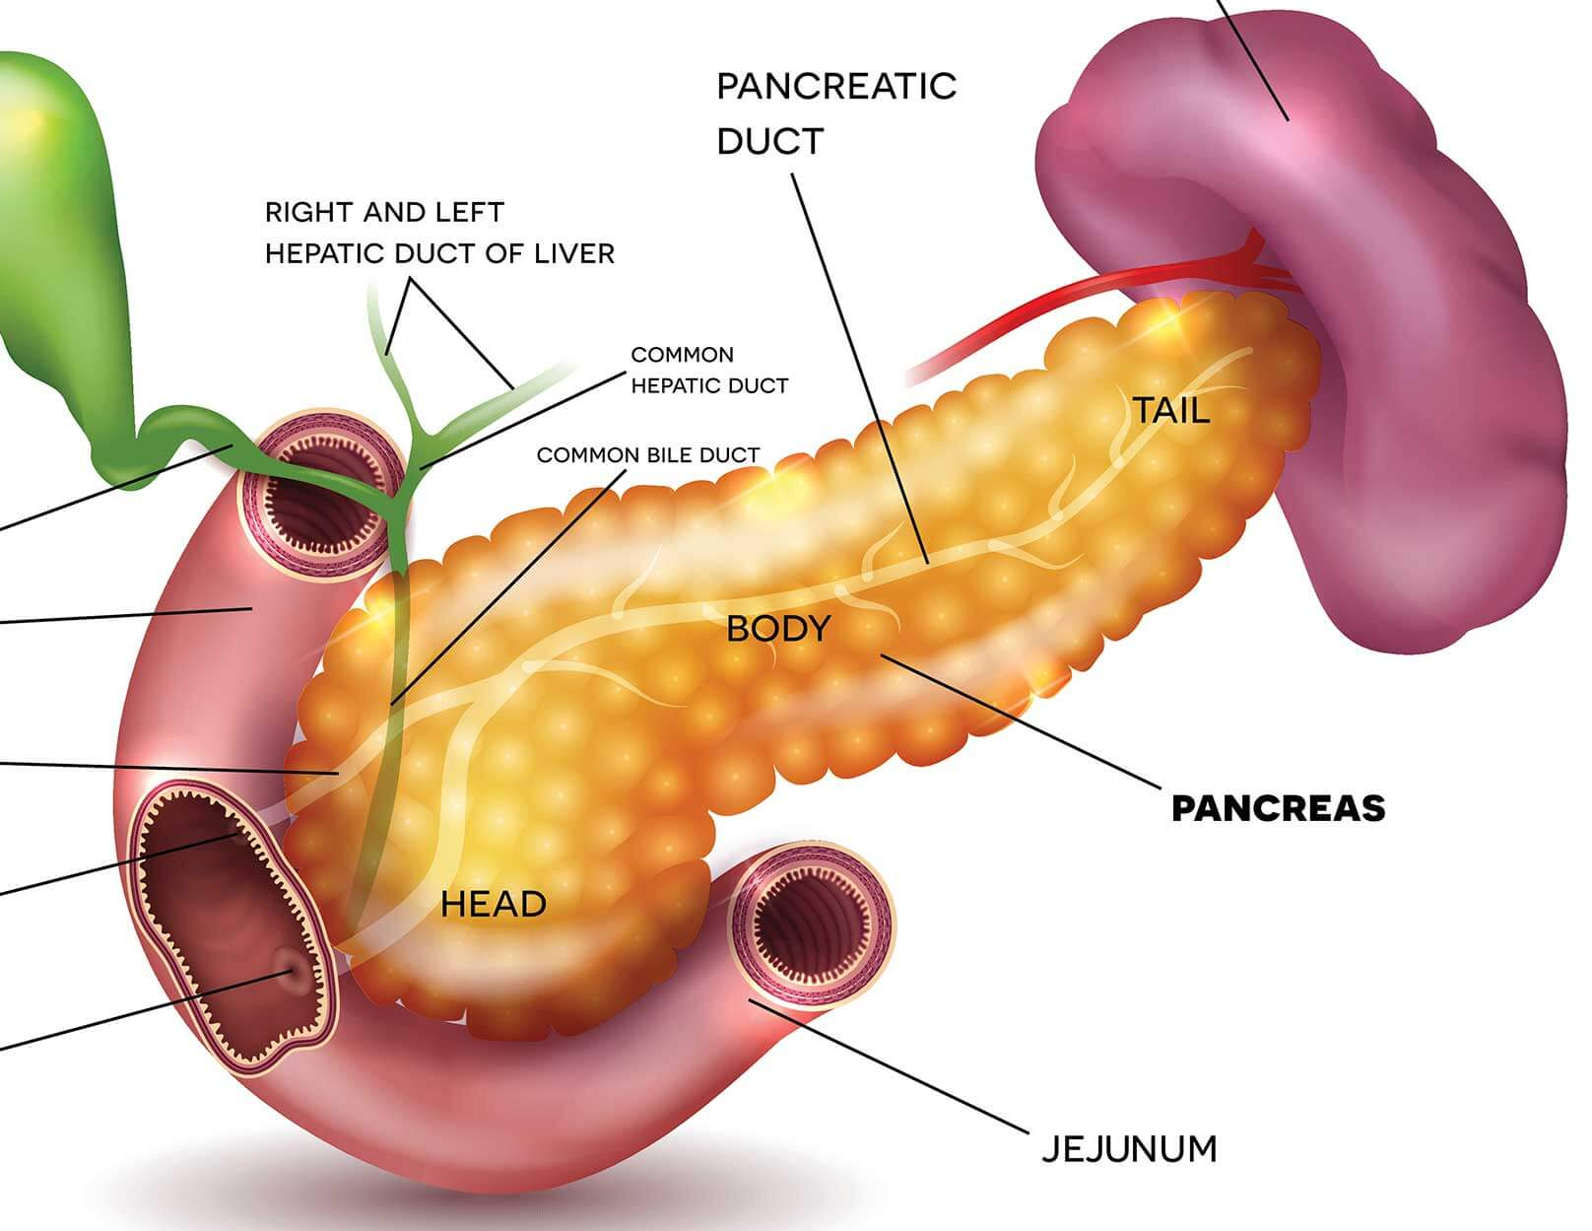
The pancreas detects changes in blood sugar levels.

Slide 20
INSULIN
(hormone)

Slide 21
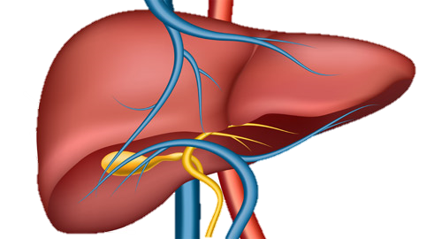
This insulin production from the pancreas stimulates the liver to take glucose out of the blood.
Glycogen
Glucose

Slide 22
What if your blood sugar level was to decrease…
Exercising
Too little glucose (sugar) in the blood!

Slide 23
The pancreas detects changes in blood sugar levels.

Slide 24
How to remember… glucose is GONE from the blood, so glucaGON is produced.
Glucagon
(hormone)

Slide 25
This glucagon production from the pancreas stimulates the liver to change glycogen back into glucose and release back into the blood.
Glycogen
Glucose

Slide 26
Copy this diagram into your jotters!
Insulin
Glucose
Glycogen
Glucagon

Slide 27
Blood glucose too high
Increase in blood glucose recognised by pancreas
Pancreas produces insulin which enters the blood
Insulin allows glucose to be stored in liver cells as glycogen
Blood glucose returns to normal

Slide 28
Blood glucose too low
Decrease in blood glucose recognised by pancreas
Pancreas produces glucagon which enters the blood
Glucagon allows glycogen in the liver cells to be broken down into glucose.
Blood glucose returns to normal

Slide 29
Knowledge check!
What are the two hormones involved in blood glucose regulation?
Insulin and Glucagon
What two organs are involved?
Liver and Pancreas
Which organ detects changes in blood glucose level?
Pancreas
What does the liver store glucose as?
Glycogen

