Slide 1
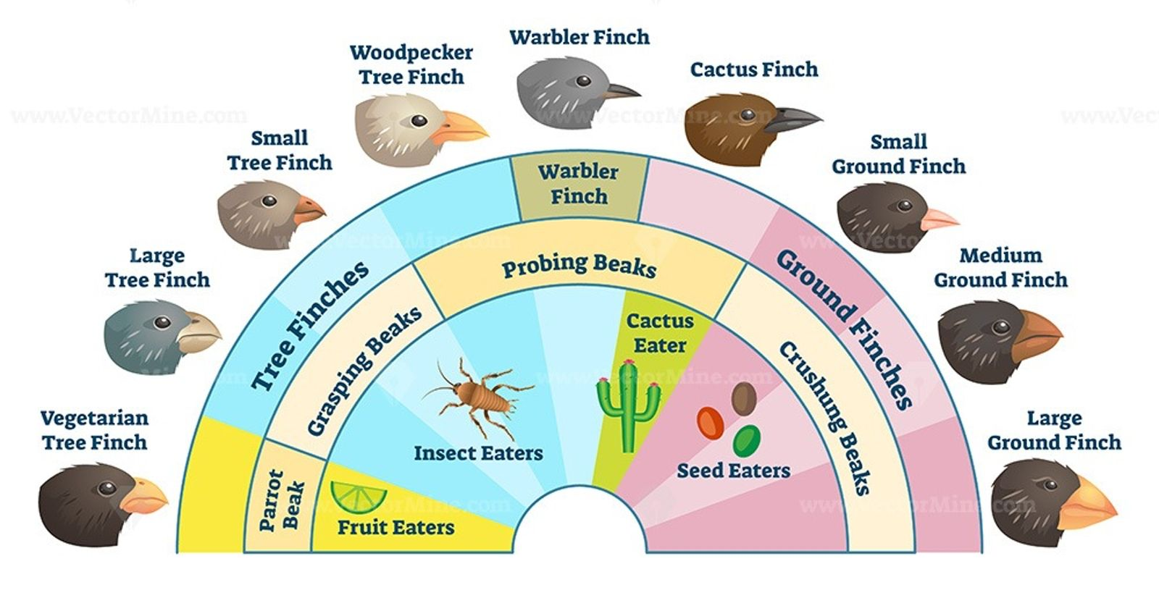
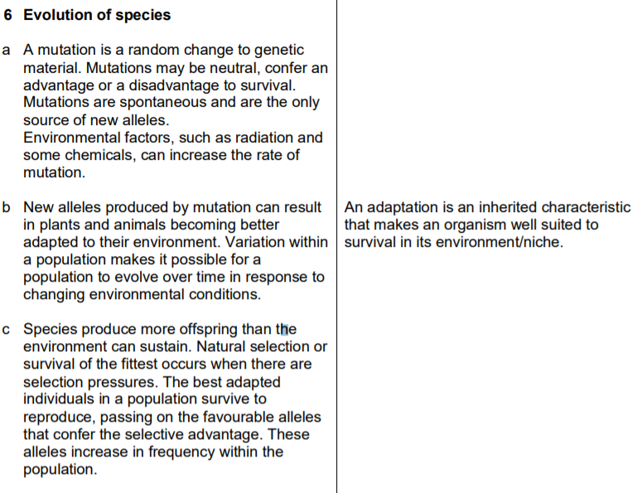
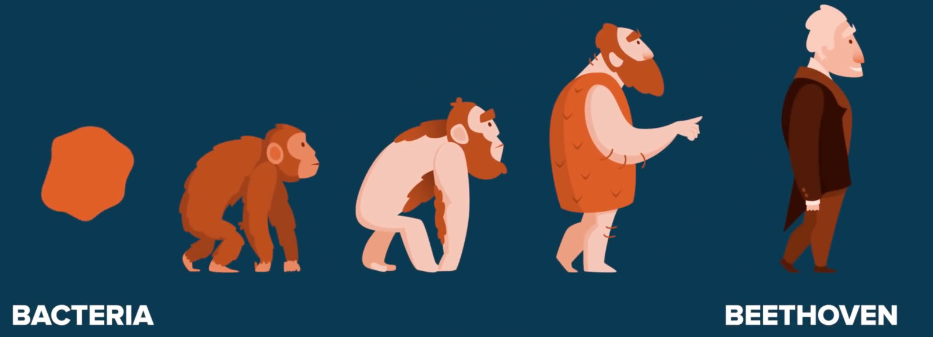
3.6 Evolution of Species

Slide 2
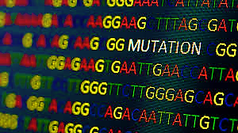
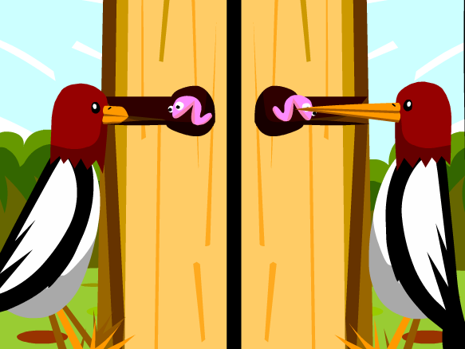
Mutations
A mutation is a random change to genetic material.
Mutations may be neutral, confer an advantage or a disadvantage to survival.
Mutations are spontaneous and are the only source of new alleles.
This bird had a mutation that made his beak extra long- helpful!

Slide 3
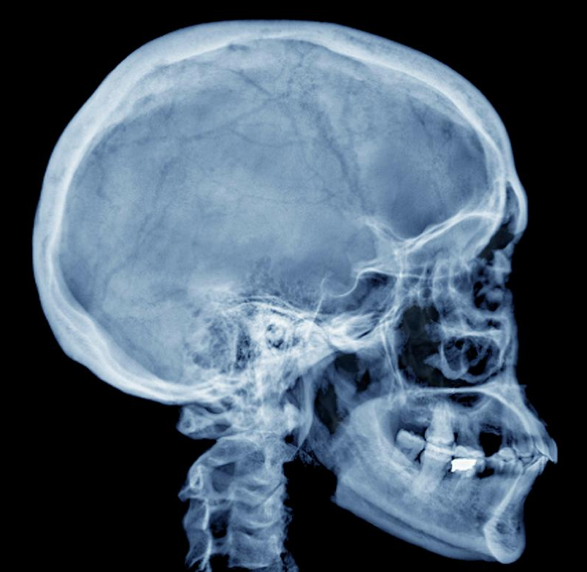
Mutations
Environmental factors, such as radiation, x-rays and some chemicals, can increase the rate of mutation.
There is a particular mutation relatively common on the Indian subcontinent which predisposes people to heart disease. Many other diseases, such as cancer, diabetes and asthma, are linked to genetic mutations.
Lets have a look at some advantageous mutations…

Slide 4
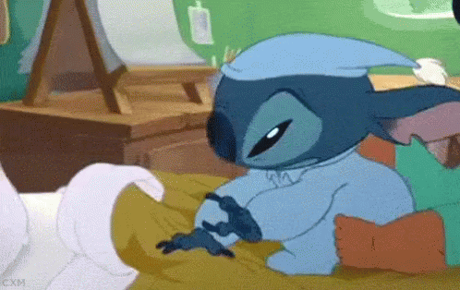
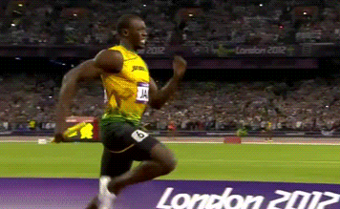
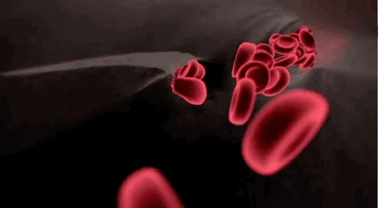
Super-sleeper mutation
It was discovered that some people contain the mutation that allows them to feel totally energised on just 4 hours of sleep each night.
Super-sprinter mutation
We all have this gene called ACTN3 but a mutation to this gene created a protein that controls fast-twitch muscle fibres, the cells responsible for the speedy tensing and flexing of the muscles involved in sprinting or weight-lifting. Athletes were found to have this, therefore it was called ‘the sports gene.
The malaria-protecting mutation
People who are carriers for sickle-cell disease - meaning that they have one sickle gene and one normal haemoglobin gene - are more protected against malaria than those who are not.

Slide 5
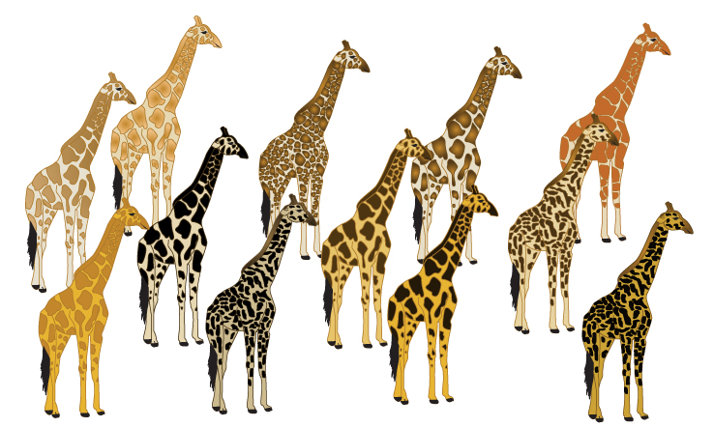
Variation
Although members of a species have many features in common they are not identical to each other.
Variation occurs as a result of mutations that create new alleles of genes.
New alleles produced by mutations can result in plants and animals becoming better adapted to their environment.
Variation within a population makes it possible for a population to evolve over time in response to changing environmental conditions.

Slide 6
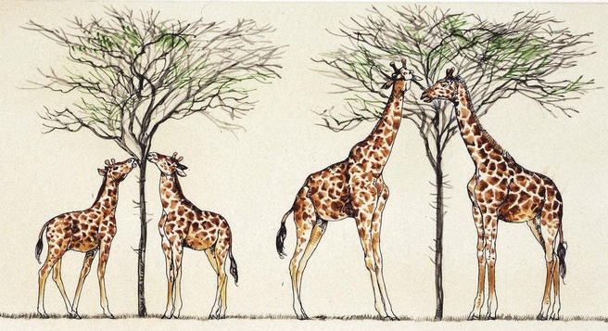
Natural Selection in Action
Explain how long necks evolved in giraffes…
There is variation within the giraffe population
More giraffes are born than can be supported by the environment
3. They compete for food (selection pressure) - the best adapted giraffes with long necks can reach the highest branches and survive (‘survival of the fittest’)
4. They breed and pass on the alleles for long necks to their offspring
5. The alleles for long necks occur more frequently in the next generation
6. Over time, the giraffes change (evolve) to become long necked

Slide 7
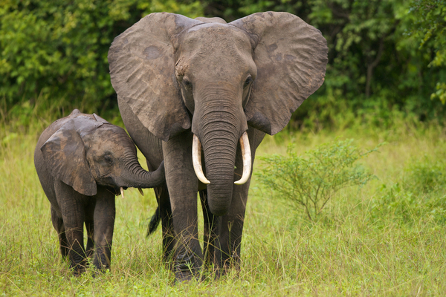
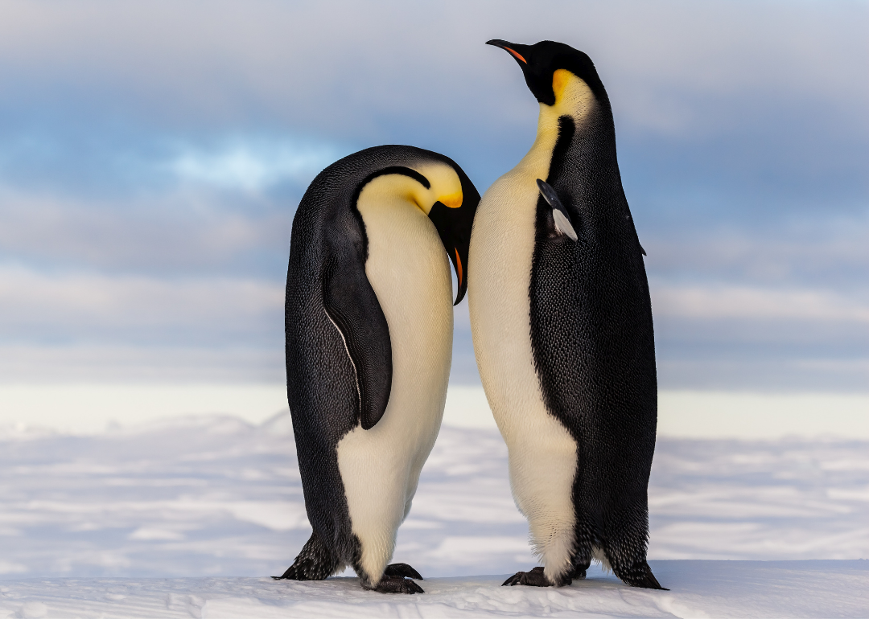
Adaptation
An adaptation is an inherited characteristic that makes an organism well suited to survival in its environment.
3
t
y
p
e
s
Move in herds to protect young, elderly etc from lions and tigers.
Rest eggs on their feet to stop the egg form getting cold on the ice. Helps eggs survive in cold weather.
Behavioural:
Structural:
Trunk long for tree tops and teeth made for grinding difficult branches.
Flipper shaped wings & feet against body for steering means they swim efficiently.
Blood vessels in their ears work as a cooling system.
Only send blood to their feet every now and again. Keep warm and conserve energy.
Physiological:

Slide 8
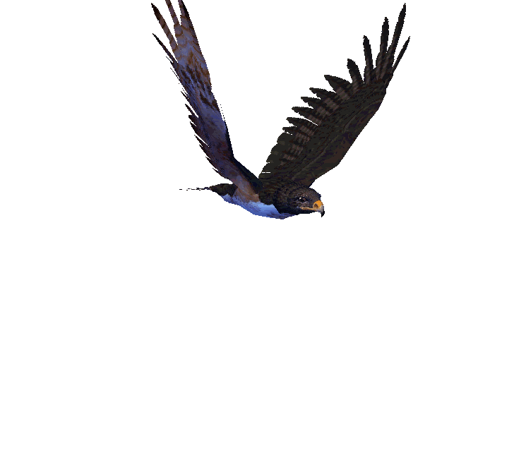
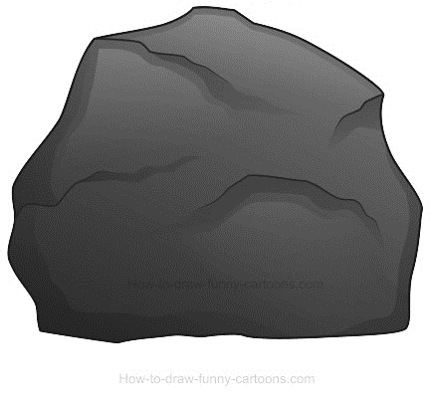
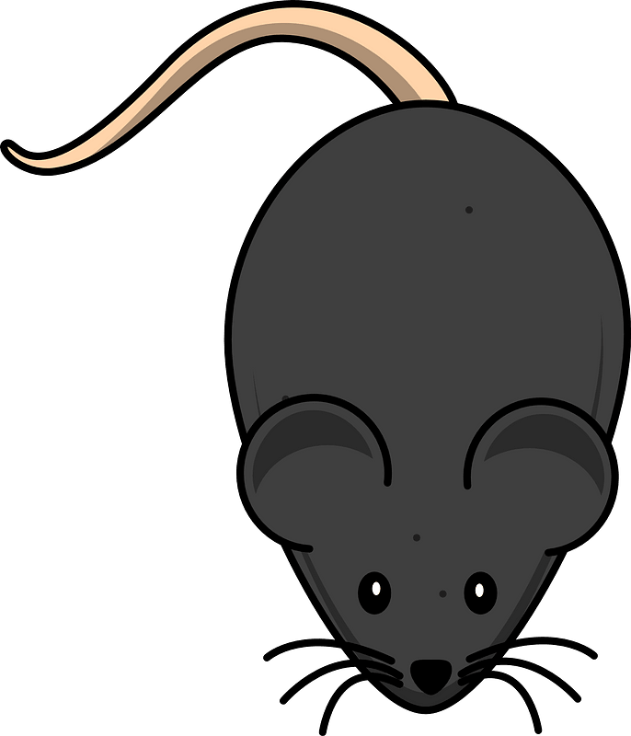
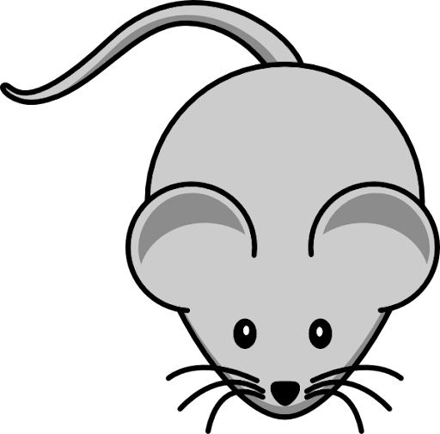
Adaptation
Watch what happens…

Slide 9
Adaptation
4. The next generation contains fewer grey mice, as they are less well adapted, and more black ones which have favourable adaptations, allowing them to survive and breed
There is variation in the population – some mice are black and some are grey.
More offspring are produced than the environment can support and individuals compete for survival.
The population is under pressure from a predator- a hawk!
Those less well adapted die out and do not reproduce and pass on their alleles. (The grey mice are less well camouflaged, and are eaten by the hawk, or maybe they taste better…)
5. The process continues over many generations, until all mice carry the advantage – the species has evolved (changed)

Slide 10
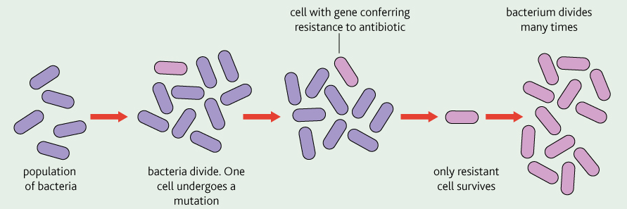
High Speed Evolution
The development of antibiotic resistance is another example of high speed evolution…
Over-prescription of anti-biotics exerts a selection pressure on bacteria, and they mutate and evolve. Many of our anti-biotics are now useless against ‘super bugs’ such as MRSA.

Slide 11
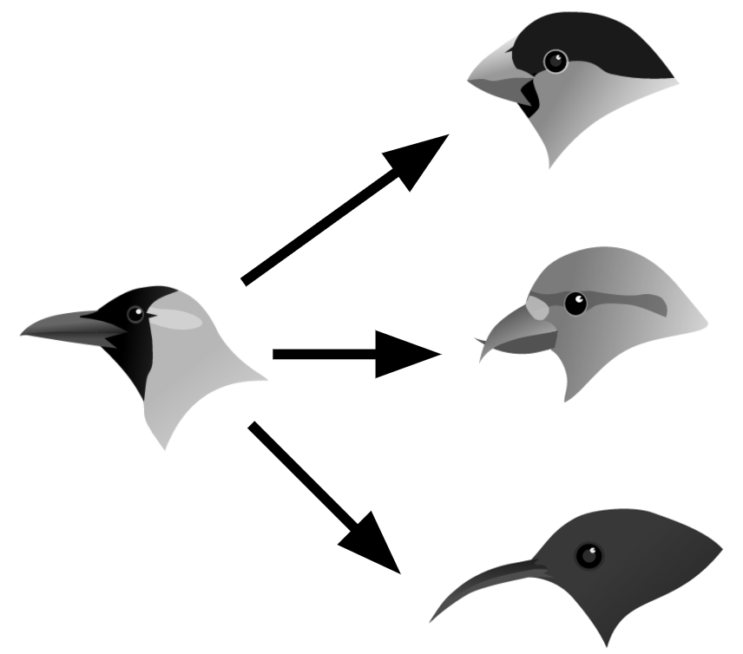
Speciation
Speciation is the production of a new species.
Evolution is the mechanism by which speciation occurs.
It involves changes to:
the genes present
the characteristics shown by the members of a population.
It allows the organisms to better exploit their environment.

Slide 12
Speciation
Speciation can occur if a breeding population becomes separated into 2 smaller populations by an isolation barrier
This population is able to breed freely and exchange alleles
Geographical (physical) barrier
These 2 smaller populations can no longer meet, breed and exchange genes
as they can’t cross the barrier
These fish can still meet, but fail to breed for a different reason – either ecological or behavioural

Slide 13
Geographical Barriers
A population becomes divided by a geographical barrier such as a mountain range, river or desert
A mutation may occur in one sub-populations which
can’t pass to the other sub-population
Natural selection acts on the different mutations on either side of the barrier
Selection pressures are different on different sides of the barrier *
*
N facing slope
*
S facing slope
Each sub-population evolves until they are so genetically different that they become 2 different species. They cannot breed if re-united.

Slide 14
Ecological Speciation
This occurs when 2 sub-populations live in the same area and could technically meet and breed, but they don’t as they live in different areas of the habitat
For example:
Hot and cold areas of the habitat
Humid and dry
Different pH (different soil types)
Salinity (how salty it is)
Altitude
These differences in ecological conditions act as barriers and prevent exchange of genes, stop mutations spreading to the other sub-population and each area has different selection pressures, resulting in speciation

Slide 15
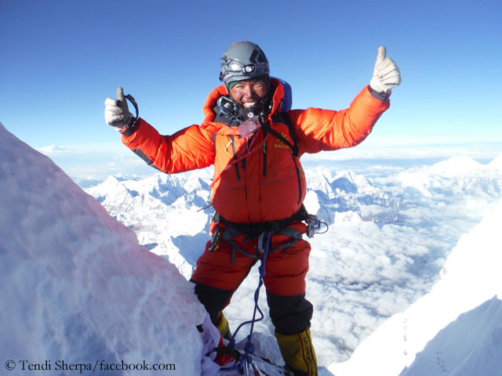
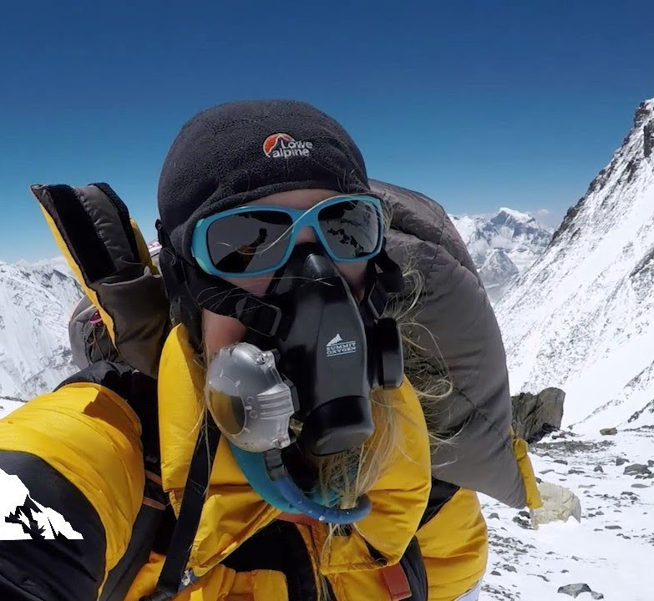
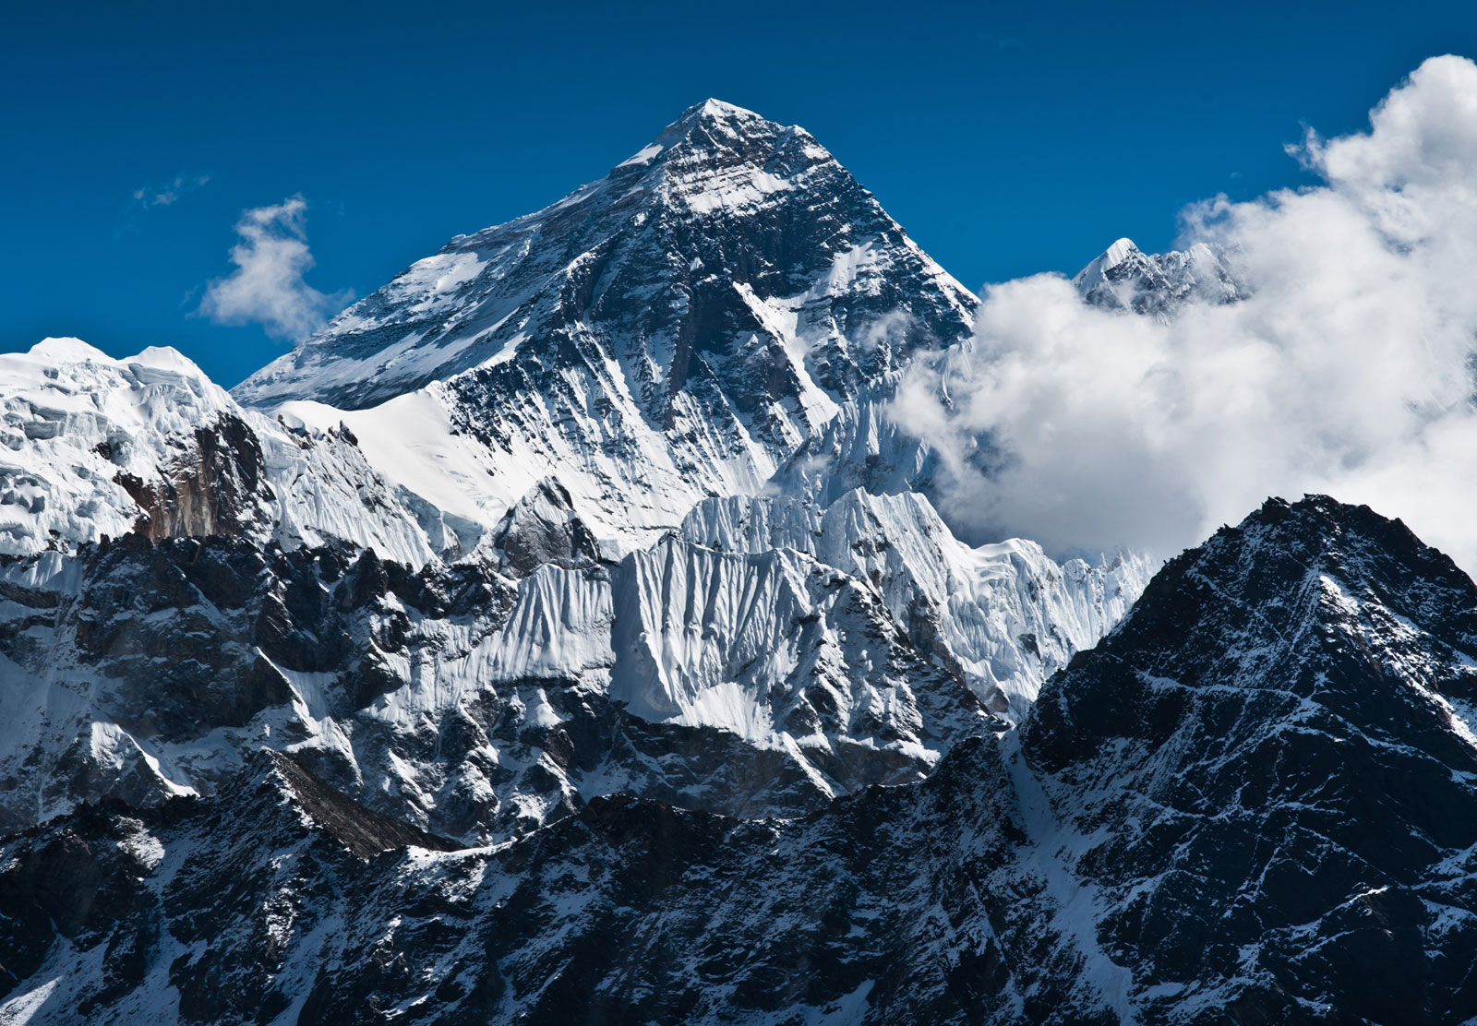
Human populations such as some Tibetans, South Americans and Ethiopians live in the otherwise uninhabitable high mountains of the Himalayas, Andes and Ethiopian Highlands.
The adaptation of humans to high altitude is an example of natural selection in action.
Most people require an oxygen mask to reach the summit of Mount Everest. Not the locals!

Slide 16
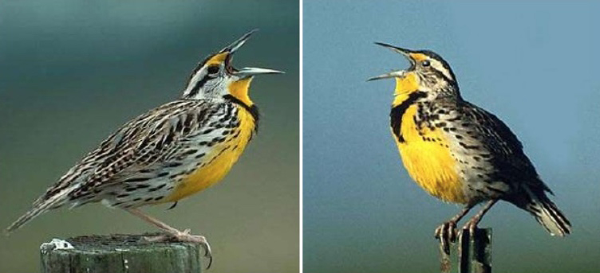
Behavioural Speciation
This occurs when 2 sub-populations live in the same area, and could
technically meet and breed, but they don’t due to changes in behaviour.
For example :
Different courtship behaviour (ie. how they attract a mate)
Diurnal/nocturnal – active at different times of day
Eastern and Western meadowlark
nocturnal and diurnal lizards
If they don’t breed, genes are not exchanged and they become isolated

Slide 17
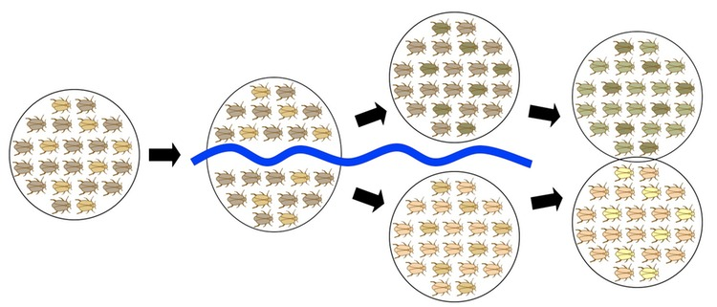
Speciation in Action
3
5
1
2
4
Original population of beetles
Original population separated into 2 sub-populations by a physical barrier (river)
Different selection pressures on either side of the barrier favour different alleles
Mutation occurs in one population creating new allele which is favoured by natural
selection and increases in frequency in the population
5. The 2 populations are so genetically different that they can’t breed when re-united –
speciation has occurred

