Slide 1
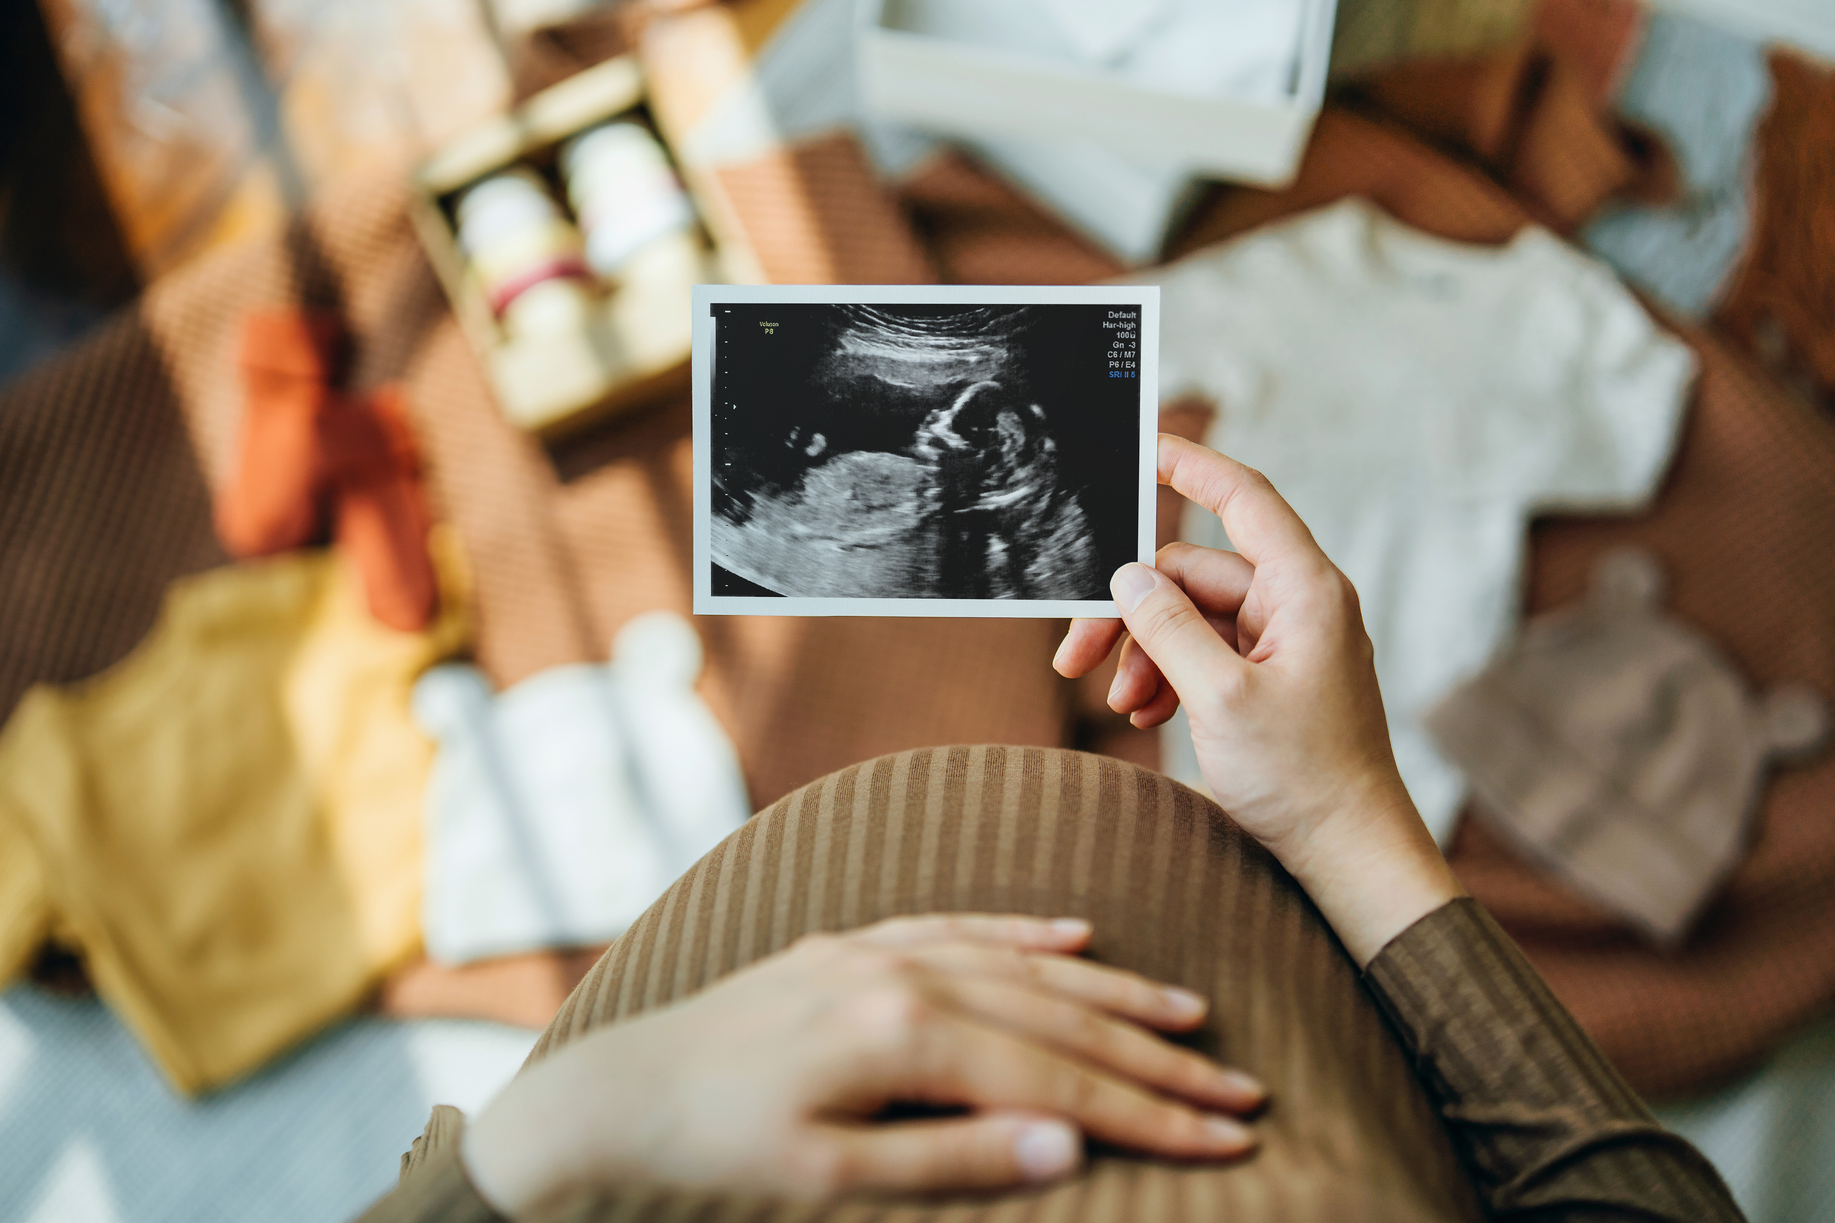
Higher Human Biology
2.4 Antenatal and postnatal screening

Slide 2
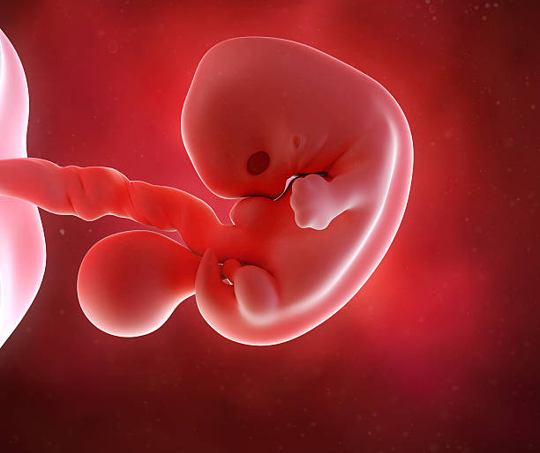
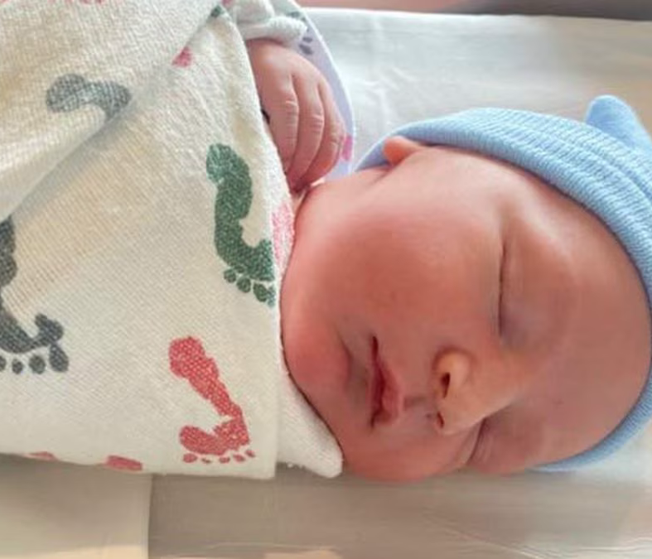
2.4 Antenatal and Postnatal screening
A variety of techniques can be used to monitor the health of the mother, developing fetus and baby.

Slide 3
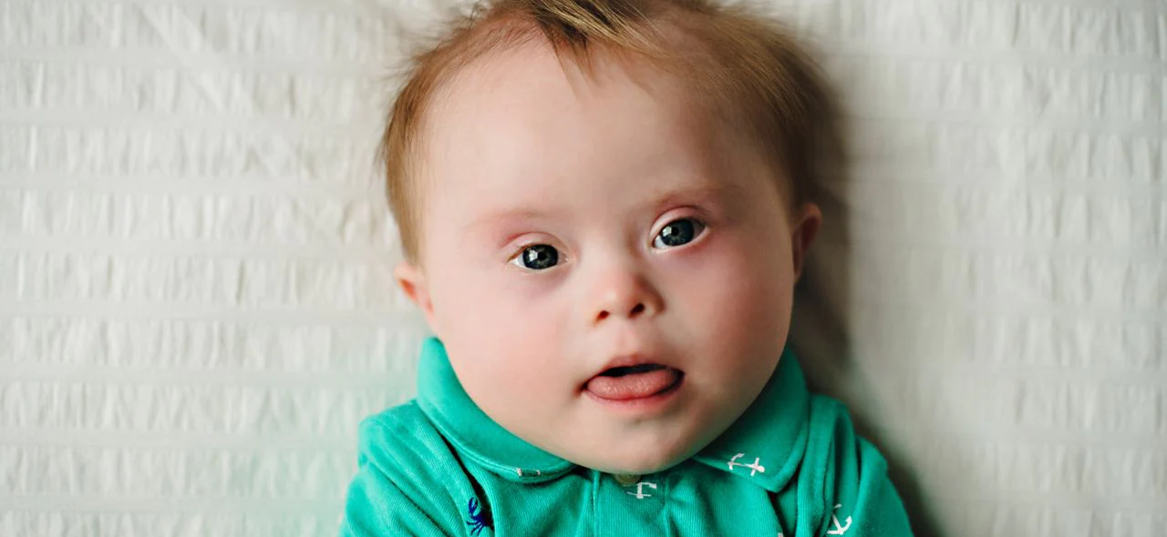
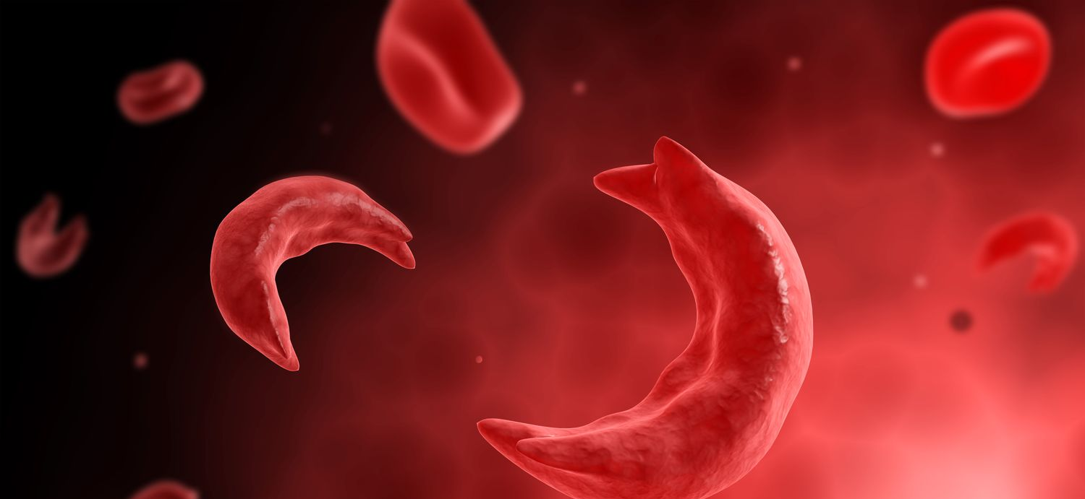
Antenatal screening
Antenatal screening identifies the risk of a disorder so that further tests and a prenatal diagnosis can be offered.
Down syndrome
Sickle Cell anemia

Slide 5
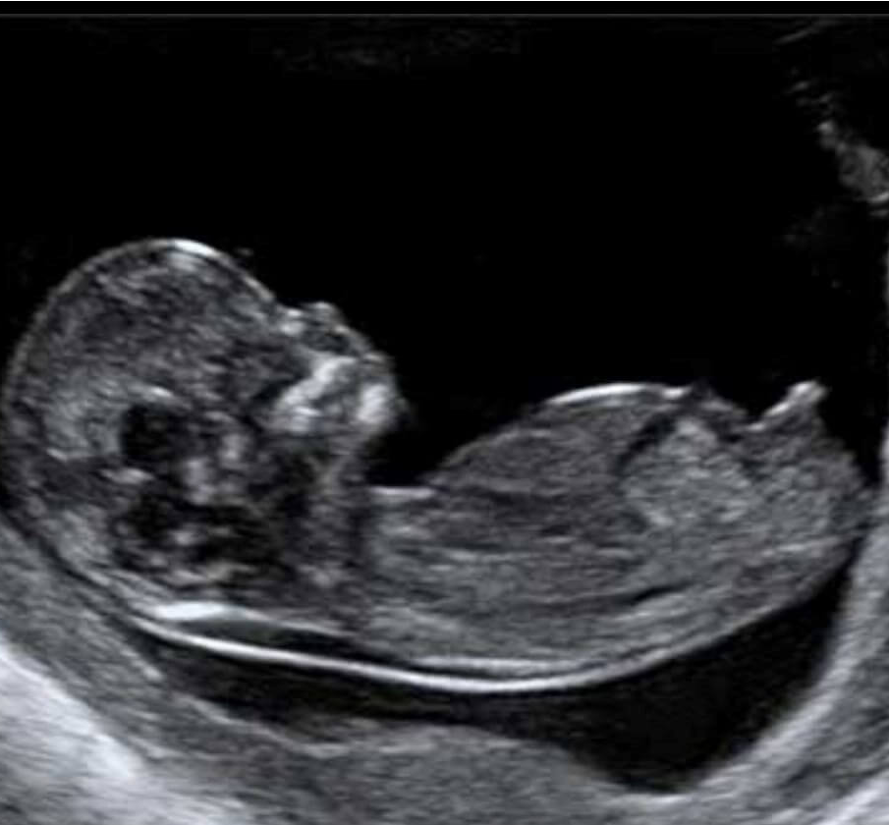
U L T R A S O U N D I M A G I N G
Pregnant women are given two ultrasound scans.
A dating scan takes place between 8 and 14 weeks
Anomaly scan between 18 and 20 weeks

Slide 6
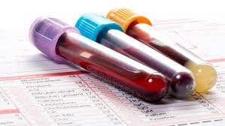
U L T R A S O U N D I M A G I N G
8-14 weeks
Dating scan determines:
Pregnancy stage
Due date
At the same time as the ultrasound scan is performed a sample of blood is taken.
There are two substances in your blood which are chemical markers of Down’s syndrome.

Slide 7
U L T R A S O U N D I M A G I N G
18-20 weeks
Anomaly scan determines:
Any serious physical abnormalities in the fetus.
It is offered to everybody, but you do not have to have it if you don’t want to.
The scan looks in detail at the baby’s bones, heart, brain, spinal cord, face, kidneys and abdomen.

Slide 8
U L T R A S O U N D I M A G I N G
18-20 weeks
Anomaly scan determines:
It allows the sonographer to look for 11 rare conditions.
anencephaly
open spina bifida
cleft lip
diaphragmatic hernia
gastroschisis
exomphalos
serious cardiac abnormalities
bilateral renal agenesis
lethal skeletal dysplasia
Edwards' syndrome, or T18
Patau's syndrome, or T13

Slide 9
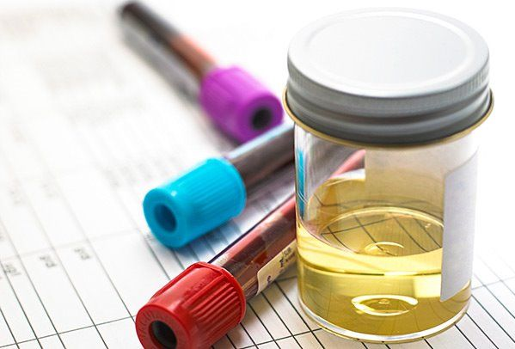
B L O O D A N D U R I N E T E S T S
Routine blood and urine tests are carried out throughout pregnancy to monitor the concentrations of marker chemicals.
Measuring a chemical at the wrong time could lead to a false positive result. An atypical chemical concentration can lead to diagnostic testing to determine if the fetus has a medical condition.

Slide 10
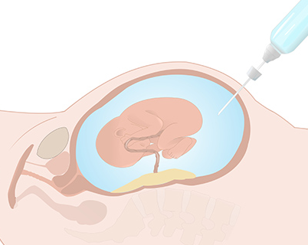
D I A G N O S T I C T E S T I N G
Amniocentesis
Test you may be offered during pregnancy to check if your baby has a genetic or chromosomal condition, such as Down’s syndrome, Edward’s syndrome or Patau’s syndrome.
It involves removing and testing a small sample of cells from amniotic fluid.
One of the main risks associated with amniocentesis is miscarriage.

Slide 11
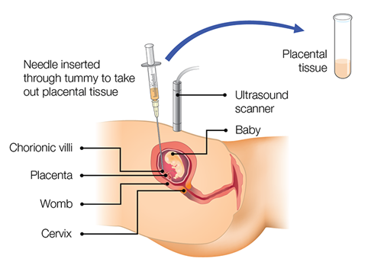
D I A G N O S T I C T E S T I N G
Chorionic villus sampling (CVS)
Can be carried out earlier in pregnancy than amniocentesis, although it has a higher risk of miscarriage.
It involves removing and testing a small sample of cells from the placenta.

Slide 12
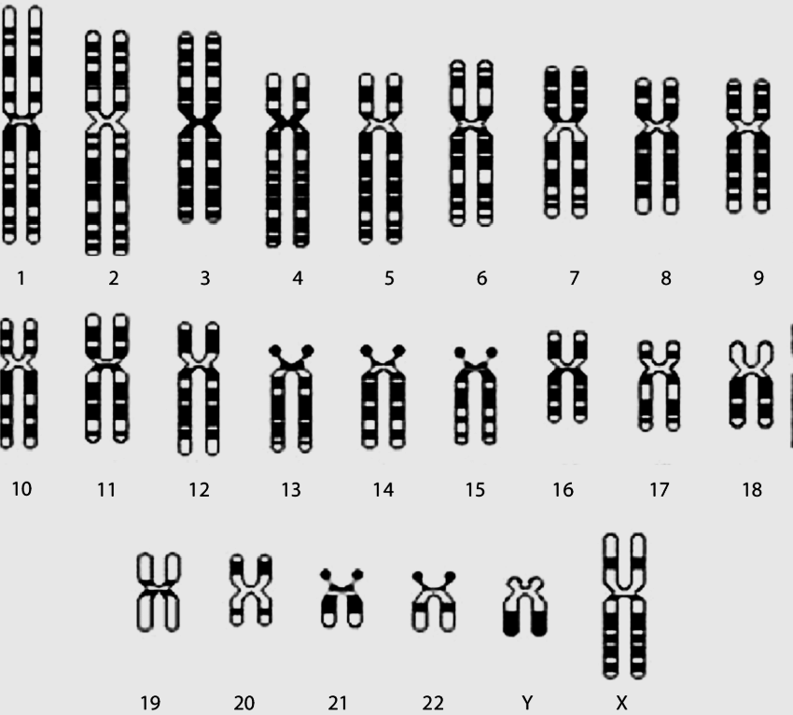
D I A G N O S T I C T E S T I N G
Cells from samples from amniocentesis and CVS can then be cultured to obtain sufficient cells to produce a karyotype to diagnose a range of conditions.
A karyotype shows an individual's chromosomes arranged as homologous pairs.

Slide 13
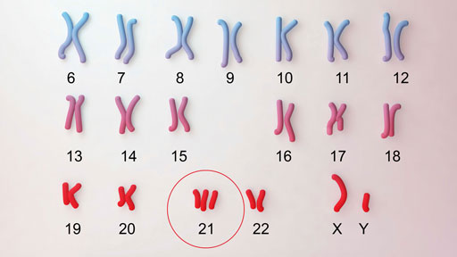
D O W N S Y N D R O M E

Slide 14
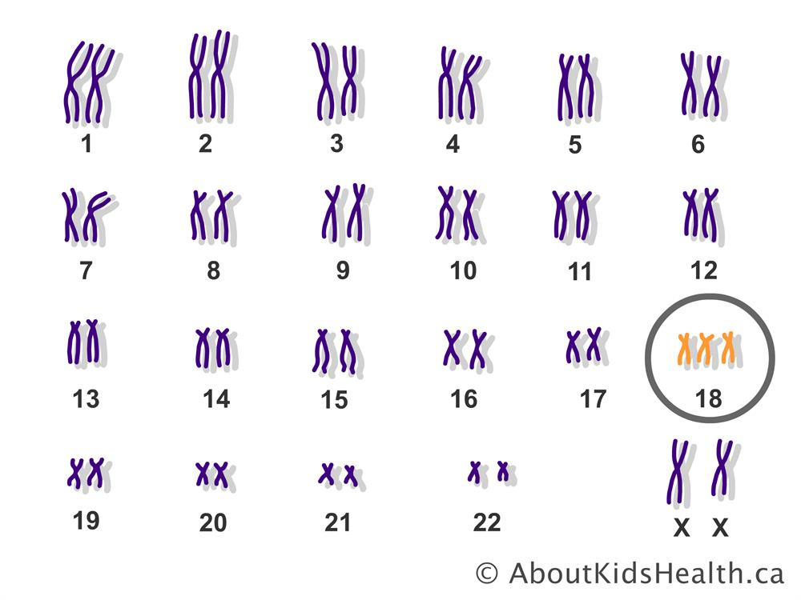
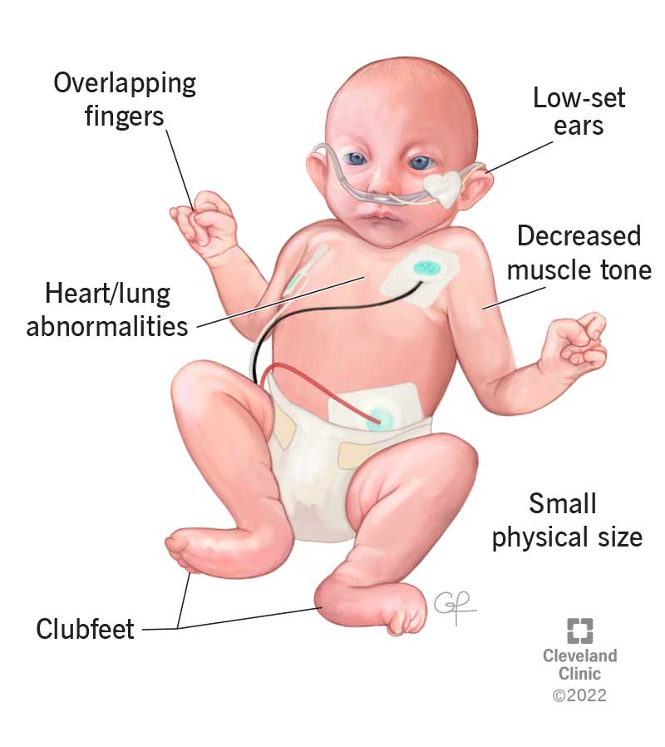
E D W A R D S S Y N D R O M E

Slide 15
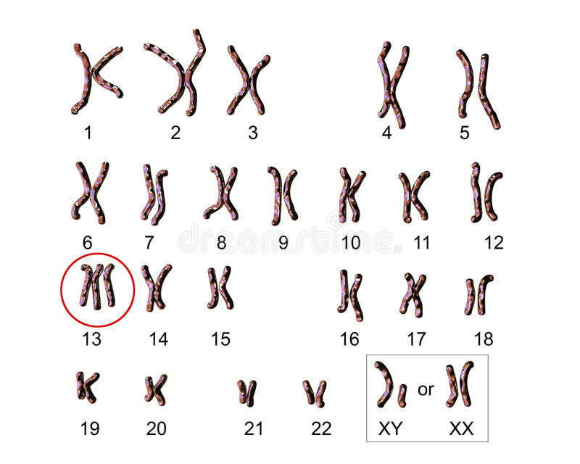
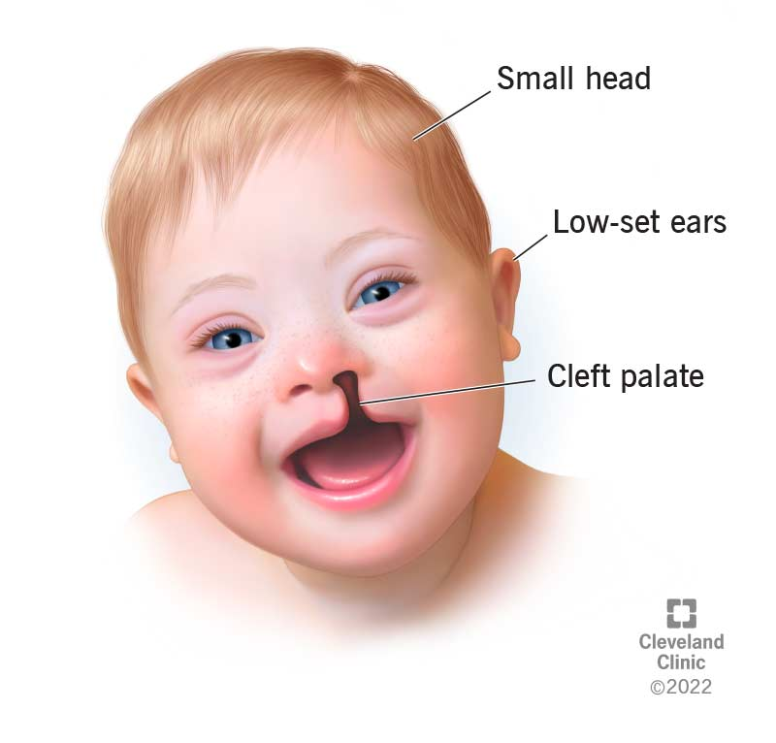
P A T A U’S S Y N D R O M E

Slide 16
Create an information poster explaining what antenatal screening and tests pregnant woman should expect.
Include details on when these tests are taken, why they are carried out and how they are conducted.
10 marks in total
- Relevant information
- In your own words
- Good use of graphics
- Eye-catching
- Use of different colours and fonts
- Easy to read (consider bullet points).
- Title short and draws attention
WHAT TO EXPECT WHEN YOUR EXPECTING

Slide 17
C O U R S E S P E C N O T E S
A variety of techniques can be used to monitor the health of the mother, developing fetus and baby.
Antenatal screening identifies the risk of a disorder so that further tests and a prenatal diagnosis can be offered.
Ultrasound imaging - Pregnant women are given two ultrasound scans. Dating scans which determine pregnancy stage and due date are used with tests for marker chemicals which vary normally during pregnancy. A dating scan takes place between 8 and 14 weeks and an anomaly scan between 18 and 20 weeks.
Anomaly scans may detect serious physical abnormalities in the fetus. Routine blood and urine tests are carried out throughout pregnancy to monitor the concentrations of marker chemicals.
Measuring a chemical at the wrong time could lead to a false positive result. An atypical chemical concentration can lead to diagnostic testing to determine if the fetus has a medical condition.
Diagnostic testing Amniocentesis and chorionic villus sampling (CVS) and the advantages and disadvantages of their use.
CVS can be carried out earlier in pregnancy than amniocentesis, although it has a higher risk of miscarriage.
Cells from samples can be cultured to obtain sufficient cells to produce a karyotype to diagnose a range of conditions.
A karyotype shows an individual’s chromosomes arranged as homologous pairs.
In deciding to proceed with these tests, the element of risk will be assessed, as will the decisions the individuals concerned are likely to make if a test is positive.

Slide 18
N A T I O N A L 5 T E R M S
alleles, dominant, recessive, homozygous, heterozygous, carriers, genotype, phenotype

Slide 19
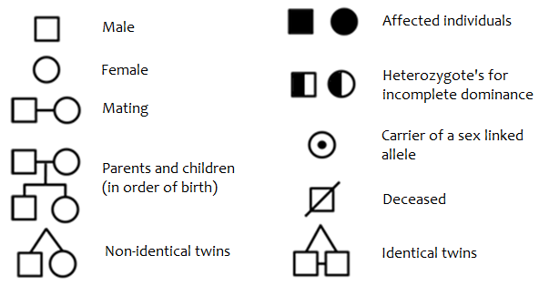
P E D I G R E E C H A R T S

Slide 20
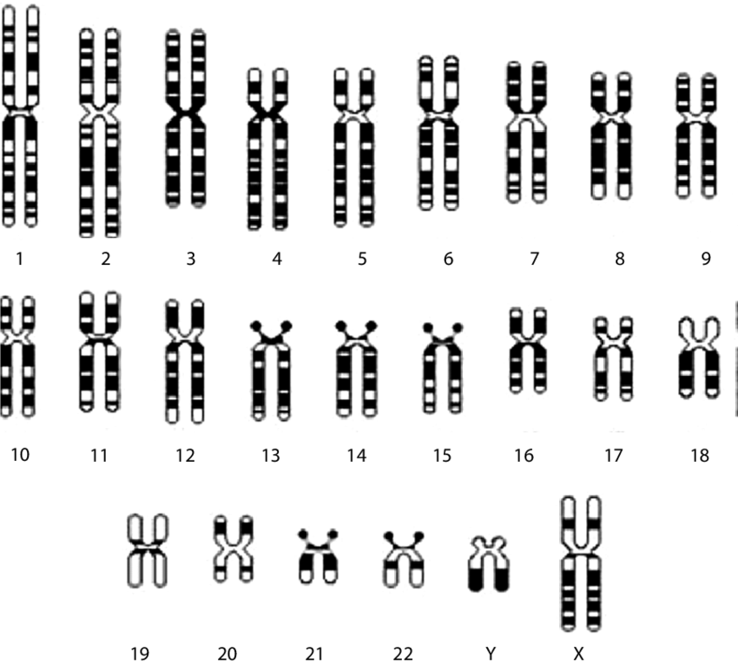
P E D I G R E E C H A R T S
In humans the X and Y chromosomes are known as the sex chromosomes.
All the other chromosomes are called autosomes.
We will be looking at the inheritance of characteristics controlled by genes on the autosomes.
Sex Chromosomes

Slide 21
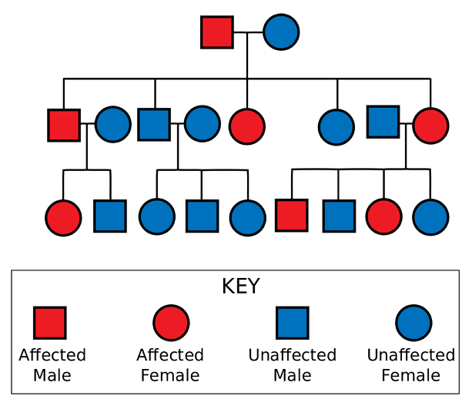
P E D I G R E E C H A R T S
Pedigree charts can be used to determine the inheritance of a particular characteristic or condition.
This can be explained to couples during genetic counselling sessions and the risk of their child having a particular characteristic or condition can be calculated.
.

Slide 22
P E D I G R E E C H A R T S
Autosomal recessive conditions are controlled by genes found on the autosomes and are recessive i.e. require two recessive alleles to show up in the phenotype e.g. homozygous for the characteristic (gg).
Autosomal recessive inheritance is characterised by;
-its rare occurrence
-it may skip generations
-it occurs equally in males and females
.

Slide 23
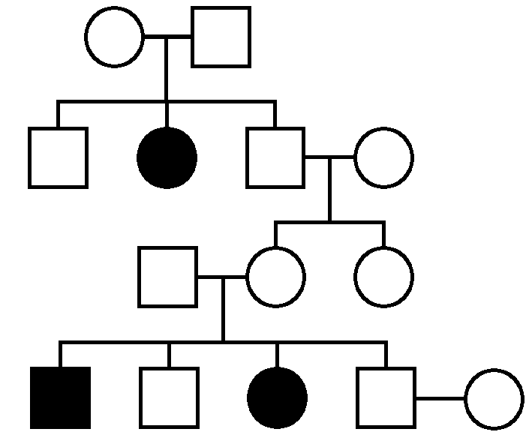
A U T O S O M A L R E C E S S I V E
Cystic fibrosis is an example of an autosomal recessive disorder.
Sufferers have two copies of the recessive allele e.g. They are homozygous( gg)
Pedigree charts can be used to identify the genotypes of some individuals.
.
How many genotypes can you work out on your pedigree chart?

Slide 24
Gg
Gg
GG/Gg
gg
GG/Gg
GG/Gg
Gg
Gg
GG/Gg
gg
GG/Gg
gg
GG/Gg
GG/Gg

Slide 25
A U T O S O M A L D O M I N A N T
Autosomal dominant conditions are controlled by genes found on the autosomes and are dominant i.e. require one dominant allele to show up in the phenotype. These alleles are given a capital letter to denote their dominance.
Autosomal dominant inheritance is characterised by;
- its appearance in every generation,
- affected individuals have an affected parent
- males and females are affected in roughly equal numbers.
.

Slide 26
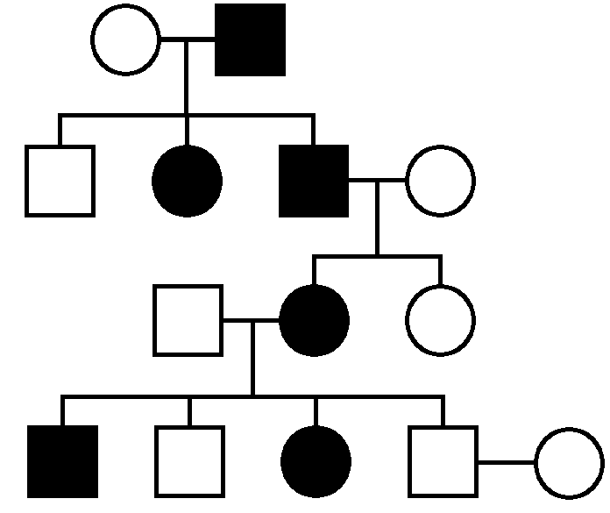
A U T O S O M A L D O M I N A N T
Huntington’s disease is an example of an autosomal dominant disorder.
Sufferers need only inherit one defective allele e.g. H –huntingtons, h- normal.
Pedigree charts can be used to identify the genotypes of some individuals.
.
How many genotypes can you work out on your pedigree chart?

Slide 27
Autosomal dominant
Example = huntingtons
hh
Hh
hh
Hh
Hh
hh
hh
Hh
hh
Hh
hh
Hh
hh
hh

Slide 28
A U T O S O M A L I N C O M P L E T E D O M I N A N C E
Autosomal incomplete dominance occurs when one allele is not completely dominant over the other. These alleles are both given a capital letter to denote they are incompletely dominant
Autosomal incomplete dominance is characterised by;
- the fully expressed form is very rare
- the partly expressed form is more common
- males and females are equally affected.
.

Slide 29
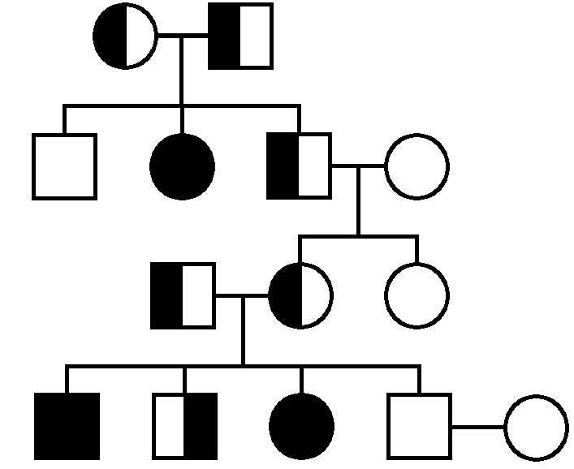
A U T O S O M A L I N C O M P L E T E D O M I N A N C E
Sickle cell anaemia is an example of a disease which shows incomplete dominance.
non sufferers have two normal alleles (e.g. HH)
affected individuals have two defective alleles e.g.( SS)and have sickle cell anaemia.
heterozygotes (e.g. HS) have the sickle cell trait
How many genotypes can you work out on your pedigree chart?

Slide 30
Autosomal incomplete dominant
Example = sickle cell anemia
HS
HS
HH
SS
HS
HH
HS
HS
HH
SS
HS
SS
HH
HH

Slide 31
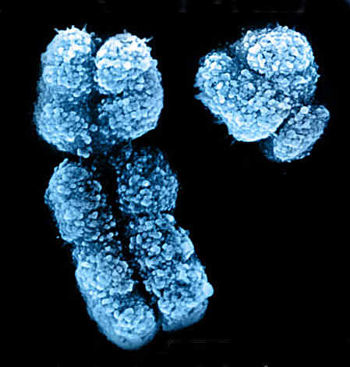
S E X- L I N K E D I N H E R I T A N C E
The X and Y chromosomes are the sex chromosomes in humans (XX – female and XY – male).
The X chromosome is much larger and carries more genes.
Some genes present on the X chromosome are absent from the Y chromosome, these genes are said to be sex-linked.
Sex-linked genes
X
Y

Slide 32
S E X- L I N K E D I N H E R I T A N C E
In a male organism (XY) the sex linked genes carried on the X chromosome will always be expressed in the phenotype.
It does not matter if they are dominant or recessive, because there is no alleles of the gene on the Y chromosome.
Sex-linked genes
X
Y

Slide 33
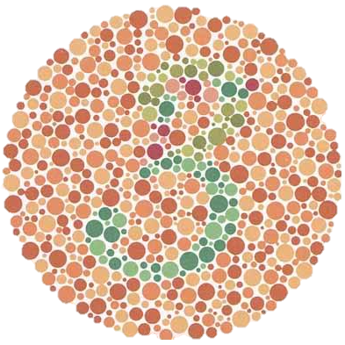
S E X- L I N K E D I N H E R I T A N C E
One example of a sex-linked gene is colour vision.
The gene for colour vision has two alleles, normal (C) or colour-blindness (c).
Because this gene is sex-linked we put an X in their genotype symbol to show they are only present on the X chromosome, for example X^{C} and X^{c}.

Slide 34
S E X- L I N K E D I N H E R I T A N C E
Genotype | Phenotype
X^{C} X^{C} | Female with normal vision
X^{C} X^{c} | Female (carrier) with normal vision
X^{c} X^{c} | Female with colour blindness
X^{C} Y | Male with normal colour vision
X^{c} Y | Male with colour blindness

Slide 35
S E X- L I N K E D I N H E R I T A N C E
A heterozygous female is known as a carrier.
She is not affected herself but has a 50% chance of passing on the colour blindness allele to each of her offspring.
This means 50% of her daughters may be carriers and 50% of her sons will have colour blindness.

Slide 36
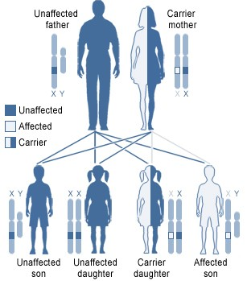
S E X- L I N K E D I N H E R I T A N C E
In humans a clotting factor called factor VIII is a sex linked gene.
This gene comes in two forms, normal (X^{H}) and abnormal (X^{h}).
If you have two copies of the abnormal form
(X^{h} X^{h}) or one copy and a Y chromosome (X^{h}Y) you will have haemophilia and your blood will not clot properly.

Slide 37
S E X- L I N K E D I N H E R I T A N C E
Sex linked recessive pattern of inheritance can be recognised by:
More males affected than females.
An affected male does not have any affected sons.
An affected male may have affected grandsons.

Slide 38
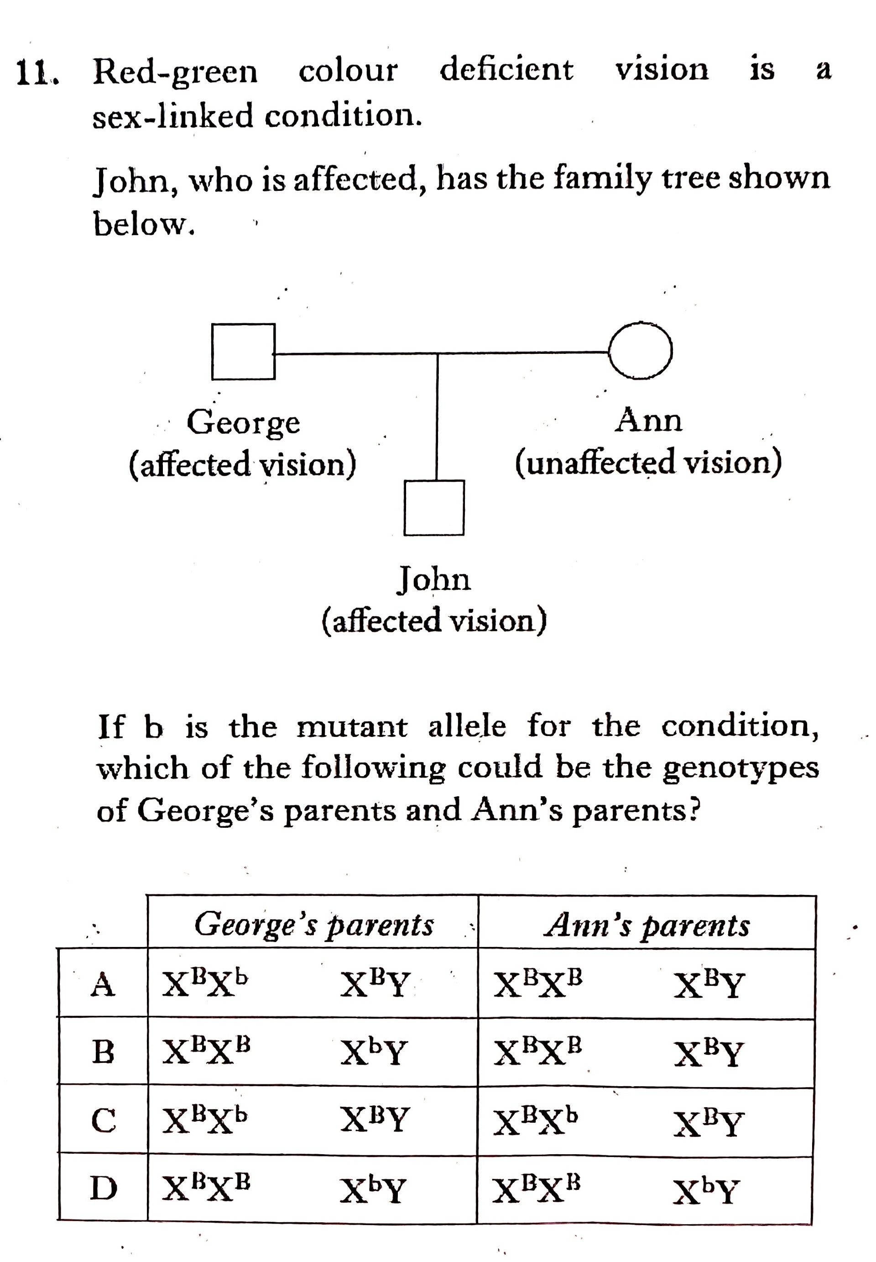

Slide 39
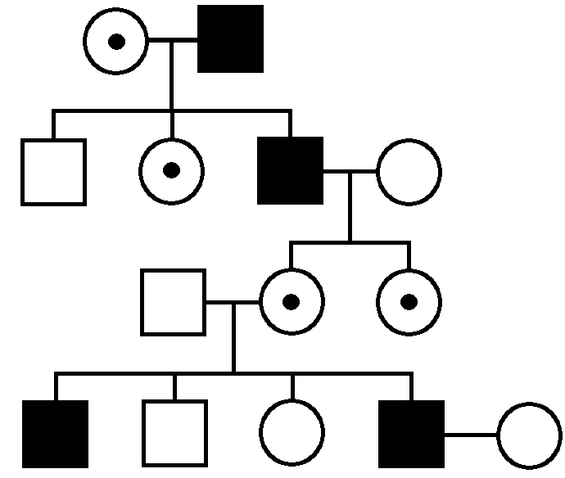
X^{H}X^{h}
X^{h}Y
X^{H}Y
X^{H}X^{h}
X^{h}Y
X^{H}X^{H}
X^{H}Y
X^{H}X^{h}
X^{H}X^{h}
X^{h}Y
X^{H}Y
X^{H}X^{H}
X^{h}Y
X^{H}X^{H}

Slide 40
P H E N Y L K E T O N U R I A ( PKU )
In PKU, a substitution mutation in the gene that codes for the enzyme which converts phenylalanine to tyrosine leaves the enzyme non-functional.
Before birth the excess phenylalanine is transferred across the placenta into the mother's blood, and removed by her liver.
Thus the presence of the disorder only becomes apparent after birth.
Phenylalanine
Enzyme
Tyrosine

Slide 41
P H E N Y L K E T O N U R I A ( PKU )
Individuals with high levels of phenylalanine are placed on a restricted diet.

