Slide 1
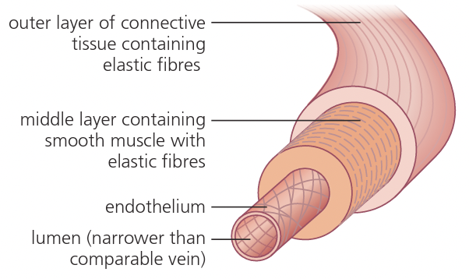
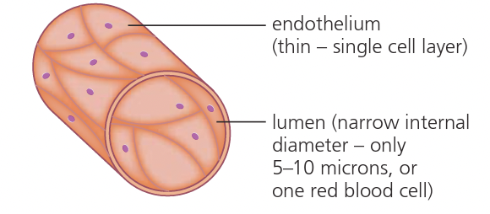
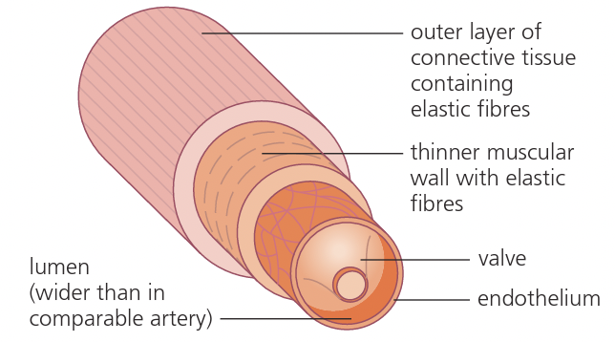
PRINT

Slide 2
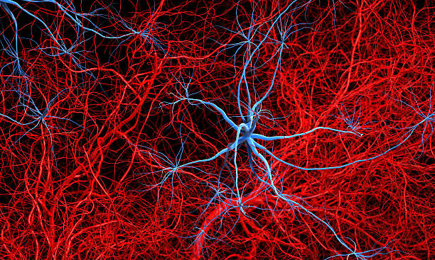
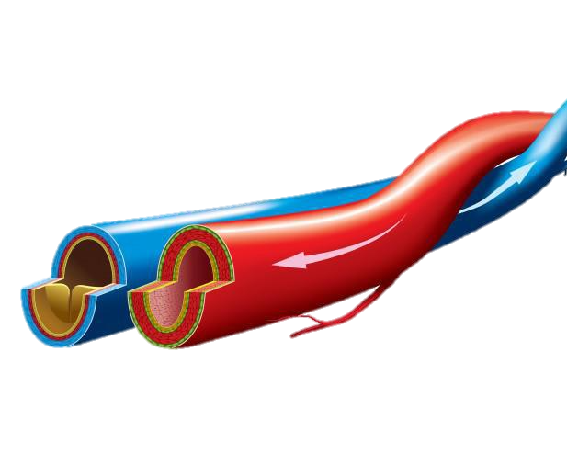
Higher Human Biology
2.5 The Structure and Function of arteries, veins and capillaries

Slide 3
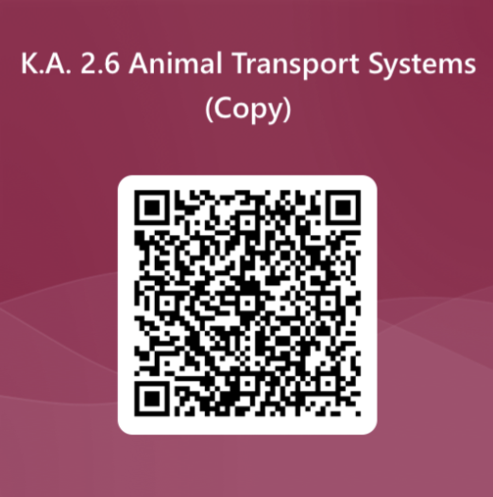
T H E S T R U C T U R E A N D F U N C T I O N O F A R T E R I E S, C A P I L L A R I E S A N D V E I N S
National 5 RECAP!

Slide 4
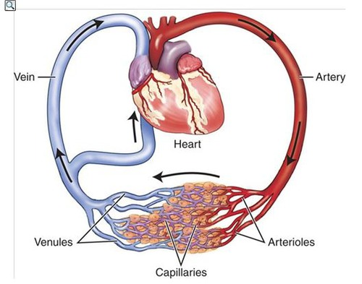
T H E S T R U C T U R E A N D F U N C T I O N O F A R T E R I E S, C A P I L L A R I E S A N D V E I N S
Blood circulates from the heart through the arteries to the capillaries then to the veins and back to the heart.

Slide 5
T H E S T R U C T U R E A N D F U N C T I O N O F A R T E R I E S, C A P I L L A R I E S A N D V E I N S
Blood circulates from the heart through the arteries to the capillaries then to the veins and back to the heart.
There is a decrease in blood pressure as blood moves away from the heart.

Slide 6
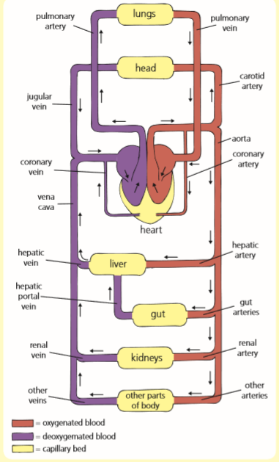
A R T E R I E S v V E I N S
Arteries
Veins
Take blood AWAY from the heart
Thicker, more muscular wall to maintain high blood pressure
Thinner central channel.
Return blood TO the heart
Thinner, less muscular wall as blood is under lower pressure
Wider central channel.

Slide 7
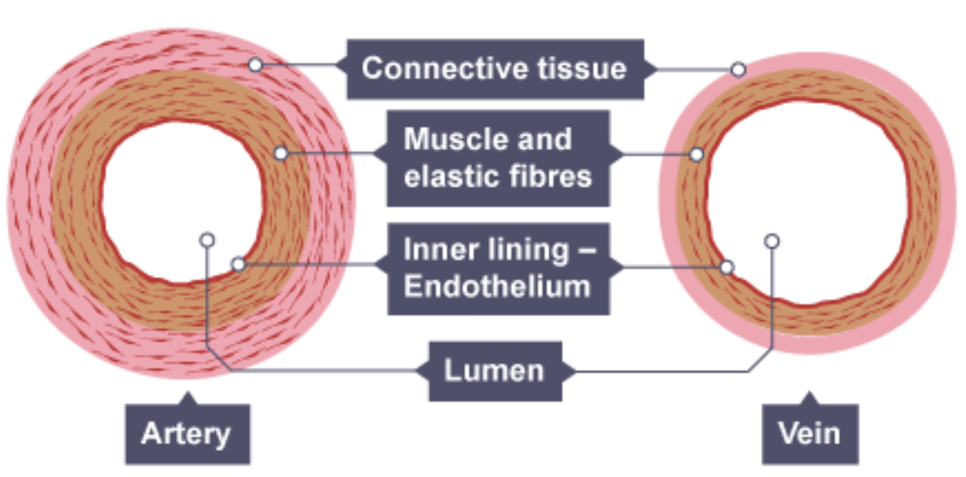
A R T E R I E S v V E I N S
Arteries
Arteries have an outer layer of connective tissue containing elastic fibres and a middle layer containing smooth muscle with more elastic fibres.
The elastic walls of the arteries stretch and recoil to accommodate the surge of blood after each contraction of the heart.

Slide 8
A R T E R I E S v V E I N S
Veins
Veins have an outer layer of connective tissue containing elastic fibres but a much thinner muscular wall than arteries.
They contain valves which prevent blood flowing backwards in veins where the pressure is relatively low.

Slide 9
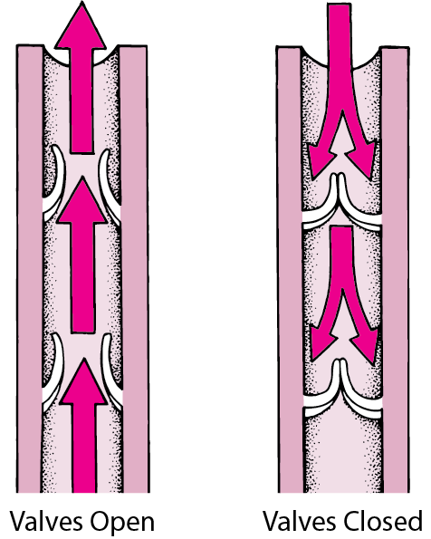
F I N D Y O U R V A L V E S
https://www.youtube.com/watch?v=u4gTeO8fZBA&t=177s

Slide 10
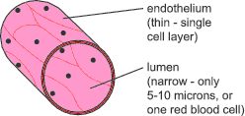
C A P I L L A R I E S
Capillaries allow exchange of substances with tissues through their thin walls.

Slide 11
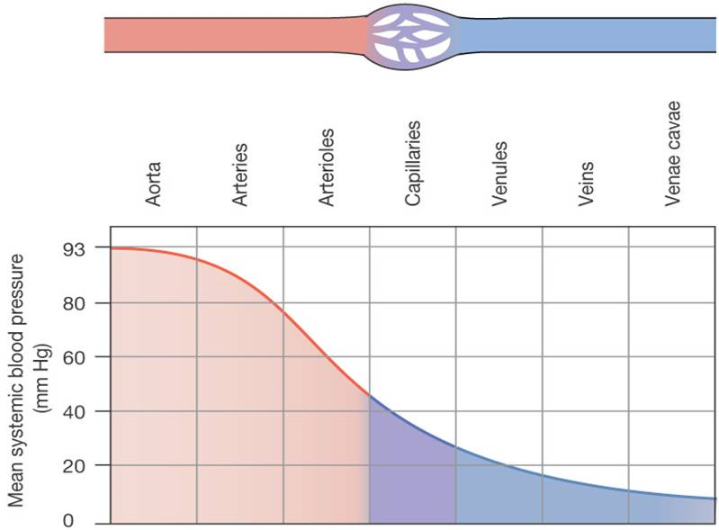
C H A N G E S I N B L O O D P R E S S U R E
There is a decrease in blood pressure as blood moves away from the heart.

Slide 12
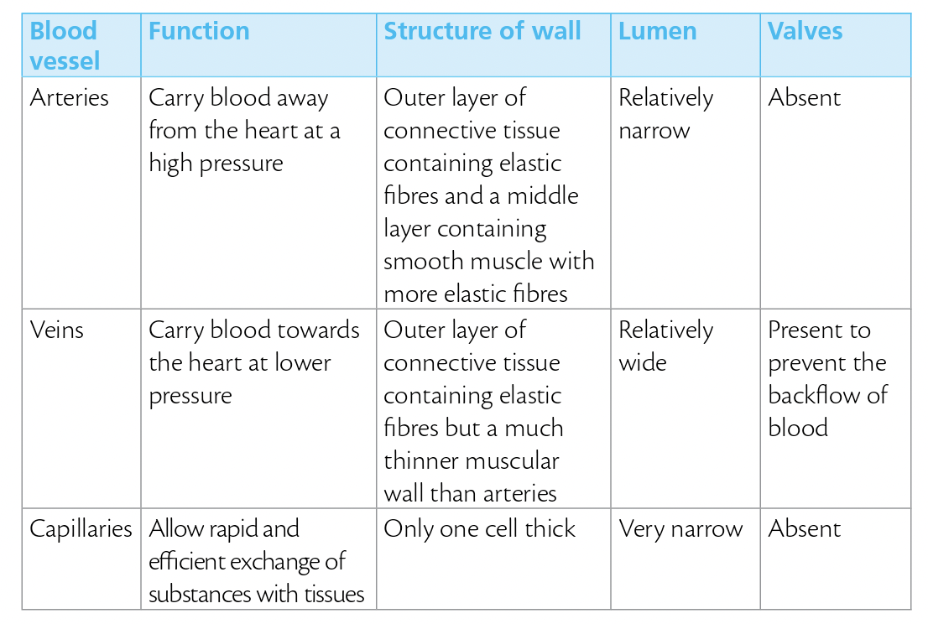
C O P Y A N D C O M P L E T E

Slide 13
C O P Y A N D C O M P L E T E

Slide 14
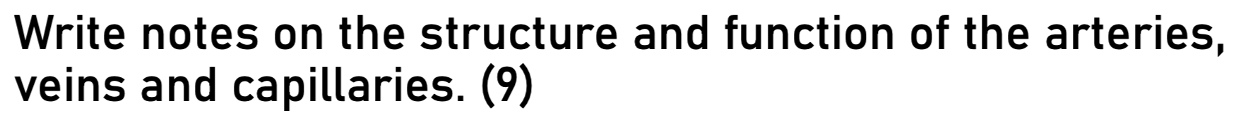
E S S A Y Q U E S T I O N

Slide 15
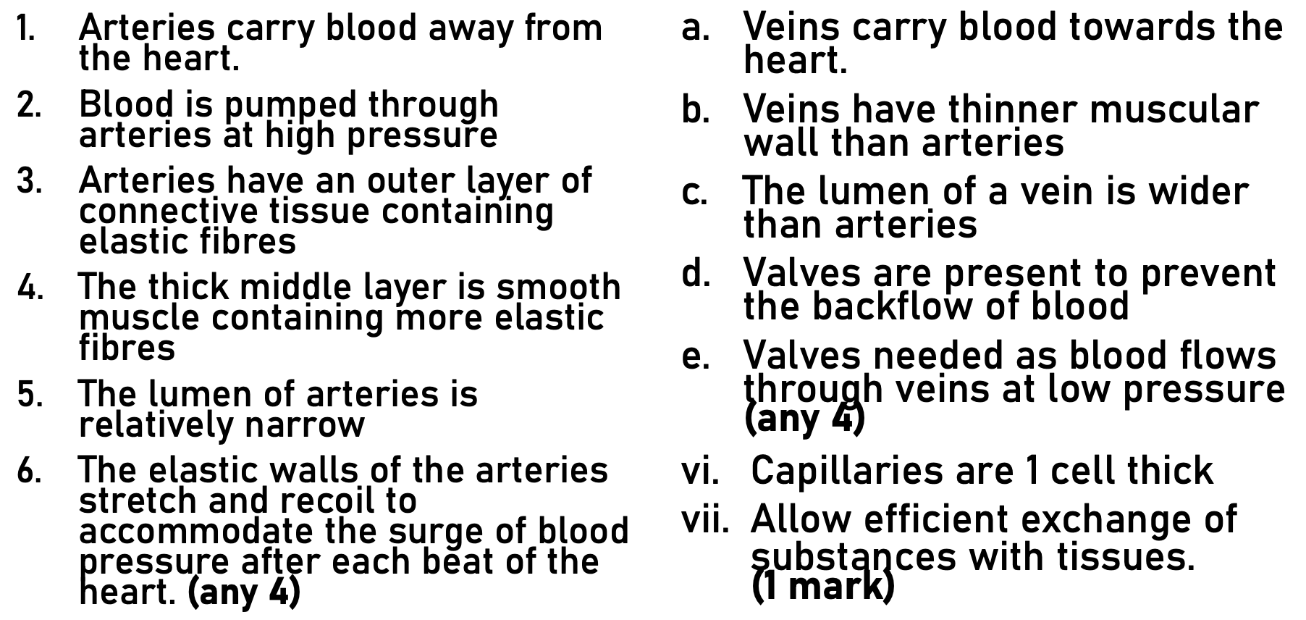
E S S A Y Q U E S T I O N

Slide 16
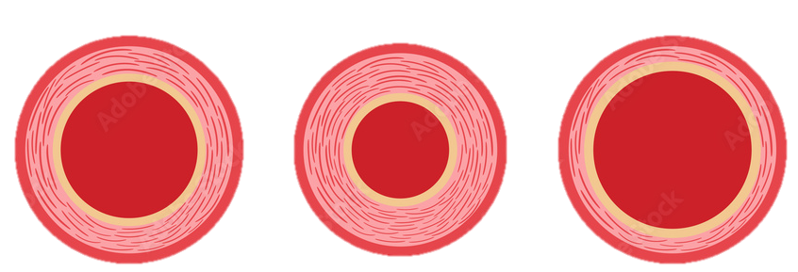
V A S O C O N S T R I C T I O N A N D V A S O D I L A T I O N
Normal
Vasoconstriction
Vasodilation

Slide 17
V A S O C O N S T R I C T I O N A N D V A S O D I L A T I O N
Normal
Vasoconstriction
Vasodilation
To control blood flow, the smooth muscle surrounding arteries can contract causing vasoconstriction or relax causing vasodilation.

Slide 18
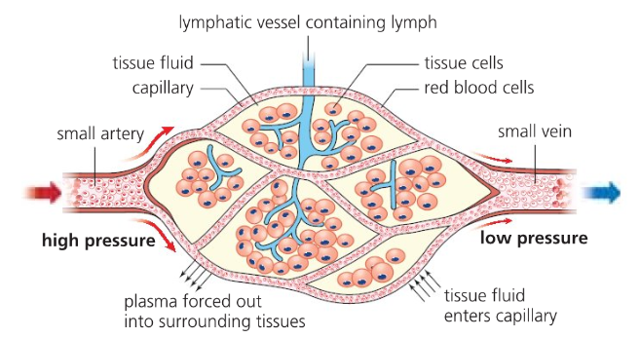
C A P I L L A R I E S AND T I S S U E F O R M A T I O N
The cells of the body are bathed in a fluid called tissue fluid.
Tissue fluid is essential for the efficient exchange of materials
between the blood and the cells.
Tissue fluid is formed at the arteriole end of the capillaries.
How The Exchange of Body Fluids in Tissues Happens? | Biology - YouTube

Slide 19
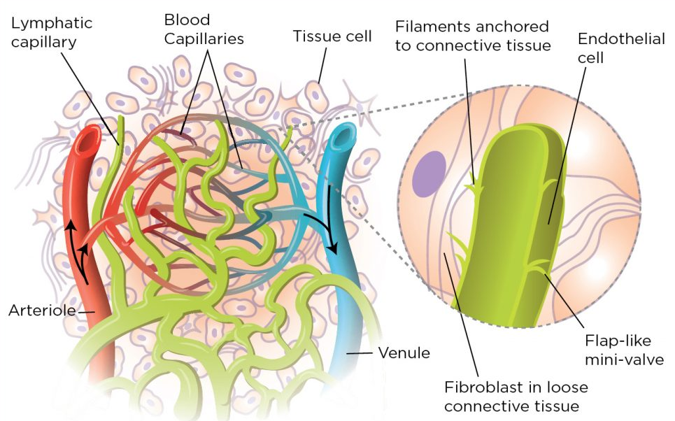
C A P I L L A R I E S AND T I S S U E F O R M A T I O N
Pressure filtration happens when blood plasma is filtered through the walls of capillaries, the smallest blood vessels in the body. This filtration process is driven by the pressure of the blood, which forces water and other small molecules out of the capillaries and into the spaces between the cells.
The tissue fluid then bathes the cells, delivering oxygen and nutrients and collecting waste products.

Slide 20
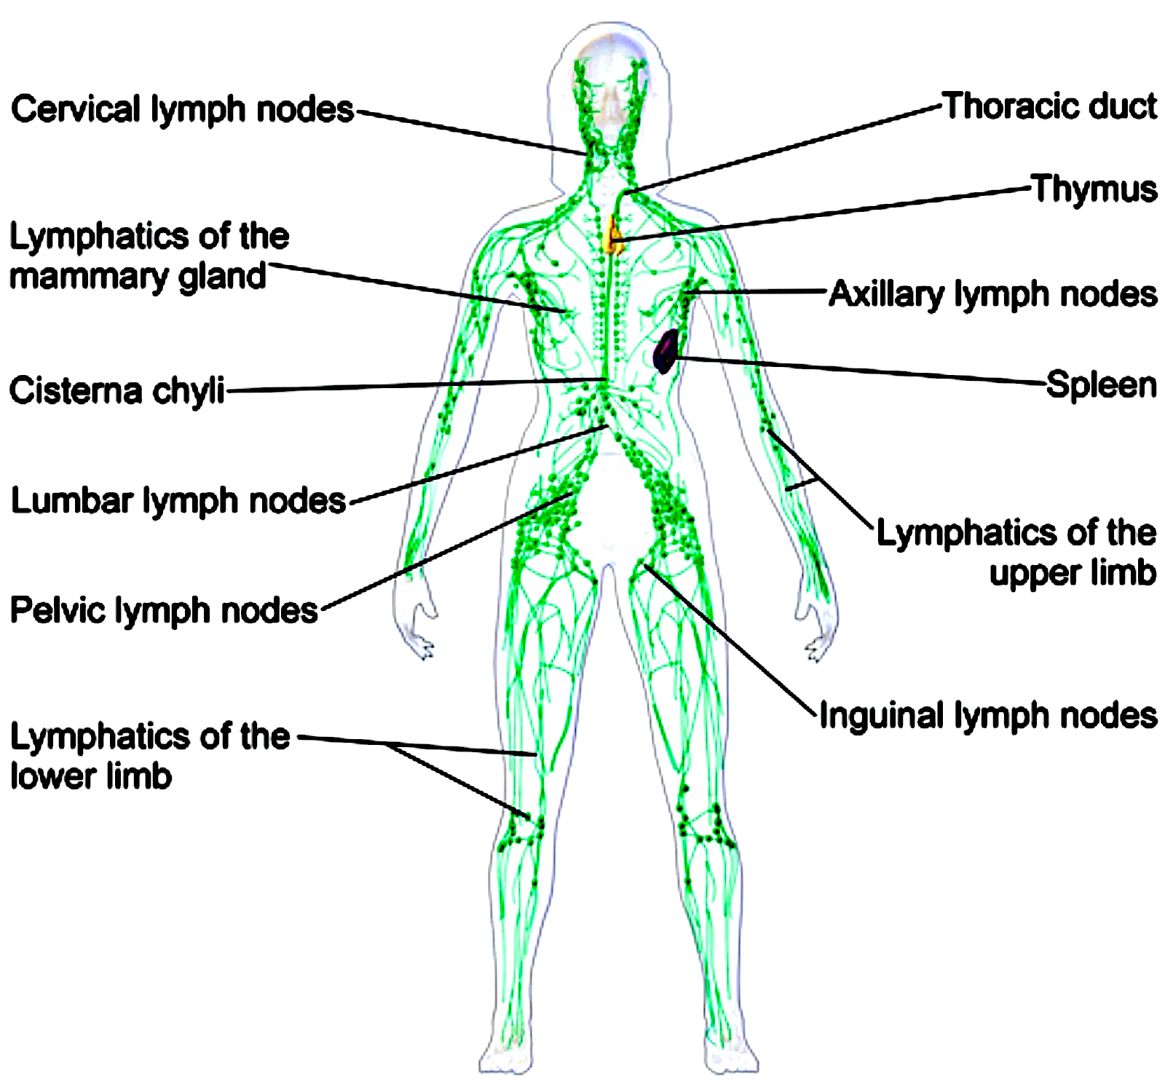
C A P I L L A R I E S AND T I S S U E F O R M A T I O N
After the tissue fluid has delivered its nutrients and collected waste products, it is collected by the lymphatic system and returned to the bloodstream as lymph. This helps to maintain the balance of fluid in the body and ensures that the cells receive the nutrients they need to function properly.

Slide 21
C A P I L L A R I E S AND T I S S U E F O R M A T I O N
small artery
lymphatic
small vein
cells
arteriole
venule
capillaries
tissue fluid
Tissue fluid is:
constantly being formed at the arteriole end of capillary beds
essential for the efficient exchange of materials between the blood and the cells
is constantly being drained away from the cells by lymph vessels

Slide 22
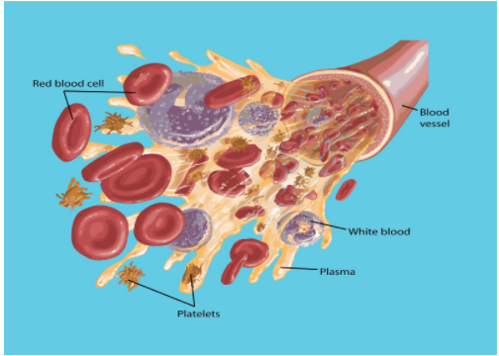
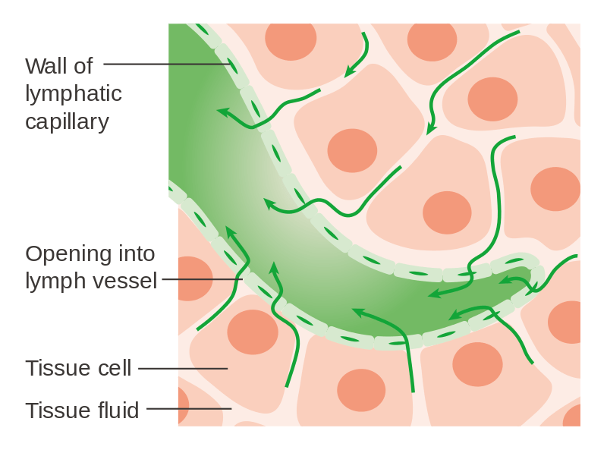
C A P I L L A R I E S AND T I S S U E F O R M A T I O N
Tissue fluid and blood plasma are similar in composition, with the exception of plasma proteins, which are too large to be filtered through the capillary walls.

Slide 23
C O U R S E S P E C N O T E S
Blood circulates from the heart through the arteries to the capillaries then to the veins and back to the heart. There is a decrease in blood pressure as blood moves away from the heart.
The structure and function of arteries, capillaries and veins: endothelium, central lumen, connective tissue, elastic fibres, smooth muscle and valves.
The endothelium lining the central lumen of blood vessels is surrounded by layers of tissue.
Arteries have an outer layer of connective tissue containing elastic fibres and a middle layer containing smooth muscle with more elastic fibres. The elastic walls of the arteries stretch and recoil to accommodate the surge of blood after each contraction of the heart.
To control blood flow, the smooth muscle surrounding arteries can contract causing vasoconstriction or relax causing vasodilation.
Capillaries allow exchange of substances with tissues through their thin walls.
Veins have an outer layer of connective tissue containing elastic fibres but a much thinner muscular wall than arteries. They contain valves to prevent the backflow of blood.
The exchange of materials between tissue fluid and cells through pressure filtration and the role of lymphatic vessels.
Pressure filtration causes plasma to pass through capillary walls into the tissue fluid surrounding the cells. Tissue fluid supplies cells with glucose, oxygen and other substances. Carbon dioxide and other metabolic wastes diffuse out of the cells and into the tissue fluid to be excreted. Much of the tissue fluid returns to the blood. Lymphatic vessels absorb excess tissue fluid and return it as lymph to the circulatory system.
Tissue fluid and blood plasma are similar in composition, with the exception of plasma proteins, which are too large to be filtered through the capillary walls.

