Slide 1
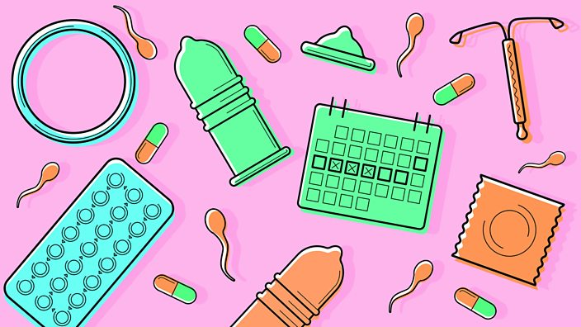
Higher Human Biology
MISS MCBRIDE
2.3 The biology of controlling fertility

Slide 2
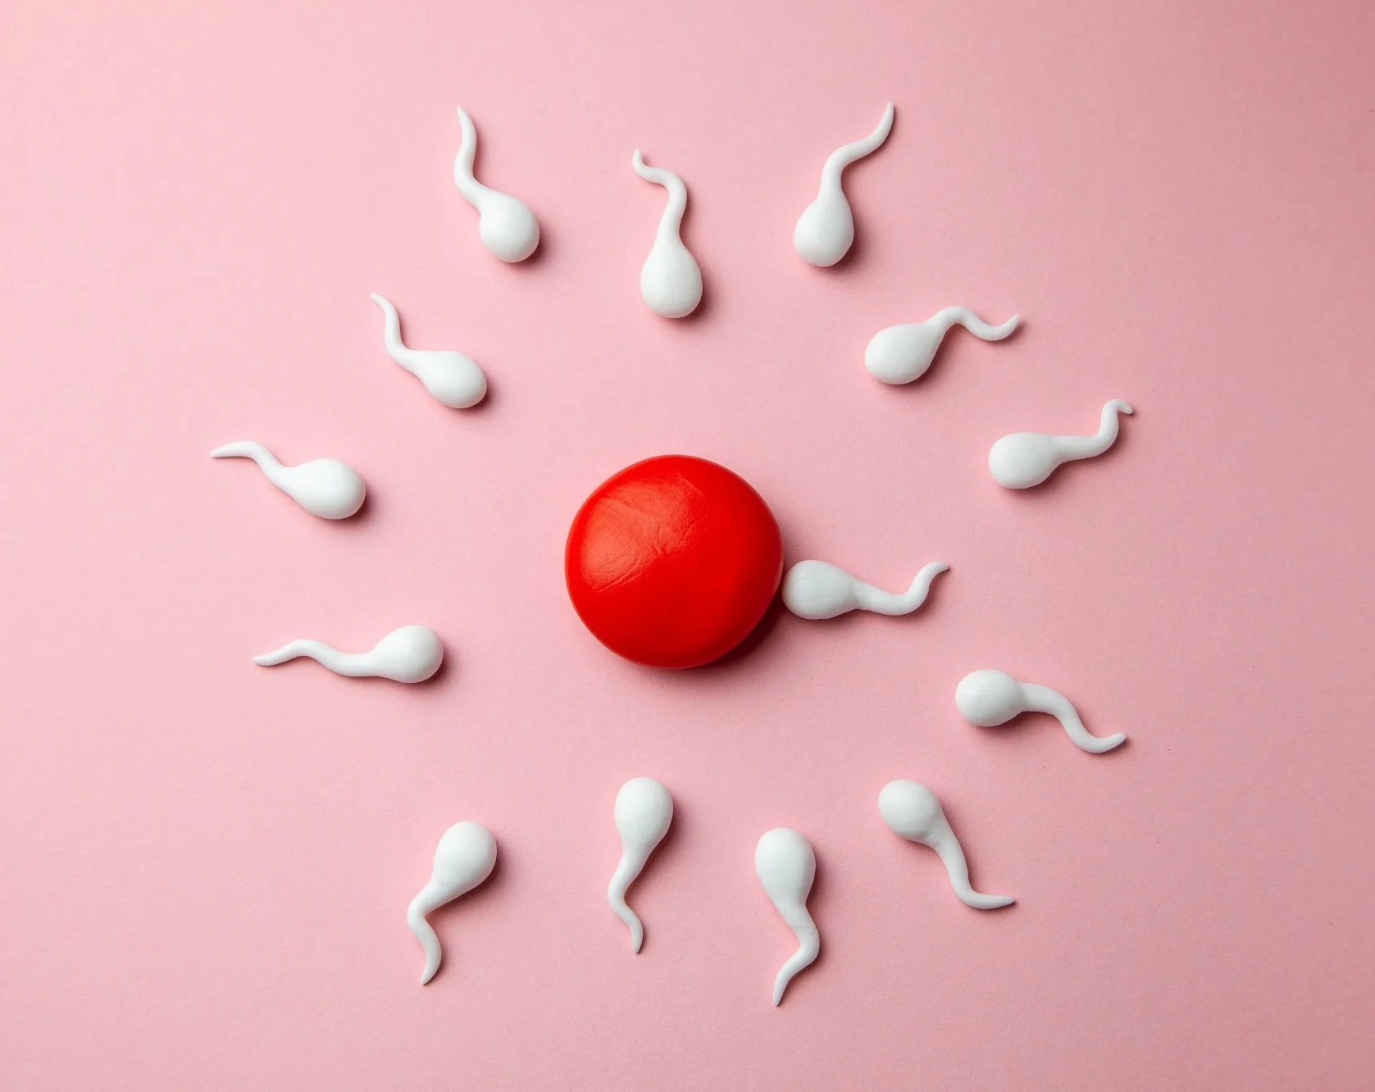
F E M A L E F E R T I L I T Y
At what times of the month are females most fertile?

Slide 3
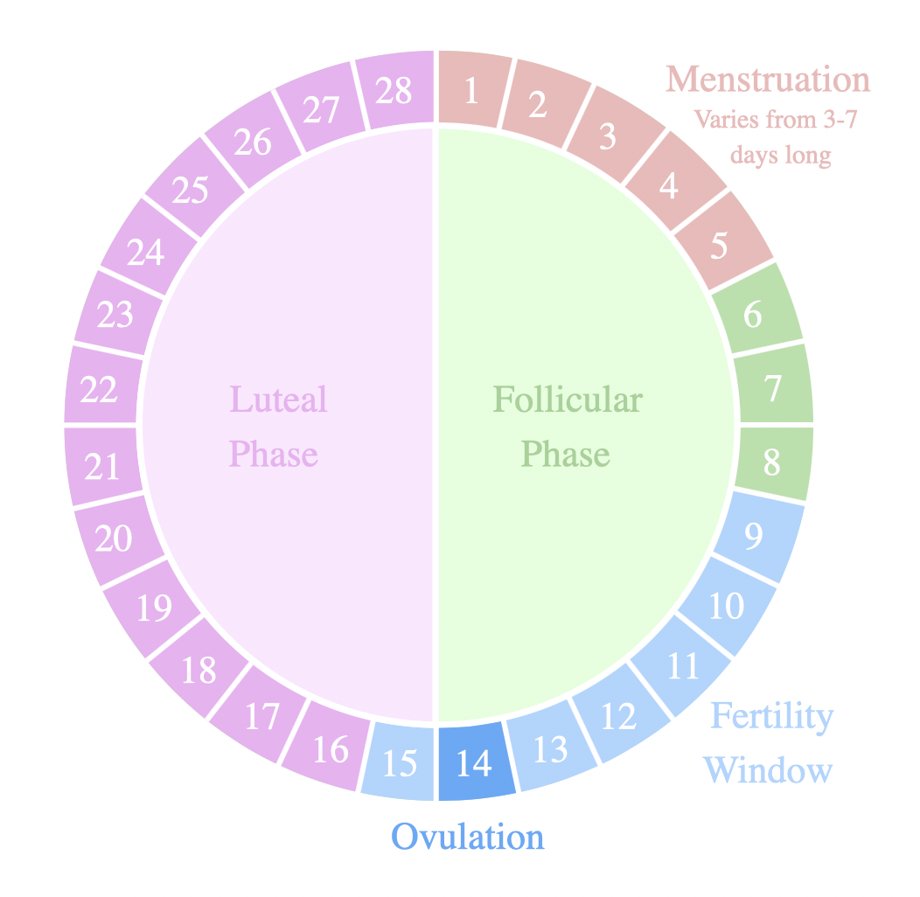
F E M A L E F E R T I L I T Y
At what times of the month are females most fertile?
Women show cyclical fertility leading to a fertile period.
Women are only fertile for a few days during each menstrual cycle.

Slide 4
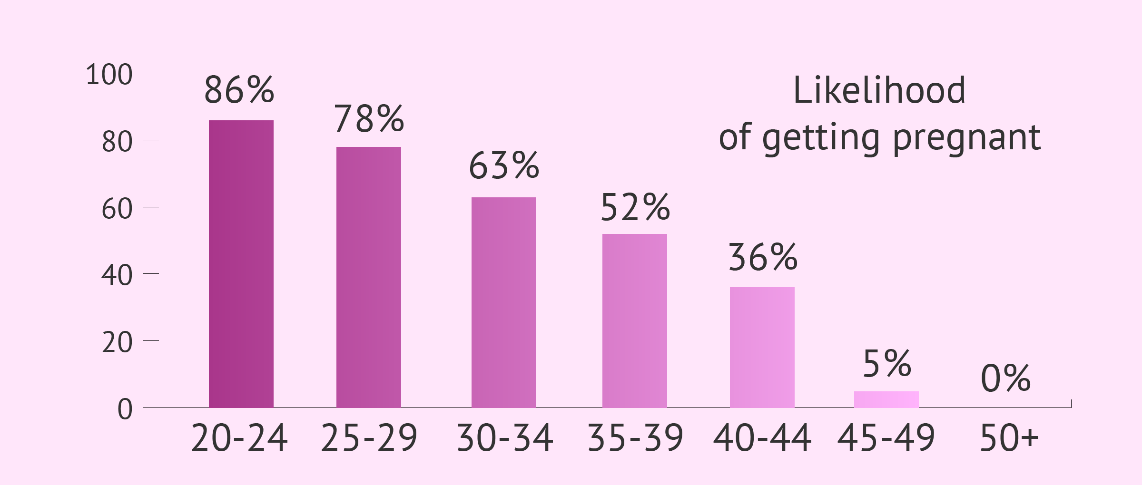
F E M A L E F E R T I L I T Y

Slide 5
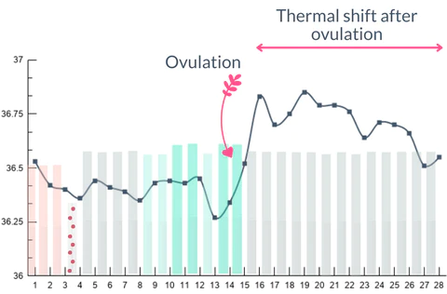
F E M A L E F E R T I L I T Y
A woman’s body temperature rises by around 0·5°C after ovulation and her cervical mucus becomes thin and watery.

Slide 6
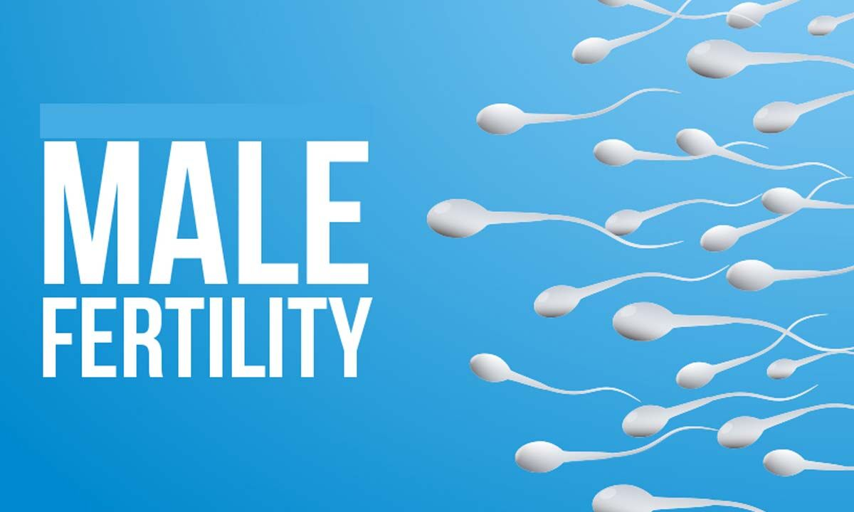
M A L E F E R T I L I T Y
At what times of the month are males most fertile?

Slide 7
M A L E F E R T I L I T Y
At what times of the month are males most fertile?
Men continually produce sperm in their testes so show continuous fertility.

Slide 8
C O U R S E S P E C N O T E S
(a) Women show cyclical fertility leading to a fertile period. Men show continuous fertility.
Women are only fertile for a few days during each menstrual cycle.
A woman’s body temperature rises by around 0·5°C after ovulation and her cervical mucus becomes thin and watery.
Men continually produce sperm in their testes so show continuous fertility.

Slide 9
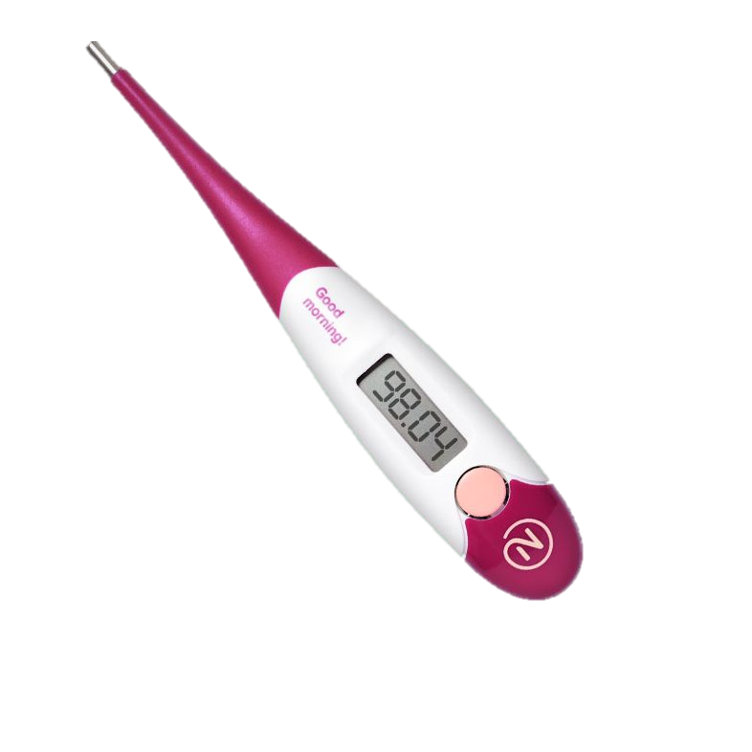
C O N T R A C E P T I O N M E T H O D S
Research the following contraceptive methods and write down how they work and how effective they are.
Thermometer (natural cycles)
(combined pill)
‘Morning After’ pill
(progesterone only pill )

Slide 10
P H Y S I C A L M E T H O D S OF C O N T R A C E P T I O N
Barriers
The male condom, female condom and diaphragm all stop the sperm getting past the cervix (so fertilisation can not occur.)
Sterilisation
Males - A vasectomy can be performed on males which cuts and ties, or seals, the sperm ducts which stops sperm entering the vagina (so fertilisation can not occur.)
Females - the fallopian tubes are blocked or sealed to prevent the eggs reaching the sperm (so fertilisation can not occur.)

Slide 11
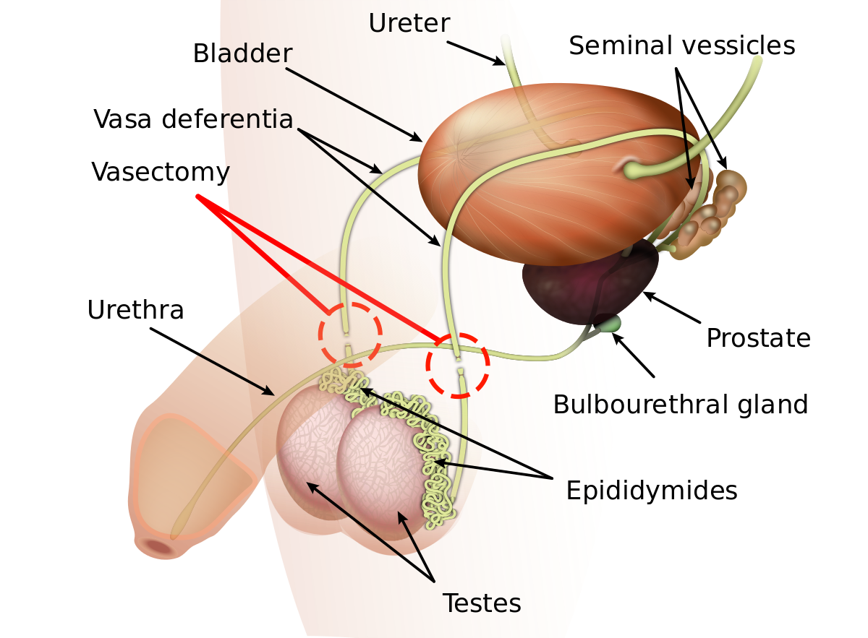
S T E R I L I S A T I O N

Slide 12
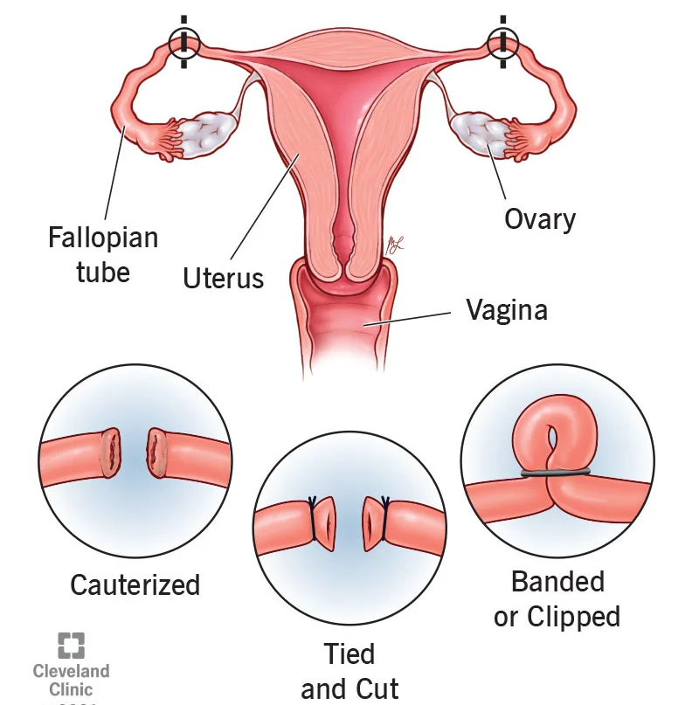
S T E R I L I S A T I O N

Slide 13
C H E M I C A L M E T H O D S OF C O N T R A C E P T I O N
Pills (female)
Combined pill: contains a combination of synthetic oestrogen and progesterone to mimic the negative feedback effect, which prevents the release of FSH and LH from the pituitary gland.

Slide 14
C H E M I C A L M E T H O D S OF C O N T R A C E P T I O N
Mini pill (progesterone only)
This pill contains only progesterone which causes thickening of the cervical mucus stopping sperm passing the cervix.

Slide 15
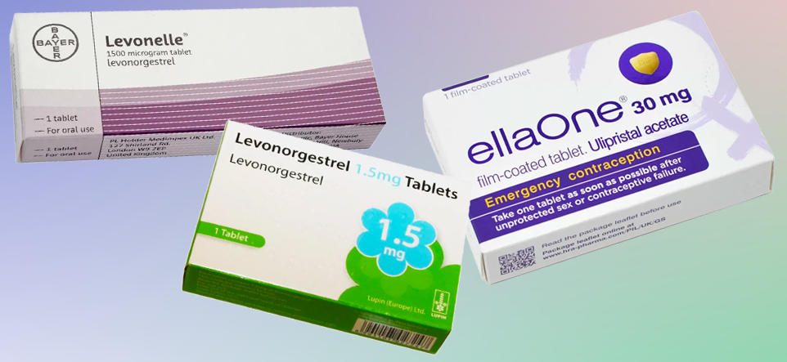
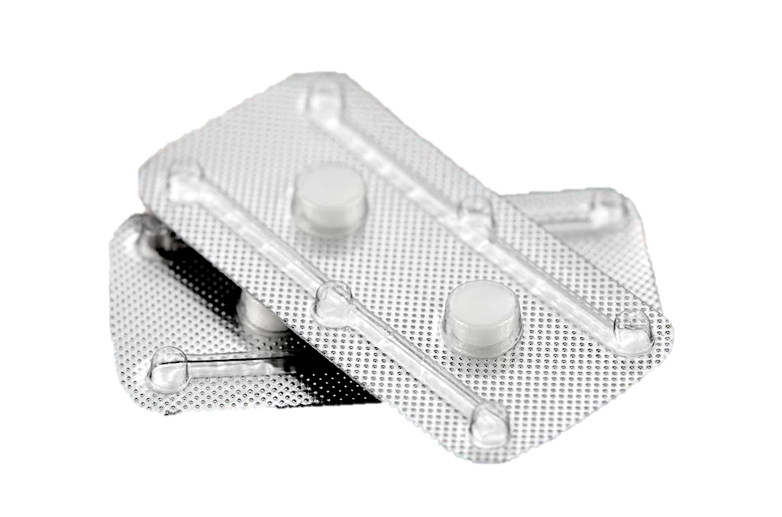
E M E R G E N C Y C O N T R A C E P T I O N
Emergency hormonal contraceptive pills prevent or delay ovulation. These pills are often referred to as ‘morning- after’ pills, but they can be taken up to 72 hours or 120 hours after unprotected sex, depending on which type of pill is used’.

Slide 16
I N T R A – U T E R I N E D E V I C E S (IUDs)
Progesterone (acts like the mini pill)
Non-hormonal: Reduces sperm motility and prevents implantation of egg

Slide 17
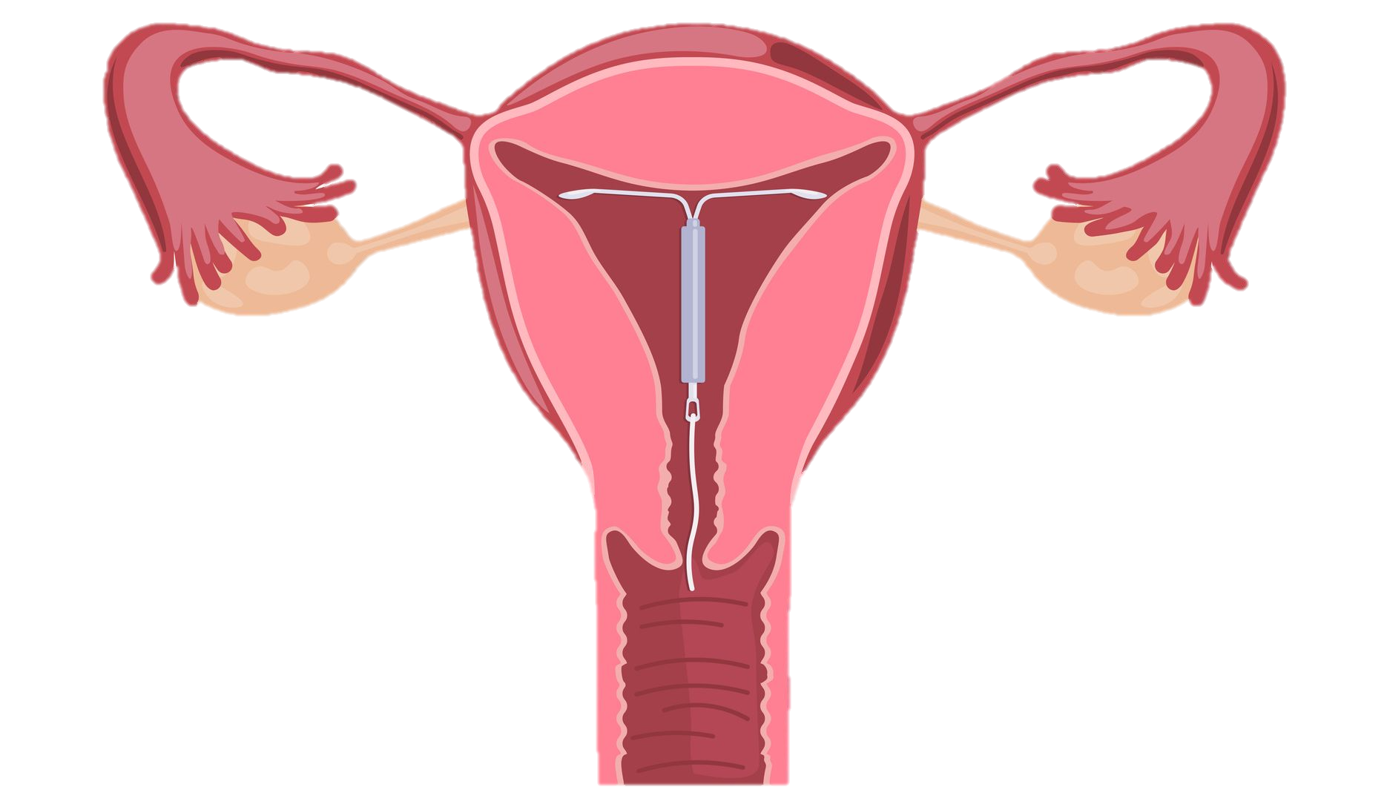
I N T R A – U T E R I N E D E V I C E S (IUDs)

Slide 18
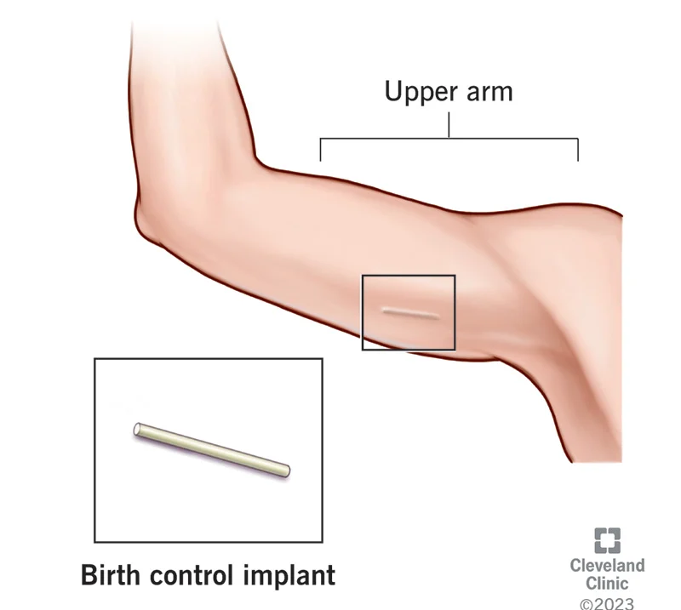
C O N T R A C E P T I V E I M P L A N T
The implant stops the release of an egg from the ovary by slowly releasing progestogen into your body.
Progestogen thickens the cervical mucus and thins the womb lining. This makes it harder for sperm to move through your cervix, and less likely for your womb to accept a fertilised egg.

Slide 19
C O U R S E S P E C N O T E S
The oral contraceptive pill is a chemical method of contraception. It contains a combination of synthetic oestrogen and progesterone that mimics negative feedback preventing the release of FSH and LH from the pituitary gland.
The progesterone-only (mini) pill causes thickening of the cervical mucus.
Emergency hormonal contraceptive pills prevent or delay ovulation. These pills are often referred to as ‘morning- after’ pills, but they can be taken up to 72 hours or 120 hours after unprotected sex, depending on which type of pill is used’.

Slide 20
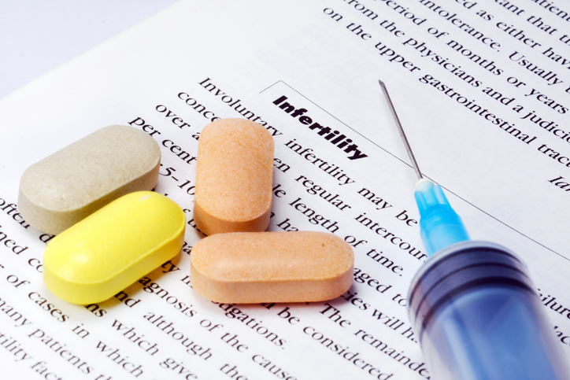
T R E A T M E N T S F O R I N F E R T I L I T Y
Stimulating Ovulation
Ovulation can be stimulated by drugs. They work by preventing the negative feedback effect of oestrogen on FSH secretion.
Other ovulatory drugs mimic the action of FSH and LH. These drugs can cause super ovulation and result in multiple births.

Slide 21
T R E A T M E N T S F O R I N F E R T I L I T Y
Artificial Insemination
This is useful where the male has a low sperm count.
Several samples of semen are collected over a period of time.
If a partner is sterile, a donor may be used to provide semen.

Slide 22
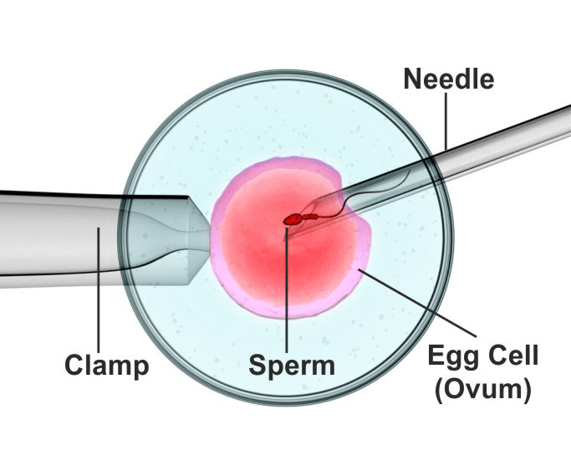
T R E A T M E N T S F O R I N F E R T I L I T Y
Intra-cytoplasmic sperm injection (ICSI)
Defective sperm, or low sperm count, ICSI can be used.
The head of the sperm is drawn into a needle and injected directly into the egg to achieve fertilisation.

Slide 23
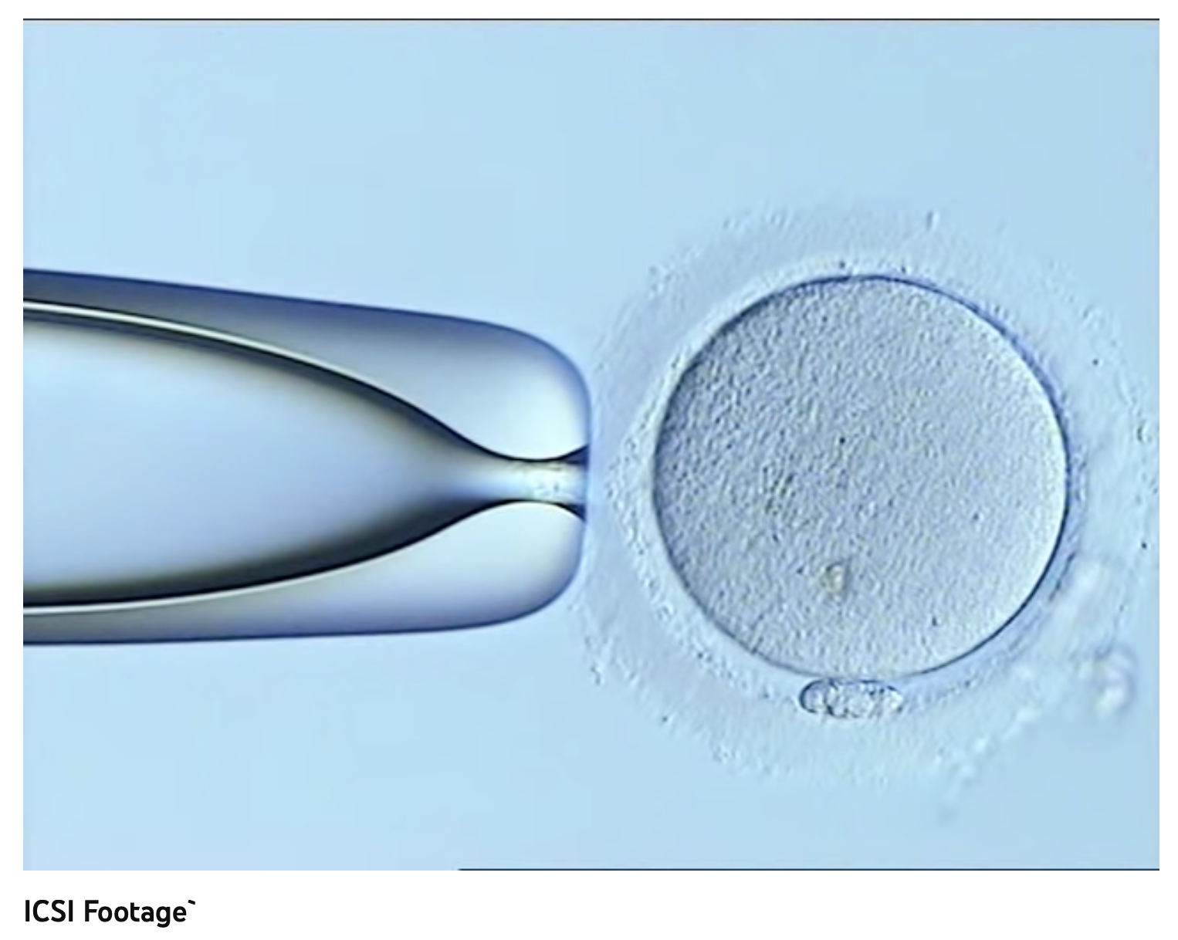
T R E A T M E N T S F O R I N F E R T I L I T Y
Intra-cytoplasmic sperm injection (ICSI)in action!

Slide 24
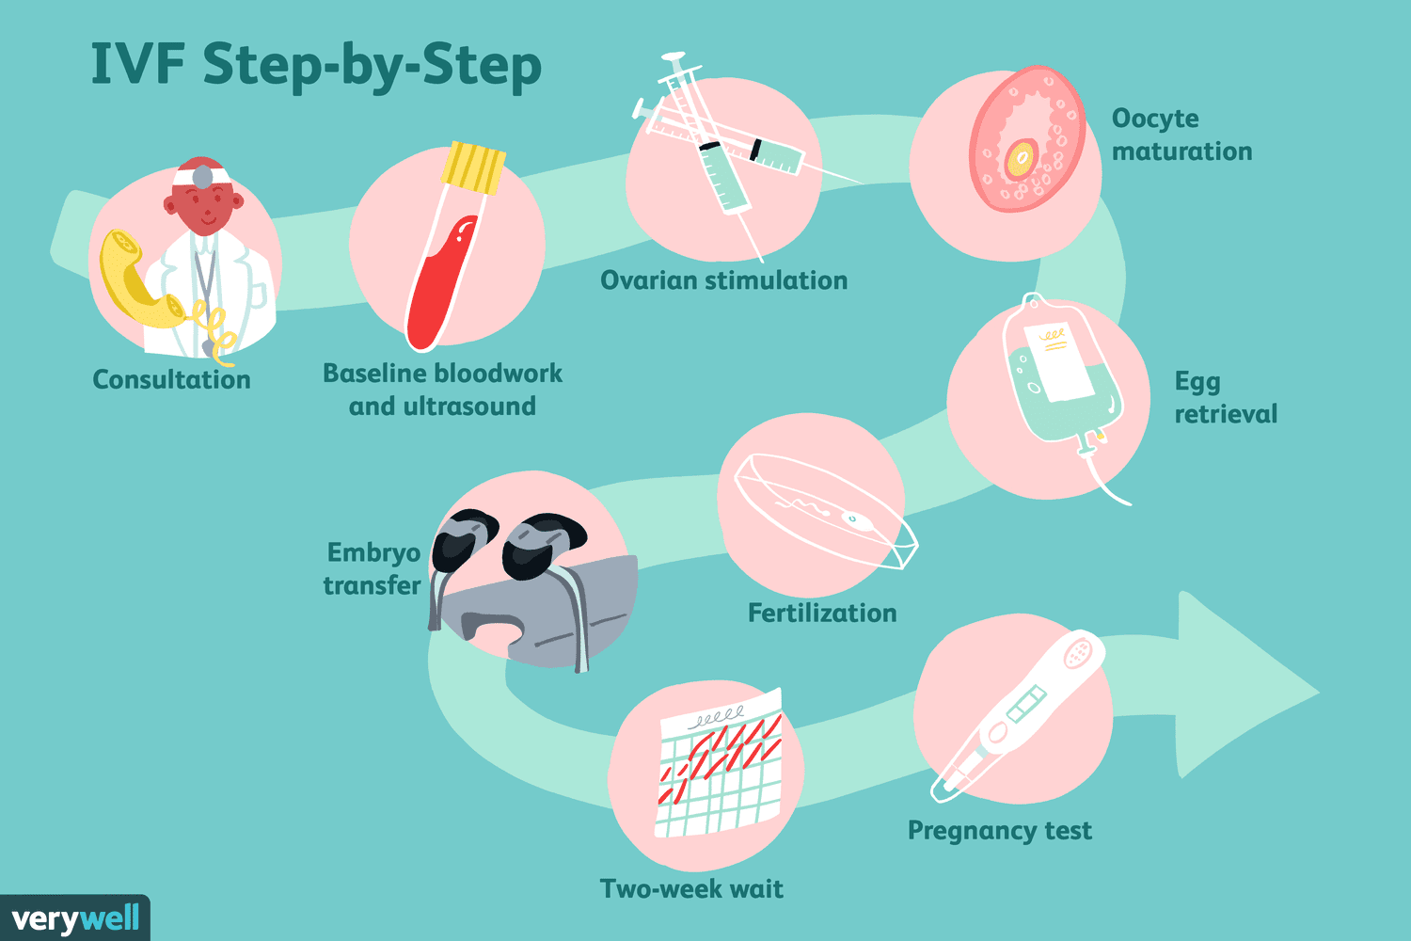
T R E A T M E N T S F O R I N F E R T I L I T Y
In vitro fertilisation (IVF)
Surgical removal of eggs from ovaries after hormone stimulation.
Eggs are mixed with sperm in a culture dish.
The fertilised eggs are incubated until they have formed at least 8 cells.
Transferred to uterus for implantation.

Slide 25
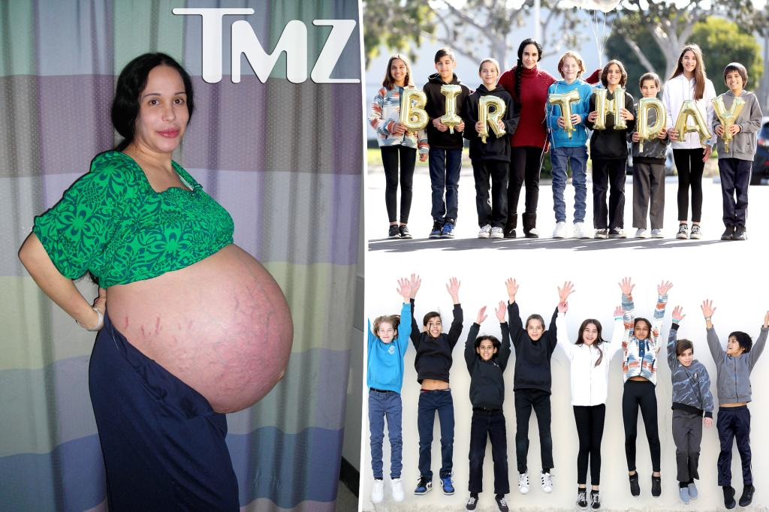
T R E A T M E N T S F O R I N F E R T I L I T Y
In vitro fertilisation (IVF)
OCTOMOM!!!

Slide 26
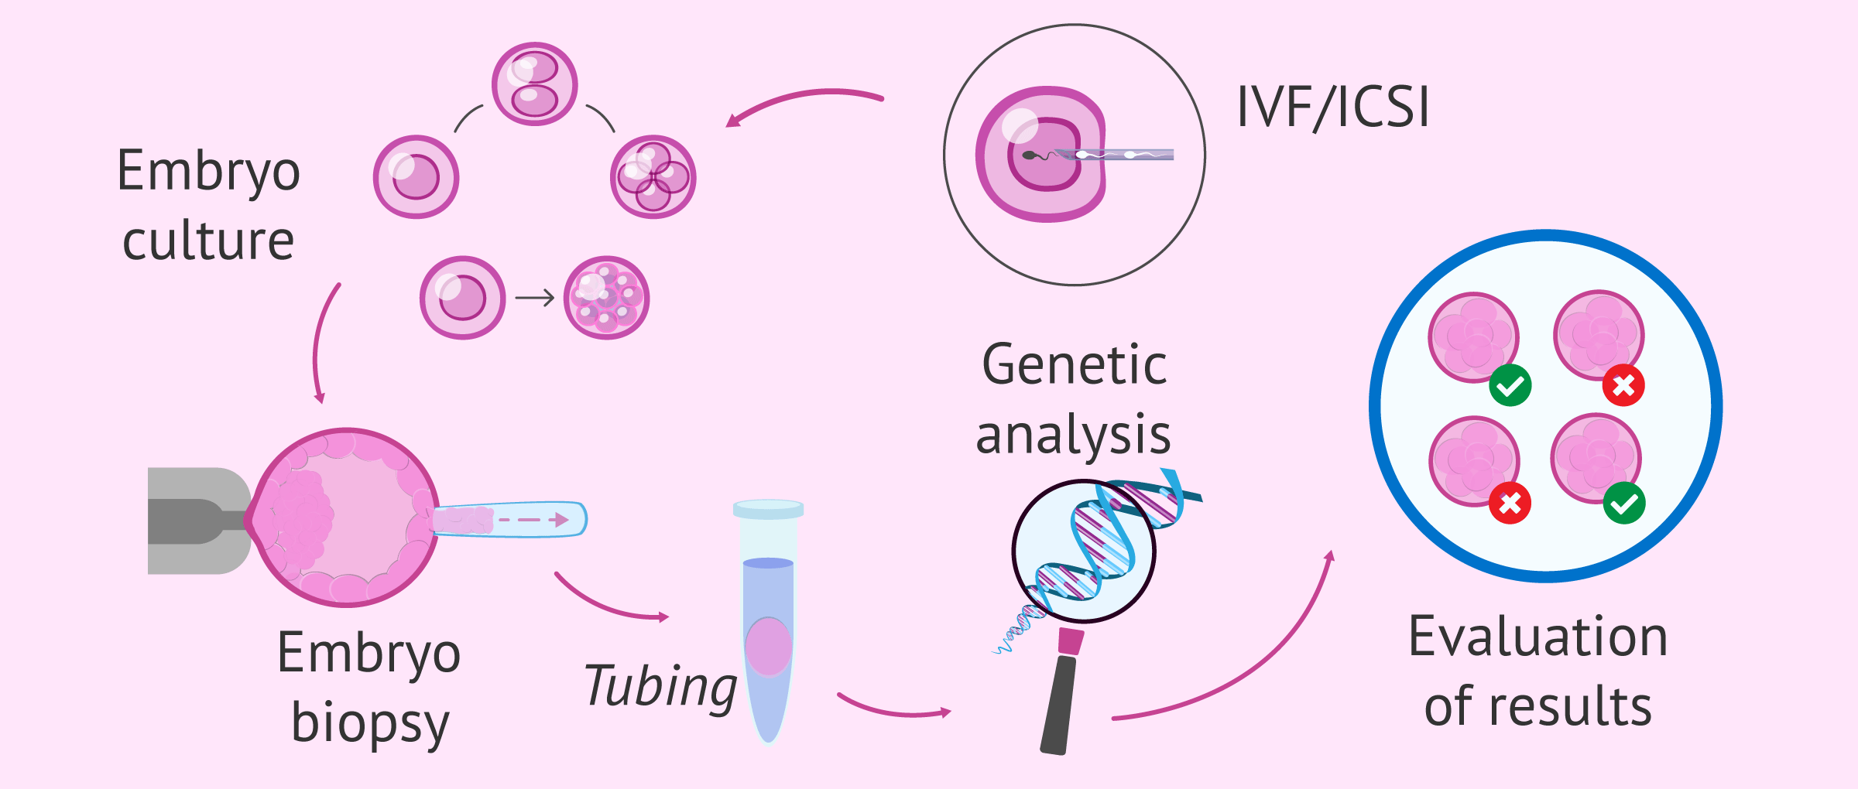
Pre-implantation Genetic Diagnosis (PGD)
T R E A T M E N T S F O R I N F E R T I L I T Y
https://www.youtube.com/watch?v=dtehNjffzIA
PGD is often used during IVF treatment to identify single gene disorders and chromosomal abnormalities.
Decisions on zygote selection can then be made based on the findings.

Slide 27
C O U R S E S P E C N O T E S
Stimulating ovulation
Ovulation is stimulated by drugs that prevent the negative feedback effect of oestrogen on FSH secretion. Other ovulatory drugs mimic the action of FSH and LH. These drugs can cause super ovulation that can result in multiple births or be used to collect ova for in vitro fertilisation (IVF) programmes.
Artificial insemination
Several samples of semen are collected over a period of time. Artificial insemination is particularly useful where the male has a low sperm count. If a partner is sterile a donor may be used to provide semen.
Intra-cytoplasmic sperm injection (ICSI)
If mature sperm are defective or very low in number, ICSI can be used. The head of the sperm is drawn into a needle and injected directly into the egg to achieve fertilisation.
In vitro fertilisation (IVF)
Surgical removal of eggs from ovaries after hormone stimulation. Incubation of zygotes and uterine implantation. The use of IVF in conjunction with pre-implantation genetic diagnosis (PGD) to identify single gene disorders and chromosomal abnormalities. Eggs are mixed with sperm in a culture dish. The fertilised eggs are incubated until they have formed at least eight cells and are then transferred to the uterus for implantation.

