Slide 1
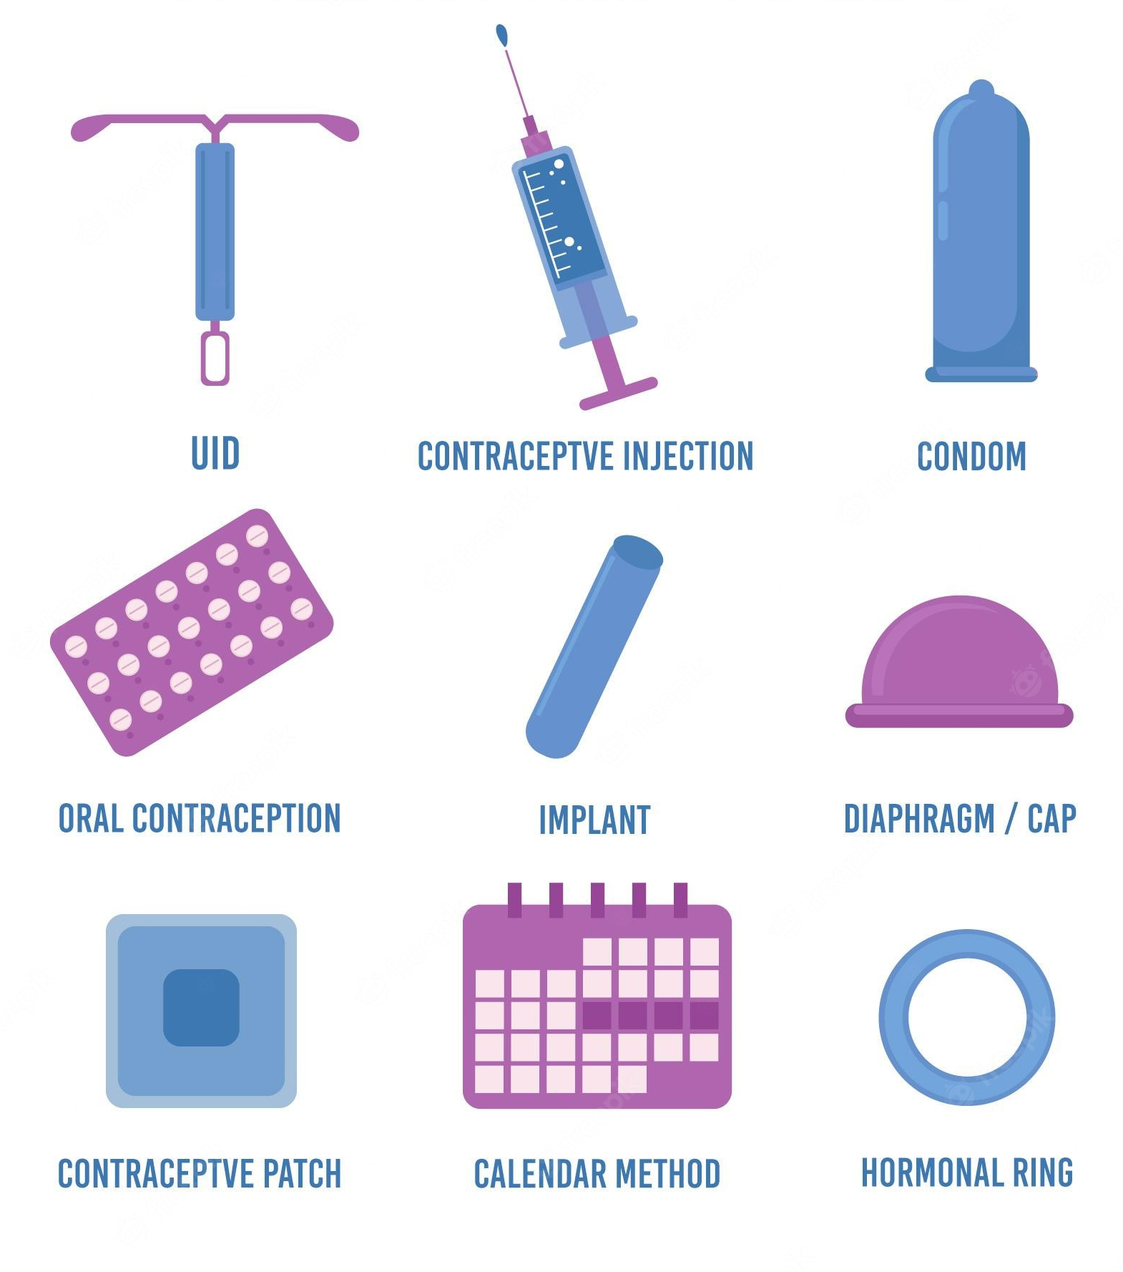
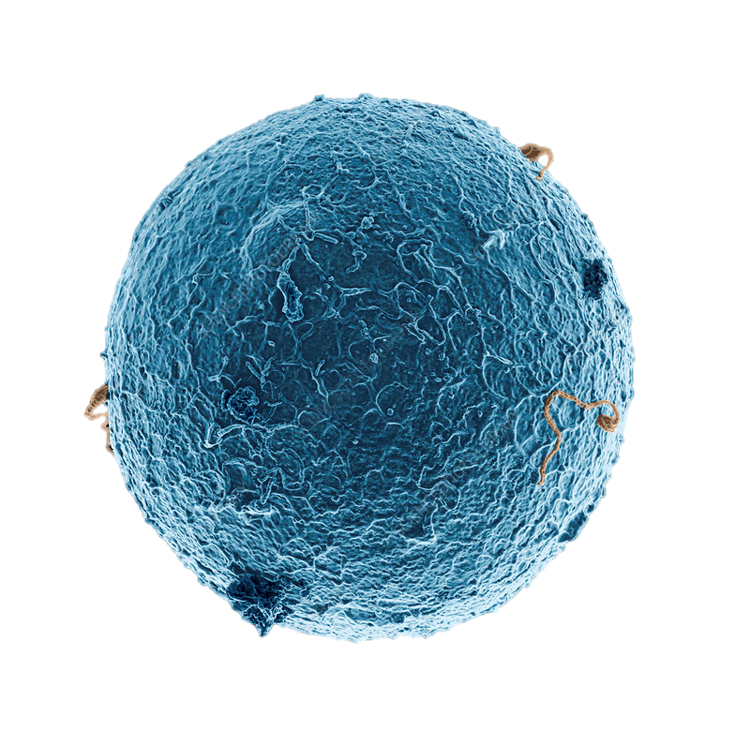
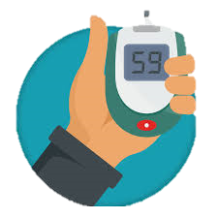
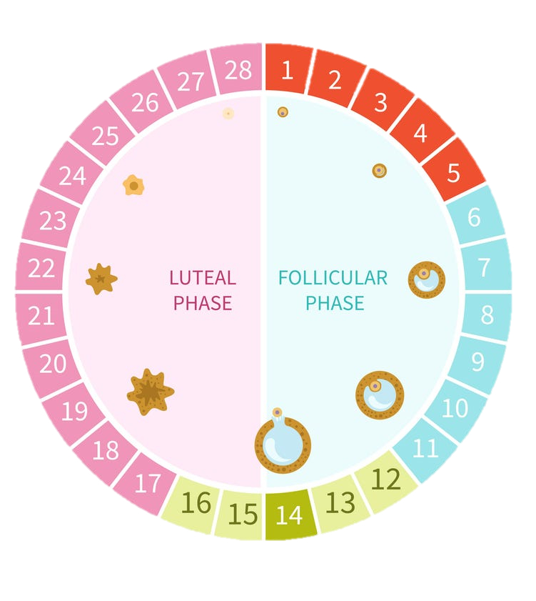
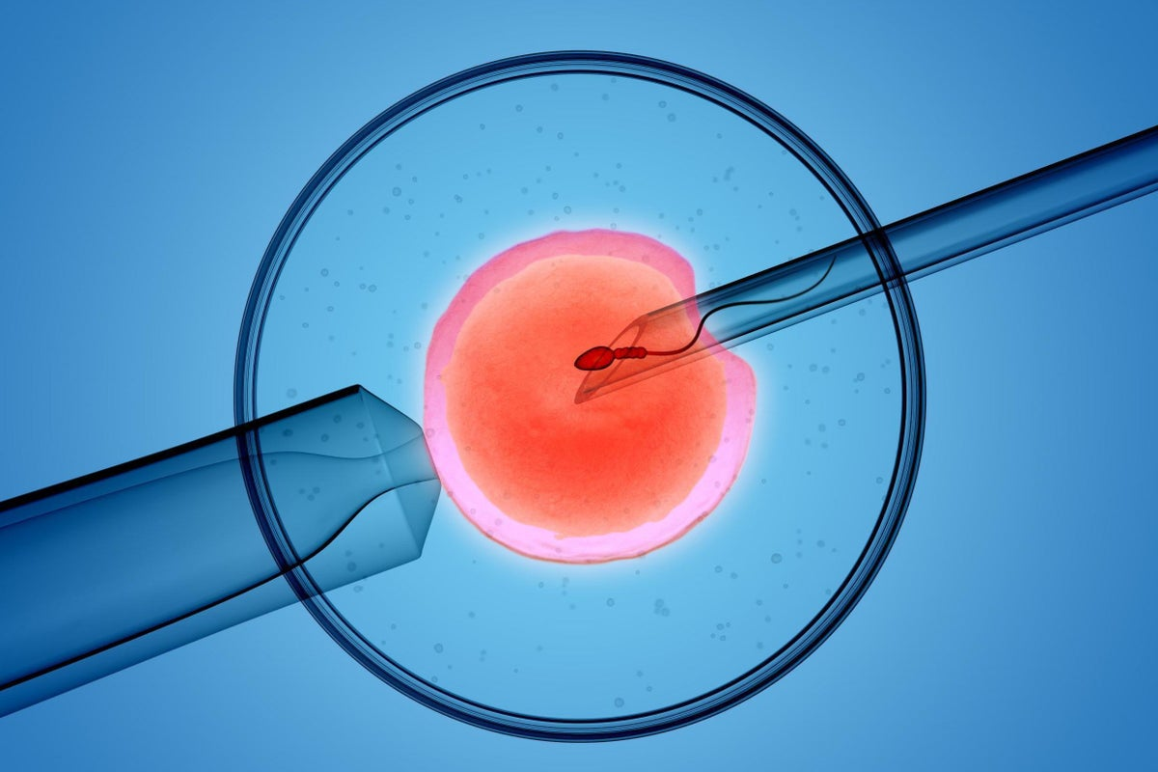
Unit 2- Physiology & Health

Slide 2
Physiology and Health
What is in this unit?
2.1 Gamete production and fertilisation
2.2 Hormonal control of reproduction
2.3 The biology of controlling fertility
2.4 Antenatal and postnatal screening
2.5 The structure and function of arteries, capillaries and veins
2.6 The structure and function of the heart
2.7 Pathology of cardiovascular disease (CVD)
2.8 Blood glucose levels and obesity

Slide 3
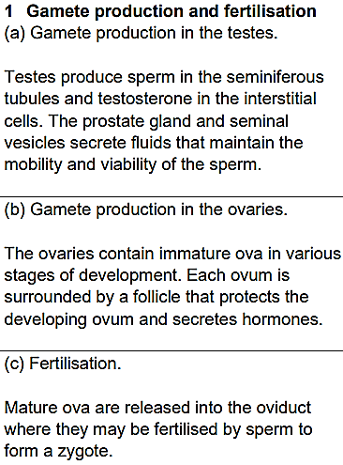
Physiology and Health
2.1 Gamete production and fertilisation
What can you remember from Nat 5?

Slide 4
Physiology and Health
2.1 Gamete production and fertilisation
Unit 1 Recall
Germline cells are gametes (sperm and ova) and the stem cells that divide to form gametes.
Germline stem cells divide by:
Mitosis & Meiosis
46
Diploid cells have ____ pairs of homologous chromosomes.
Sperm
Ova
23
Haploid gametes contain ____ single chromosomes.

Slide 5
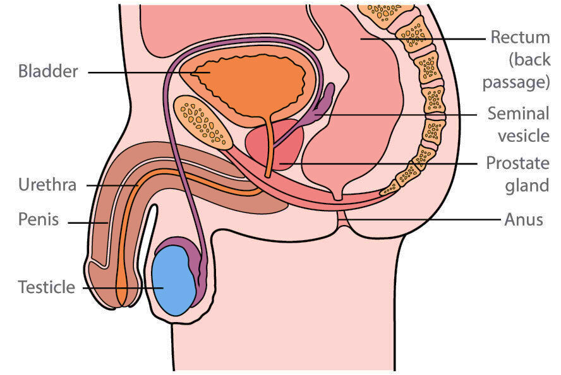
Male Reproductive System
Rectum
Bladder
Seminal
Vesicle
Prostate
Urethra
Gland
Penis
Anus
Testes

Slide 6
Gamete production: testes
Testes

Slide 7
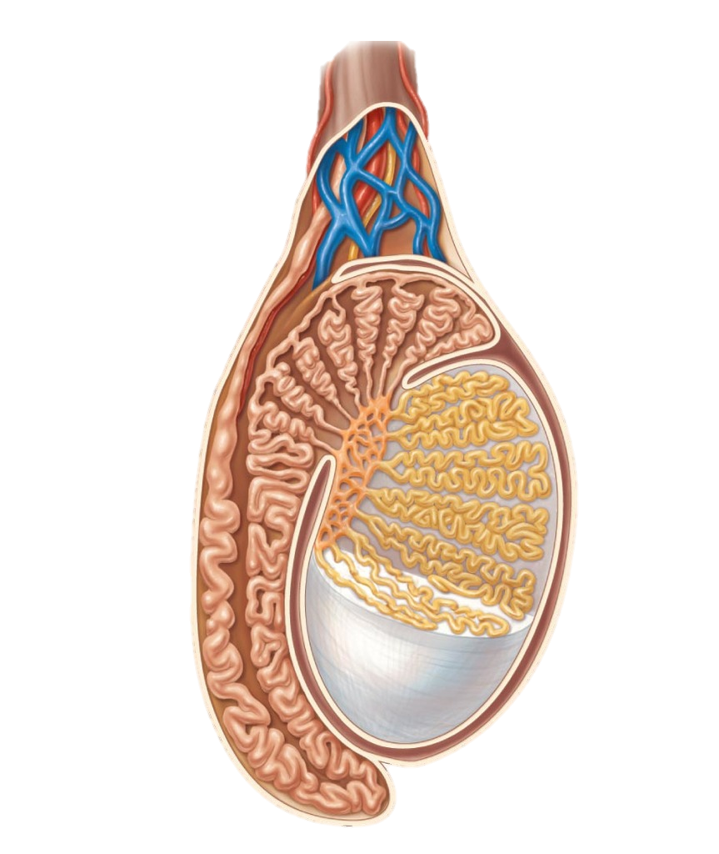
Gamete production: testes
Cross section of a teste
The testes have two functions:
Sperm production
Testosterone production

Slide 8
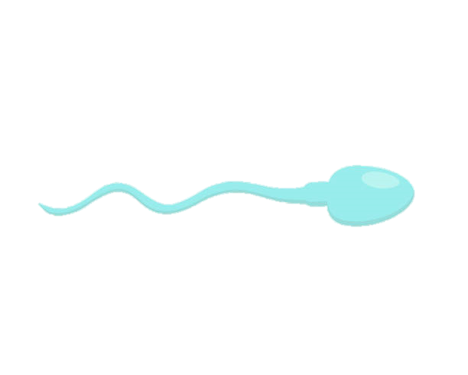
Gamete production: testes
Cross section of a teste
Sperm is produced in the seminiferous tubules.
Seminiferous tubules

Slide 9
Male Reproductive System
Seminal
Vesicle
Prostate
Urethra
Gland
Penis
Testes

Slide 10
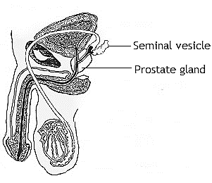
Seminal vesicles secrete a liquid rich in fructose. This gives the sperm energy to swim.
This liquid also contains compounds (prostaglandins) which cause contractions of the female reproductive tract to help the sperm reach the oviduct faster.

Slide 11
The prostate gland gland secretes a lubricating liquid which contains enzymes to keep the fluid at the correct viscosity to allow the sperm to swim.
Semen contains sperm from the testes and fluid secretions from the seminal vesicles and prostate gland.
The prostate gland and seminal vesicles secrete fluids that maintain the mobility and viability of the sperm.

Slide 12
Hormone production: testosterone
Cross section of a teste
Testosterone is produced in the interstitial cells.
Seminiferous tubules

Slide 13
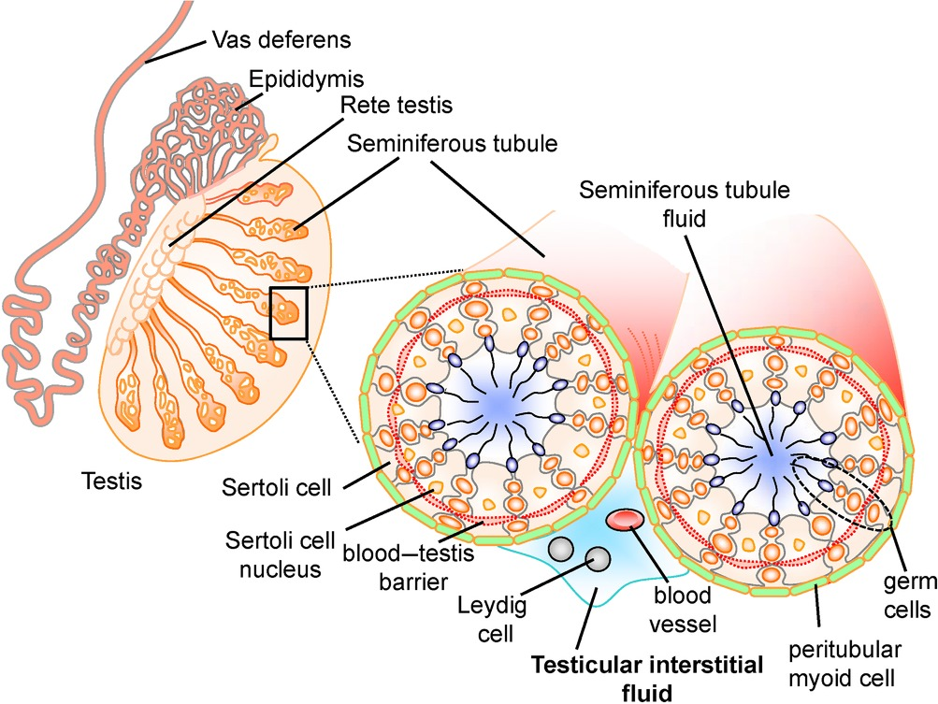
Hormone production: testosterone
Testosterone is produced in the interstitial cells.

Slide 14
Hormone production: testosterone
Testosterone is produced in the interstitial cells.

Slide 15
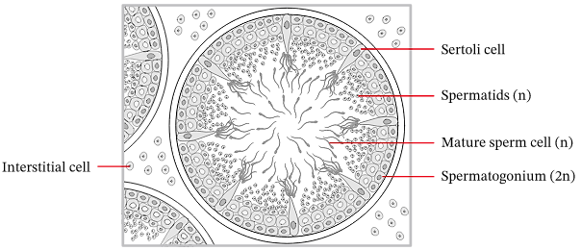
Hormone production: testosterone

Slide 16
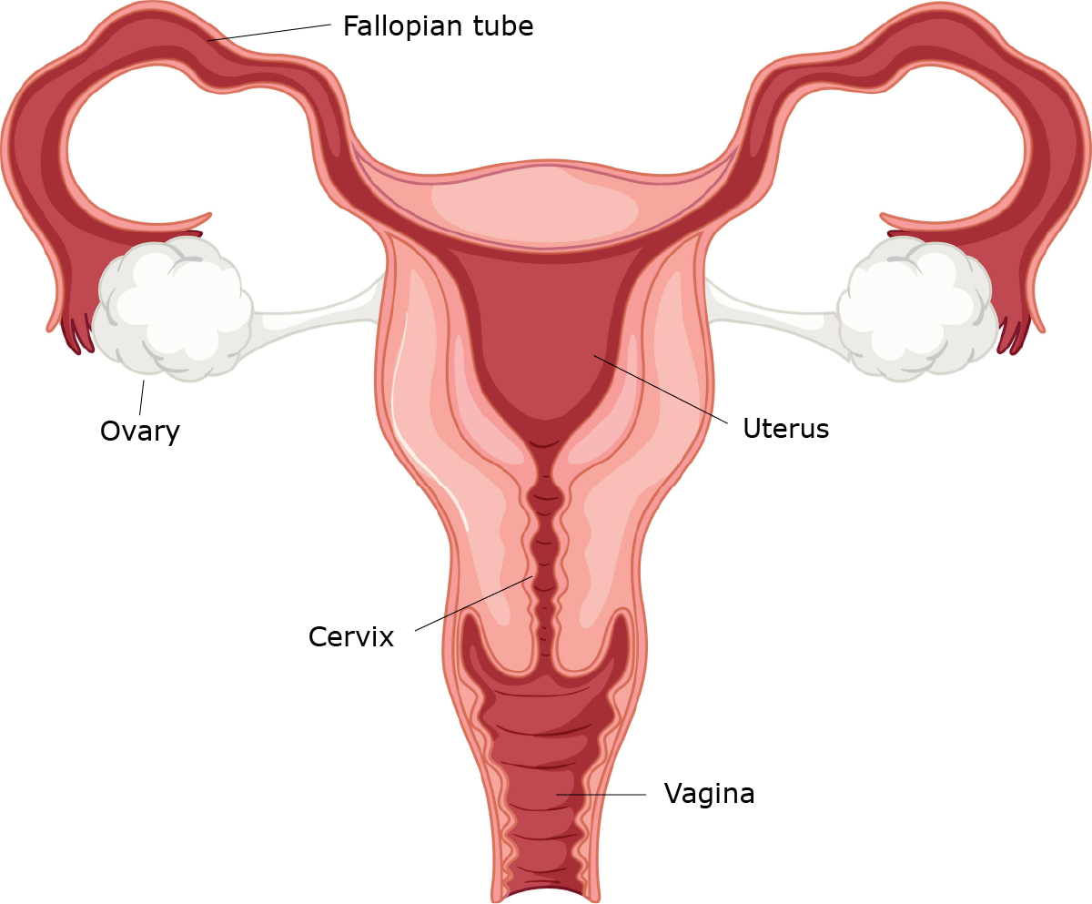
Gamete production: Ovaries
Oviduct
Ovary
Uterus
Cervix
Vagina

Slide 17
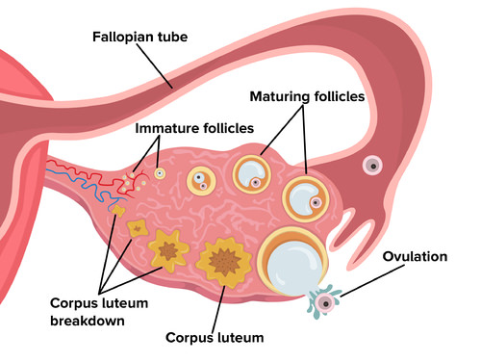
Gamete production: Ovaries
Oviduct
The ovaries contain immature ova in various stages of development.
Each ovum is surrounded by a follicle that protects the developing ovum and secretes hormones.

Slide 18
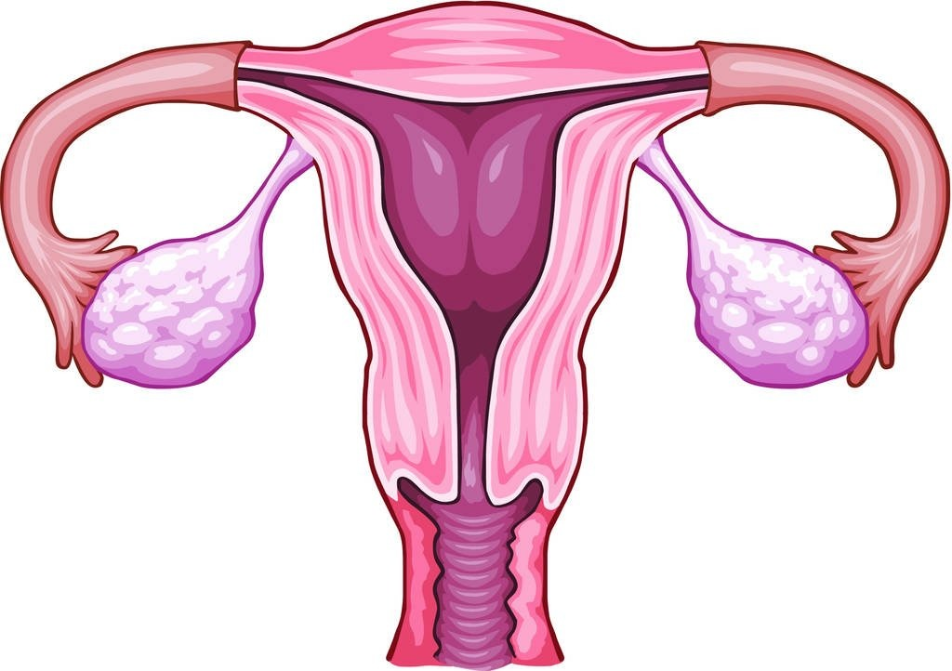
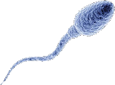
2
Oviduct
Ovary

Slide 19
FERTLISATION!!!
Happens in the oviduct!

Slide 20
Zygote is formed

Slide 21
C O U R S E S P E C N O T E S
Gamete production in the testes.
Testes produce sperm in the seminiferous tubules and testosterone in the interstitial cells. The prostate gland and seminal vesicles secrete fluids that maintain the mobility and viability of the sperm.
Gamete production in the ovaries.
The ovaries contain immature ova in various stages of development. Each ovum is surrounded by a follicle that protects the developing ovum and secretes hormones.
Fertilisation.
Mature ova are released into the oviduct where they may be fertilised by sperm to form a zygote.

Slide 22
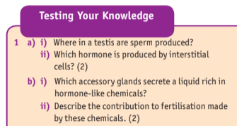

Slide 23
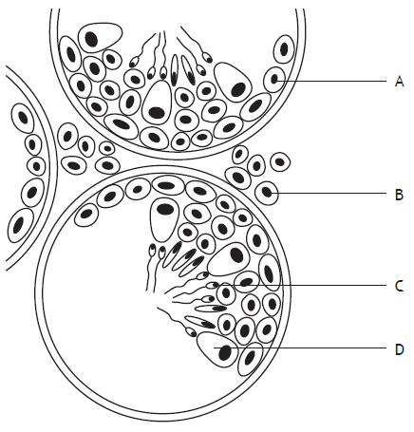
PPQs
The diagram below shows a section through part of the testes.
Which cells produce testosterone?

Slide 24
PPQs
The diagram below represents sperm production in a cross section through part of a testis.
Name structure A

Slide 25
PPQs
The diagram shows a germline cell dividing to produce sperm cells.
Name this type of cell division.

Slide 27
Which part of the male reproductive system produces sperm?

Slide 28
Which part of the male reproductive system produces sperm?
Testes

Slide 29
Which part of the testes secretes testosterone?

Slide 30
Which part of the testes secretes testosterone?
Interstitial cells

Slide 31
Where does fertilisation take place?

Slide 32
Where does fertilisation take place?
Oviduct

Slide 33
Which part of the testes produces sperm?

Slide 34
Which part of the testes produces sperm?
Seminiferous Tubules

Slide 35
What is the function of the follicle in the ovary?

Slide 36
What is the function of the follicle in the ovary?
Protect developing ovum and secretes hormone

Slide 37
What do the prostate and seminal vesicles do?

Slide 38
What do the prostate and seminal vesicles do?
Secrete fluids that maintain mobility and viability of sperm

Slide 39
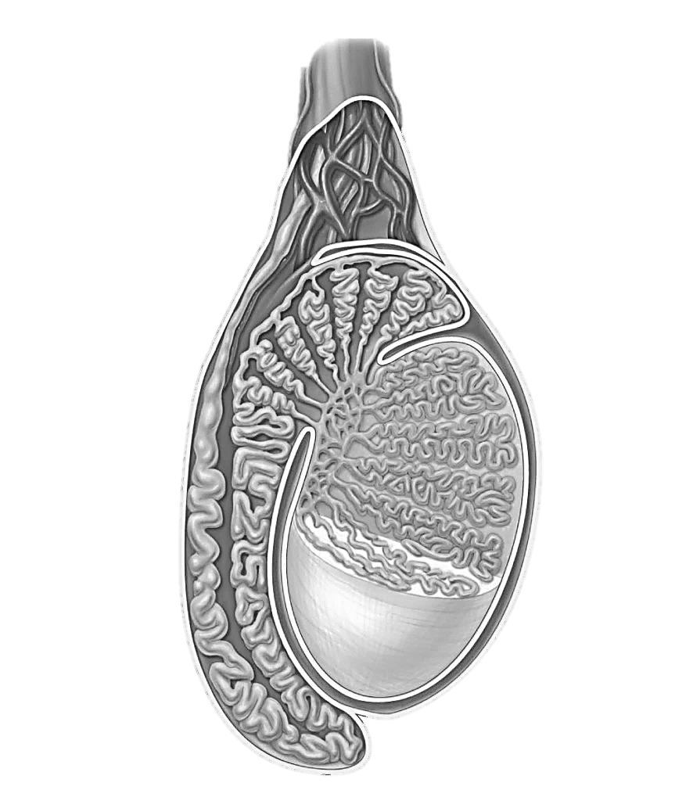

Slide 40
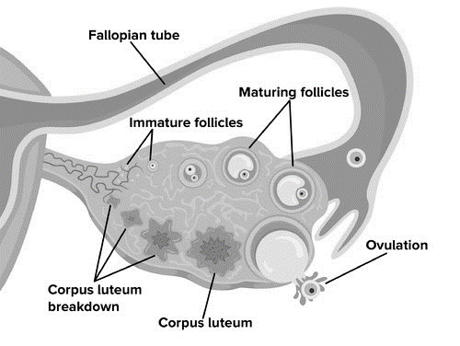
Oviduct
Oviduct
Oviduct
Oviduct

Slide 41
