Slide 1
KA 1.1 Cell Structure

Slide 2
Question
What is the function of a cell wall?

Slide 3
Answer
Provides structure/support to the cell.

Slide 4
Question
What is the function of a mitochondria?

Slide 5
Answer
Site of cellular respiration

Slide 6
Question
What is the function of a chloroplast?

Slide 7
Answer
Site of photosynthesis

Slide 8
Question
What is the function of a cell membrane?

Slide 9
Answer
Controls what enters and exits the cell.

Slide 10
Question
What is the function of a cytoplasm?

Slide 11
Answer
Site of chemical reactions

Slide 12
Question
What is the function of a vacuole?

Slide 13
Answer
Contains sell sap

Slide 14
Question
What is the function of a nucleus?

Slide 15
Answer
Controls all cell activities and stores genetic information.

Slide 16
Question
What is the function of a ribosome?

Slide 17
Answer
Site of protein synthesis

Slide 18
Question
What is the function of a plasmid?

Slide 19
Answer
Plasmids contains DNA.

Slide 20
Question
What are plant cell walls made of?

Slide 21
Answer
Plant cell walls are made of cellulose.

Slide 22
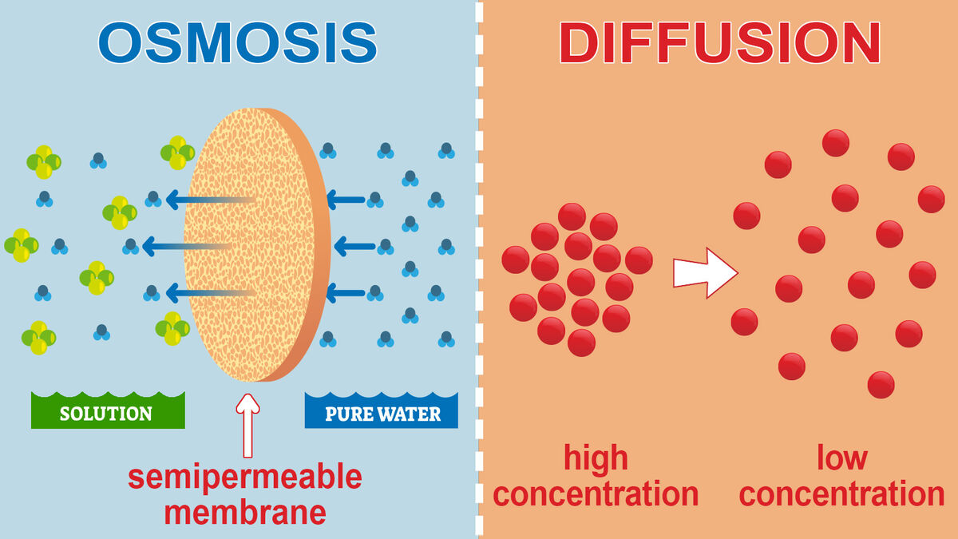
KA 1.2 Transport across membranes

Slide 23
Question
What does the cell membrane consist of?

Slide 24
Answer
Phospholipids and proteins.

Slide 25
Question
The cell membrane is described as being…

Slide 26
Answer
Selectively permeable.

Slide 27
Question
What does selectively permeable mean?

Slide 28
Answer
Some molecules can move through the membrane and some cannot.

Slide 29
Question
What is passive transport?

Slide 30
Answer
Passive transport occurs down a concentration gradient (high to low).

Slide 31
Question
Does passive transport require energy?

Slide 32
Answer
Passive transport does not require energy.

Slide 33
Question
Give two examples of passive transport.

Slide 34
Answer
Diffusion and osmosis.

Slide 35
Question
What is the definition of diffusion?

Slide 36
Answer
Diffusion is the movement of molecules down a concentration gradient from a higher to a lower concentration.

Slide 37
Question
Name 3 substances that are moved in/out of cells by diffusion.

Slide 38
Answer
Glucose, oxygen and carbon dioxide.

Slide 39
Question
What is the definition of osmosis?

Slide 40
Answer
Osmosis is the movement of water molecules from a higher water concentration to a lower water concentration through a selectively permeable membrane.

Slide 41
Question
What happens to an animal cell in pure water?

Slide 42
Answer
Animal cells burst in pure water or in an environment with a higher water concentration than inside the cell.

Slide 43
Question
What happens to an animal cell in an environment with a lower water concentration outside the cell than inside?

Slide 44
Answer
The animal cell would shrink.

Slide 45
Question
What would happen to a plant cell placed in pure water?

Slide 46
Answer
It would become turgid.

Slide 47
Question
Why do animal cells burst and not become turgid like plant cells in a similar solution?

Slide 48
Answer
Animal cells do not have a cell wall. Plant cells have a cell wall and maintains its structure.

Slide 49
Question
What term is given to a plant cell placed in strong salt solution?

Slide 50
Answer
Plasmolysed (the cell membrane pulls away from the cell wall)

Slide 51
Question
What is the type of transport called that requires energy?

Slide 52
Answer
Active Transport

Slide 53
Question
Which direction does active transport move moleccules?

Slide 54
Answer
Active transport moves molecules and ions against the concentration gradient.

Slide 55
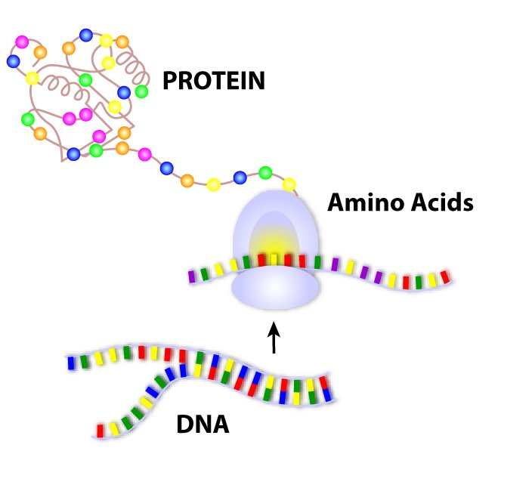
KA 1.3 DNA and the production of proteins

Slide 56
Question
How would you describe the twisted structure of DNA?

Slide 57
Answer
Double stranded helix

Slide 58
Question
How are the two strands of DNA held together?

Slide 59
Answer
Complimentary base pairs

Slide 60
Question
What are the four bases?

Slide 61
Answer
Adenine, guanine, thymine and cytosine.

Slide 62
Question
Which bases are complimentary to each other?

Slide 63
Answer
Adenine + Thymine
Guanine + Cytosine
(Straight letters AT
Curly letters GC)

Slide 64
Question
What does the base sequence of DNA determine?

Slide 65
Answer
The amino acid sequence in proteins.

Slide 66
Question
What is a gene?

Slide 67
Answer
A section of DNA which codes for a protein.

Slide 68
Question
What is mRNA and what does it do?

Slide 69
Answer
Messenger RNA is a molecule which carries a complimentary copy of the genetic code form the DNA, in the nucleus, to a ribosome.

Slide 70
Question
What happens after the complementary copy of the genetic code reaches the ribosome?

Slide 71
Answer
Amino acids are assembled to make a protein.

Slide 72
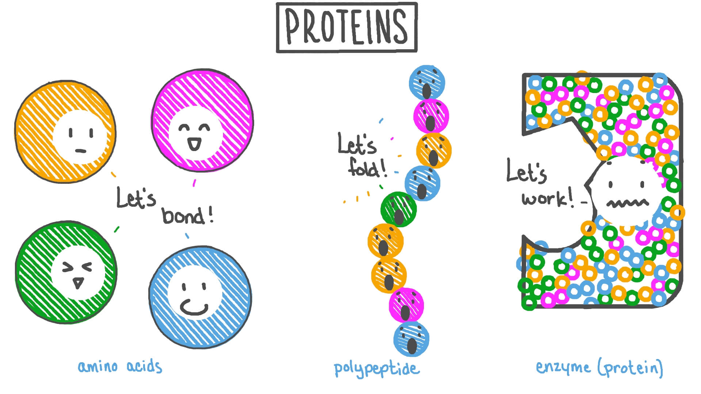
KA 1.4 Proteins

Slide 73
Question
Why do proteins have a variety of shapes and functions?

Slide 74
Answer
The difference in the sequence of amino acids.

Slide 75
Question
What are the 5 main functions of proteins?

Slide 76
Answer
Structural, hormones, antibodies, receptors and enzymes (SHARE)

Slide 77
Question
What is an enzyme?

Slide 78
Answer
Biological Catalyst

Slide 79
Question
What are biological catalysts?

Slide 80
Answer
Speed up chemical reactions

Slide 81
Question
True or false: Enzymes are made by all living cells.

Slide 82
Answer
True: Enzymes are made by all living cells.

Slide 83
Question
True or False: Enzymes are changed in the process.

Slide 84
Answer
False: Enzymes remain unchanged in the process (can be used again and again!)

Slide 85
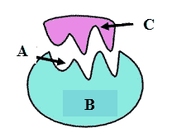
Question
Label the enzyme:

Slide 86
Answer
Substrate
Active Site
Enzyme

Slide 87
Question
What word would you use to describe the shape of the active site to the substrate?

Slide 88
Answer
Enzyme active sites are complimentary to their specific substrate.

Slide 89
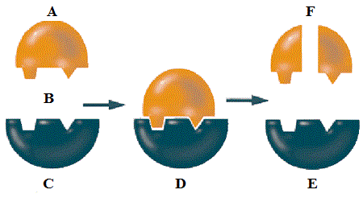
Question
What type of enzyme reaction is this?

Slide 90
Answer
Degradation reaction (larger molecule broken down into smaller molecules)

Slide 91
Question
What type of enzyme reaction is this?

Slide 92
Answer
Synthesis reaction (smaller molecules build up into a larger molecule)

Slide 93
Question
Fill in the diagram:

Slide 94
Answer
Enzyme
Substrate
Product

Slide 95
Question
Give an example of a degradation reaction.

Slide 96
Answer
SAM
Amylase
Starch
Maltose

Slide 97
Question
What are enzymes, and other proteins, affected by?

Slide 98
Answer
Temperature and pH

Slide 99
Question
What happens to an enzyme if the temperature is too high?

Slide 100
Answer
Becomes denatured.

Slide 101
Question
What does it mean when an enzyme is denatured?

Slide 102
Answer
Change in their shape which will affect the rate of reaction.

Slide 103
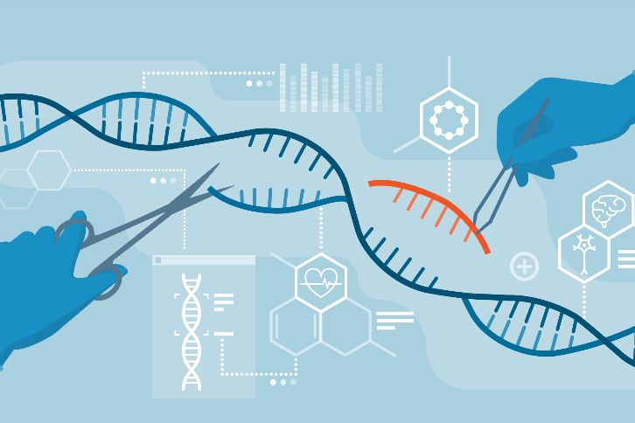
KA 1.5 Genetic Engineering

Slide 104
Question
What is genetic engineering?

Slide 105
Answer
Genetic information is where DNA can be transferred from one cell to another.

Slide 106
Question
Insert required gene into bacterial plasmid.
Extract required gene.
Put the stages of genetic engineering into the correct order:
Identify section of DNA that contains required gene from source chromosome.
Extract plasmid from bacterial cell.
Insert plasmid into host bacterial cell to produce a genetically modified (GM) organism.

Slide 107
Identify section of DNA that contains required gene from source chromosome.
Answer
Extract required gene.
Extract plasmid from bacterial cell.
Insert required gene into bacterial plasmid.
Insert plasmid into host bacterial cell to produce a genetically modified (GM) organism.

Slide 108
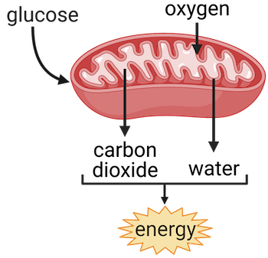
KA 1.6 Cellular Respiration

Slide 109
Question
What is respiration?

Slide 110
Answer
The chemical energy stored in glucose must be released by all cells through a series of enzyme-controlled reactions called respiration.

Slide 111
Question
What is the energy released from the breakdown of glucose used to generate?

Slide 112
Answer
ATP

Slide 113
Question
What are the 4 cellular activities ATP is used for?

Slide 114
Answer
Muscle cell contractions, cell division, protein synthesis and transmission of nerve impulses.

Slide 115
Question
What is glucose broken down into?

Slide 116
Answer
Glucose is broken down into two molecules of pyruvate.

Slide 117
Question
The breakdown of glucose into two molecules of pyruvate releases what?

Slide 118
Answer
Yields two molecules of ATP

Slide 119
Question
What needs to be present for aerobic respiration to take place?

Slide 120
Answer
Oxygen

Slide 121
Question
What happens to the pyruvate when oxygen is available?

Slide 122
Answer
Pyruvate is broken down to carbon dioxide and water, releasing enough energy to yield a large number of ATP molecules.

Slide 123
Question
What happens to pyruvate when there is an absence of oxygen?

Slide 124
Answer
Fermentation

Slide 125
Question
What are the pyruvate molecules converted to in fermentation in animal cells?

Slide 126
Answer
Pyruvate is converted to lactate in animal cells.

Slide 127
Question
What are the pyruvate molecules converted to in fermentation in plant and yeast cells?

Slide 128
Answer
Pyruvate is converted carbon dioxide and ethanol in plant and yeast cells

Slide 129
Question
What is the word equation for respiration?

Slide 130
Answer
Glucose + oxygen → Carbon dioxide + water + energy

Slide 131
Question
What is the word equation for fermentation in animal cells?

Slide 132
Answer
Glucose → lactate +energy

Slide 133
Question
What is the word equation for fermentation in yeast and plant cells?

Slide 134
Answer
Glucose → carbon dioxide + ethanol +energy

Slide 135
Question
Where in the cell does respiration begin?

Slide 136
Answer
Cytoplasm

Slide 137
Question
Where is the process of fermentation completed?

Slide 138
Answer
Fermentation also takes place in the cytoplasm.

Slide 139
Question
Where is aerobic respiration completed?

Slide 140
Answer
Mitochondira

Slide 141
Question
Correct this sentence: The lower the energy requirement of a cell, the smaller the number of mitochondria present in that cell.

Slide 142
Answer
Correct this sentence: The higher the energy requirement of a cell, the greater the number of mitochondria present in that cell.

Slide 143
Question
Give an example of a cell that would have a large number of mitochondria?

Slide 144
Answer
Sperm cells

