Slide 1
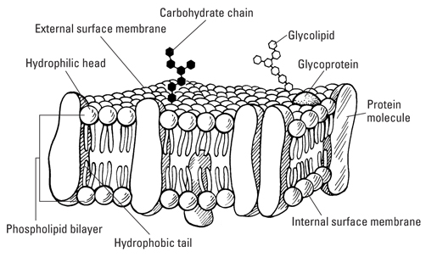
Unit 1: Cell Biology
1.2 Transport across membranes

Slide 2
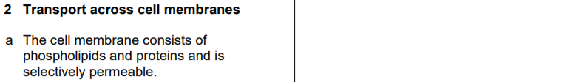
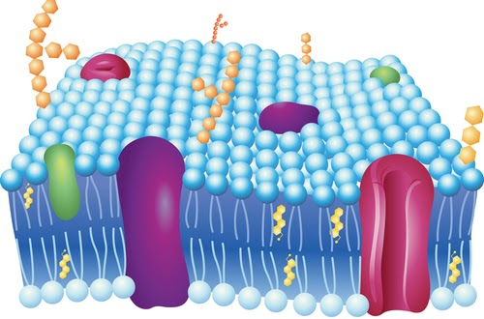
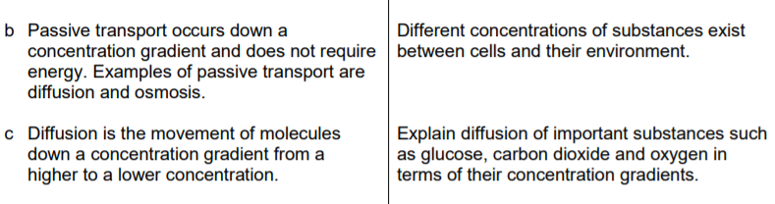
1.2 Transport Across Membranes

Slide 3
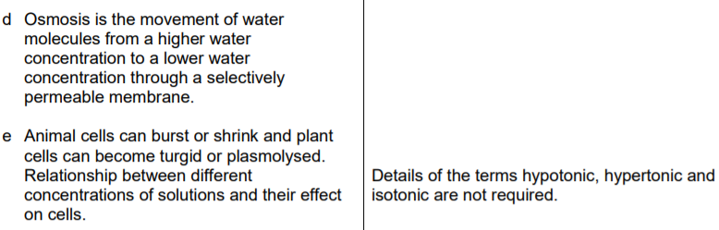

1.2 Transport Across Membranes
c

Slide 4
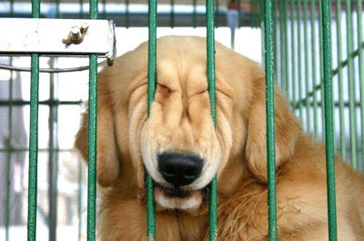
How …
… do substances get in and out of a cell?

Slide 5
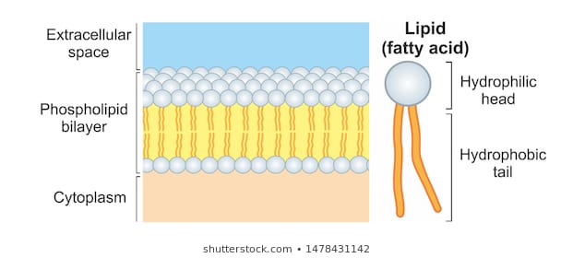
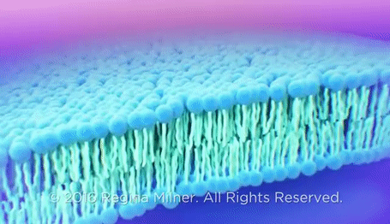
Lets look closer at the cell membrane…
FLUID MOSAIC MODEL

Slide 6

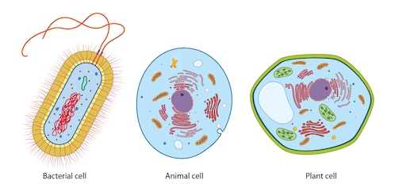
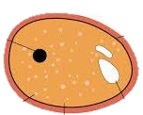
ALL CELLS HAVE CELL MEMBRANES!
Fungal Cell

Slide 7
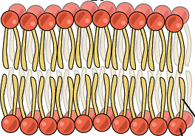
Cell Membrane Structure
The cell membrane is made up of two layers of phospholipids.
This is called a phospholipid bilayer.
Small molecules such as water, oxygen and carbon dioxide can pass directly through the phospholipids in the cell membrane. Glucose is an example of a molecule too large to pass through freely.
It is selectively permeable.
There are proteins within this membrane.

Slide 8
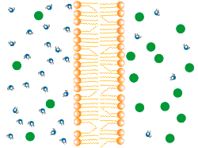
The Cell Membrane is SELECTIVELY PERMEABLE.
This means it allows water and other small molecules to pass through tiny pores, but not larger molecules such as starch.

Slide 9
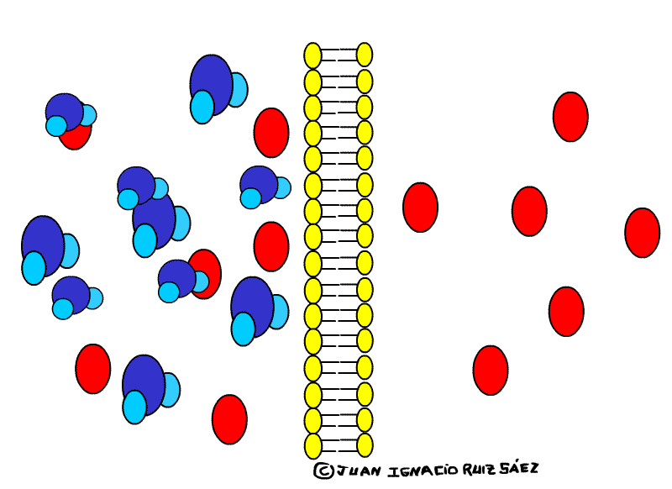
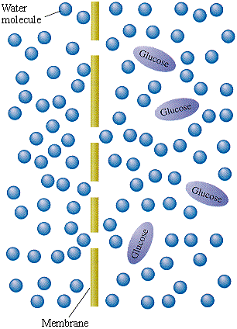
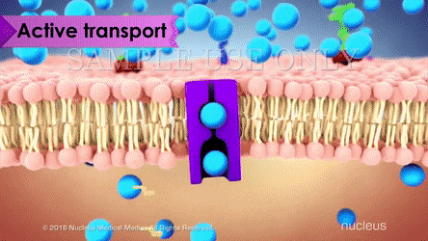
There are three ways of moving molecules in and out of the cell…
Diffusion
Osmosis
Active Transport

Slide 10
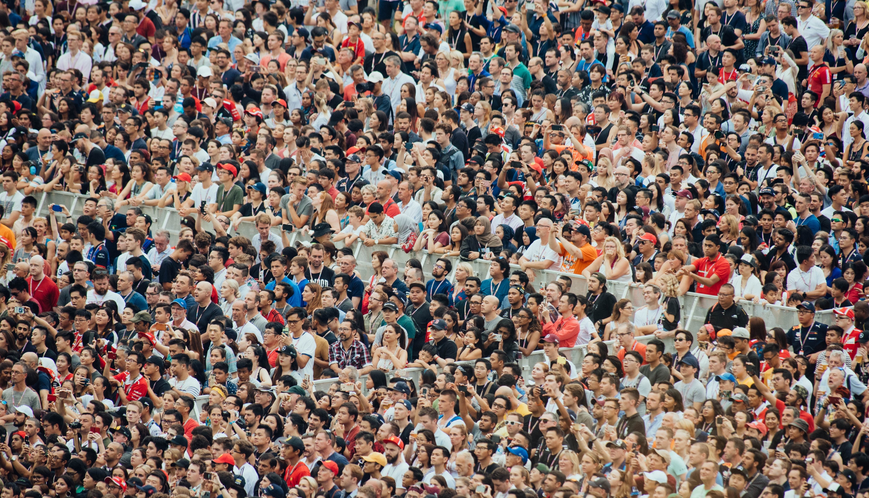

Diffusion

Slide 11
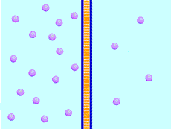
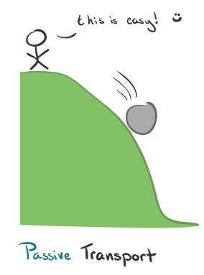
Diffusion
Diffusion is the movement of molecules through the cell membrane.
Molecules will naturally move from a higher concentration to a lower concentration.
Because this is a passive process it doesn’t require energy to happen.

Slide 12
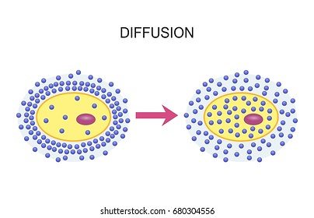
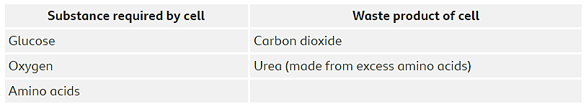
Diffusion
Your cells are always carrying out diffusion to obtain required substances and to get rid of waste products.

Slide 13
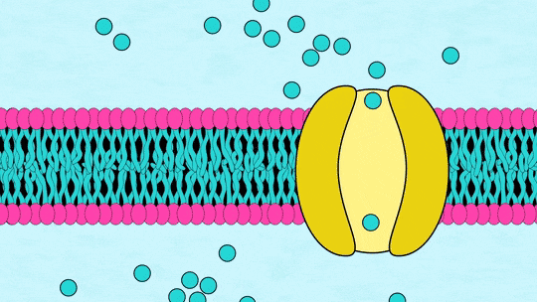
Diffusion definition to take note of…
The movement of molecules from a high concentration to a low concentration.

Slide 14
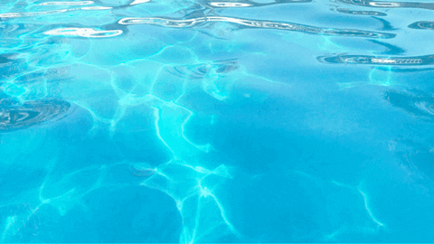
Osmosis
Osmosis is the second passive process you need to know.
Water molecules are moving this time, from a high water concentration to a low water concentration. .
No energy required.

Slide 15
Osmosis definition to take note of…
The movement of water molecules from a high water concentration to a low water concentration across a selectively-permeable membrane.

Slide 16
Water
Starch

Slide 17
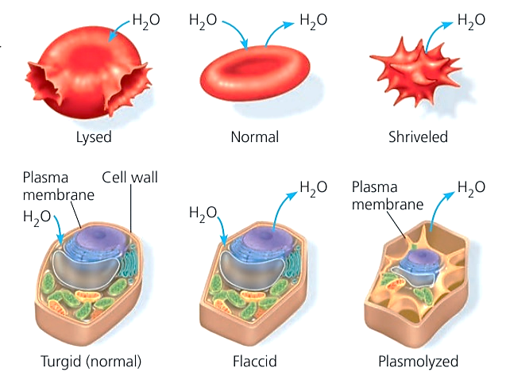
Shrunk
Burst

Slide 18
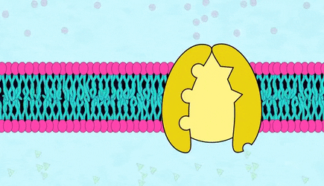
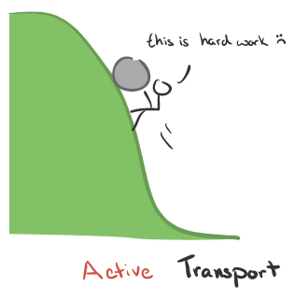
Active Transport
Sometimes molecules need to still move across the cell membrane but there isn’t enough of them to do it passively from a high to low concentration.
It can still make its way through the membrane through a process called active transport.
This uses energy as it is against the concentration gradient (low to high).

Slide 19
What do cells need and what waste products do they produce?
Useful substance needed by cells | Waste product removed from cells
Glucose | Carbon Dioxide
Oxygen | Urea
Water

Slide 20
Effect of osmosis on plant cells
Potato in water
Potato in strong salt solution
Potato in weak salt solution
 | Mass at start (g) | Mass after 24 hours (g) | Change in mass (g) | Texture of potato at end
Potato in water
Potato in strong salt solution
Potato in weak salt solution

Slide 21
Effect of osmosis on plant cells
Cut three cylinders of potato with a cork borer, cut them to the same length
Dry the outside of the potato cylinder with a paper towel
Use a balance to work out the mass of each potato and record it in your table
Place one cylinder in a test tube with 10cm³ of water, label it
Place another cylinder in a test tube with 10cm³ of strong salt solution, label it
Place the last cylinder in a test tube with 10cm³ of weak salt solution, label it
Leave the cylinders until the next lesson and then reweigh them and record your results

Slide 22
