Slide 1
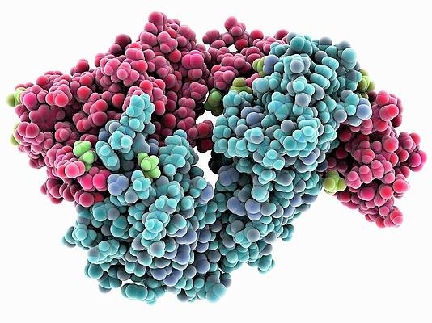
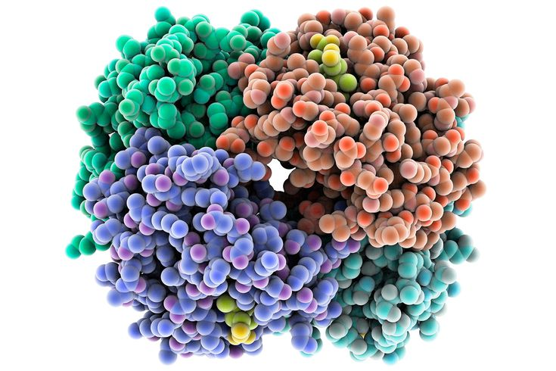
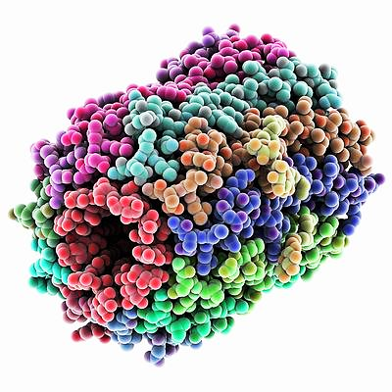
1.4 Proteins

Slide 2
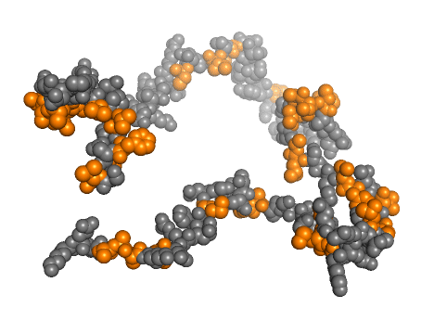
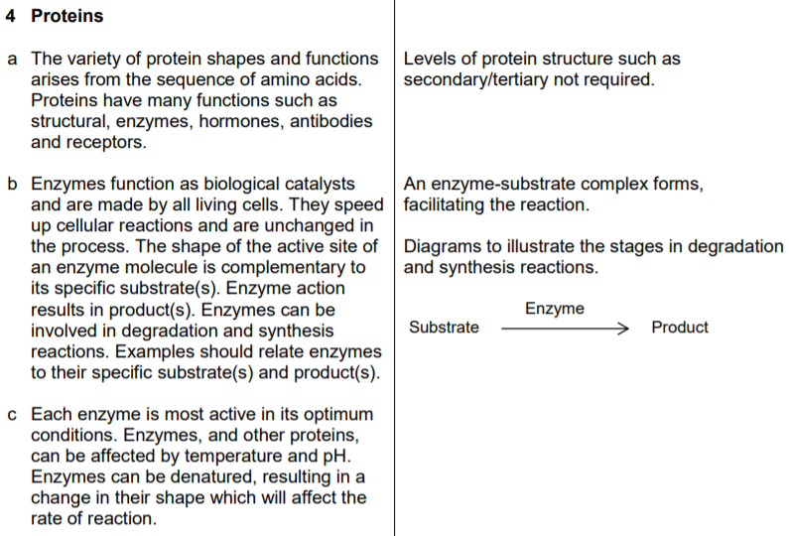
1.4 Proteins

Slide 3
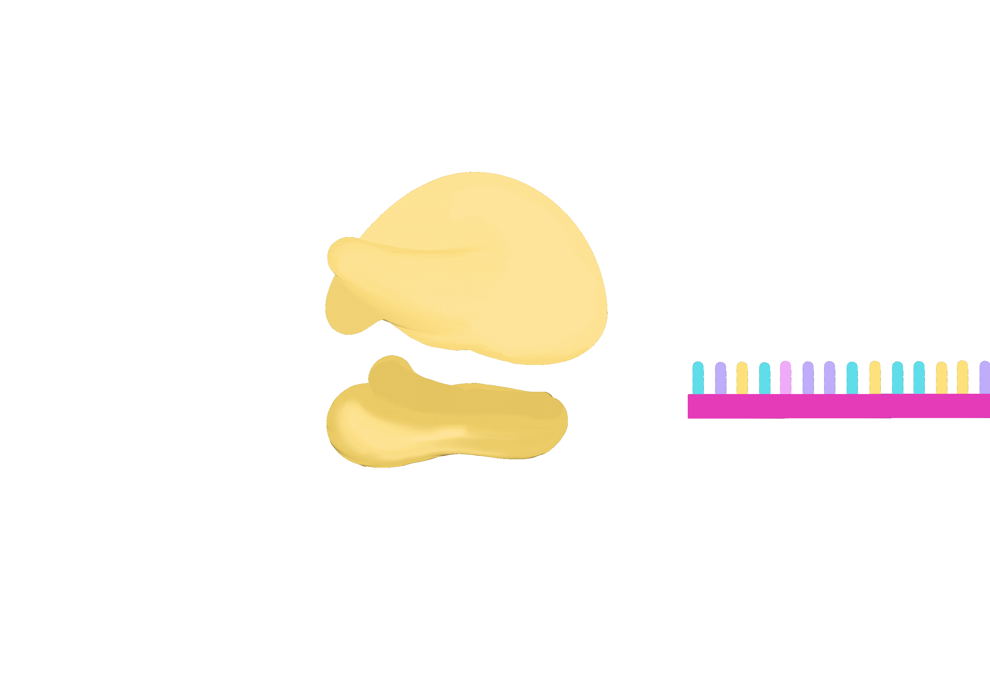
The chain of amino acids created by the ribosome fold up to create the coded protein.

Slide 4
The shape of the protein determines its function.
There are 5 functions you need to know at Nat 5.
Use the word SHARE to remember.

Slide 5
Proteins
SHARE to remember!
S
tructural
H
ormones
A
ntibodies
R
eceptors
E
nzymes

Slide 6
Function
Example
S
tructural
Forms supporting frameworks inside cells and forms body structures.
e.g. spindle fibres during mitosis
H
ormones
Communication between different parts of the body. Hormones are released from endocrine glands and are transported in the blood to target cells
e.g. Insulin: released from pancreas, stimulates liver cells to take up glucose from the blood and Glucagon
A
ntibodies
Part of the immune system. They are produced by white blood cells (lymphocytes)
e.g. Your body produces around one million different types of antibody
R
eceptors
e.g. Hormones are complimentary to receptors on their target cells.
Found on the surface of cells.
E
nzymes
Let’s look at Enzymes in more detail…

Slide 7
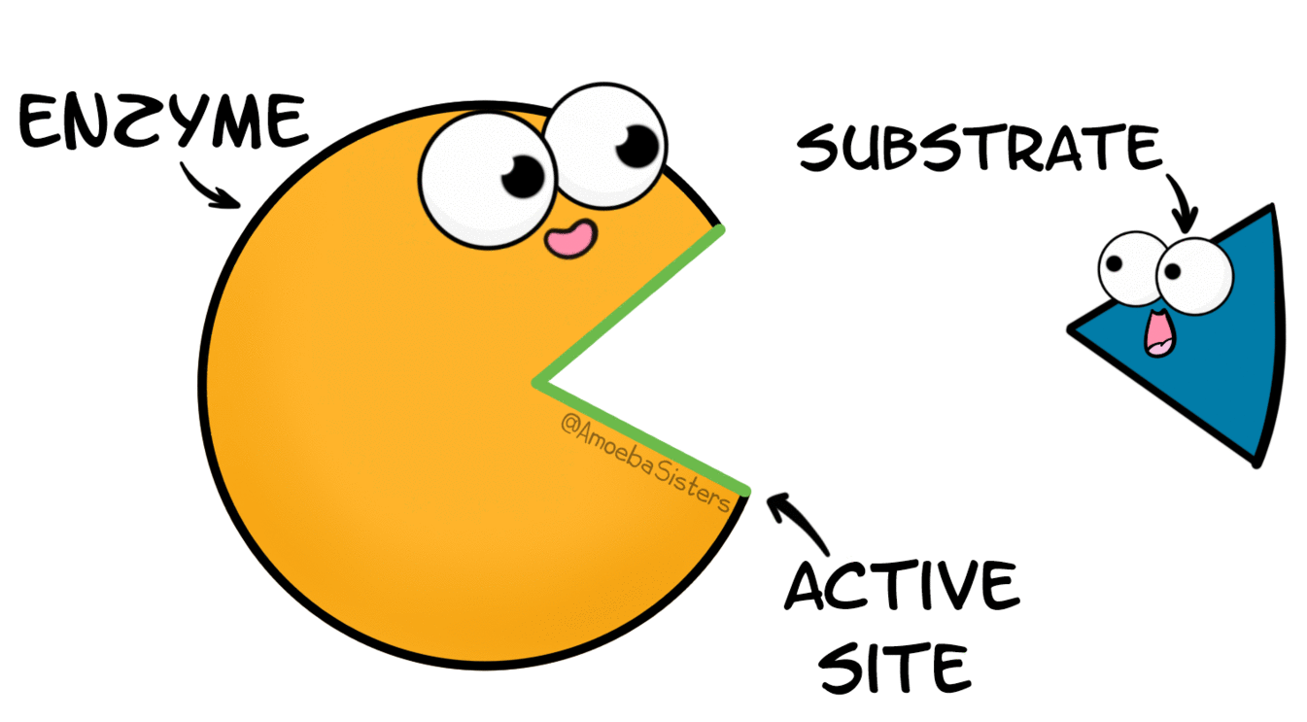
Enzymes

Slide 8
Enzymes
Enzymes function as biological catalysts and are made by all living cells.
They speed up cellular reactions and are unchanged in the process.
The shape of the active site of an enzyme molecule is complementary to its specific substrate(s).
Enzyme action results in product(s).

Slide 9
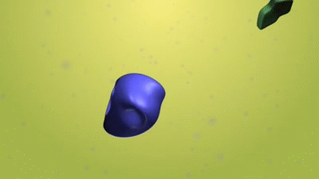
Degradation reactions and Synthesis reactions
Synthesis (building up)
Degradation (breaking down)

Slide 10
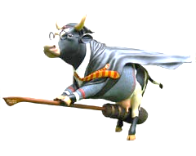
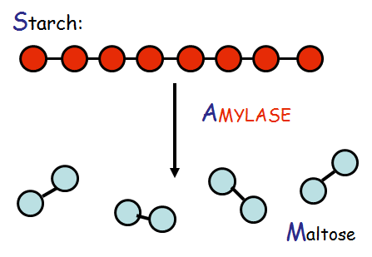
Examples to remember…
Phosphorylation
Starch
Pepsin
Proteins
Peptides

Slide 11
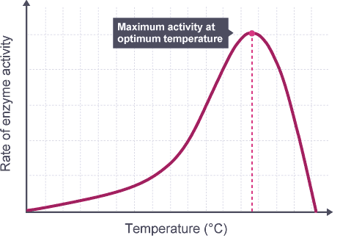
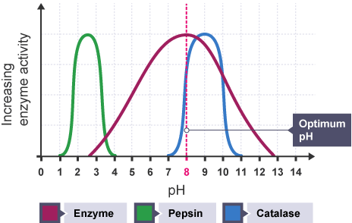
Each enzyme is most active in its optimum conditions.
Enzymes, and other proteins, can be affected by temperature and pH.
Enzymes can be denatured, resulting in a change in their shape which will affect the rate of reaction.

Slide 12
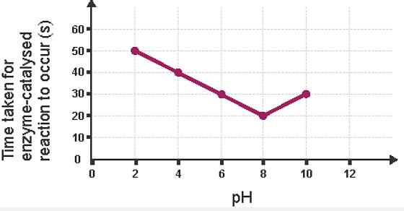
The graph shows the effect of pH on the time taken for an enzyme-catalysed reaction to occur.
What is the optimum pH of the enzyme?
8

