Slide 1
National 5 SQA 2016 Past Paper

Slide 2
Go through this Power Point in Slideshow view to avoid seeing the answers straight away.

Slide 3
The diagram below shows part of a plant cell.
Which part of this cell is composed of cellulose?

Slide 4
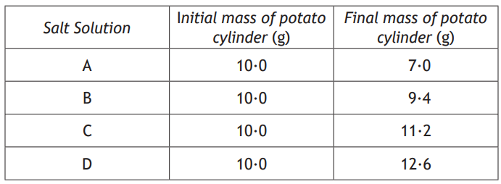
Four cylinders of potato tissue were weighed and each was placed into a salt solution of a different concentration.
The cylinders were reweighed after one hour and the results are shown below.
In which salt solution would most potato cells be plasmolysed?

Slide 5
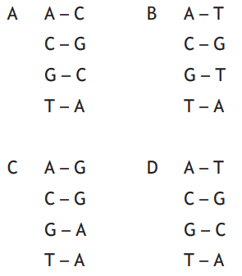
Which of the following shows the correct DNA base pairing?

Slide 6
Hormones are composed of…
glycerol
glucose
protein
starch

Slide 7
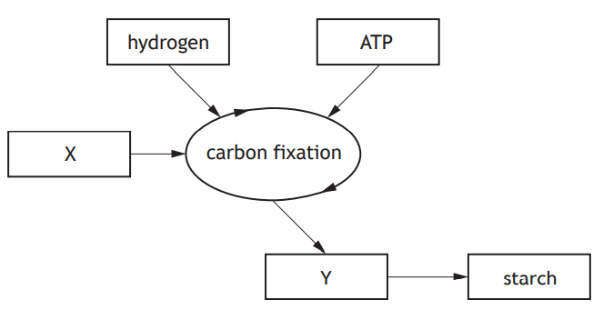
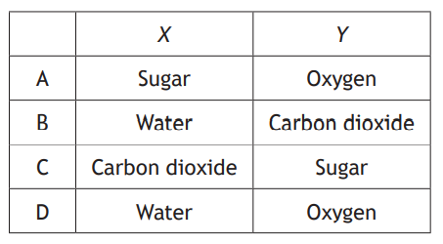
The diagram below shows the carbon fixation stage of photosynthesis.
Which row in the table identifies X and Y?

Slide 8
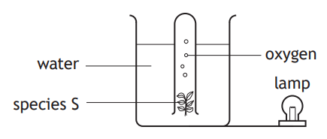
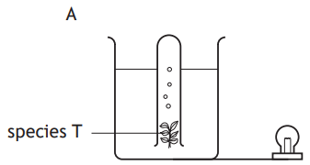
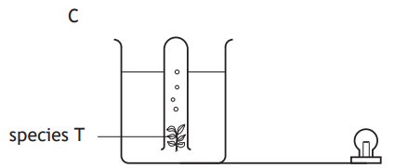
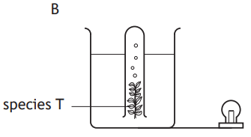
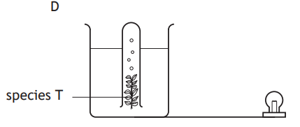
An investigation was carried out to compare the rate of oxygen gas production by two different species of water plant, S and T.
Which diagram below shows the set-up for species T, that would allow a valid comparison in the rate of oxygen production of the two species?

Slide 9
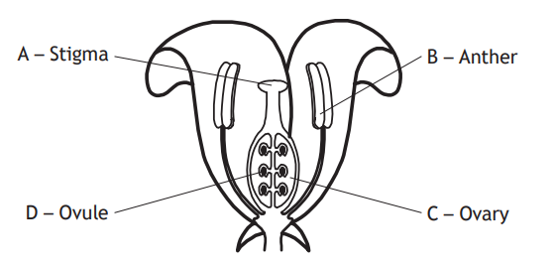
The diagram below shows the structure of a flower. Where are the male gametes produced?

Slide 10
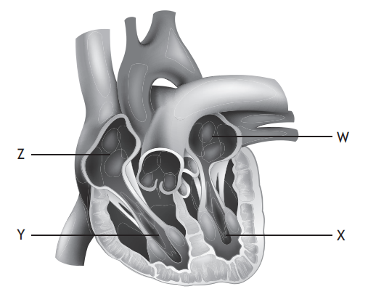
The diagram below shows the heart and associated blood vessels.
Which of the following statements is correct?
A W is the left atrium which receives blood from the body.
B X is the left ventricle which pumps blood to the body.
C Y is the right atrium which receives blood from the lungs.
D Z is the right ventricle which pumps blood to the lungs.

Slide 11
Each skin cell in a mouse has 40 chromosomes. How many chromosomes were present in each cell after dividing four times during cell culture?
10
20
160
40

Slide 12
An ecosystem receives 6 000 000 units of energy from the sun.
Of this energy, 95% is not used in photosynthesis.
The amount of energy captured by the producers in this ecosystem is…
30 000
300 000
570 000
5 700 000

Slide 13
Which of the following is a source of new alleles in a population?
Mutation
Isolation
Natural Selection
Environmental Conditions

Slide 14
Indicator species can provide information about…
Numbers of organisms in a lake
Numbers of predators in a woodland
Levels of light in an ecosystem
Levels of pollution in a river

Slide 15
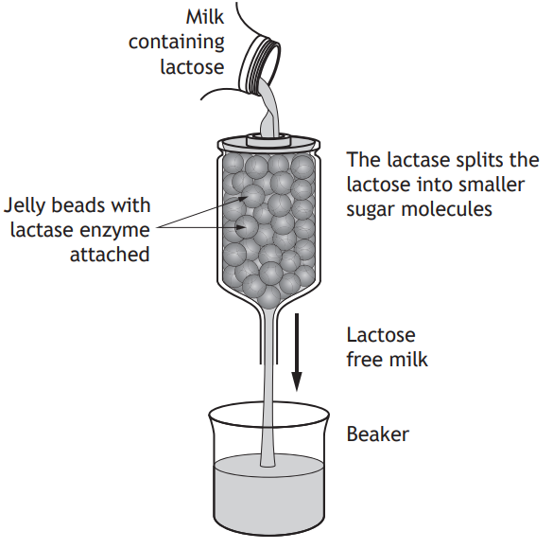
The diagram below shows how the enzyme lactase is used in the production of lactose-free milk.
The Underline one option in each of the brackets to make the following
sentences correct.
synthesis
This process is an example of a reaction.
In this reaction, lactose is the of lactase.
degradation
product
substrate

Slide 16
A fault in the production resulted in boiling water running over the
lactase enzyme.
Using your knowledge of enzymes, predict how the milk produced
would differ from the expected product (2)
Prediction (1):
Explanation (1):
All or some) lactose would not be removed from the milk /milk would contain lactose/it would not be lactose free (1)
Not acceptable: might/may contain lactose/milk will be the same/milk will be unchanged
Enzyme/lactase denatured
OR
enzyme/active site has changed shape/description of change of shape
In the context of this particular question, enzyme destroyed/does not work will be acceptable Not acceptable: enzyme/active site has changed explanation including reference to above the optimum or above 37˚C

Slide 17
Enzymes such as lactase are biological catalysts.
Explain the role of enzymes in living cells
Speed up
(chemical/biological/biochemical)
reactions/allow reactions to occur at
lower temperatures/lower the
activation energy
Unchanged in process does not negate.
Not acceptable: Control reactions. Can break down/build up…

Slide 18
Name the substance of which enzymes are made.
Protein/ Amino acids

Slide 19
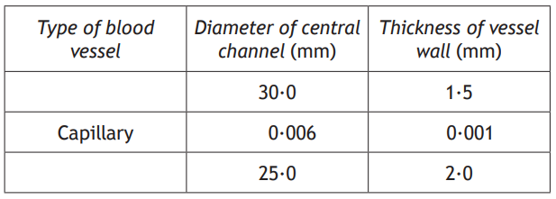
The table below gives information about features of three different types of blood vessel.
(a) (i) Complete the table by writing the name of the missing types of blood vessels in the empty boxes.
Vein
Artery
Not acceptable: specific name of blood vessel.

Slide 20
State a feature of the cell membrane which allows the movement of only some substances into the cell.
Selectively permeable / semi-permeable / proteins / protein channels/carriers
Not Acceptable: porous/pores

Slide 21
Osmosis is a process which can occur across the cell membrane.
Describe the effect of osmosis on a leaf cell placed in pure water.
Cell swells/becomes turgid
Not Acceptable: description of osmosis alone

Slide 22
Name a process, other than osmosis, which allows molecules to pass through the cell membrane.
Diffusion / Active Transport

Slide 23
The diagram below represents part of the process of genetic engineering.
Name Structure X
Plasmid

Slide 24
Continued:
The bacteria have an initial concentration of 1000 cells/cm3.
Each cell divides once every 30 mins.
Calculate how long it will take for the concentration to become greater than 15 000 cells/cm3.
2 hours

Slide 25
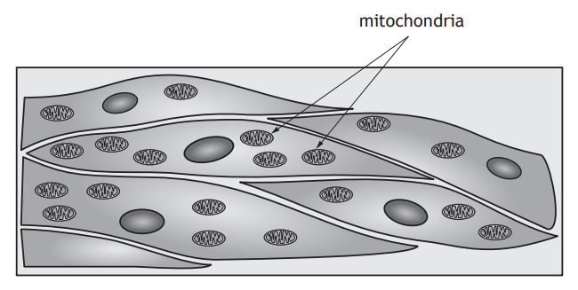
The diagram below shows muscle cells.
Explain why muscle cells require many mitochondria (2).
Requires/uses/needs a lot of energy/ ATP
AND
For movement/contraction

Slide 26
Name one substance produced by a cell carrying out aerobic respiration.
Co2, Water, ATP

Slide 27
A muscle cell will carry out fermentation when oxygen is not available. Describe the fermentation pathway in muscle cells (3)
Glucose converted/broken down to pyruvate/pyruvic acid (1)
Pyruvate/pyruvic acid converted to lactic acid. (1)
(2) ATP produced. (1)
The addition of CO2 negates.

Slide 28
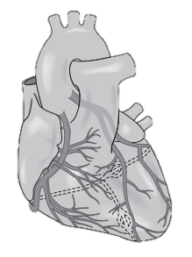
The heart is a muscle which pumps blood around the body and requires its own blood supply.
Name the blood vessel which supplies the heart muscle with blood.
Coronary Artery

Slide 29
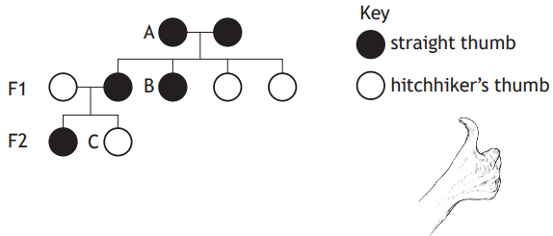
The following diagram represents part of a family tree showing the inheritance of hitchhikers thumb, where the thumb can bend back as shown below.
Complete the table below for individuals A and C.
Tt
Hitchhikers (thumb)

Slide 30
In a survey of 90 students, it was found that 25 of them had hitchhiker’s thumb.
Calculate the number of students with straight thumb to hitchhiker’s thumb as simple, whole number ratio.
13
5
________ : ________
Straight Hitchhiker

Slide 31
The predicted ratio was 3 straight thumb : 1 hitchhiker’s thumb.
Explain why the predicted ratio was different to the actual ratio.
Fertilisation is a random process OR Numbers in sample too small.

Slide 32
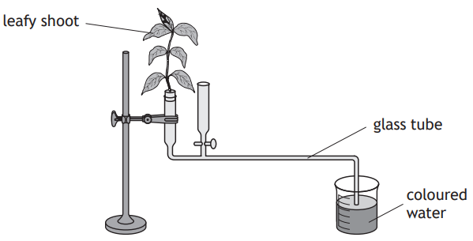
The rate of transpiration in plants can be measured using the apparatus shown below.
As the plant transpires, coloured water is drawn up the glass tube and its volume measured, over a set period of time, to give the rate of transpiration.
Changes in the surrounding environment can have an effect on the rate of transpiration.
(i) Select one of the environmental changes listed below and state the effect of this change on the rate of transpiration.
decreases
increases
increases

Slide 33
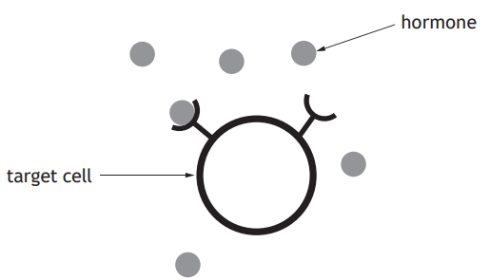
The diagram below represents a hormone binding to a cell within its target tissue.
Explain why only the target cells are affected by this hormone.
They have receptors/receptor proteins AND these are specific/match this hormone.

Slide 34
A food chain from a river is shown below.
Algae → water flea → stickleback → perch
Using the information in the food chain, identify an organism which is both predator and prey.
Stickleback

Slide 35
A food chain from a river is shown below.
Algae → water flea → stickleback → perch
Using the information in the food chain, name the organism which would accumulate the greatest concentration of pesticides in its body over a period of time due to run off from farm land into rivers.
Perch

Slide 36
State one way in which energy may be lost between stages in a food chain.
Heat / movement / undigested material / faeces / excrement / fur/ bones/ hair
Additional incorrect answer would negate.

Slide 37
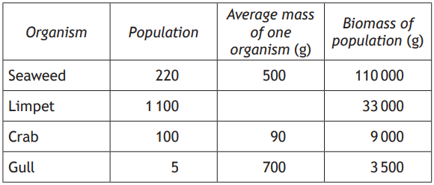
In an investigation, students estimated the population and biomass of some organisms found on part of a rocky shore.
The table below shows the results.
30
Calculate the table to show the average mass of one limpet.

Slide 38
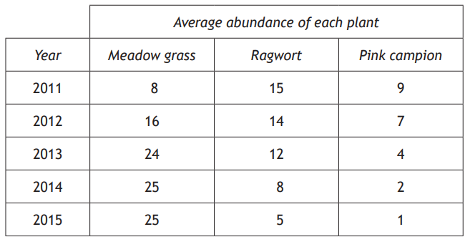
A group of students carried out a five year investigation into plant growth in an area of abandoned farmland.
They sampled the area using quadrats.
The results are shown in the table below.
Calculate the average decrease per year in the abundance of ragwort over the five-year period.
2

Slide 39
The students also sampled invertebrates such as beetles and spiders.
Name a sampling technique they could have used and describe a possible source of error with this technique (2)
Not acceptable:
Use of the term ‘lid’ as it implies it seals the container.
Pit fall trap (1)
Traps left too long/not checked regularly
Too high above soil surface/too low below soil surface/ not level
Not camouflaged
Too shallow
No drainage holes.

Slide 40
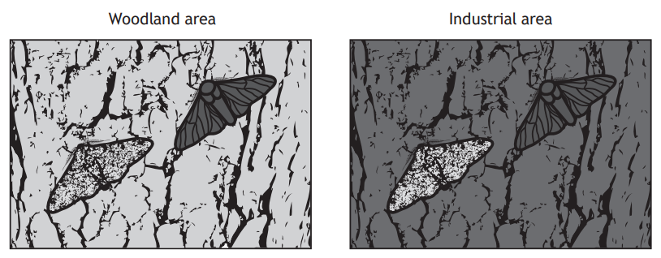
The diagrams below show the light and dark varieties of a moth which can be found in woodland areas. These moths rest on the bark of trees during the day and can be eaten by birds. Normally the bark of trees in the woodland is light coloured. However in industrial areas, pollutants cause the tree bark to
darken.
The dark variety of the moth is the result of a random change in genetic information. State the term used to describe this change.
Mutation

Slide 41
Name the process which results in the better adapted variety of moth being more likely to survive and reproduce.
Natural selection / Survival of the fittest

Slide 42
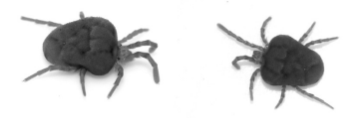
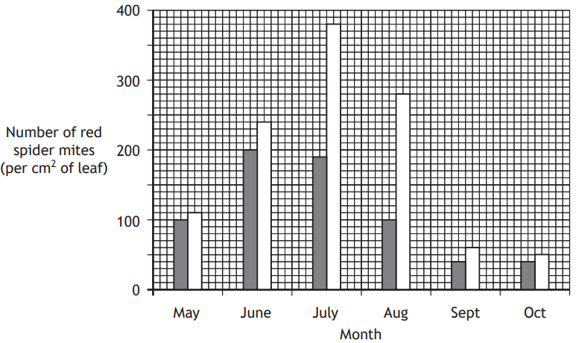
Red spider mites are a common pest which destroy tomato plants. Some of the mites are resistant to chemical pesticides.
Tomato growers aimed to investigate whether a predator would reduce the spider mite numbers in their greenhouses. Two identical greenhouses were used and the predator was released into only one greenhouse.
The results are shown in the graph below.
With reference to the aim of this investigation, give the conclusion that the tomato growers would have drawn from these results.
When predators are present (the number of red spider) mites decrease/ there are more (red spider) mites when there is no predator OR converse

Slide 43
State the term which describes the use of a predator as an alternative to pesticides.
Biological Control

